Slide 1
Career Preparation
Successful Employment Searches
April 13, 2018
Jerry Baker – jerry.baker@dslextreme.com

Slide 2
Agenda
Background
Start Early
Resources – Getting the Interview
Preparing for the Interview
Interviewing
Interviewing Aftermath

Slide 3
Educational Background
B. S. - Mathematics – Ohio State University
M. S. - Statistics – Florida State University
M. B. A. - Pepperdine University

Slide 4
Employment Background
15 Companies Including:
Strong healthcare delivery experience including:

Slide 5
Start Early
Target an industry of interest to you.
Look for entry-level/intern opportunities.
Review social media for opportunities to “sanitize”.
Consider school-related opportunities.
Tutoring
Organizations
Industry on-campus recruiting
Document achievements for use in your profile/resume.

Slide 6
Getting the Interview
Networking is still the most effective tactic.
Create a resume/profile - one to two pages.
Use a cover letter (from a template you created earlier).
Minimize redundancy between profile and cover letter
Explain, briefly, why you think you are perfect for the position
Bullet points are good
Avoid lengthy paragraphs
Ask for the opportunity to meet in your conclusion
Include contact information
If appropriate, indicate you will call to schedule an interview
Pay close attention to quality.
Typos
Start bullet points with “action” words
Proof read
When should you decline an interview?

Slide 7
Targeted Responses?
Rank the opportunities.
Select the one that best fits your interests and background.
Tailor your base profile to the opportunity.
Tailor your base cover letter to the opportunity.
Take as much time as needed to create a quality product.

Slide 8
Prepare for the Interview
Research the company.
Research commonly asked questions (& prepare responses).
Strengths/Weaknesses
Where you see yourself over some time horizon (e.g., Five years)
Review prior interviews for commonly asked questions.
Prepare a few questions to ask the interviewer(s).
Suppose you are given a choice of time slots, which one should you choose?
Dress sensibly and consistent with the targeted industry.
Realize that no set rules for an interview format exist.
One-on-one
Group
Sequential

Slide 9
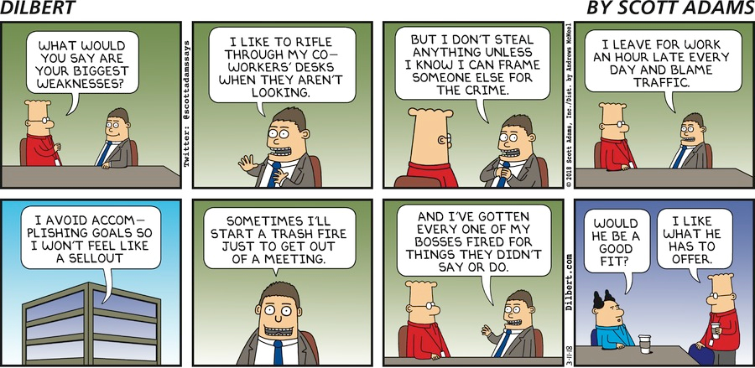
Prepare for the Interview
Research commonly asked questions (& prepare responses).
Strengths/Weaknesses

Slide 10
Prepare for the Interview
I know everyone has a go-to “weakness” in these job interviews,
but what’s your real biggest weakness?
by Kate Lopaze - The Job Network

Slide 11
Prepare for the Interview
I know everyone has a go-to “weakness” in these job interviews,
but what’s your real biggest weakness?
I tend to take on too much myself, because I have high standards
and get impatient when others don’t meet them.
But I’m working on my delegating skills and learning
how to let others do their jobs while I do mine.
by Kate Lopaze - The Job Network

Slide 12
During the Interview
REMEMBER
This is your opportunity to sell yourself
Bring energy and enthusiasm
Interviewers love anecdotes – Here’s a situation and here’s what I did about it.
The length of time your responses take is important – Not too short; Not too long.
Look for opportunities to ask your questions.
If more relevant points come up during discussions, inquire about those items
The better interviews are ones with discussions occurring vs. all interviewer Q & A
Look for “buying signals” and warning signals.
As the interview wraps up, ask about
Next steps
Timing
Confirm the point of contact
The decision process – who/how
“Is there anything I said that requires further clarification?”

Slide 13
Post Interview – Review Cycle
Interview
Modify
Responses
Question & Response
Analysis

Slide 14
Post Interview
Should you send “thank you” notes?
Tracking & Follow-up

Slide 15
Stay in Charge of Your Career
Keep track of the industry trends.
Map your plan to stay current.
Execute the plan.
Jerry Baker – jerry.baker@dslextreme.com

Slide 16
Questions?
?
?
?
?

Slide 17
Prepare for the Interview
How would you deal with a colleague who threw you under
the bus for something that was their fault?
by Kate Lopaze - The Job Network

Slide 18
Prepare for the Interview
How would you deal with a colleague who threw you under
the bus for something that was their fault?
Office politics are always fun, right? Seriously, though, I’d start
by taking it up with the person directly.
I don’t think there’s anything to gain from publicly humiliating anyone,
even if they just tried to do it to me.
I’d also make sure that my boss privately understands the reality of what went on
—what my role was in the issue, whether I shared any of the blame,
or what I did to help resolve the problem.
by Kate Lopaze - The Job Network

