Slide 1
Plant Propagation Paul Snyder, OARDC

Slide 2
To clear up common misconceptions about plant propagation and inspire you to try it.

Slide 3
Provide information and resources from personal experience.

Slide 4
Plant propagation will always challenge you, but it doesn’t always have to be challenging.

Slide 5
Type of propagation, time and environment are big challenges…

Slide 6
BUT with a little understanding we can eliminate most of the challenges.

Slide 7
Discuss
What has your experience with plant propagation been?
How would you describe your success with plant propagation?
What fascinates you most about plant propagation?

Slide 8
Variety
“A group or class of plants subordinate to a species. The term is assigned to individuals displaying rather marked differences in nature. The differences are inheritable and reproduce true-to-type in succeeding generations.”
M. Dirr, Manual of Woody Landscape Plants

Slide 9
Cultivar
“Any variety of a plant, originating through cloning or hybridization known only in cultivation…in sexually propagated plants, a cultivar is a pure line (for self-pollinated plants) or, for cross-pollinated plants, a population that is genetically distinguishable.”
Webster’s Dictionary

Slide 10
What method best meets your needs?
Sexual Propagation
Seed
Asexual Propagation
Cutting
Grafting
Division
Layering

Slide 11
Seed

Slide 13
Seed Collection and Storage

Slide 14
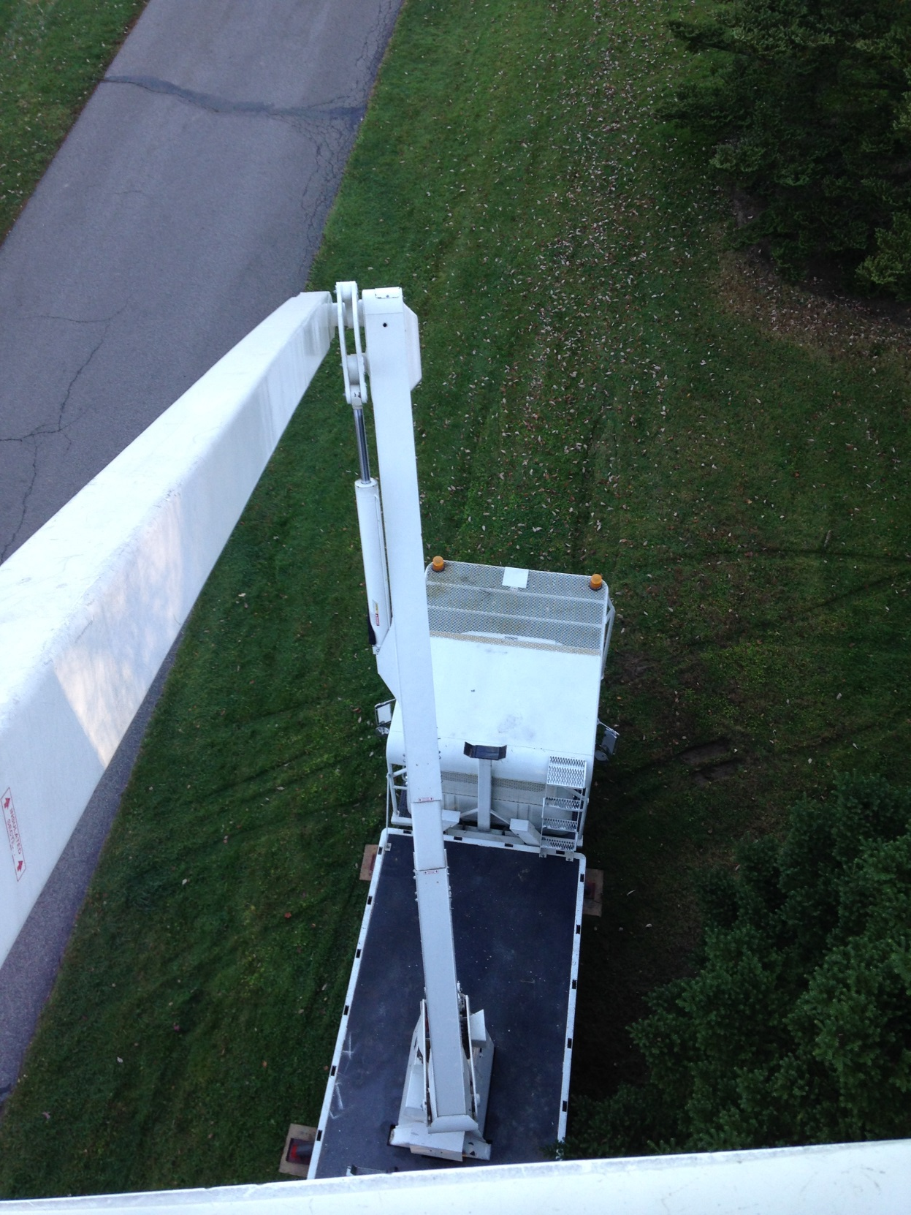

Slide 15
Provenance
The climatic and geographic locality where seed is produced.
A Red Maple (Acer rubrum) from Ohio much different than one from Florida.

Slide 16
Collecting Seed
Perhaps the most difficult aspect of seed collection is knowing when to collect.
Seeds are ripe when there is no increase in fresh weight.
Helpful to know the normal size of the fruit.
Timing has to be just right
Too soon, embryo might not be developed
Too late, fruit may fall, dehisce (split), shatter, or be eaten by animals.

Slide 17
Seed that dehisce may be placed in a paper bag in a warm location.
Clean fleshy seed by rubbing them over a screen and rinsing away the pulp.
Blender.
Dry seed thoroughly before storing.

Slide 18
Seed Storage
Place seed in airtight containers at low humidity and cool temperatures. (Refrigerator or freezer).
Seeds are living organisms.

Slide 19
Physical dormancy Physiological dormancy

Slide 20
Stratification: the storing of seeds at low temperatures under moist conditions in order to break dormancy.
Unifies and hastens germination of some species
After-ripening: the time required for seed in warm storage to lose dormancy, or to finish developing.
Scarification: the breaking, scratching or softening of the seed coat.

Slide 22
When does the seed mature?
How much time is needed for
after-ripening or stratification?
How soon do the seeds germinate?

Slide 23
Growing Seeds

Slide 24
Germination Test
Performed to determine the percentage of viable seed.
If percentage is less than 70, purchase new seed.

Slide 25
Three most important factors in germination:
Water
Oxygen
Temperature

Slide 26
Growing Medium
Affects the germination factors.
Must be moist but well drained.
Typical components
Peat
Perlite
Vermiculite
Regular fertilizer applications are necessary.

Slide 27
Seedling Care
Transplant into larger containers (if needed) once seedlings have first true leaves.
Keep soil evenly moist. Allow surface to dry between waterings.
Roots need oxygen and water.

Slide 29
Temperature
Day: 65-70
Night: 55-60
10-15 degree difference is ideal for plant growth.
Light
Bright light such as direct sun is needed right after germination.

Slide 30
Harden seedlings off by allowing them to gradually be exposed to outdoor conditions.

Slide 31
Discuss
If you collected seeds in the fall, what would you do to get them to germinate?
Why are water and oxygen so important to root growth? What happens if you have too much of one?
Would you rather grow redbud seed from Ohio or from Oklahoma? Why?

Slide 32
Cuttings

Slide 34
New plants can be generated from plant pieces because all plant parts contain cells that can duplicate all other plant cells.
Parenchyma cells
Why Cuttings?
Produce genetically identical (and therefore uniform) plants.
Cheaper than grafting

Slide 35
Stem Cuttings
Softwood: tissue is very soft (easily bruised), with a gradation of leaf sizes (end leaves are smallest).
Semi-hardwood: Leaves are mature, wood is firm.
Hardwood: taken during dormancy.

Slide 36
When to take the cuttings
How long does it take for the cuttings to root?
After-care?

Slide 37
Take cuttings from healthy, vigorous plants.
Collect from the current season’s growth (Juvenile tissue works best).
Avoid collecting during flowering.
Morning is best to take cuttings

Slide 38
Cutting should be 3-6” long with about 6 sets of leaves.
Remove bottom 1/3 of leaves
Semi-hardwood and hardwood cuttings benefit from wounding (increases auxin intake).
Dip in rooting compound
Stick in well aerated medium (50:50 Peat:Perlite)

Slide 39
Rooting Compounds
Auxin is applied to stimulate root production.
Synthetics mimic naturally occurring auxins.
IAA (Indole-3-acetic-acid)
IBA (indole-3-butyric-acid)
NAA (Naphthaleneacetic acid)
Available in liquid and powdered forms.
Strength varies from species to species

Slide 40
Carbohydrates and auxins naturally accumulate in the wounded area. This leads to cell division and the formation of root primordia.

Slide 41
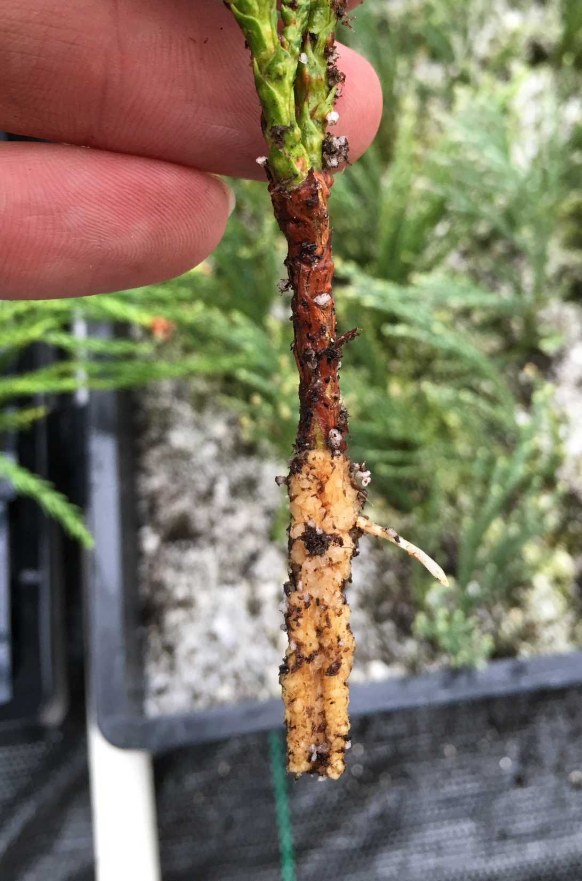

Slide 42
Care
High humidity
Temperature between 65-77º F
Higher temps promote bud elongation and water loss from the leaves.
Indirect sunlight
Light is still needed for photosynthesis
Too intense of a light can be detrimental to cuttings.

Slide 43
Leaf cuttings
Leaf or leaf with petiole may be used to generate new plants.
Commonly used with begonia, African violet, and sanseveria.
Hormone may or may not be needed.
Insert leaf 1/3 of leaf into rooting media.
Carefully divide new plantlets once formed.

Slide 44
Discuss
What plant structure makes cutting propagation possible (hint: cells).
Why is it important to know how long something takes to root (think practically)?
Why is a high-humidity environment important?
What do auxins stimulate in the basal end of the cutting?

Slide 45
Grafting

Slide 46
Grafting: The process of joining two plants or plant parts together in such a manner that they will unite and continue their growth as one.
Scion: a short stem piece with two or more buds and is that part of the graft combination which develops into the top (shoot) of the plant.

Slide 47
Rootstock/understock: The lower part that becomes the root system. Can be seedling or clonal in origin.

Slide 48
Why Graft?
Control size (dwarfing rootstocks)
Plant cannot be propagated other ways
Preserve a tree
Create unusual forms
Disease control

Slide 49
Can the plant be produced by grafting?
What tools are needed?

Slide 50
What type of graft?
When do you graft?
Dormant
Actively growing

Slide 51
Consider graft compatibility
Size of rootstock

Slide 52
What to Graft onto
The closer the plants are related taxonomically, the more likely the graft will be compatible.
Plants are generally grafted onto a rootstock of the same species/genera.
Ex. Malus ‘Centennial’ grafted onto Malus spp.

Slide 53
Side veneer graft
https://youtu.be/NY2z-zp_YI0

Slide 54
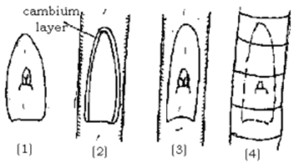

Slide 55
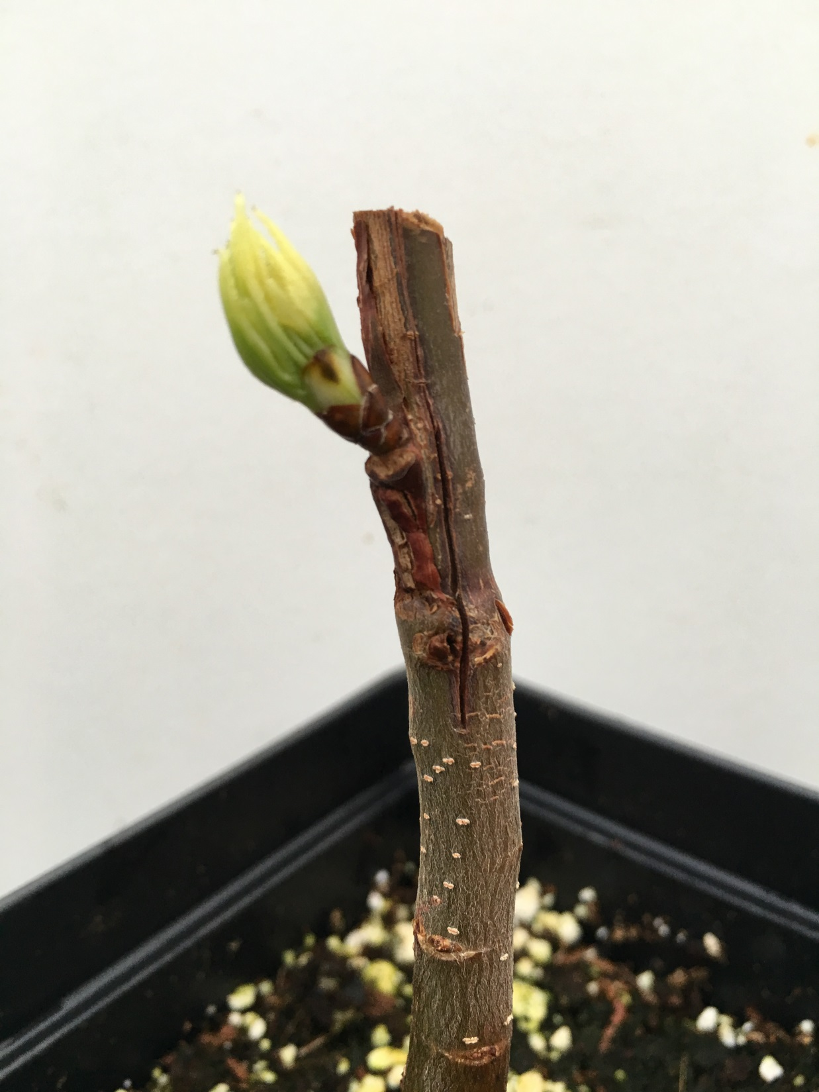
Grow-Straight

Slide 56
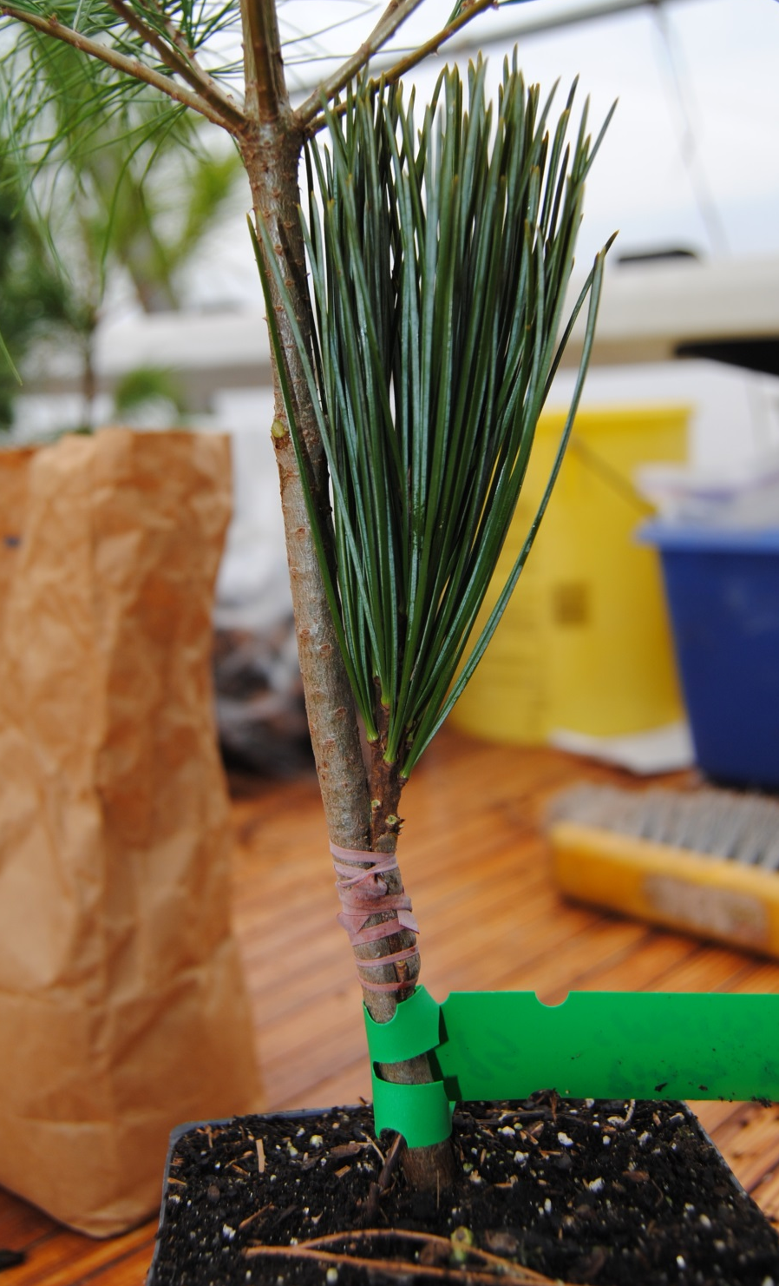

Slide 57
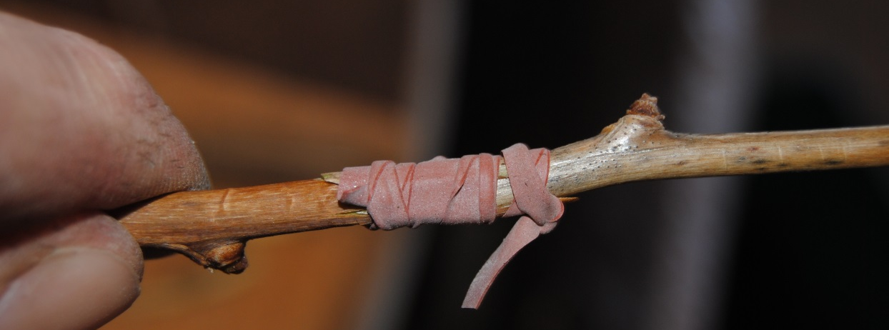

Slide 60
Care
Grafts must be kept warm (between 40 and 70 degrees), humid, out of direct sunlight, and well-ventilated.
After graft has started to grow, cut rootstock back to just above graft union.
Promotes growth of scion.

Slide 61
Discuss
What would you like to graft?
How have you seen grafting used?
If no literature is available, how do to know what can be used as an understock?
Removing the top of the understock does what to the scion?

Slide 62
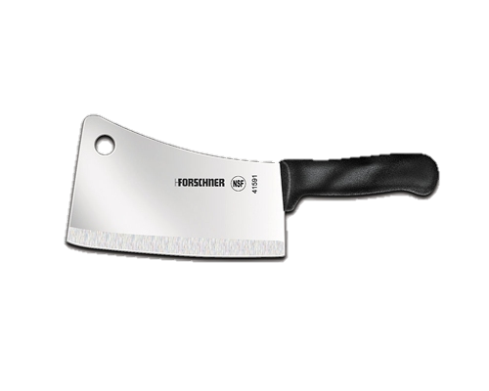
sion
Divi

Slide 63
The Best Time
Spring
Fall

Slide 64
Usually done before growth begins in the spring or at the end of the growing season.
Plants that bloom in the spring should be divided in the fall
Plants that bloom in the fall should be divided in the spring.

Slide 65
Divide perennials when the center of the clump begins to die out.
Useful for propagating small quantities of plants.

Slide 66
Layering

Slide 67
A form of rooting cuttings in which adventitious roots are initiated on a stem while still attached to the plant.
The rooted layer is removed once it has its own root system.

Slide 68
Does the plant respond to layering?
How long will it take?

Slide 69
The Process
Bend branch to the ground (in early spring or fall).
Sometime the stem is wounded and rooting compound applied.
Pin stem to ground
Cover portion of stem with soil, compost, or mulch.
Do not cover tip of branch.

Slide 70
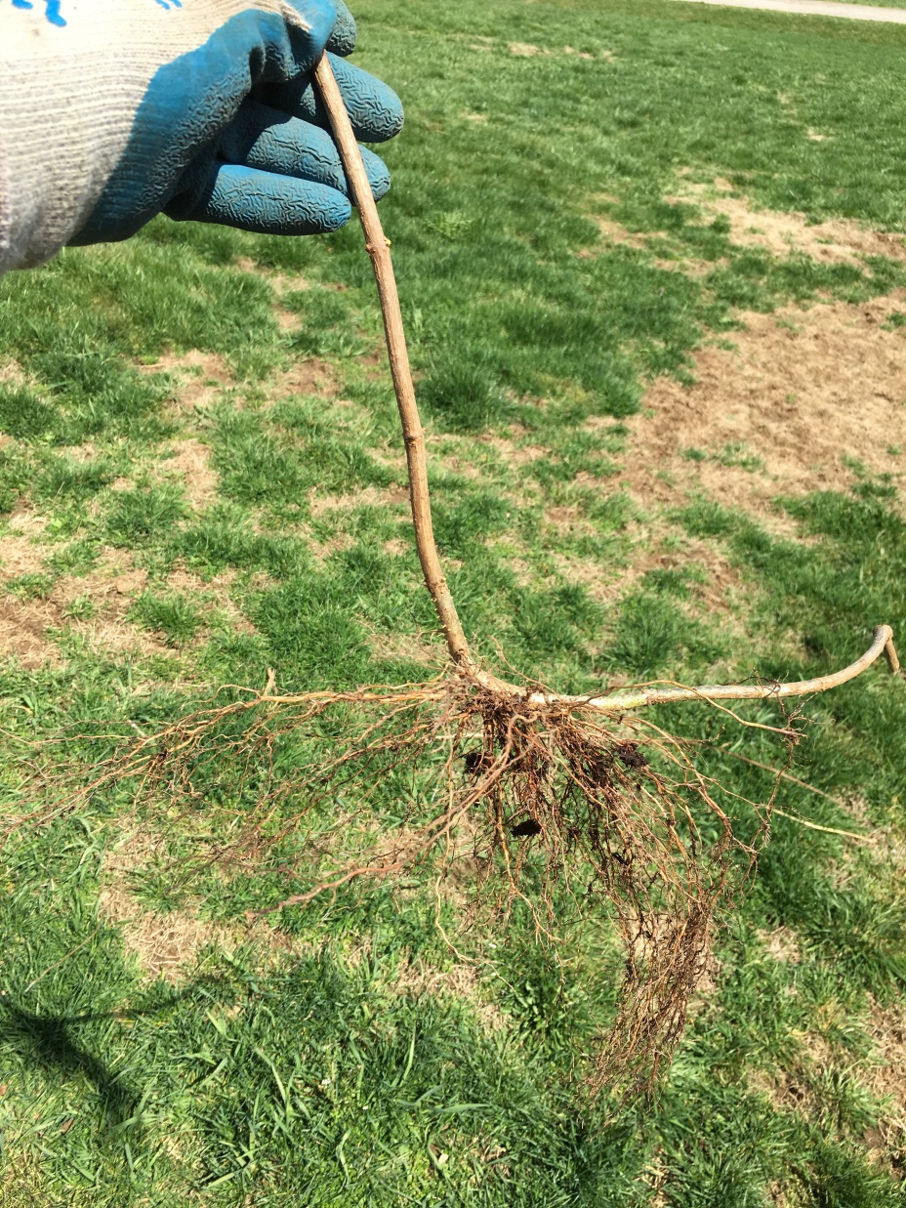

Slide 71
Discuss
How do you know when it is time to divide a plant?
How do you know if a plant might layer successfully?
What have you seen layer naturally?

Slide 72
Resources

Slide 73
The Reference Manual of Woody Plant Propagation

Slide 74
Plant Propagation: Principles and Practices

Slide 75
The Woody Plant Seed Manual (USFS)

Slide 76
ipps.org

Slide 77
Plant propagation will always challenge you, but it doesn’t always have to be challenging.

Slide 78
The biggest challenge is you.

Slide 79
Paul Snyder
Program Assistant
College of Food, Agricultural, and Environmental Sciences
Ohio Agricultural Research and Development Center
Secrest Arboretum
Administration, 1680 Madison Avenue
Wooster, Ohio 44691
snyder.1062@osu.edu
Secrest.osu.edu

