Slide 1
MATERNAL HEALTHCARE
Clayton Rush
Michael Xiong
Maya Ben-Yosef
Kyle Fein
Harliv Kaur

Slide 2
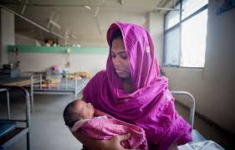
What is our Millennium Goal?
Our goal is to reduce the maternal mortality rate and achieve universal access to reproductive health

Slide 3
Why is our Millennium Goal important?
Conditions related to pregnancy and childbirth are the second leading causes of death among women of reproductive age in developing countries
Most of these complications could have been prevented if these women would have received proper medical interventions or were properly educated about the precautions to be taken before, during, and after pregnancy

Slide 4
Which countries make up your region?
-Southeast Asia consists of countries that are geographically south of China, east of India, west of New Guinea, and north of Australia
The country we chose was India

Slide 5
Why India?
As a developing country with a population that is sky rocketing, adequate and affordable maternal health care is a critical factor in determining the future well being of the country’s citizens
Estimated that India will become the most populated country by 2022
India is a country where little power is given to women in the social and political context
Notes:
-Therefore, some women are often left uneducated about safe childbirth and life before/after a pregnancy

Slide 6
What groups of people are affected by the problem your goal addresses?
Women of low economic status
affected by the lack of education about safe childbirth and methods of taking care of oneself pre-child birth
lack of money to pay for regular doctor visits and the hospital bills
inability to pay for expensive medicine

Slide 7
Groups of people con’td
Women from rural areas
home birth is common
rates of death and illness immediately after birth are higher because of unsanitary and unsafe delivery and care of the mother
do not have the option of hospitals and health care workers at close proximity
rural birth givers are also half as likely to have a post natal check up, as compared to the urban population

Slide 8
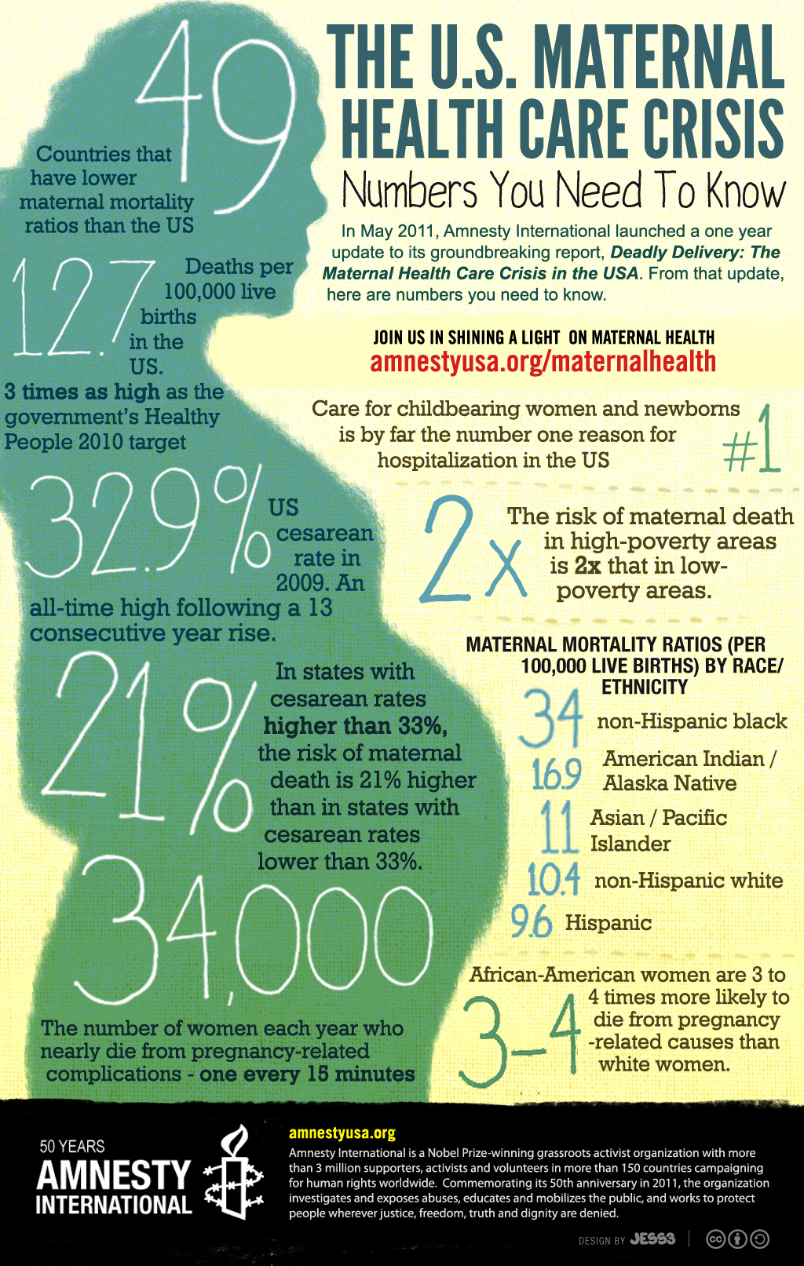
Causes of Maternal Health Care Concerns

Slide 9
Universal Components of Health Care
Notes:
There are three main components of maternal health care that are universal: the health of women during pregnancy, during childbirth and during the post-delivery stage.
Maternal health care’s quality is dependent on the region.
Several factors, including the healthcare system, the political leadership, parenthood planning, education, availability and usage of resources, employment, cooperation of maternal health care providers and more determine the level of maternal health care in a given region.
When many of these areas suffer, often maternal health care suffers with it.

Slide 10
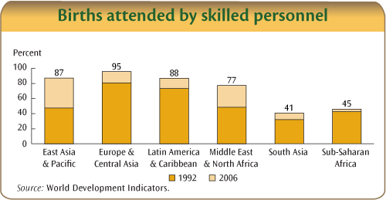
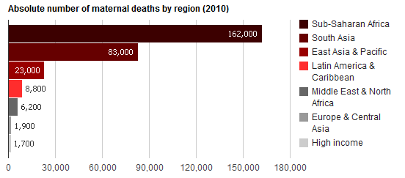
Difficulties in Developing Nations
Notes:
This is very true in developing nations, where a lack of basic needs for maternity is common, especially for those who may be in poverty.
Maternal mortality is known to be more prevalent in these rural, impoverished areas. India is a prominent example of a developing country with a severe poverty issue, with over 20 percent of the population being below the poverty line.
Hygiene is paid little attention to, creating a severe issue when mothers are faced with pregnancy. Some mothers choose home-delivery, rather than facing the costs of going to a proper hospital or obtaining necessary medicines.
This heightens the risk of complications during labor.

Slide 11
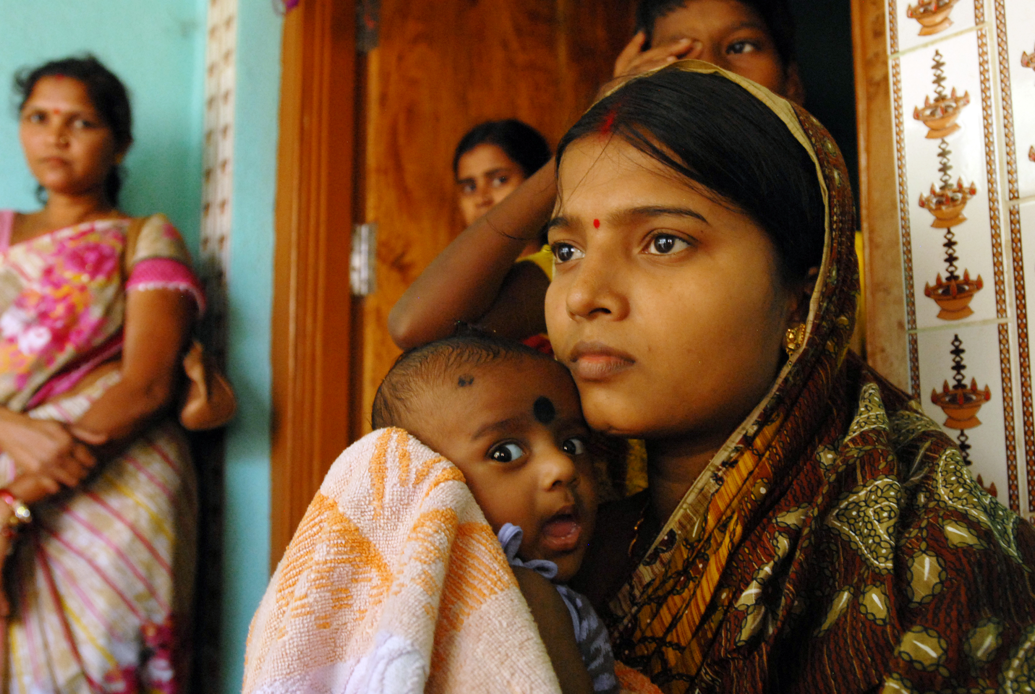
How this Relates to India
Notes:
The government hospitals are overcrowded and not preferable for mothers in India.
Those of the middle or upper-class spend an absurd amount of rupees for private nursing or care during pregnancy.
The conditions in India are not favorable for maternal health care, where maternity-related issues contribute to the majority of deaths and disabilities among women who are of a reproductive age.

Slide 12
Improvements to Maternal Healthcare on a
Global Scale
Since 1990 the maternal mortality ratio has decreased by almost 50% 290000 deaths in 2013
More than 71% of births in 2014 were assisted by a healthcare professional
Maternal mortality has declined by about two thirds in Northern Africa as well as Southern and Eastern Asia

Slide 13
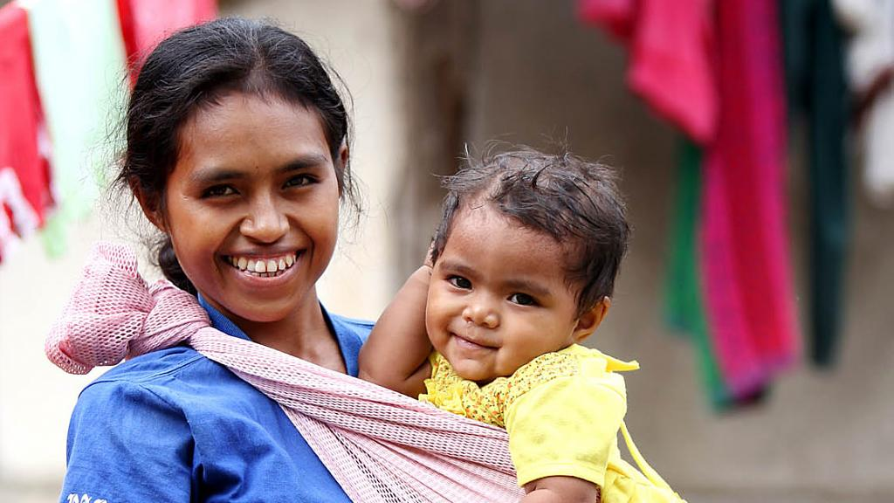
Maternal Health care improvements in India
Even though India is unlikely to reach the health care related MDG for 2015, the government is attempting to improve and accelerate progress towards the goal.
Increase the amount of mothers that deliver in an actual facility
Provide education and knowledge to promote healthier behaviors

Slide 14
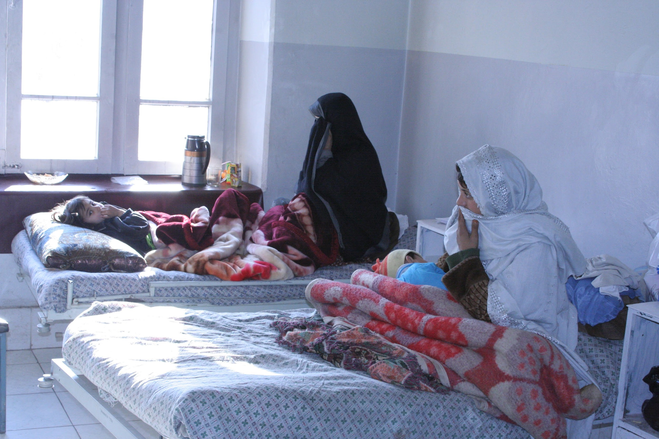
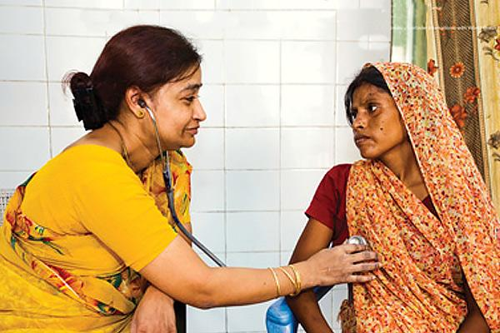
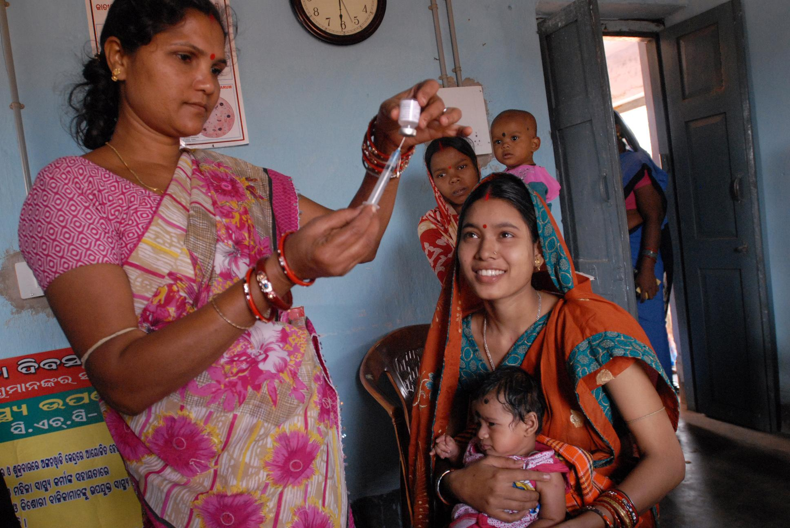
How Does The UN Propose That Your Millennium Goal Will Be Reached?
At antenatal health clinics, “women should receive at least a basic care package, including nutritional advice. They should also be alerted to warning signs indicating possible problems during their pregnancy and get support in planning a safe delivery”

Slide 15
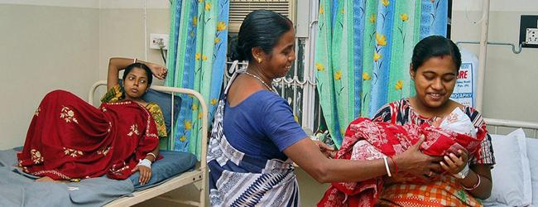
UN Proposition
They planned on completing this goal by providing skilled health personnel, which assisted in births, and believed that proven health-care interventions can prevent or manage these complications (maternal deaths), including antenatal care in pregnancy, skilled care during childbirth (medical doctor, nurse, or midwife) and care and support in the weeks after childbirth.

Slide 16
Sources
"Maternal Mortality." World Health Organization. WHO Media Centre, May 2014.
Web. 6 Oct. 2015.
"MDG 5: Improve Maternal Health." WHO. N.p., May 2015. Web. 05 Oct. 2015.
Mosadeghrad, Ali Mohammad. “Factors Influencing Healthcare Service Quality.” International
Journal of Health Policy and Management 3.2 (2014): 77–89. PMC. Web. 7 Oct. 2015.
Nair, Harish, and Rajmohan Panda. “Quality of Maternal Healthcare in India: Has the National
Rural Health Mission Made a Difference?” Journal of Global Health 1.1 (2011): 79–86. Print.
"United Nations Millennium Development Goals." UN News Center. UN, n.d. Web. 05 Oct.
2015.
Vora, Kranti S. et al. “Maternal Health Situation in India: A Case Study.” Journal of Health,
Population, and Nutrition 27.2 (2009): 184–201. Print.

