Slide 1
Colony Collapse Disorder
Chris Crunkleton, Maddi Depinet, Sneha Rajagopal

Slide 2
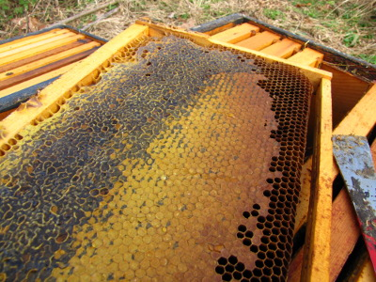
Introduction
CCD in bees
Decrease in worker bees’ population
Queen bee & immature bees
http://media.npr.org/assets/img/

Slide 3
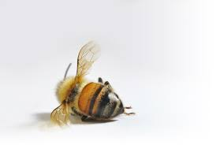
Signs and Symptoms
Bee loss
No dead bees in hive
Food
Infants
Queen bee
http://i2.ytimg.com/vi/AZegtHc0lyM/mqdefault.jpg

Slide 4
What Causes CCD?
Combination of Several Factors
Parasites
Pesticides
Mobile devices
Winter weather condition
Nutrition problems
https://img.4plebs.org/boards/x/image/1394/41/1394416649600.png

Slide 5
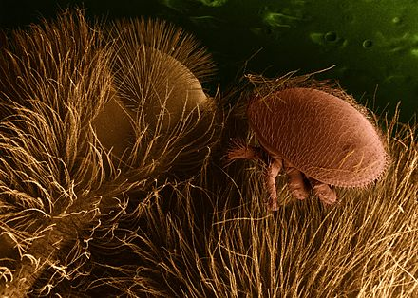
Possible Causes- Parasites
Most commonly accepted cause
The mite Varroa Destructor
Carries viruses
Deformed wings
Weakened immune system
https://img.4plebs.org/boards/pol/image/1398/72/1398721801248.png

Slide 6
Possible Causes- Pesticides
Harsh chemicals
Disorients
https://img.4plebs.org/boards/x/image/1394/41/1394416649600.png

Slide 7
Possible Causes- Mobile Devices
Popular theory as to why bees are disappearing
Rates of bee loss increase as the number of mobile devices increase
Devices interfere with bees’ magnetic senses
https://img.4plebs.org/boards/s4s/image/1394/20/1394204432567.png

Slide 8
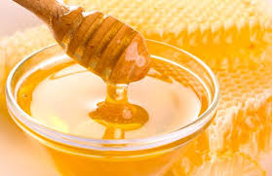
Impact of CCD
Dead bees
Pollination
Honey
https://img.honey.org/boards/s4s/image/1394/20/1394204432567.jpeg

Slide 9
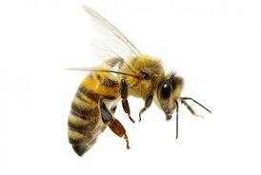
The Future with CCD
No more bees
No more honey
Pollination by hand
http://i3.kym-cdn.com/photos/images//000/939/492/873.png

Slide 10
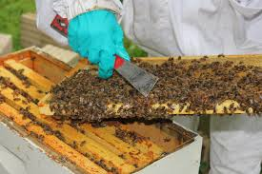
Solutions to CCD
Less pesticides
Improve bee management practices
Control parasites
Manual pollination
https://fbcdn-photos-f-a.akamaihd.net/hphotos-ak-frc3/v/t1.0

Slide 11
References
Bellingan, Laura. "Colony Collapse Disorder." Biologist 54.3 (2007): 124. Academic Search Complete. Web. 30 Sept. 2015.
Chensheng, L. U., Kenneth M. Warchol, and Richard A. Callahan. "In situ replication of honey bee colony collapse disorder." Bulletin of Insectology
65.1 (2012): 99-106.
Farooqui, Tahira. “A Potential Link among Biogenic Amines-based Pesticides, Learning and Memory, and Colony Collapse Disorder: A Unique
Hypothesis.” Neurochemistry International 62.1 (2013): 122-136. ScienceDirect Journals. Web. 17 Sept. 2015.
"Home." The Bees in Decline. Greenpeace, 2014. Web. 28 Sept. 2015.
"Related Topics." ARS : Honey Bee Health and Colony Collapse Disorder. ARS, 23 Sept. 2015. Web. 28 Sept. 2015.
Vanengelsdorp, Dennis, Jay D. Evans, Claude Saegerman, Chris Mullin, Eric Haubruge, Bach Kim Nguyen, Maryann Frazier, Jim Frazier, Diana
Cox-Foster, Yanping Chen, Robyn Underwood, David R. Tarpy, and Jeffery S. Pettis. "Colony Collapse Disorder: A Descriptive Study." PLoS
ONE 4.8 (2009): n. pag. Web.

Slide 12
References
VanEngelsdorp, Dennis, Niko Speybroeck. “Weighing Risk Factors Associated with Bee Colony Collapse Disorder by Classification and Regression
Tree Analysis.” Journal of Economic Entomology 103.5 (2010): 1517-1523. BioOne. Web. 17 September 2015.
Watanabe, Myrna E. “Colony Collapse Disorder: Many Suspects, No Smoking Gun.” BioScience 58.5 (2008): 384-388. BioOne. Web. 17 September
2015.
Williams, GR, DR Tarpy, D vanEngelsdorp, MP Chauzat, DL Cox-Foster, KS Delaplane, P Neumann, JS Pettis, RE Rogers, and D Shutler. "Colony
Collapse Disorder in Context." Bioessays : News and Reviews in Molecular, Cellular and Developmental Biology. 32.10 (2010): 845-6. Print.

