Slide 1
BUILDING EMERGENCY ACTION PLAN
Notes:
Shannon Starts

Slide 2
Ohio Union Events and Student Activities
disaster's DON’T PLAN AHEAD, BUT YOU CAN.
We cannot prepare for every situation, but we can give you the resources to respond appropriately to every situation.

Slide 3
Ohio Union Events and Student Activities
What is a Building Emergency Action Plan (BEAP)?
The BEAP describes what needs to be done and who does it in the event of an emergency.

Slide 4
Ohio Union Events and Student Activities
WHAT EMERGENCIES DO WE HAVE BEAP FOR?
EMT for an accident/injury
Severe Weather
Police for an incident
Active Threat
Fire/ General Evacuation

Slide 5
Ohio Union Events and Student Activities
WHAT POSITIONS ARE PART OF THE BEAP?
Student Staff
Staff
EVERYONE!
Full Time
Dining/ Catering
Police, Fire, EMT
EVS

Slide 6
Ohio Union Events and Student Activities
WHAT FACTORS COULD EFFECT THE STEPS OF THE BEAP?
Number of staff
Environmental Conditions
Availability of Staff
Types of Activities
Conditions can change throughout the day which could require you to adapt the BEAP to a particular situation

Slide 7
Ohio Union Events and Student Activities
WHAT ARE THE STEPS FOR A BEAP?
Recognition/Activation
See something; say something.
If something doesn’t look right or feels “off”, say something.
Students contact Building Manager
Radio Channel 1
614.402.4335
Supervisors/Building Manager contact:
Jeff/Adrienne/Patrick and SRS.
Medical emergencies:
Call 911 first then find Building Manager/SRS

Slide 8
Ohio Union Events and Student Activities
WHAT ARE THE STEPS FOR A BEAP?
Recognition/Activation
292-2121 = OSU police non-emergency number.
Best way to contact public safety if we cannot see the officer immediately in the building.
Include the Building Managers as soon as something happens
If your supervisor is here they can help you contact the Building Manager, but if your supervisor is not here then the Building Manager should be your first call.

Slide 9
Ohio Union Events and Student Activities
WHAT ARE THE STEPS FOR A BEAP?
Recognition/Activation
Know when to stay and when to go
Be aware of your environment. What’s happening around you?
Identify ways to safety
Know evacuation routes, shelter in place locations, emergency exits & rally points.
Your first priority is you
Do NOT put yourself in harm’s way even if trying to help someone else.

Slide 10
Ohio Union Events and Student Activities
WHAT ARE THE STEPS FOR A BEAP?
Recognition/Activation
Know your place
You are not the authority nor are you a police officer, fire fighter, EMT, or doctor.
Hands Off
Avoid touching anyone at any point if at all possible. Avoid blood and unidentifiable fluids. Disturbed vs. Disruptive Individuals.
Practice good judgment
Use common sense and listen to your gut instinct.

Slide 11
Ohio Union Events and Student Activities
WHAT ARE THE STEPS FOR A BEAP?
Completion of the BEAP
Wait for further instructions from:
Your manager
Emergency Personnel
Resources (weather.com, Buckeye Alerts, Twitter)
Building Manager will complete the Incident Report and send to Jeff, Adrienne, Patrick

Slide 12
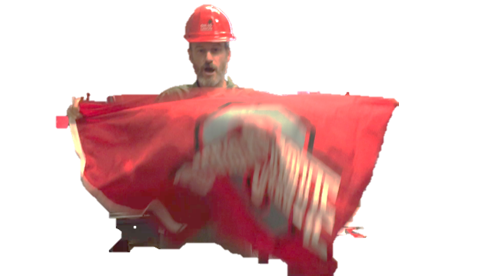
Ohio Union Events and Student Activities
Notes:
Megan Starts here

Slide 13
Ohio Union Events and Student Activities
When you hear the fire alarm… and professional staff is gone
The following student areas have additional responsibilities during an evacuation procedure FOR EVENINGS AND WEEKENDS or times when professional staff is not present.
Building Managers Security Staff
Dining Operations
A/V Information Desk
Resource Room Catering
When present, professional staff will lead the evacuation procedures.
Notes:
When you hear the fire alarm immediately begin to evacuate the building. Do not wait- if you hear the alarm it is time to move, we do not have fake alarms.
The following student areas have additional responsibilities during an evacuation procedure FOR EVENINGS AND WEEKENDS or times when professional staff is not present. Again, when present, Professional staff will lead the evacuation procedures.
The Student Lead Evacuation Areas of Responsibility are
Building Manager:
Coordinate evacuation w/ Security Staff Student Manager to ensure all areas are cleared. Meet Security Student Manager at Fire Panel. Make sure all staff members are flushing down and out of the building. Designate staff member(s) to drive traffic away from the building and to the designated landing areas around the building.
Security Staff:
Loading dock areas, food storage spaces/coolers, foodservice offices, Union Market, Woody’s, Espress-oh, all respective food prep and dining areas, lower level back of house from bottom of stairwell including locker rooms and break area; also to clear loading dock stairwells beginning at 3rd floor and including all landing areas and storerooms. In addition ensure GHMR kitchenettes are clear.
AV Staff:
Evacuate event spaces: Archie Griffin Grand Ballroom, Performance Hall, U.S. Bank Conference Theater, Dressing Rooms, Green Room, ALL GROUND floor meeting spaces and restrooms, ALL Lower Level Meeting Spaces and restrooms, CAP Reception and Roth Lounge. Once areas are cleared, radio Building Manager and head outside to West Plaza to help drive people 50 ft. away from building.
Production Staff:
Evacuate 2nd and 3rd floor meeting rooms, 2nd and 3rd floor lounge areas, restrooms, and storage closets. Evacuate BuckID, VP Suite, UAFYE, and Off-Campus/Neighborhood Services and Collaboration. Once areas are cleared radio Building Manager and head outside to Potter Plaza to help drive people 50 ft. away from the building.
Info Center Staff:
Clear Great Hall, and push back people from near High Street doors out to bench/sidewalk area.
Center Staff:
Graphics, video room, resource room, lounge spaces, all offices, meeting rooms, in the Center for Student Leadership and Service. Exit using the stairwell down and out to PHLD.
Catering:
FOH kitchen prep area, rear ballroom area, storage rooms. Catering Kitchen staff: walk in coolers/freezers, entire kitchen and dish area, storage space, office
Sloopys:
To be cleared by their MOD.
All other student employees are to clear their office area and move outside to the nearest evacuation assembly point
Remember that if you have a cash drawer or cash handling responsibilities to lock the drawers away before leaving the building.

Slide 14
Ohio Union Events and Student Activities
Building Manager:
Coordinate evacuation with Security Staff Student Manager to ensure all areas are cleared. Meet Security Student Manager at Fire Panel. Make sure all staff members are flushing down and out of the building. Designate staff member(s) to drive traffic away from the building and to the designated landing areas around the building.
S/R/S Staff:
Evacuate spaces: Loading dock areas, food storage spaces/coolers, foodservice offices, Union Market, Woody’s, Espress-oh, all respective food prep and dining areas, lower level back of house from bottom of stairwell including locker rooms and break area; also to clear loading dock stairwells beginning at 3rd floor and including all landing areas and storerooms. In addition ensure GHMR kitchenettes are clear.
Notes:
When you hear the fire alarm immediately begin to evacuate the building. Do not wait- if you hear the alarm it is time to move, we do not have fake alarms.
The following student areas have additional responsibilities during an evacuation procedure FOR EVENINGS AND WEEKENDS or times when professional staff is not present. Again, when present, Professional staff will lead the evacuation procedures.
The Student Lead Evacuation Areas of Responsibility are
Building Manager:
Coordinate evacuation w/ Security Staff Student Manager to ensure all areas are cleared. Meet Security Student Manager at Fire Panel. Make sure all staff members are flushing down and out of the building. Designate staff member(s) to drive traffic away from the building and to the designated landing areas around the building.
Security Staff:
Loading dock areas, food storage spaces/coolers, foodservice offices, Union Market, Woody’s, Espress-oh, all respective food prep and dining areas, lower level back of house from bottom of stairwell including locker rooms and break area; also to clear loading dock stairwells beginning at 3rd floor and including all landing areas and storerooms. In addition ensure GHMR kitchenettes are clear.
AV Staff:
Evacuate event spaces: Archie Griffin Grand Ballroom, Performance Hall, U.S. Bank Conference Theater, Dressing Rooms, Green Room, ALL GROUND floor meeting spaces and restrooms, ALL Lower Level Meeting Spaces and restrooms, CAP Reception and Roth Lounge. Once areas are cleared, radio Building Manager and head outside to West Plaza to help drive people 50 ft. away from building.
Production Staff:
Evacuate 2nd and 3rd floor meeting rooms, 2nd and 3rd floor lounge areas, restrooms, and storage closets. Evacuate BuckID, VP Suite, UAFYE, and Off-Campus/Neighborhood Services and Collaboration. Once areas are cleared radio Building Manager and head outside to Potter Plaza to help drive people 50 ft. away from the building.
Info Center Staff:
Clear Great Hall, and push back people from near High Street doors out to bench/sidewalk area.
Center Staff:
Graphics, video room, resource room, lounge spaces, all offices, meeting rooms, in the Center for Student Leadership and Service. Exit using the stairwell down and out to PHLD.
Catering:
FOH kitchen prep area, rear ballroom area, storage rooms. Catering Kitchen staff: walk in coolers/freezers, entire kitchen and dish area, storage space, office
Sloopys:
To be cleared by their MOD.
All other student employees are to clear their office area and move outside to the nearest evacuation assembly point
Remember that if you have a cash drawer or cash handling responsibilities to lock the drawers away before leaving the building.

Slide 15
Ohio Union Events and Student Activities
AV Staff:
Evacuate event spaces: Archie Griffin Grand Ballroom, Performance Hall, U.S. Bank Conference Theater, Dressing Rooms, Green Room, ALL GROUND floor meeting spaces and restrooms, ALL Lower Level Meeting Spaces and restrooms, Roth Lounge. Once areas are cleared, radio Building Manager and head outside to West Plaza to help drive people 50 ft. away from building.
Operation Staff:
Evacuate 2nd and 3rd floor meeting rooms, 2nd and 3rd floor lounge areas, restrooms, and storage closets. Evacuate BuckID, VP Suite, UAFYE, and Off-Campus/Neighborhood Services and Collaboration. Once areas are cleared radio Building Manager and head outside to Potter Plaza to help drive people 50 ft. away from the building.
Notes:
When you hear the fire alarm immediately begin to evacuate the building. Do not wait- if you hear the alarm it is time to move, we do not have fake alarms.
The following student areas have additional responsibilities during an evacuation procedure FOR EVENINGS AND WEEKENDS or times when professional staff is not present. Again, when present, Professional staff will lead the evacuation procedures.
The Student Lead Evacuation Areas of Responsibility are
Building Manager:
Coordinate evacuation w/ Security Staff Student Manager to ensure all areas are cleared. Meet Security Student Manager at Fire Panel. Make sure all staff members are flushing down and out of the building. Designate staff member(s) to drive traffic away from the building and to the designated landing areas around the building.
Security Staff:
Loading dock areas, food storage spaces/coolers, foodservice offices, Union Market, Woody’s, Espress-oh, all respective food prep and dining areas, lower level back of house from bottom of stairwell including locker rooms and break area; also to clear loading dock stairwells beginning at 3rd floor and including all landing areas and storerooms. In addition ensure GHMR kitchenettes are clear.
AV Staff:
Evacuate event spaces: Archie Griffin Grand Ballroom, Performance Hall, U.S. Bank Conference Theater, Dressing Rooms, Green Room, ALL GROUND floor meeting spaces and restrooms, ALL Lower Level Meeting Spaces and restrooms, CAP Reception and Roth Lounge. Once areas are cleared, radio Building Manager and head outside to West Plaza to help drive people 50 ft. away from building.
Production Staff:
Evacuate 2nd and 3rd floor meeting rooms, 2nd and 3rd floor lounge areas, restrooms, and storage closets. Evacuate BuckID, VP Suite, UAFYE, and Off-Campus/Neighborhood Services and Collaboration. Once areas are cleared radio Building Manager and head outside to Potter Plaza to help drive people 50 ft. away from the building.
Info Center Staff:
Clear Great Hall, and push back people from near High Street doors out to bench/sidewalk area.
Center Staff:
Graphics, video room, resource room, lounge spaces, all offices, meeting rooms, in the Center for Student Leadership and Service. Exit using the stairwell down and out to PHLD.
Catering:
FOH kitchen prep area, rear ballroom area, storage rooms. Catering Kitchen staff: walk in coolers/freezers, entire kitchen and dish area, storage space, office
Sloopys:
To be cleared by their MOD.
All other student employees are to clear their office area and move outside to the nearest evacuation assembly point
Remember that if you have a cash drawer or cash handling responsibilities to lock the drawers away before leaving the building.

Slide 16
Ohio Union Events and Student Activities
Info Center Staff:
Clear Great Hall, and push back people from near High Street doors out to bench/sidewalk area.
Resource Room:
Graphics, video room, resource room, lounge spaces, all offices, meeting rooms, in the Center for Student Leadership and Service. Exit using the stairwell down and out to PHLD.
Catering:
FOH kitchen prep area, rear ballroom area, storage rooms. Catering Kitchen staff: walk in coolers/freezers, entire kitchen and dish area, storage space, office
Sloopys:
To be cleared by their manger on duty.
Notes:
When you hear the fire alarm immediately begin to evacuate the building. Do not wait- if you hear the alarm it is time to move, we do not have fake alarms.
The following student areas have additional responsibilities during an evacuation procedure FOR EVENINGS AND WEEKENDS or times when professional staff is not present. Again, when present, Professional staff will lead the evacuation procedures.
The Student Lead Evacuation Areas of Responsibility are
Building Manager:
Coordinate evacuation w/ Security Staff Student Manager to ensure all areas are cleared. Meet Security Student Manager at Fire Panel. Make sure all staff members are flushing down and out of the building. Designate staff member(s) to drive traffic away from the building and to the designated landing areas around the building.
Security Staff:
Loading dock areas, food storage spaces/coolers, foodservice offices, Union Market, Woody’s, Espress-oh, all respective food prep and dining areas, lower level back of house from bottom of stairwell including locker rooms and break area; also to clear loading dock stairwells beginning at 3rd floor and including all landing areas and storerooms. In addition ensure GHMR kitchenettes are clear.
AV Staff:
Evacuate event spaces: Archie Griffin Grand Ballroom, Performance Hall, U.S. Bank Conference Theater, Dressing Rooms, Green Room, ALL GROUND floor meeting spaces and restrooms, ALL Lower Level Meeting Spaces and restrooms, CAP Reception and Roth Lounge. Once areas are cleared, radio Building Manager and head outside to West Plaza to help drive people 50 ft. away from building.
Production Staff:
Evacuate 2nd and 3rd floor meeting rooms, 2nd and 3rd floor lounge areas, restrooms, and storage closets. Evacuate BuckID, VP Suite, UAFYE, and Off-Campus/Neighborhood Services and Collaboration. Once areas are cleared radio Building Manager and head outside to Potter Plaza to help drive people 50 ft. away from the building.
Info Center Staff:
Clear Great Hall, and push back people from near High Street doors out to bench/sidewalk area.
Center Staff:
Graphics, video room, resource room, lounge spaces, all offices, meeting rooms, in the Center for Student Leadership and Service. Exit using the stairwell down and out to PHLD.
Catering:
FOH kitchen prep area, rear ballroom area, storage rooms. Catering Kitchen staff: walk in coolers/freezers, entire kitchen and dish area, storage space, office
Sloopys:
To be cleared by their MOD.
All other student employees are to clear their office area and move outside to the nearest evacuation assembly point
Remember that if you have a cash drawer or cash handling responsibilities to lock the drawers away before leaving the building.

Slide 17
Ohio Union Events and Student Activities
All other student employees: clear your office area and go outside to the evacuation assembly point
*Remember that if you have a cash drawer or cash handling responsibilities to lock the drawers away before leaving the building.
Radio when your area is clear or inform Managers at Fire Panel near Info Desk that your space is clear
Notes:
When you hear the fire alarm immediately begin to evacuate the building. Do not wait- if you hear the alarm it is time to move, we do not have fake alarms.
The following student areas have additional responsibilities during an evacuation procedure FOR EVENINGS AND WEEKENDS or times when professional staff is not present. Again, when present, Professional staff will lead the evacuation procedures.
The Student Lead Evacuation Areas of Responsibility are
Building Manager:
Coordinate evacuation w/ Security Staff Student Manager to ensure all areas are cleared. Meet Security Student Manager at Fire Panel. Make sure all staff members are flushing down and out of the building. Designate staff member(s) to drive traffic away from the building and to the designated landing areas around the building.
Security Staff:
Loading dock areas, food storage spaces/coolers, foodservice offices, Union Market, Woody’s, Espress-oh, all respective food prep and dining areas, lower level back of house from bottom of stairwell including locker rooms and break area; also to clear loading dock stairwells beginning at 3rd floor and including all landing areas and storerooms. In addition ensure GHMR kitchenettes are clear.
AV Staff:
Evacuate event spaces: Archie Griffin Grand Ballroom, Performance Hall, U.S. Bank Conference Theater, Dressing Rooms, Green Room, ALL GROUND floor meeting spaces and restrooms, ALL Lower Level Meeting Spaces and restrooms, CAP Reception and Roth Lounge. Once areas are cleared, radio Building Manager and head outside to West Plaza to help drive people 50 ft. away from building.
Production Staff:
Evacuate 2nd and 3rd floor meeting rooms, 2nd and 3rd floor lounge areas, restrooms, and storage closets. Evacuate BuckID, VP Suite, UAFYE, and Off-Campus/Neighborhood Services and Collaboration. Once areas are cleared radio Building Manager and head outside to Potter Plaza to help drive people 50 ft. away from the building.
Info Center Staff:
Clear Great Hall, and push back people from near High Street doors out to bench/sidewalk area.
Center Staff:
Graphics, video room, resource room, lounge spaces, all offices, meeting rooms, in the Center for Student Leadership and Service. Exit using the stairwell down and out to PHLD.
Catering:
FOH kitchen prep area, rear ballroom area, storage rooms. Catering Kitchen staff: walk in coolers/freezers, entire kitchen and dish area, storage space, office
Sloopys:
To be cleared by their MOD.
All other student employees are to clear their office area and move outside to the nearest evacuation assembly point
Remember that if you have a cash drawer or cash handling responsibilities to lock the drawers away before leaving the building.

Slide 18
Ohio Union Events and Student Activities
Once outside: proceed to evacuation assembly point- which is a safe distance away (at least 50 ft.) from the building and wait for building staff to give the all clear
If you exit on the…
High St. side- you must be by the concrete benches adjacent to High St.
12th Ave side- you must be across the street near law school
College Rd. side- you must be by the bus stop
DO NOT go back inside until the all-clear call is given over the speaker system
Notes:
Once outside: proceed to evacuation assembly point- which is a safe distance away (at least 50 ft.) from the building and wait for building staff to give the all clear.
If you exit on the…
High St. side- you must be by concrete benches adjacent to High St.
12th Ave side- you must be across the street near law school
College Rd. side- you must be by bus stop
DO NOT go back inside until the all-clear call is given over the speaker system. As an employee who works in the Ohio Union, guests will look to you for instruction. Please be sure to evacuate a proper distance away from the building and know that the staff inside will communicate with you as soon as possible. Continue to stay outside until you hear an all-clear announcement- even if the lights and sounds from the alarm stop.
3 SLIDES FOLLOW WITH PHOTOS OF EVACUATION ASSEMBLY POINTS

Slide 19
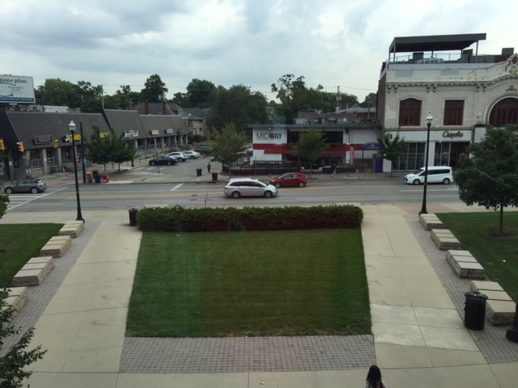
Ohio Union Events and Student Activities
Evacuation Assembly Point: High Street
OR
Managed by: Info Center
Notes:
High St. side- you must be by concrete benches adjacent to High St.

Slide 20
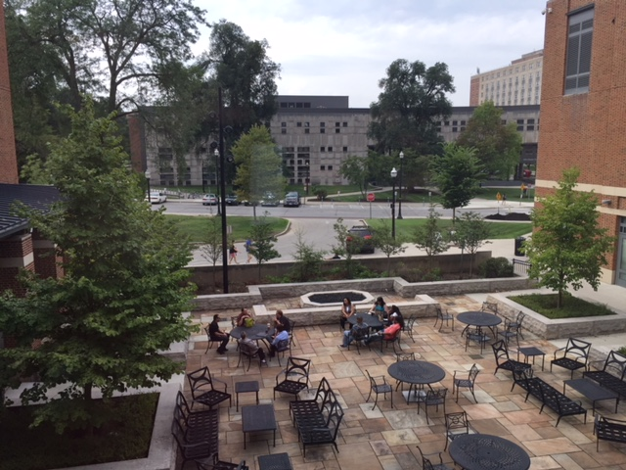
Ohio Union Events and Student Activities
Evacuation Assembly Point: 12th Avenue
Managed by: Operations
Notes:
High St. side- you must be by concrete benches adjacent to High St.

Slide 21
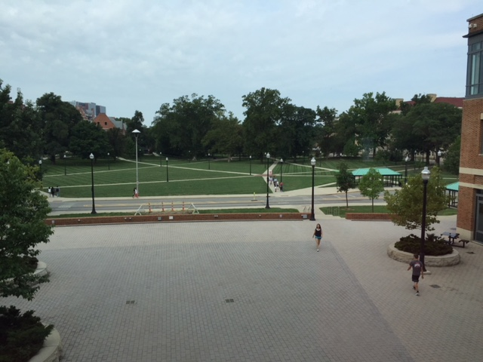
Ohio Union Events and Student Activities
Evacuation Assembly Point: College Road
Managed by: AV
Notes:
High St. side- you must be by concrete benches adjacent to High St.

Slide 22
Ohio Union Events and Student Activities
REMEMBER:
The lights and sounds will stop AND the all-clear announcement will be made before staff and guests are allowed back into the building
Notes:
We mentioned this before but again a reminder:
The lights and sounds will stop before you are allowed back into the building
DO NOT go back inside until the all-clear call is given over the speaker system
Please be sure to let guests know this as well, they will be looking to you for instructions.
Megan’s Last Slide

Slide 23
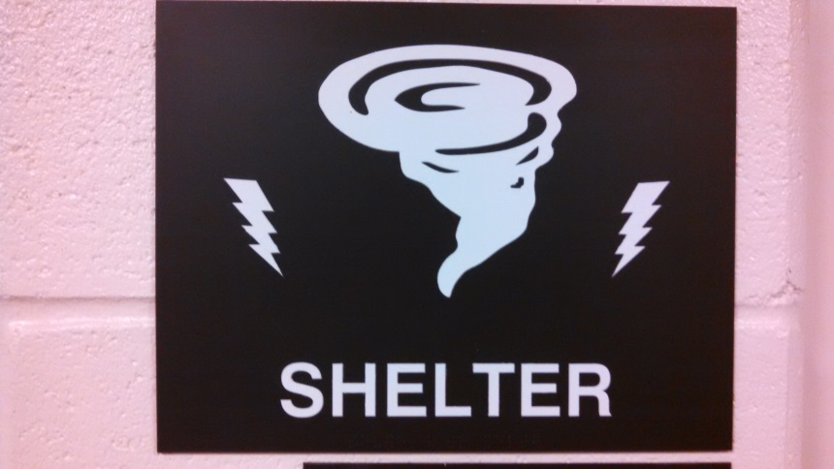
Ohio Union Events and Student Activities
Severe Weather
Management will determine when to seek shelter. This is based on local weather warnings and campus weather information
Announcements will be made over the Fire Panel system for severe weather and warnings
This sign indicates a designated sheltering location in the Ohio Union for severe weather
Notes:
Management will determine when to shelter. This is based on local weather warnings and campus weather information. If severe weather is expected in the area Building Managers and security staff will monitor weather updates on a regular basis and inform the rest of the building as necessary.
What do all those watches and warnings mean?
Tornado Watch: Be Prepared! Tornadoes are possible in and near the watch area. Be ready to act quickly if a warning is issued or you suspect a tornado is approaching.
Tornado Warning: Take Action! A tornado has been sighted or indicated by weather radar. There is imminent danger to life and property. Move to an interior room on the lowest floor of a sturdy building. Warnings are issued by your local forecast office. Warnings typically encompass a much smaller area (around the size of a city or small county) that may be impacted by a tornado identified by a forecaster on Radar or by a trained spotter/law enforcement who is watching the storm.
Severe Thunderstorm Watch: Be Prepared! Severe thunderstorms are possible in and near the watch area. Stay informed and be ready to act if a severe thunderstorm warning is issued.
Severe Thunderstorm Warning: Take Action! Severe weather has been reported by spotters or indicated by radar. Warnings indicate imminent danger to life and property. Take shelter in a substantial building. Warnings are issued by your local forecast office. Warnings typically encompass a much smaller area (around the size of a city or county) that may be impacted by an on-going severe thunderstorm.
Announcements will be made over the Fire Panel system for severe weather and warnings. There are various announcements that can be made, including a call to ask individuals to move away from windows and a call to seek sheltering locations in the Ohio Union.
We cannot force people to stay in the building, but if they stay, they must move to a sheltering location.
THE NEXT TWO SLIDES INDICATE SHELTERING LOCATIONS

Slide 24
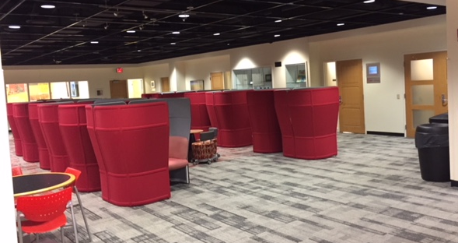
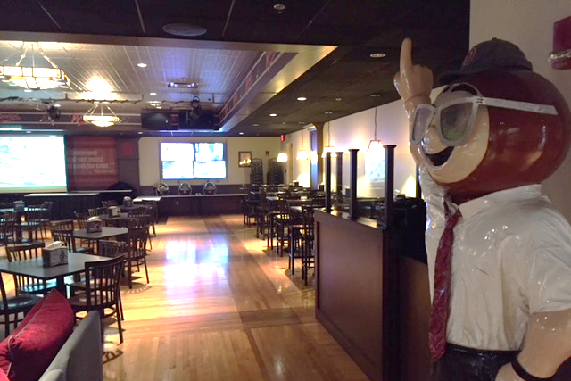
Ohio Union Events and Student Activities
Where are the sheltering Locations in the Ohio Union?
Lower Level
Woodys
Notes:
Where are the sheltering locations? They are: Great Hall Meeting Room, U.S. Bank Conference theatre, Lower Level Back of House, 2nd floor Back of House, Catering kitchen. Remember if you cannot get to these locations that standard tornado sheltering information tell us to go to the most interior rooms in the building on the lowest floor you can reach.

Slide 25
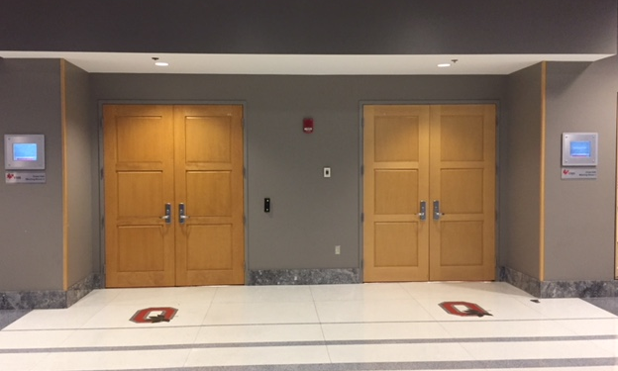
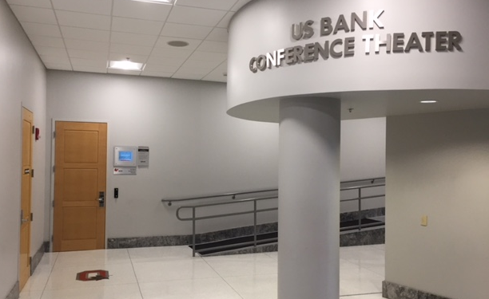
Ohio Union Events and Student Activities
Sheltering Locations
Great Hall Meeting Rooms
US Bank Conference Theater
Notes:
Where are the sheltering locations? They are: Great Hall Meeting Room, U.S. Bank Conference theatre, Lower Level Back of House, 2nd floor Back of House, Catering kitchen. Remember if you cannot get to these locations that standard tornado sheltering information tell us to go to the most interior rooms in the building on the lowest floor you can reach.

Slide 26
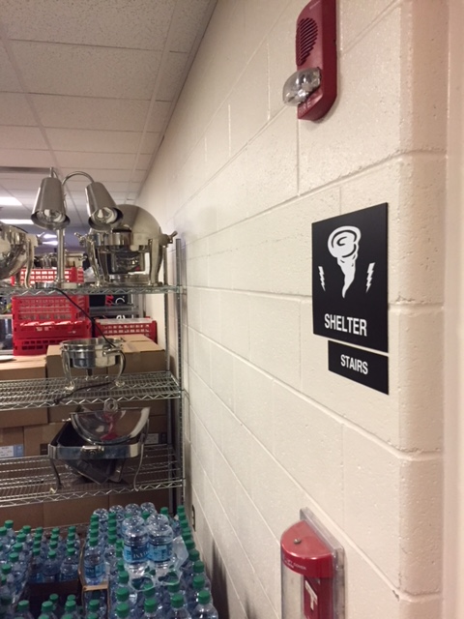
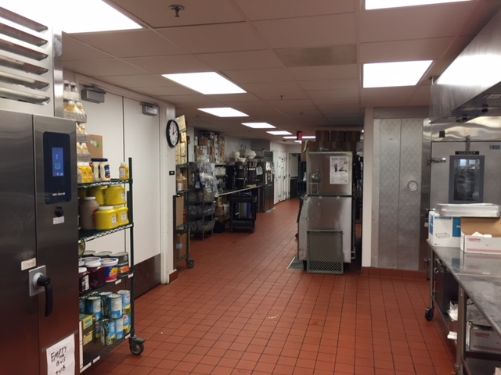
Ohio Union Events and Student Activities
Sheltering Locations
2nd floor back of house
Catering Kitchen
If none of these options are available go to the most interior room on the lowest floor of the building
Notes:
Where are the sheltering locations? They are: Great Hall Meeting Room, U.S. Bank Conference theatre, Lower Level Back of House, 2nd floor Back of House, Catering kitchen. Remember if you cannot get to these locations that standard tornado sheltering information tell us to go to the most interior rooms in the building on the lowest floor you can reach.

Slide 27
Ohio Union Events and Student Activities
Assisting Guests & Clients
Calmly inform guests what is happening and direct them to the nearest exit or sheltering location
Elevators should not be used during an evacuation or sheltering procedure
Persons without disabilities must evacuate to the nearest exit or proceed to their nearest sheltering location - we can’t keep people here, but if they stay they need to shelter
Notes:
How do you help guests and clients during an evacuation procedure?
Calmly inform guests what is happening and direct them to the nearest exit or sheltering location
Elevators should not be used during an evacuation procedure. Once a fire alarm is activated elevators will automatically descend to the ground floor and lock open. Elevators should not be used during a severe weather situation.

Slide 28
Ohio Union Events and Student Activities
Assisting Guests and Clients
Persons with disabilities have four basic evacuation options:
Horizontal evacuation
Stairway evacuation
Stay in Place: unless danger is imminent, remaining in a room with an exterior window, telephone, and a solid door. Dial 9-1-1 and report location
Stairway landing
As you exit the building, report the location of the individual with a disability to the Building Manager and CFD and OSUPD
Note for visual and hearing impairment
Notes:
There are also specific guidelines on how do you help an individual with a mobility impairment:
There are four evacuation options:
Horizontal evacuation- meaning leave on the floor you are on- the first floor of the Ohio Union has ADA accessible exits, so this is a viable option for everyone. If danger is imminent and depending on an individuals impairment, there is a horizontal exit on the second floor behind the East Ballroom leading to the parking garage
Stairway evacuation- this is appropriate if an individual has a non-wheelchair mobility impairment and can navigate stairs if danger is imminent. If there is no immediate danger they may choose to stay in place
Stay in Place: unless danger is imminent, move to or remain in a room with an exterior window, telephone, and a solid/fire resistant door. Dial 9-1-1 and report location. On the 3rd floor we recommend sending someone to the Round Meeting Room. On the second floor we recommend the Traditions Room.
Stairway landing- as a fourth option an individual with a wheelchair bound mobility impairment may choose a stairway landing as their Stay in Place location, but they are advised to wait until the traffic has passed.
As you exit the building, report the location of the individual with a disability to Building Managers who will inform CFD and OSUPD.
If an individual has a hearing impairment, we might need to write a note to let them know what is happening. Both the alarms and strobe lights will go off during a fire alarm.
If an individual has a visual impairment, they might need additional assistance evacuating the building since their path could be different. The assistant should offer their elbow to the individual with a visual impairment and guide him or her through the evacuation route. During the evacuation the assistant should communicate as necessary to assure safe evacuation.
During a sheltering procedure, remember that we still cannot use the elevators. Direct guests to a sheltering location on their floor or the most interior room away from windows on the floor they are on.

Slide 29
Ohio Union Events and Student Activities
Medical Emergencies
Call 9-1-1 first
Notify building staff of location, so we can direct EMS/EMT upon arrival
Have elevators ready for EMT

Slide 30
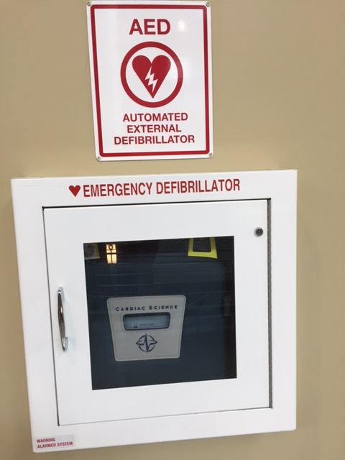
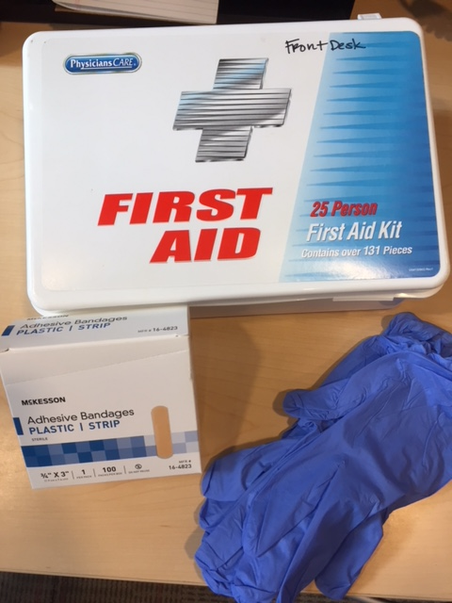
Ohio Union Events and Student Activities
Medical Emergencies
Location of AEDs, First Aid Kits
One on each floor by elevator 4
Each desk area has a first aid kit
Next to:
Creative Arts Room
Performance Hall
Admin Offices
Brutus Buckeye
Info Center
Admin Desk
Resource Room
S/R/S

Slide 31
Ohio Union Events and Student Activities
Active Threat Response
www.go.osu.edu/active-shooter
Building response (lock-down, serve as shelter) will be determined by location of threat
Building announcements will communicate Buckeye Alert messaging to guests

Slide 32
Ohio Union Events and Student Activities
Active Threat Response

Slide 33
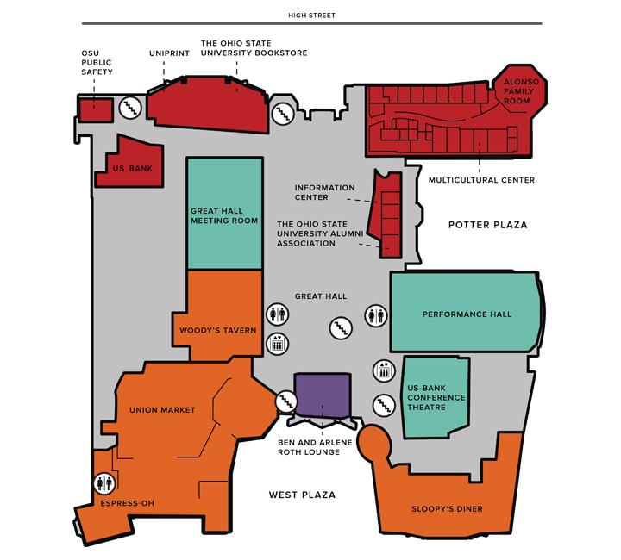
Ohio Union Events and Student Activities
Employee After-Hour Access
Students Enter NE entrance by U.S Bank
Students Enter NW Entrance by Loading Dock West Entrance
24 hour access by Sloopy’s Diner
Notes:
A reminder of the 2 student employee access points:
1- NE entrance of building by Garages and U.S. Bank
2- NW entrance of building behind Espress-OH
In addition there is a 24-Hour access door- entrance nearest Sloopy’s. This entrance is behind the gates when the building is closed and provided 24 hour access to the Center for Student Leadership and Service.

Slide 34
Ohio Union Events and Student Activities
Employee After-Hour Access
It is your responsibility to make sure nobody follows you into the building.
If someone tries to follow you in - ask for their ID and ask where they work.
Notes:
A reminder of the 2 student employee access points:
1- NE entrance of building by Garages and U.S. Bank
2- NW entrance of building behind Espress-OH
In addition there is a 24-Hour access door- entrance nearest Sloopy’s. This entrance is behind the gates when the building is closed and provided 24 hour access to the Center for Student Leadership and Service.

Slide 35
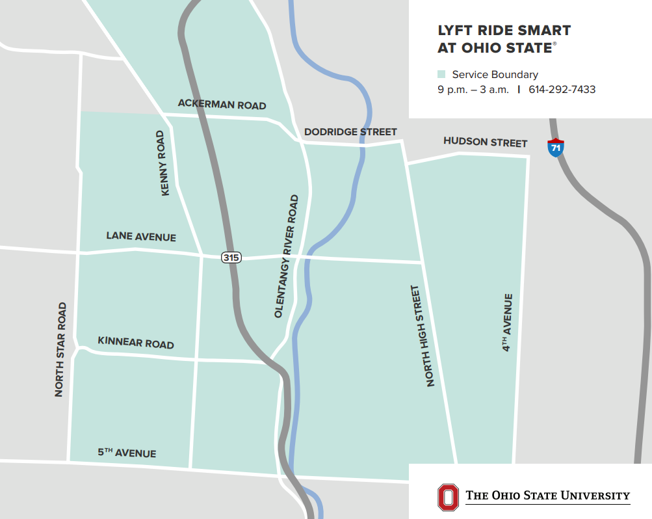
Ohio Union Events and Student Activities
Lyft Ride Smart at Ohio State
Lyft Ride Smart at Ohio State offers eligible students discounted rides, inside the university designated service area,
from 9p to 3a
Average cost expected to be $2 or less

Slide 36
Ohio Union Events and Student Activities
Numbers to know
Public Safety Non-Emergency Number:
614-292-2121
Ohio Union Building Manager:
614-402-4335

Slide 37
Ohio Union Events and Student Activities
Numbers to know
Ohio Union Security Office (SRS):
614-247-6242
Ohio Union Information Center:
614-688-4636

Slide 38
Ohio Union Events and Student Activities
QUESTIONS?

