Slide 1
Transition Options Post Secondary (TOPS) Program

Slide 2
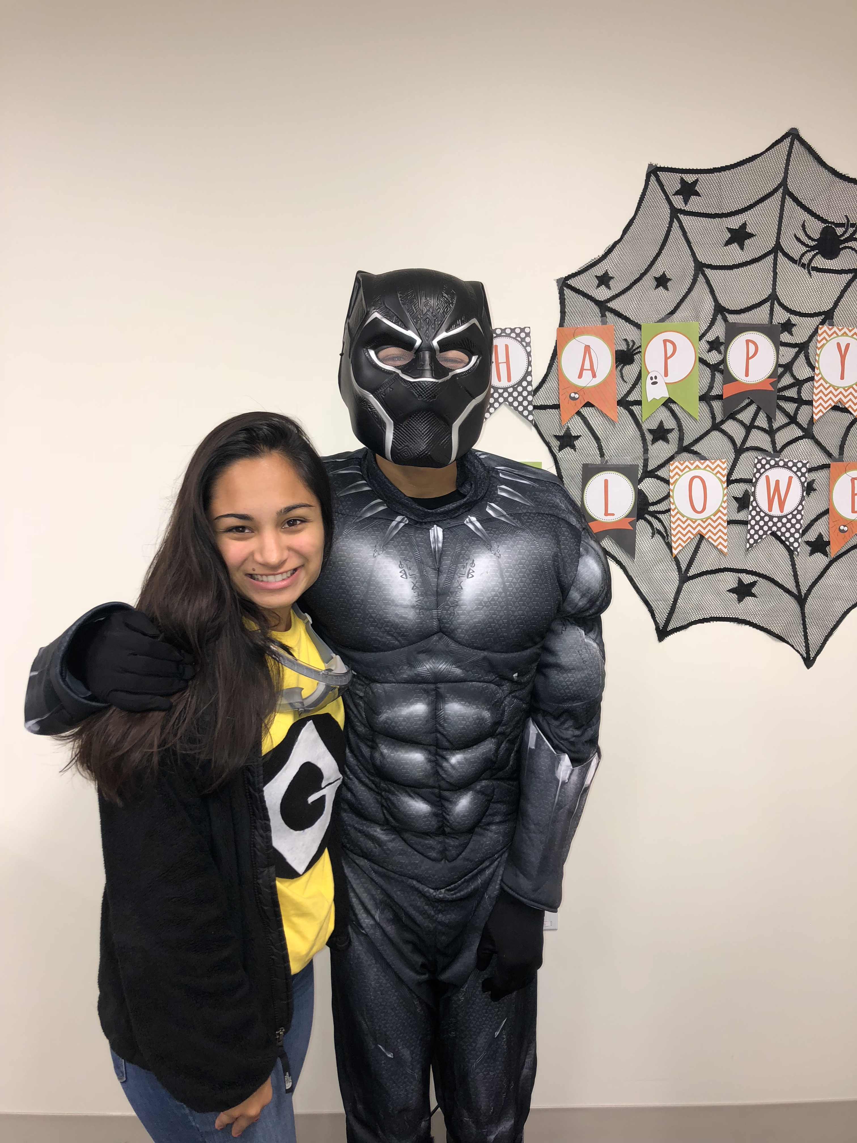
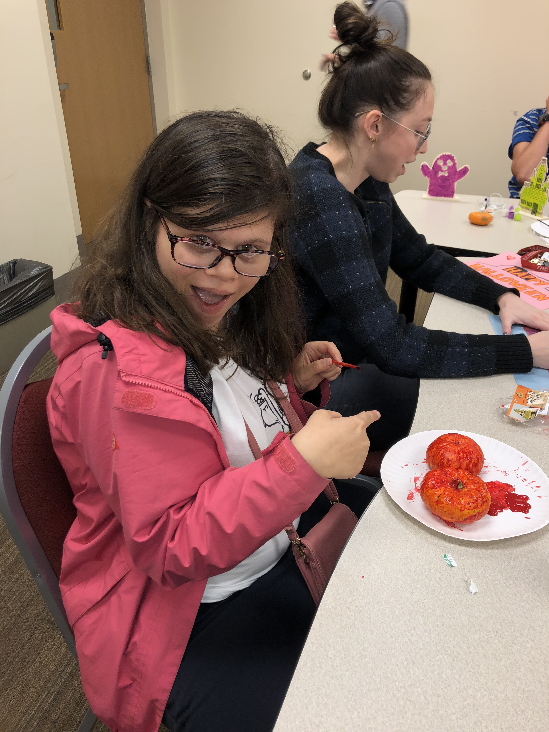
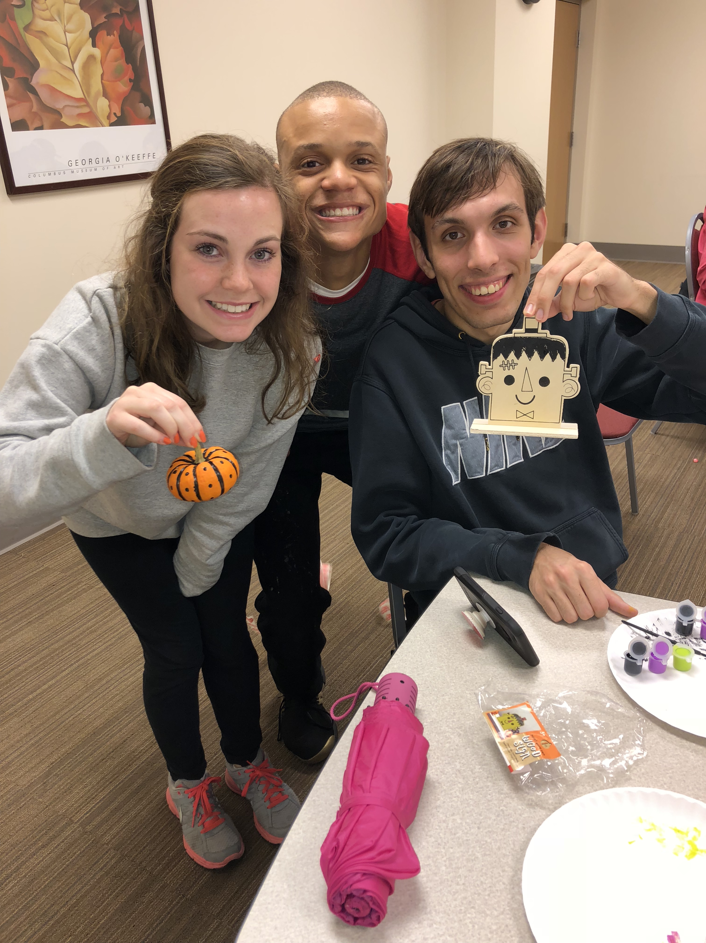
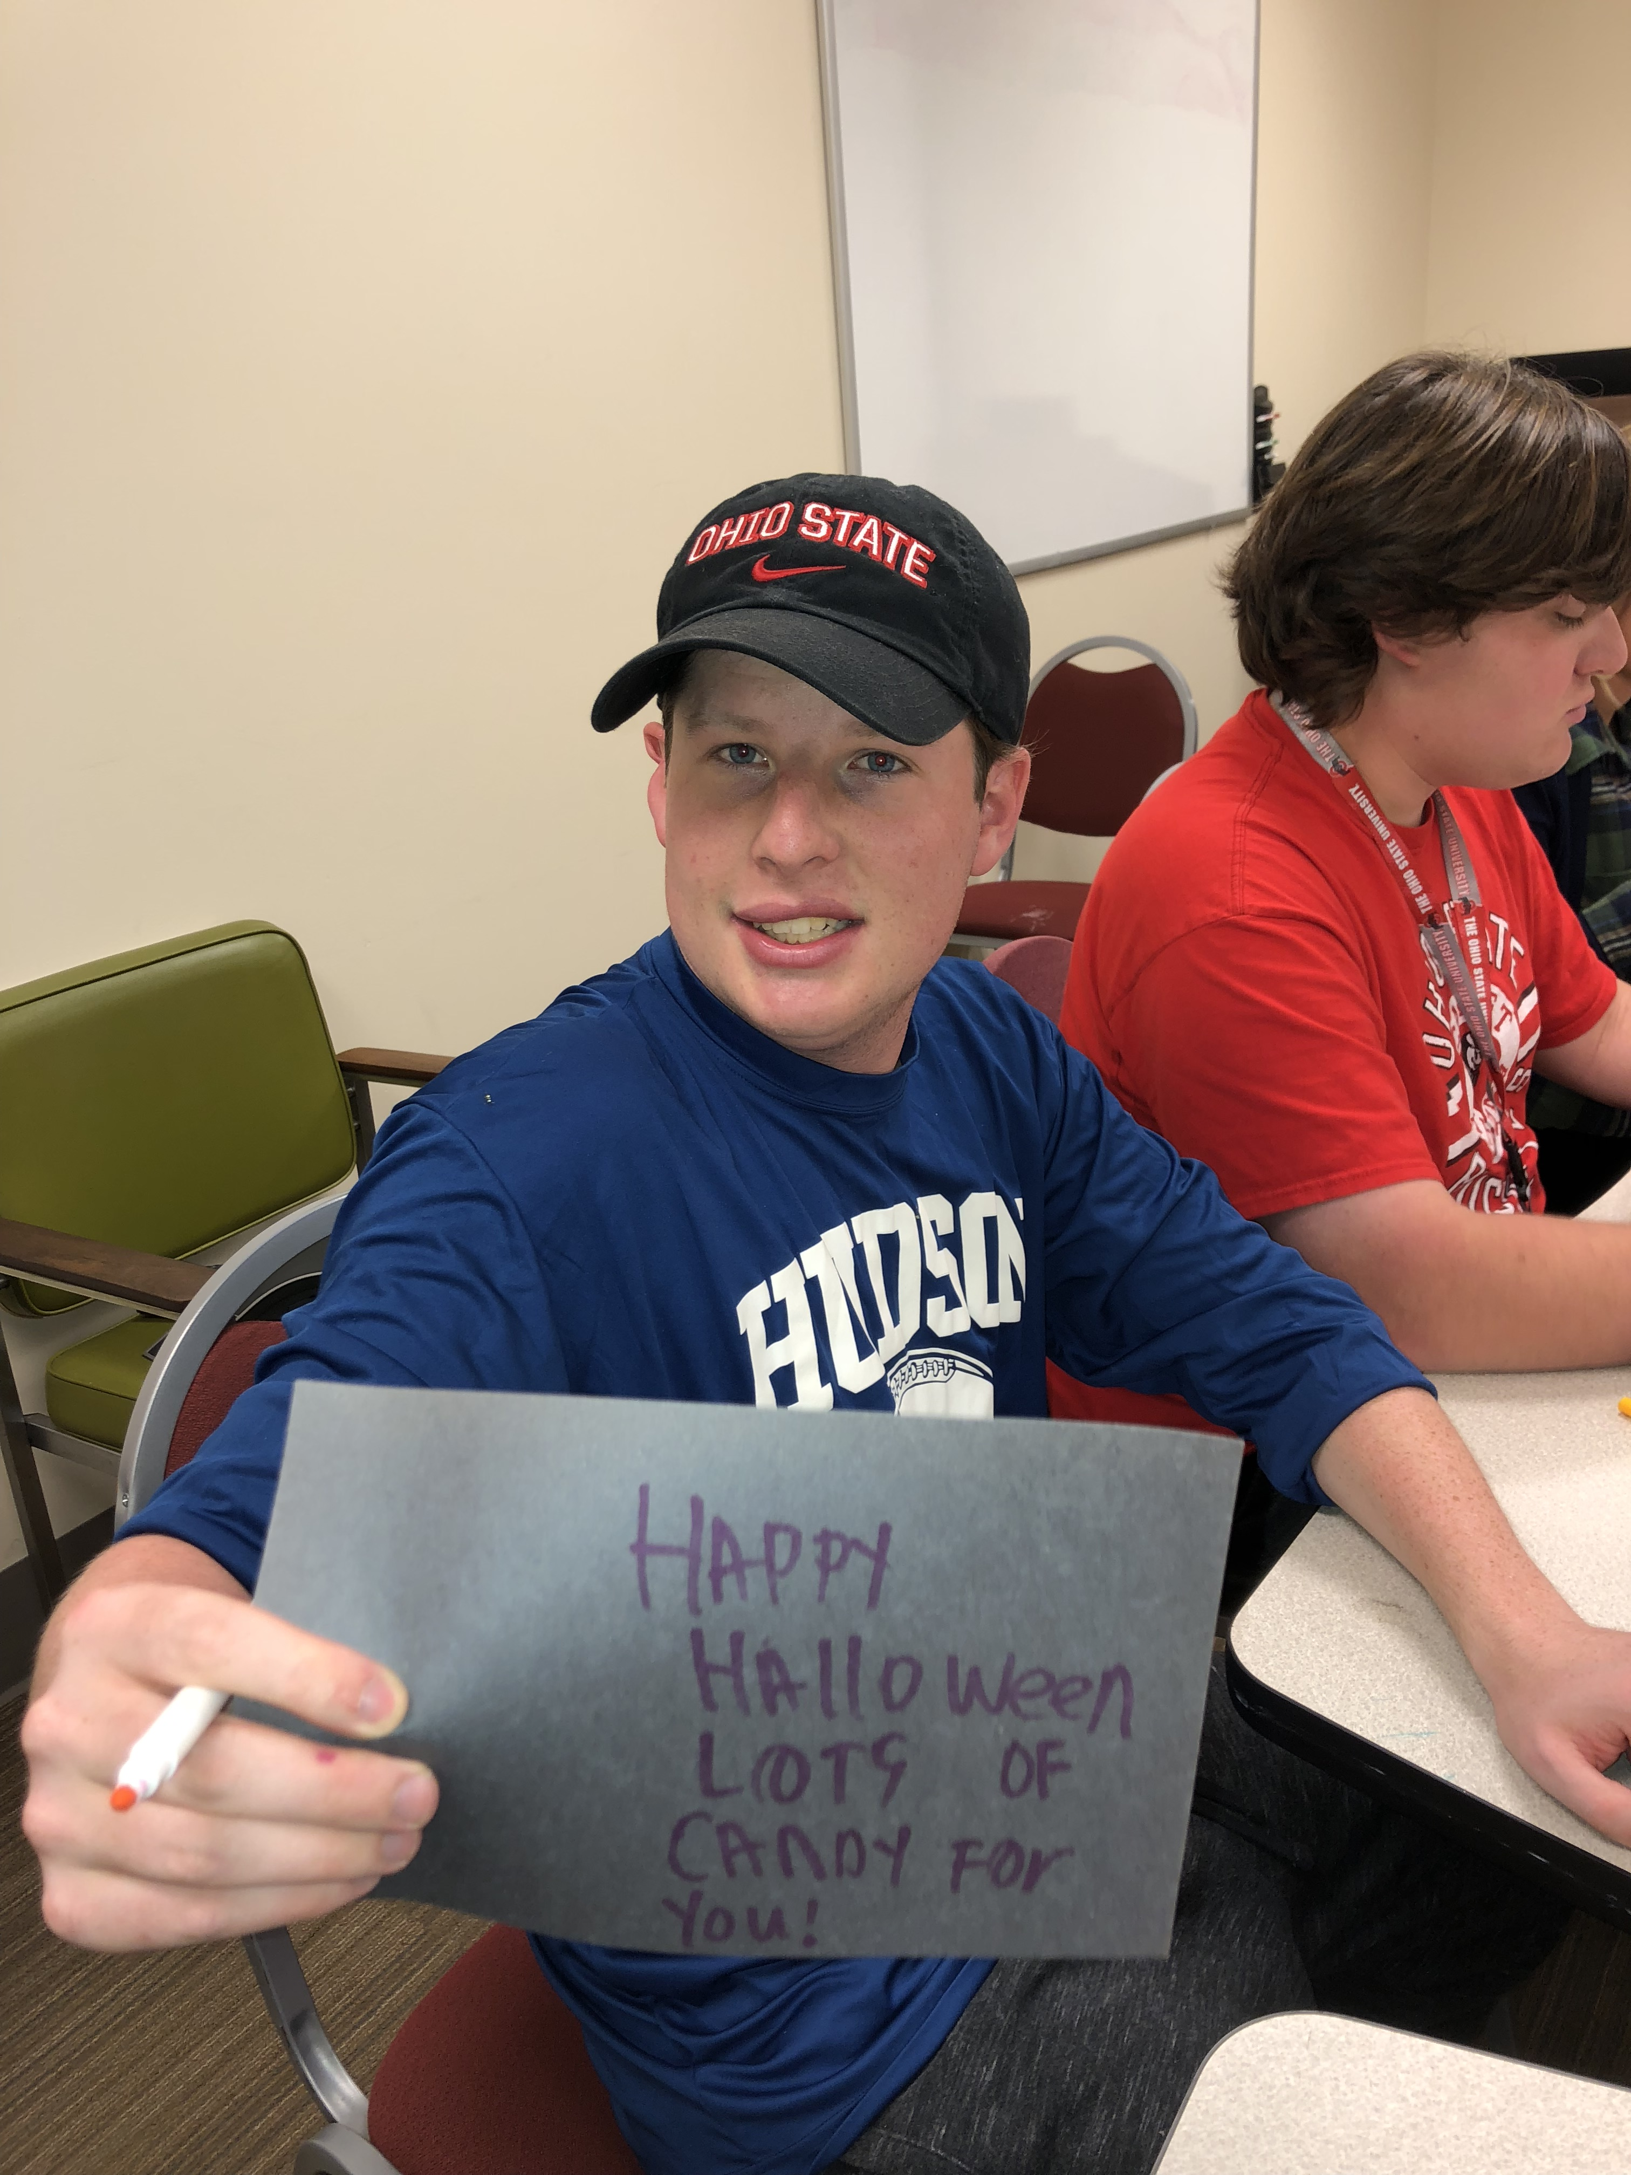

Slide 3
About the Program
Working with students that attend Ohio State who have Intellectual and Developmental Disabilities
Get two credit hours worth because it is a “class” that you enroll in
They have accommodations
4 different Positions:
Educational Coach
Attended Ohio State audited class with student
Social Coach
Go to different places in the community with TOPS students and other volunteers to help become more comfortable in social settings
In Class Mentor
Attended TOPS class and help students
Tutor Coach
Help students in the Academic Center with their homework and studying

Slide 4
Contact Information
Mallory Workman – Program Coordinator
Mallory.workman@osumc.edu

