Slide 1
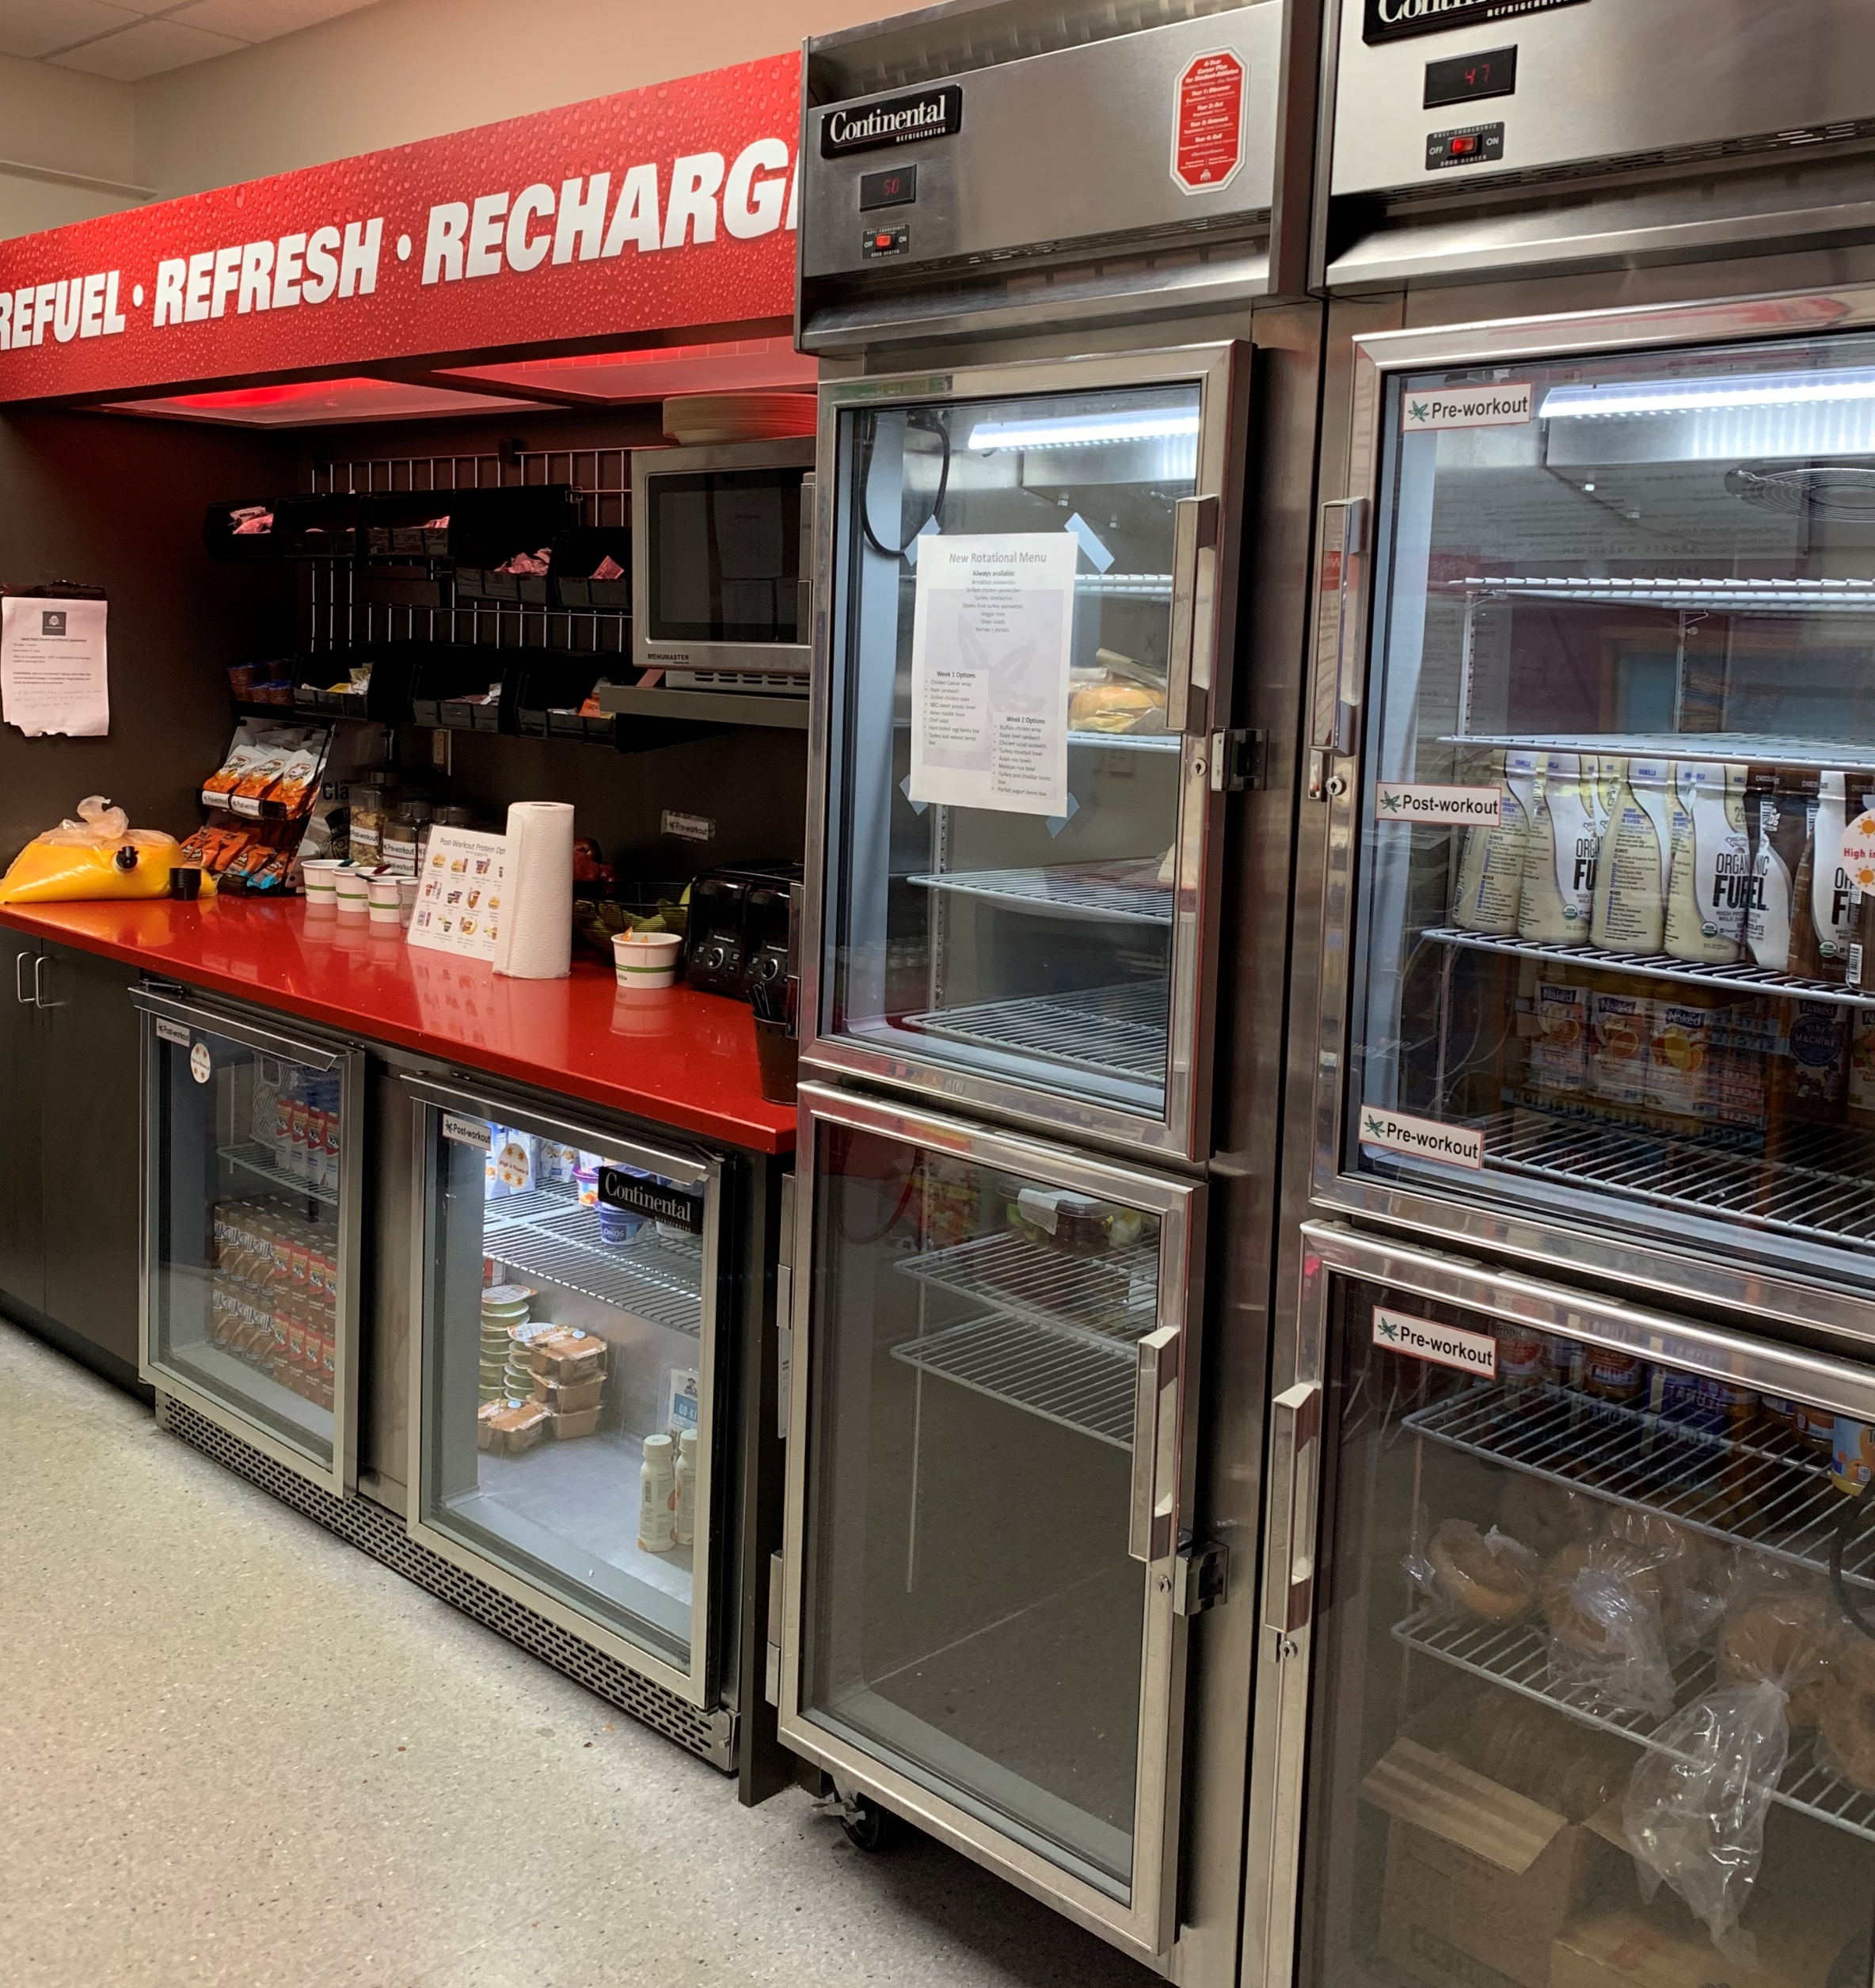
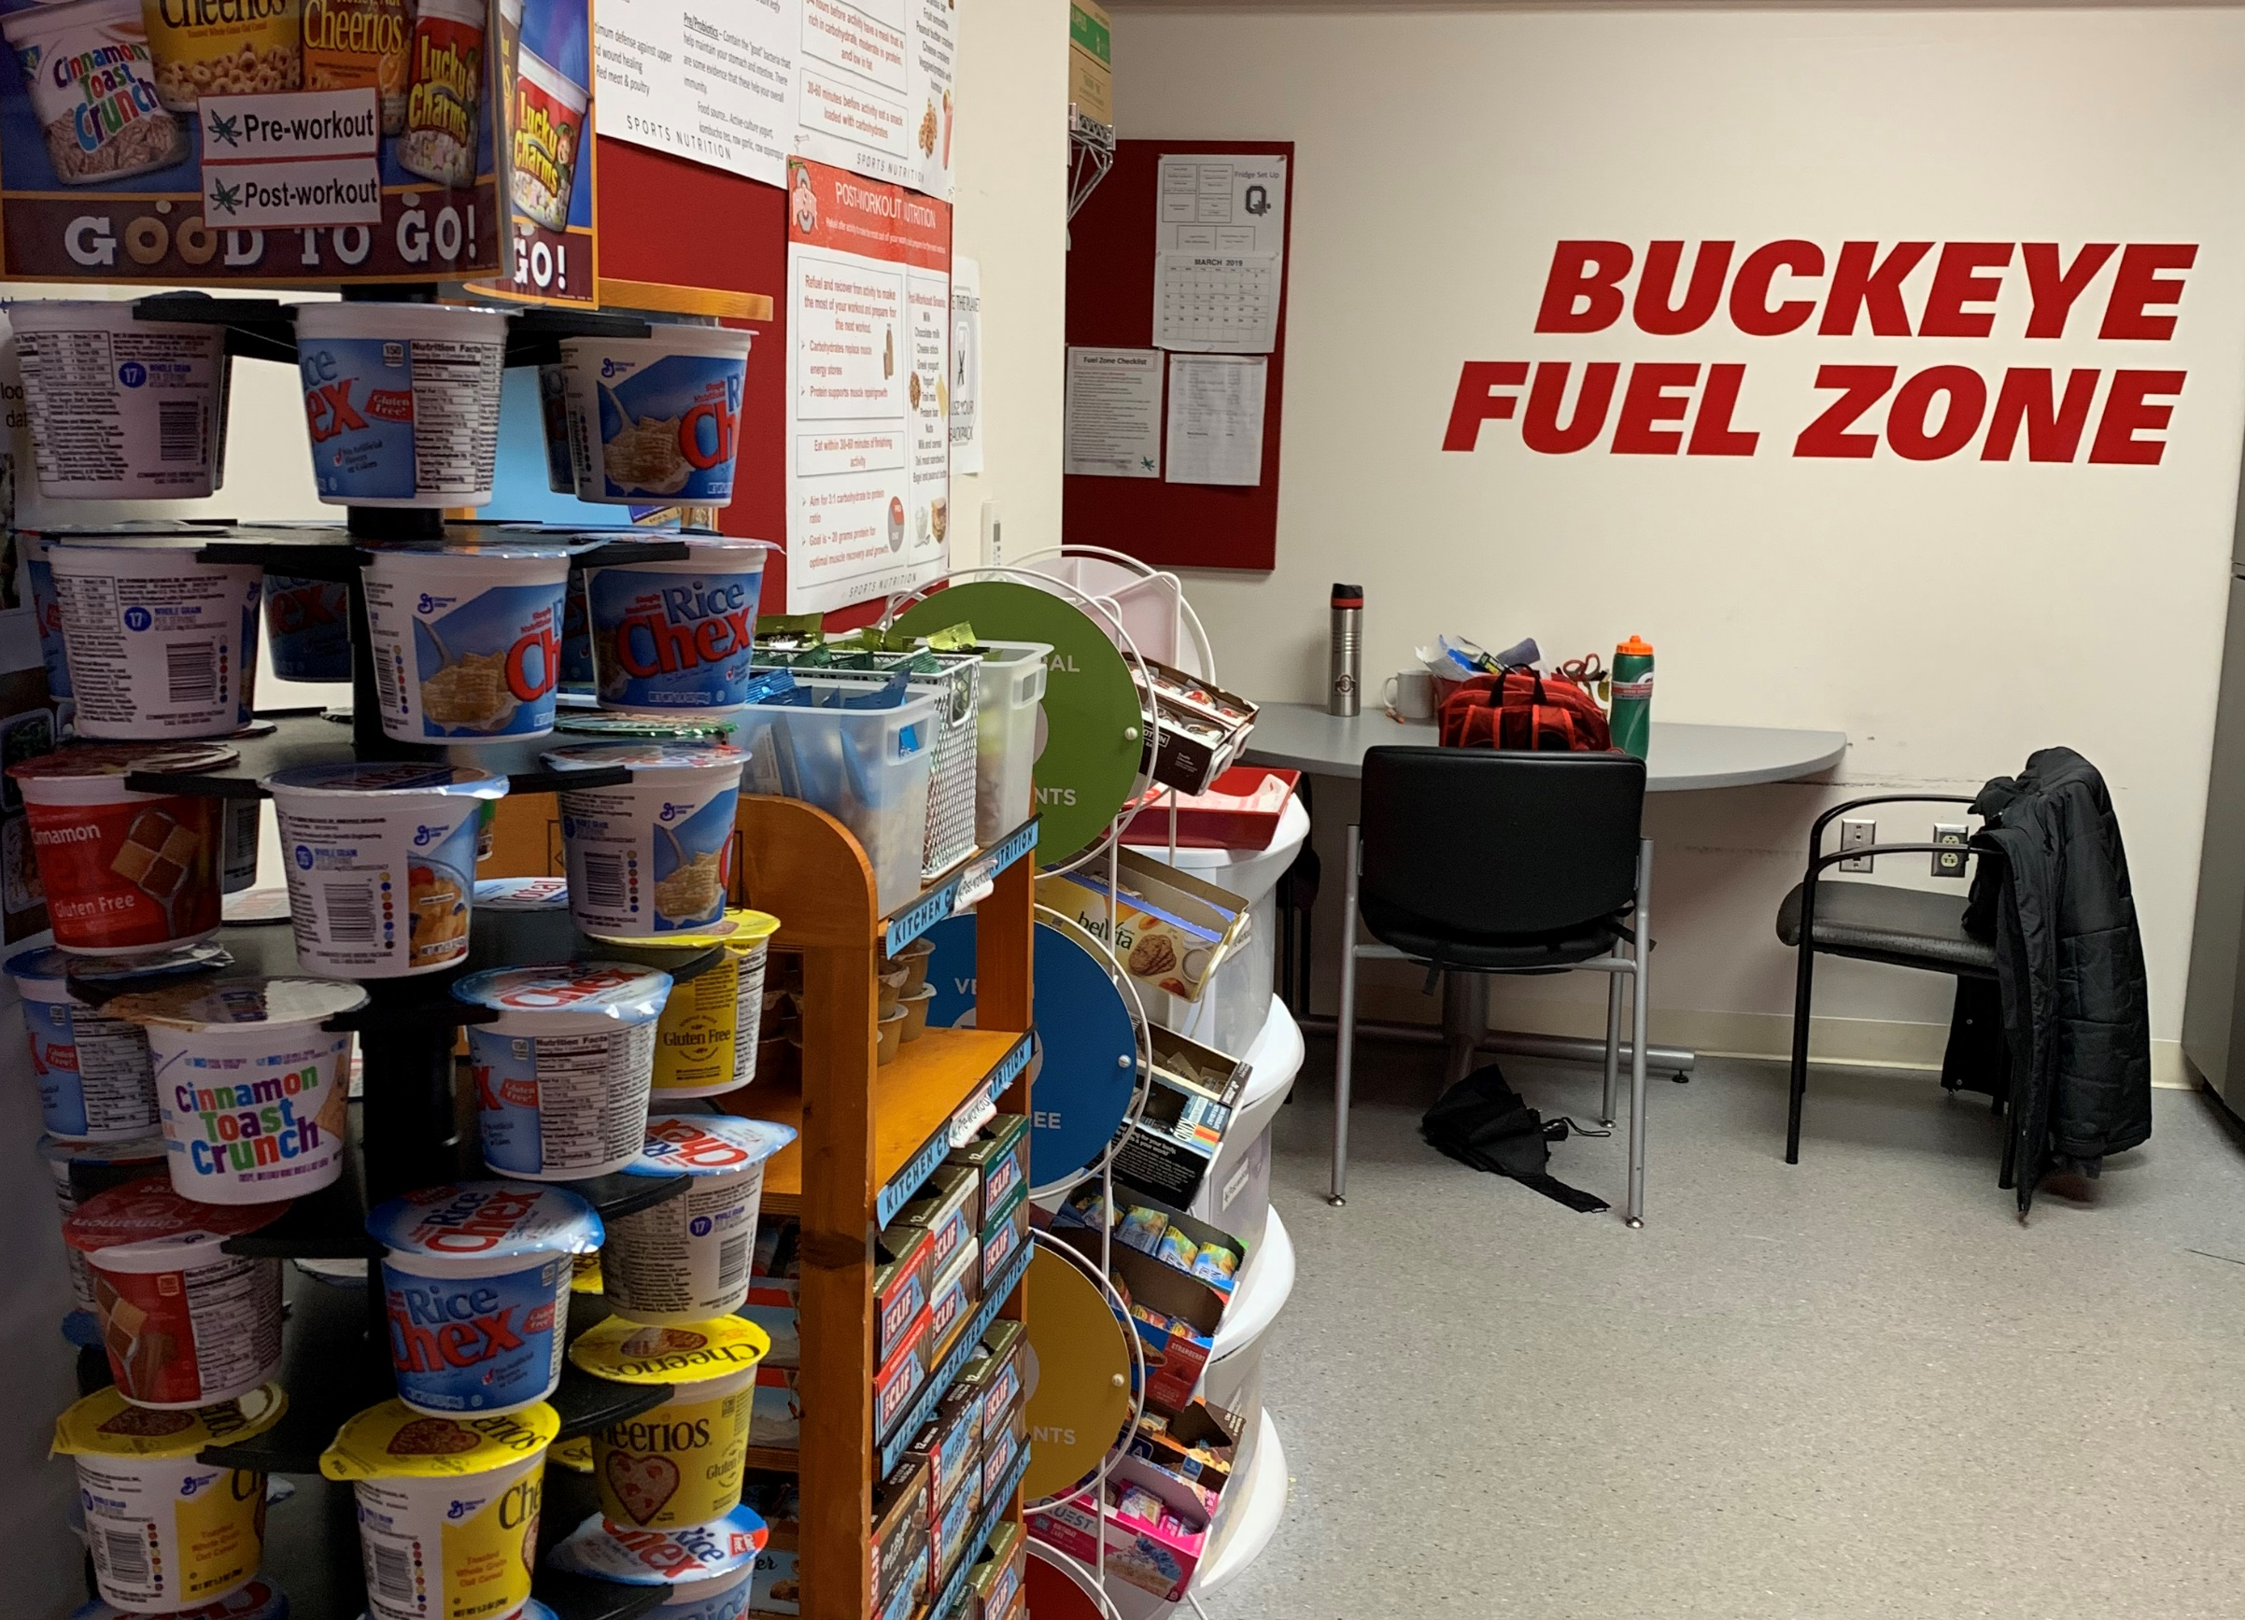
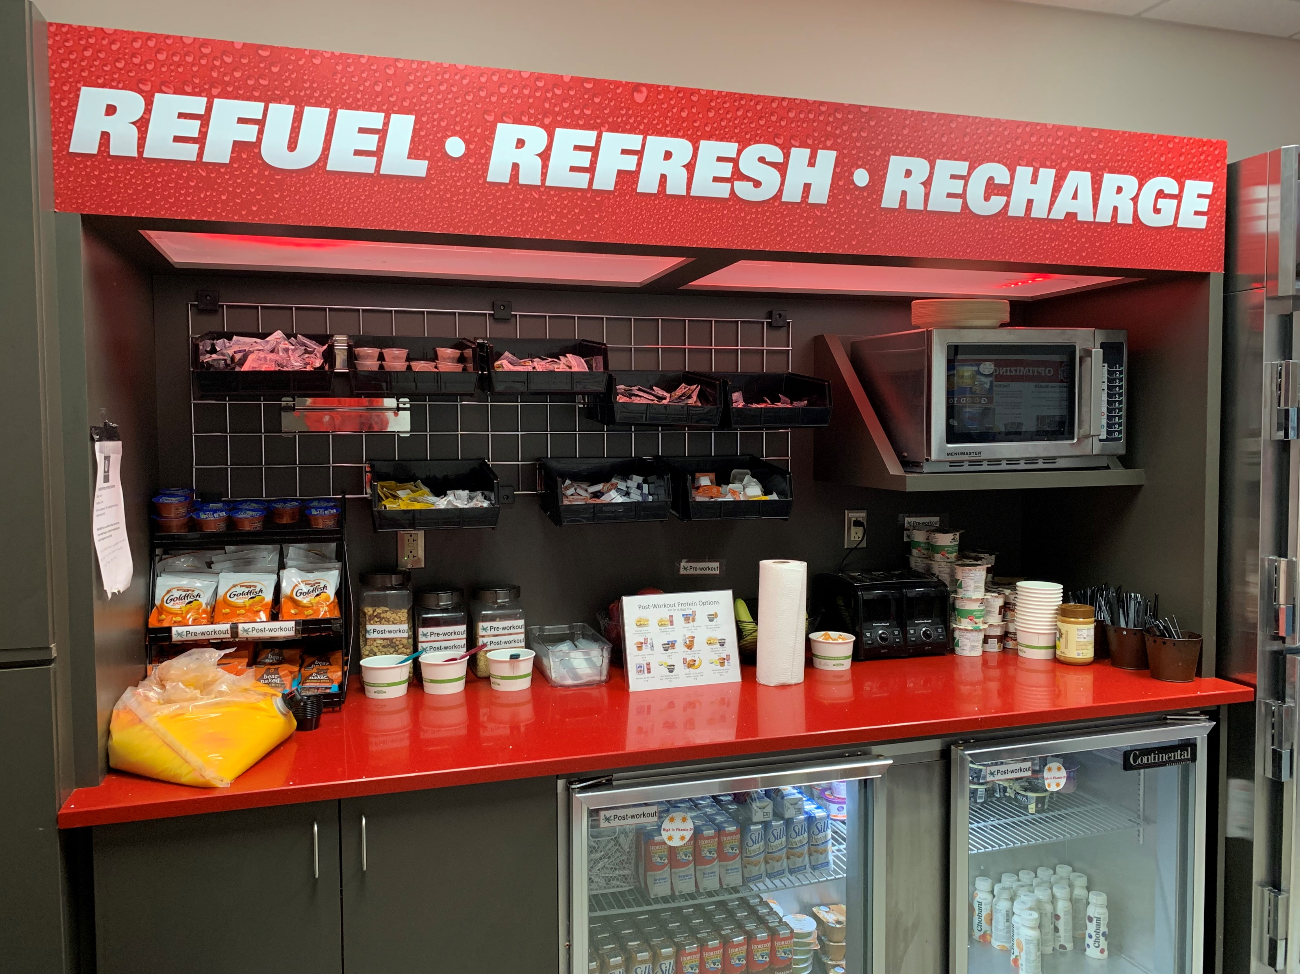
Ohio State University Sports Nutrition Volunteer Program Katie Kreinbrink
Volunteers work in the Fuel Zones in each of OSU’s athletic training facilities and ensure that they are fully stocked at all times
Fuel Zones are “snack rooms” where OSU student-athletes are able to get food for fuel before practices or workouts and to refuel after a practice or workout
Volunteers are also responsible for teaching student-athletes basic nutrition-related information by creating games, posters, etc.
As a volunteer, I worked closely with the Sports Nutritionists in the Department of Athletics and learned a lot about what their jobs consist of.
As an OSU student-athlete, I gained a greater appreciation for the Sports Nutritionists that work with each sports team.
I was also able to expand my knowledge about human nutrition and apply things that I learned in my classes while volunteering.
Contact Information:
Nicole Jontony – jontony.2@osu.edu

