Slide 1
Major Information Session Radiologic Sciences & Therapy
School of Health and Rehabilitation Sciences

Slide 2
School of Health and Rehabilitation Sciences
What we will cover:
What is Radiologic Sciences & Therapy
How to become a pre-major
How to run a degree audit
Next Steps
HRS Student Services Office

Slide 3
School of Health & Rehabilitation Sciences
Radiologic Sciences & Therapy
Is the occupational study of the science of utilizing radiation for diagnostic or therapeutic purposes in health care
There are 3 tracks to this major:
Radiography – utilizes x-ray generating equipment to produce radiographic images of the human body. Includes: fluoroscopy, surgery, mammography, CT scans or MRI
Sonography – diagnostic medical procedure that uses high-frequency waves (ultrasound) to produce dynamic visual images of organs, tissues or blood flow inside the body
Radiation Therapy – treating disease with penetrating beams of high-energy radiation (to treat cancer alone or with conjunction with surgery and/or chemotherapy)

Slide 4
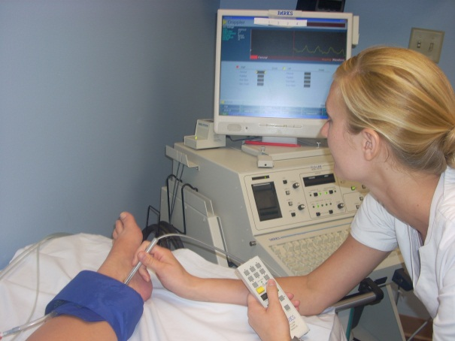
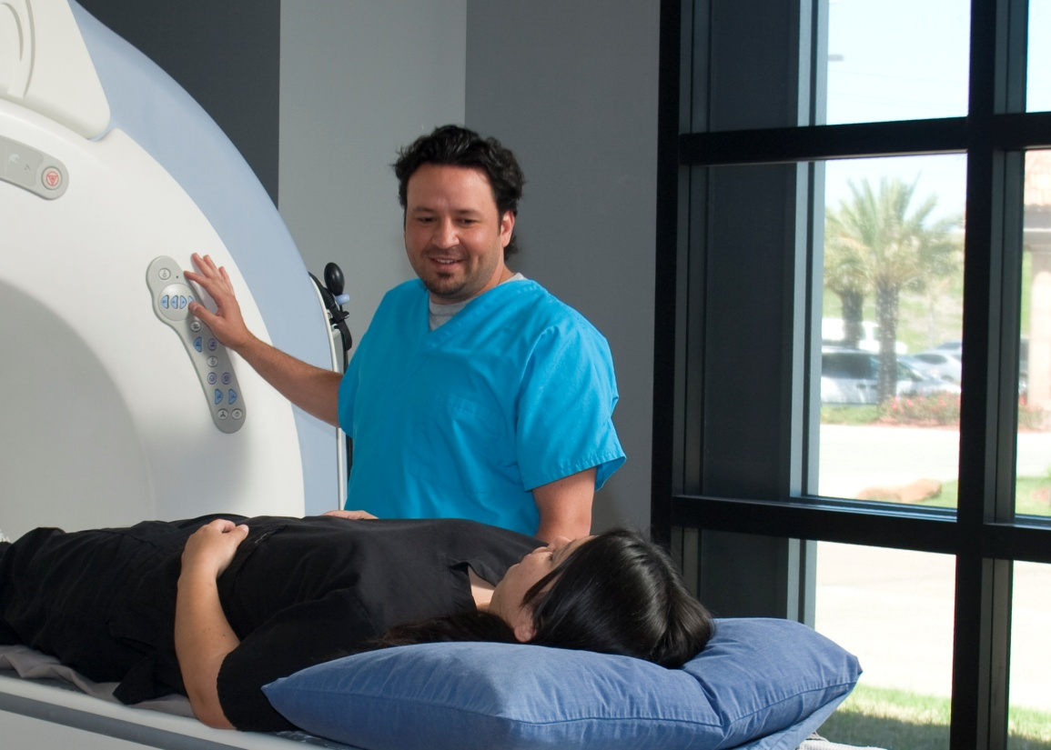
School of Health & Rehabilitation Sciences
Who are Radiologic Scientists?
People who like to help others
People who like to develop creative solutions to problems & thinking critically
People who like to work with their hands and manipulating tools or operating technology

Slide 5
School of Health & Rehabilitation Sciences
Why major in Radiologic Sciences & Therapy?
Multiple certifications
XRay, MRI, Fluoroscopy, CT, Mammography
Generally leads to higher salary
Bachelors program including - administrative and quality management courses
Near 100% pass rates (1st time attempts) for all 3 tracks
***Partnership with General Electric for cutting edge technology – may be more up to date with technology than clinical preceptors (good for job placement!)***

Slide 6
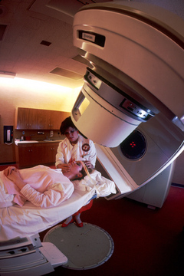
School of Health and Rehabilitation Sciences
Current OSU students: Steps to declare an HRS pre-major
Complete one full term at OSU; if you are a freshman or transfer student, you can not be switched until your first term grades are posted
Have an OSU GPA of at least a 2.5
Complete the MIS Quiz in Google
and check the appropriate box to change your major
Students will be notified at the end of the semester if their major was changed
If for some reason we cannot change your major you will be notified explaining the reason

Slide 7
School of Health & Rehabilitation Sciences
As a pre-major…
Students complete SHRS prerequisite courses and GEs
Apply to the major (one application cycle per year)
Deadline is January 31
Students must earn a C- or higher on all prerequisite coursework
Pre-major students must still apply to the professional program of interest

Slide 8
School of Health & Rehabilitation Sciences
Non-OSU students who intend to transfer to OSU:
Apply as a transfer student - Indicate on the Common App that you are interested in a SHRS major when you apply to Ohio State
Or apply directly to the professional program via http://gpadmissions.osu.edu/ - if you apply and get directly accepted into your major that would be your acceptance into OSU
For students in the state of Ohio please visit the http://admissions.osu.edu/standards to find transfer course equivalents
For students who would like to transfer from out of state, we would encourage you to contact the Graduate and Professional Admissions Office – complete a pre-requisite evaluation form

Slide 9
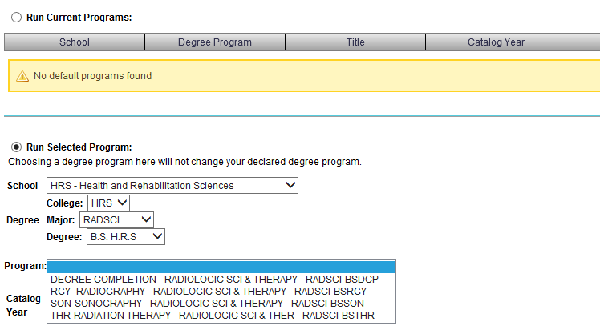
School of Health & Rehabilitation Sciences
How a current OSU student runs a degree audit for Radiologic Sciences & Therapy

Slide 10
School of Health & Rehabilitation Sciences
Next Steps
For all interested students: Complete the Quiz in Google
Request to change your major - this will be the last question of the quiz
AND/OR
Contact the Student Services Office

Slide 11
School of Health and Rehabilitation Sciences
Student Services Office
School of Health & Rehabilitation Sciences
206 Atwell Hall
453 West 10th Avenue
Columbus, Ohio 43210
Appointment Line: 614-292-1706
Email: hrsstudentservices@osumc.edu
Website: https://hrs.osu.edu/

