Slide 1
Major Information Session Medical Laboratory Science
School of Health and Rehabilitation Sciences

Slide 2
School of Health and Rehabilitation Sciences
What we will cover:
What is Medical Laboratory Science
How to become a pre-major
How to run a degree audit
Next Steps
HRS Student Services Office

Slide 3
School of Health & Rehabilitation Sciences
Medical Laboratory Science
The use of clinical laboratory tests to detect, diagnose, monitor and treat disease
Determine presence of disease, extent of illness, identify treatment options, monitor treatment effectiveness and health
Blood, tissue and body fluids can be chemically analyzed and examined for foreign organisms and abnormalities
Two tracks: Certification (students who want to become Medical Laboratory Scientists) or Medical Science (students who want to pursue graduate studies in any medical field)
It is a 2 year program once admitted into the major

Slide 4
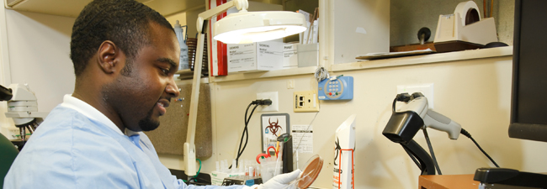
School of Health & Rehabilitation Sciences
Who are Medical Laboratory Scientists?
People who like solving puzzles
People who enjoy working with their hands and using tools & technology
People who are organized, dependable, and who enjoy office/laboratory work and managing data

Slide 5
School of Health & Rehabilitation Sciences
Why major in Medical Laboratory Science?
There is a national shortage of Medical Laboratory Scientists, so jobs are plentiful!
They are affiliated with a number of excellent hospitals in Ohio that provide you with hands-on experience in both routine and specialized testing
Students will receive great letters of recommendations from their faculty members
It’s an integrated internship program – that exposes you to 5 major areas of MLS
Clinical chemistry, Hematology, Immunology, Microbiology, and Immunohematology (Blood Banking)

Slide 6
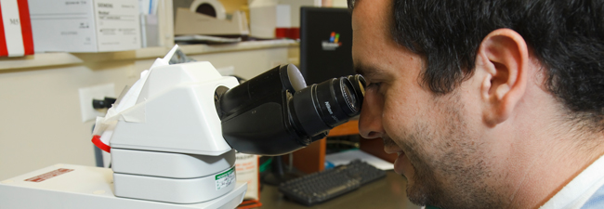
School of Health & Rehabilitation Sciences
Why major in Medical Laboratory Science?
This will help prepare you for a graduate/professional program because…
You understand what the range of values from the test results mean and what abnormal values indicate
You will have a deeper understanding of biological processes at the cellular level (Example: white blood cells, viruses and how they interact)
You’ll know what type of conditions will prompt certain types of tests
Good experience of handling specimen and maintaining sterile fields
You’re responsible for running 85 % of the tests that determine treatment decisions

Slide 7
School of Health and Rehabilitation Sciences
Current OSU students: Steps to declare an HRS pre-major
Complete one full term at OSU; if you are a freshman or transfer student, you can not be switched until your first term grades are posted
Have an OSU GPA of at least a 2.5
Complete the MIS Quiz in Google
and check the appropriate box to change your major
Students will be notified at the end of the semester if their major was changed
If for some reason we cannot change your major you will be notified explaining the reason

Slide 8
School of Health & Rehabilitation Sciences
As a pre-major…
Students complete SHRS prerequisite courses and GEs
Apply to the major (one application cycle per year)
Deadline is January 31 (this deadline applies to the undergrad major)
Students must earn a C- or higher on all prerequisite coursework
Pre-major students must still apply to the professional program of interest

Slide 9
School of Health & Rehabilitation Sciences
Non-OSU students who intend to transfer to OSU:
Apply as a transfer student - Indicate on the Common App that you are interested in a SHRS major when you apply to Ohio State
Or apply directly to the professional program via http://gpadmissions.osu.edu/ - if you apply and get directly accepted into your major that would be your acceptance into OSU
For students in the state of Ohio please visit the http://admissions.osu.edu/standards to find transfer course equivalents
For students who would like to transfer from out of state, we would encourage you to contact the Graduate and Professional Admissions Office – complete a pre-requisite evaluation form

Slide 10
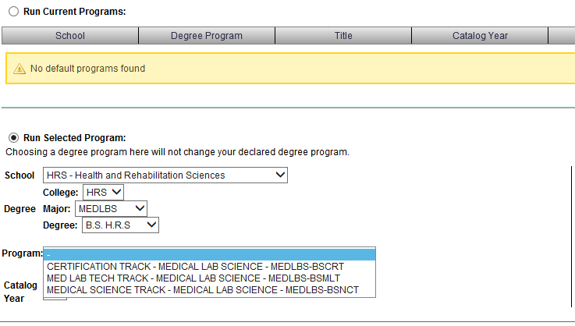
School of Health & Rehabilitation Sciences
How a current OSU student runs a degree audit for Medical Laboratory Science

Slide 11
School of Health & Rehabilitation Sciences
Next Steps
For all interested students: Complete the Quiz in Google
Request to change your major - this will be the last question of the quiz
AND/OR
Contact the Student Services Office

Slide 12
School of Health and Rehabilitation Sciences
Student Services Office
School of Health & Rehabilitation Sciences
206 Atwell Hall
453 West 10th Avenue
Columbus, Ohio 43210
Appointment Line: 614-292-1706
Email: hrsstudentservices@osumc.edu
Website: https://hrs.osu.edu/

