Slide 1
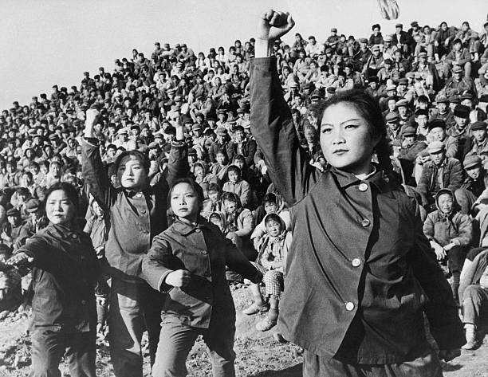
Module 1
Origins of the Cultural Revolution

Slide 2
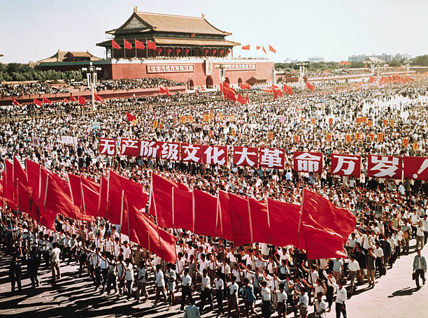
Major Questions:
What was the Cultural Revolution?
Who was responsible for the Cultural Revolution?
What were the origins of the Cultural Revolution?
What were the long-term consequences of the Cultural Revolution?

Slide 3
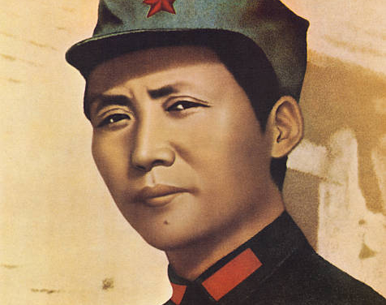
Module 1 Question:
Was Mao Zedong a dictator?
A form of government in which absolute power is concentrated in a dictator or a small clique.
How were events in the Soviet Union connected to the Cultural Revolution?

Slide 4
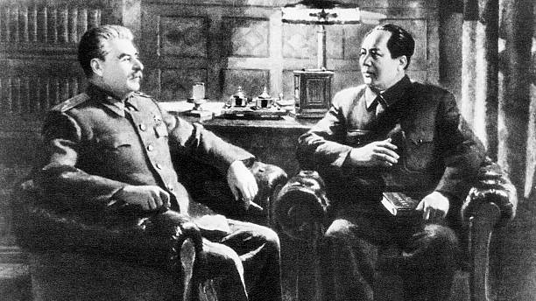
Module Theme:
Competing Visions for China

Slide 5
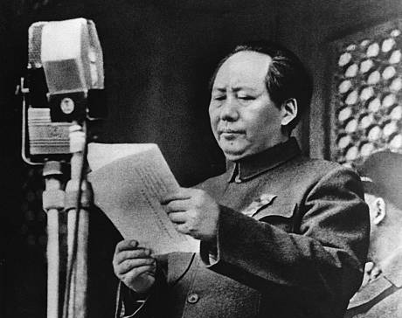
Setting the Stage for the Cultural Revolution
October 1, 1949, Mao Zedong proclaims the establishment of the People’s Republic of China.
“New China” would “Lean to one side.”
Siding in the Soviet Union.
Following the Soviet Model by creating a highly bureaucratic state.

Slide 6
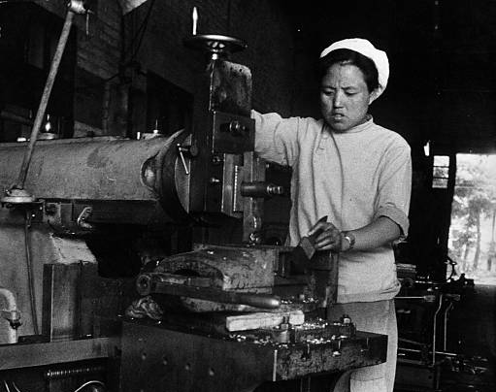
The First Five Year Plan (1953-1957)
Soviet Planned Economy
Heavy industry as a prerequisite for further growth.
Emphasized Heavy Industry
88% percent of budget dedicated to heavy industries: Steel, Machine Building, Fuel, Electric Power, Metallurgy, and Basic Chemicals.
Only 11% of investment to go to light industries.
Economic Growth at 14.7%.
Fostered rapid urbanization.
Notes:
Based on Soviet Union First Five Year Plan. The assumption was that a strong base of heavy industry was needed before any country could develop consumer industries.

Slide 7
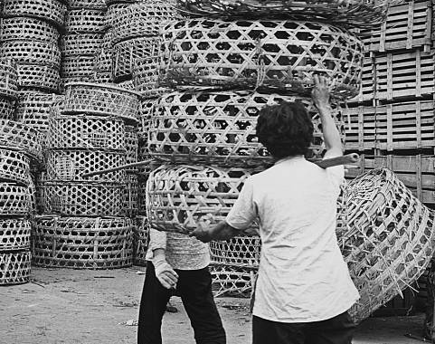
The First Five-Year Plan Continued
New & Growing Modes of Inequity
Urban vs. Rural Divide
Stagnating Agricultural Production
Agricultural Growth 2.7%
Population Growth 2.2%
Growth of Education Opportunities
Increase from 26,000,000 to 64,000,000 formal students
University Enrollment from 117,000 to 441,000.
Notes:
New Modes of Political Expertise

Slide 8
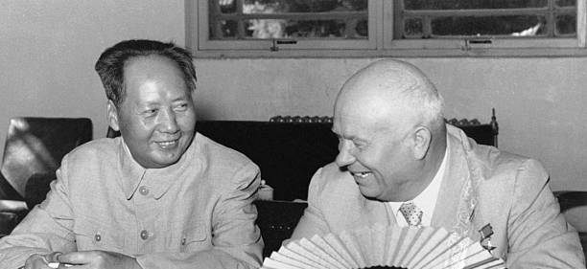
Nikita Khrushchev's Secret Speech
Joseph Stalin (1878-1953)
Leader of the Soviet Union 1922-1952
Defeated Hitler & Boosted the Soviet Union’s economy
A ruthless dictator
Responsible for the deaths of millions
February 25th, 1956
Khrushchev denounces Stalin for his “Cult of Personality”

Slide 9
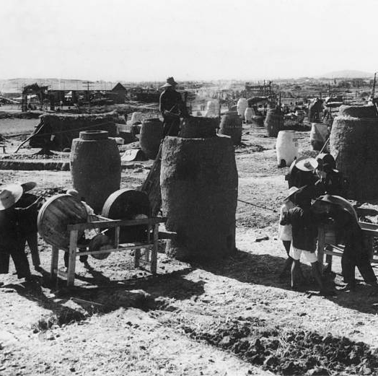
Mao’s Criticism & The Great Leap Forward
Mao’s criticism
“Red vs. Expert”
Red = Marxist/Maoist Revolutionary
Expert = Possessing expertise.
Older revolutionaries replaced by industrial experts.
The Great Leap Forward (1958-1962):
Mao’s attempt for China to leap from socialism to communism.
Stages of development: Feudalism, Capitalism, Socialism, Communism.
“Socialist Ends by Socialist Means”
Mao planned to use the leap to surpass Britain in industrial production in under 15 years.
Industrialization of the countryside.

Slide 10
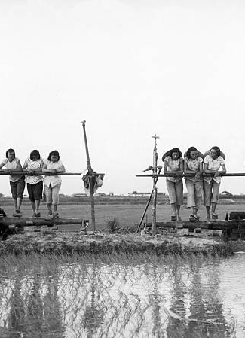
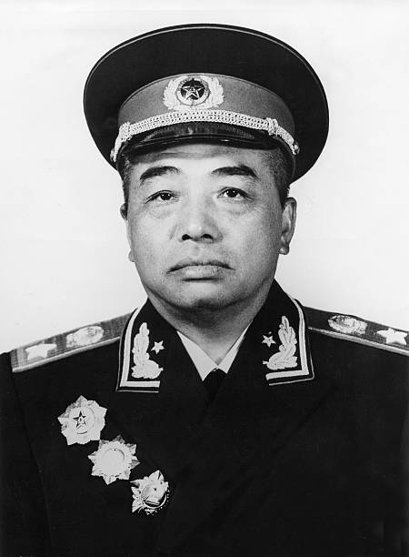
The Lushan Plenum (1959)
Peng Dehuai
Long time communist general and leader of Chinese forces during the Korean War (1950-1953).
Penned a letter critical of Mao’s Great Leap Forward. In it, he warned of a growing catastrophy.

Slide 11
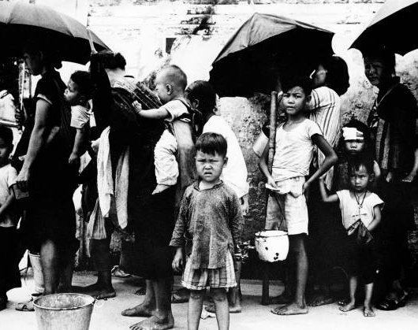
The Results of the Great Leap Forward (1960-1962)
Natural Disasters
Severe Flooding
The Sino-Soviet Split
China and the Soviet Union dispute over ideology
The Soviet Union recalls its 1,400 scientist and industrial specialist
Agricultural woes
Grain output 1958 (200,000,000 tons) vs. Grain output 1960 (144,000,000 tons)
Crushing Famine
15,000,000 to 30,000,000 Famine related deaths between 1959-1961

Slide 12
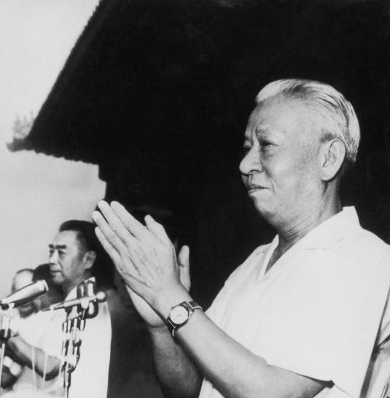
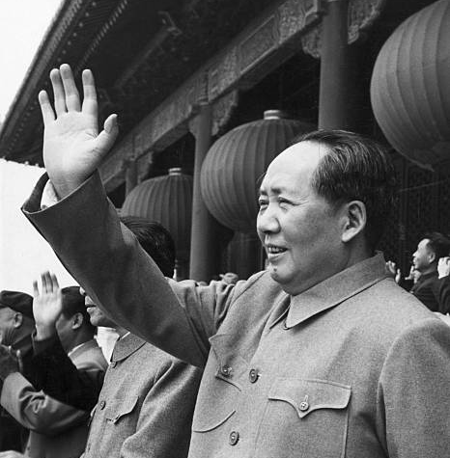
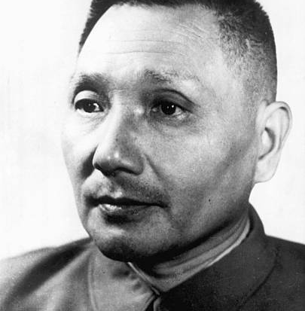
Mao Sidelined
Between 1960-1965, Mao complained he was treated like a “dead ancestor.”
Mao was Chairman of the CCP but could not set party policy.
Liu Shaoqi & Deng Xiaoping (among others) guided the party.

Slide 13
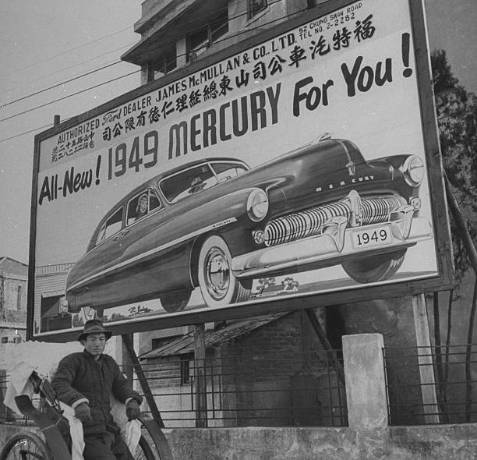
Competing Views of “New” China.
Mao’s Revolutionary Model vs. the Soviet Model
Mao believed that the revolutionary spirit could overcome China’s poverty.
Liu Shaoqi wanted to build up China government and heavy industries to guide China into the future.
Question Review
Was Mao Zedong a dictator?
a form of government in which absolute power is concentrated in a dictator or a small clique.
How were events in the Soviet Union connected to the Cultural Revolution?

