Slide 1
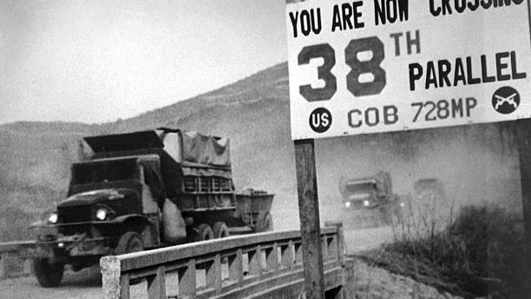
The Korean War
Origins of War 1900-1950

Slide 2
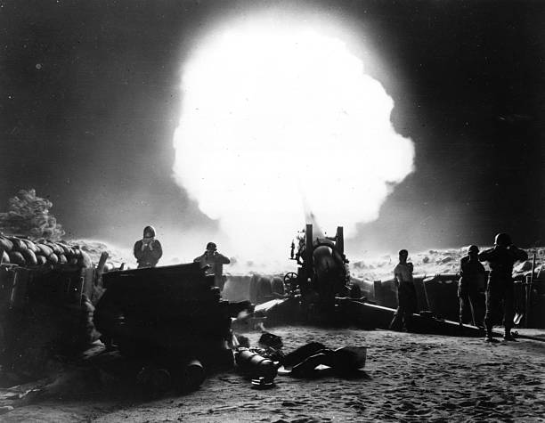
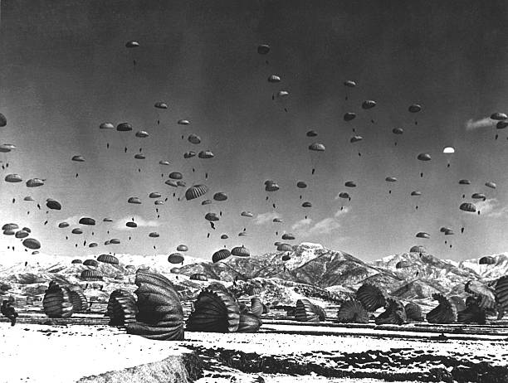
Major Questions
Who is responsible for the Korean War?
When did the Korean War begin and when did it end?
Module 1 Questions
How did World War II lead to the Korean War?
What influence did the Cold War have on post-World War II Korea?

Slide 3
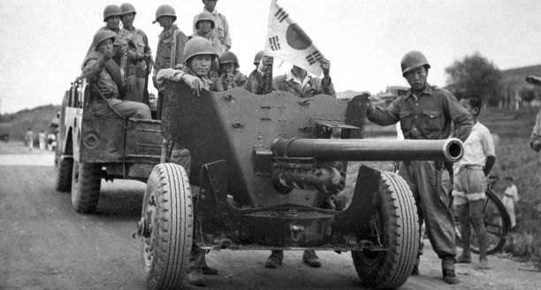
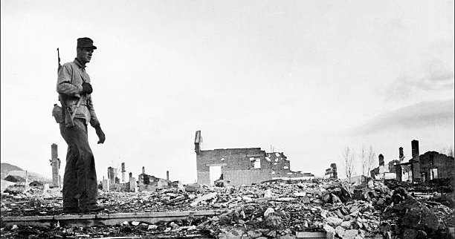
Module Theme:
How to Make a Civil War

Slide 4
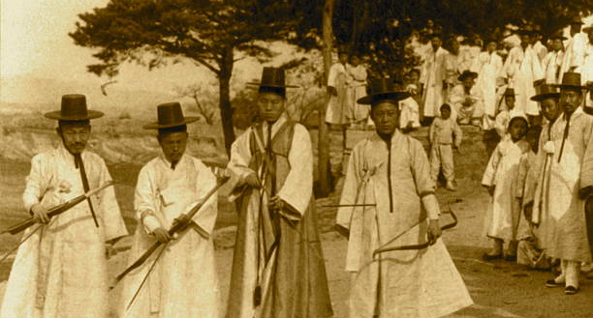
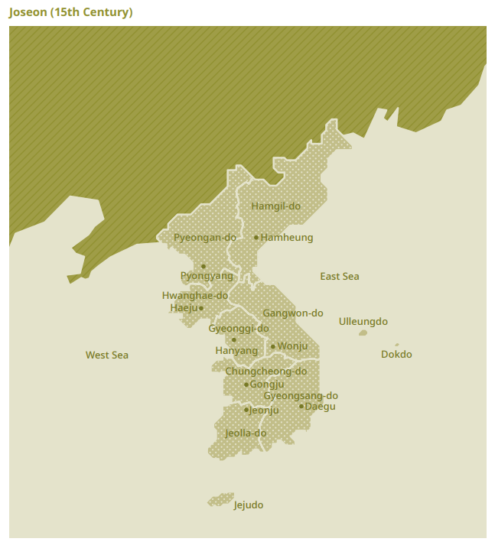
Joseon Korea (1392-1897)
Founded by Yi Seongye
Territory
Roughly the size of Minnesota
Governed by the Yangban
A hereditary social class
Slave Society
Chinese Tributary
Ming China (1392-1644)
Qing China (1944-1895)
One of the longest unbroken dynasties in human history

Slide 5
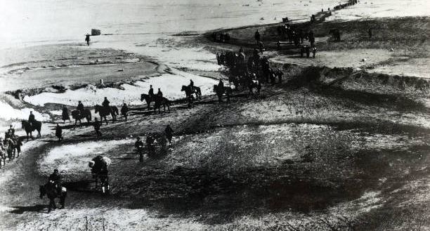
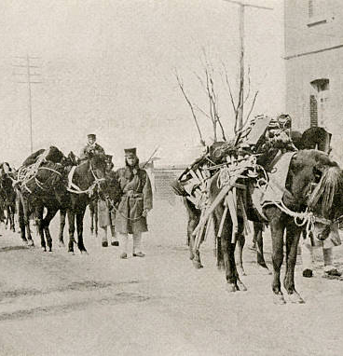
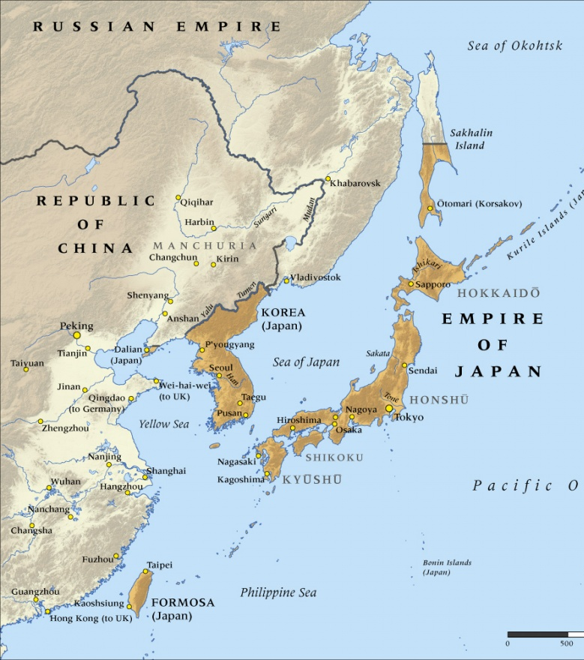
Battle Ground of Empires (Qing, Russian, Japanese)
Sino-Japanese War (1894-95)
Donghak Rebellion (1894)
China helps King Gojong but Japan uses opportunity to install government friendly to Japan
Crushing defeat for the Qing Empire in 1895
Established Japan as the dominant East Asian power
Russo-Japanese War (1904-1905)
Results in Ito Hirobumi & Japan establishing protectorate over Korea (1905)
Ito assassinated in 1909
August 22, 1910, Korea becomes Japanese Colony

Slide 6
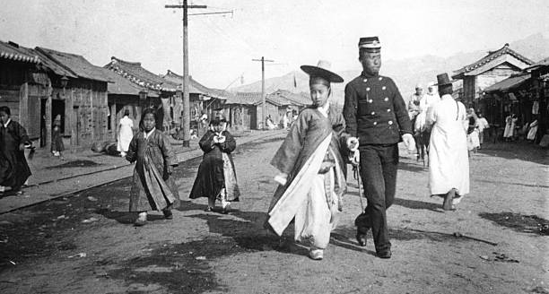
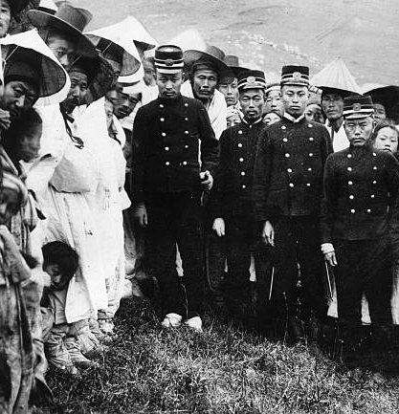
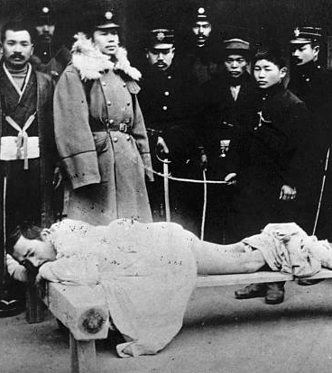
Colonial Korea
Three Phases of Japanese Colonial Rule:
Phase I (1910-1919): Government General
“It eliminated all Korean political participation, restricted Korean business activity, and invested heavily in the promotion of rice cultivation for export to Japan.”
Police could fine, flog, and torture for minor offenses.
March 1st, Movement 1919
Koreans push for independence
Phase II(1919-1931): “Cultural Government”
Greater degree of political participation, freer speech, and business rights.
Phase III (1931-1945): Military Rule
Huge amounts of Japanese Investment in Korean heavy industry and infrastructure.
Repression of freedoms that Koreans enjoyed under Phase II.
Koreans forced to take Japanese names, speak Japanese, and join Japanese religious and military institutions.

Slide 7
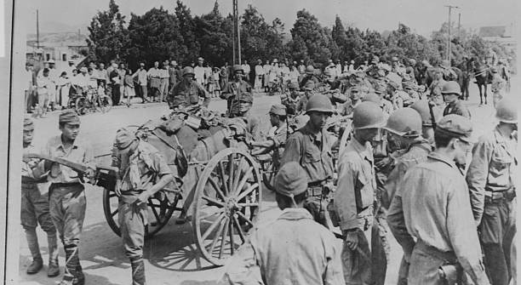
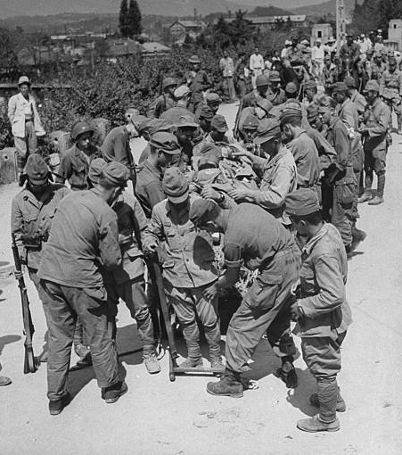
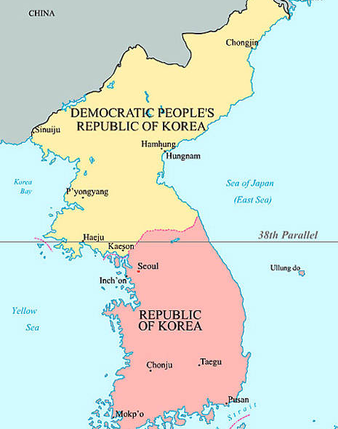
The End of World War II & Divided Korea
Soviet Invasion of Manchuria & Atomic Bombs
Soviets attack Japanese Empire (August 1945)
Russian forces enter Korea
Americans drop atomic bombs (August 1945)
Both effectively end World War II
Soviet American Competition
Soviets invade from the North
Americans send troops from the South (one week after wars end on August 15, 1945)
They meet at the 38th Parallel
Koreans formed local “People’s Committes”
Soviets used these committees to install leaders they favored (Jo Mansik)
Banned collaborators
Lowered working hours to 8 hours per day
Redistributed land
Banned child labor
Established prison camps
Americans used these committees to install leaders they favored (Syngman Rhee)
Railroad strike
Farmer riots
Violent strikes
Republic of Korea founded August 15th,1948
Leader Syngman Rhee
Democratic People’s Republic of North Korea founded September 9th 1948
Leader Kim Il-Sung
Kim replaced Jo Mansik in 1946
Jo opposed Stalin’s agreement to set up a trusteeship for Korea with the United States

Slide 8
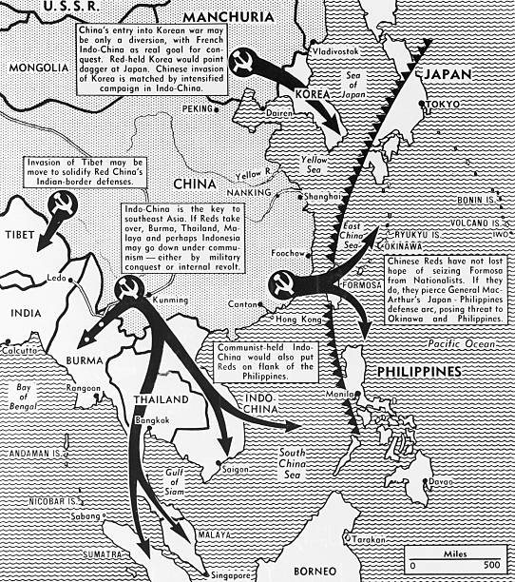
The Cold War (1947-1991):
The Truman Doctrine
Domino Theory
Communist expansion in one country will lead to communist expansion in neighboring countries.
Cold Wars vs. Hot Wars

Slide 9
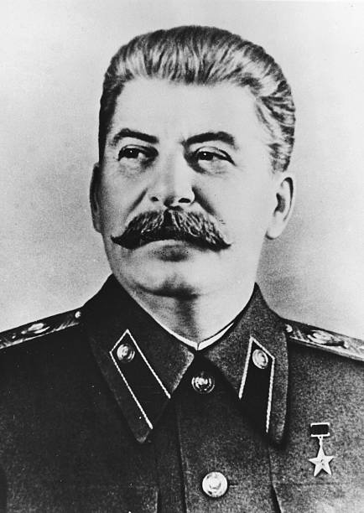
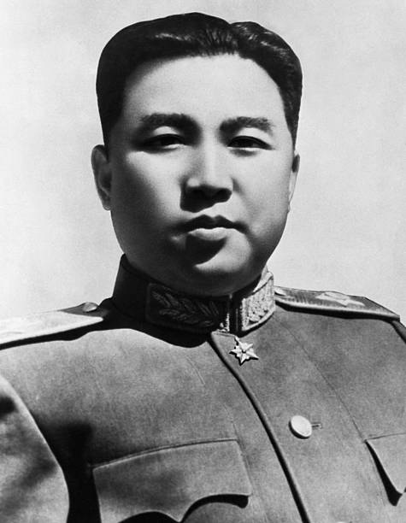
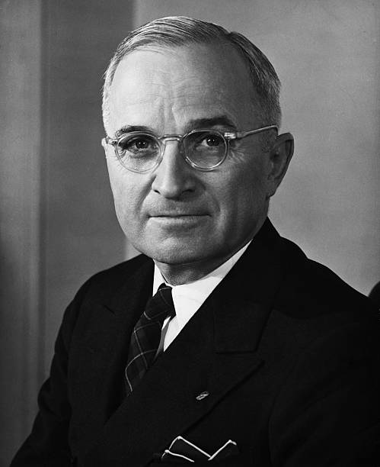
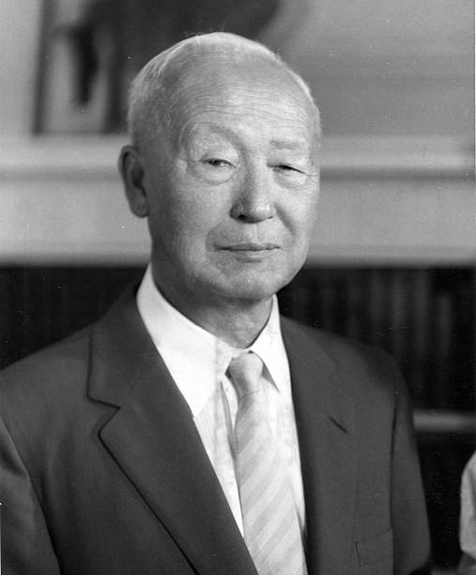
Starting a War (1948-1950)
North Korea & China
30,000 North Korean Soldiers fighting in Chinese Civil War in April 1947 (15 to 25 Percent of CCP forces).
Fought even as far south has Hainan
Guerilla Warfare in the South
3,000 to 6,000 Soldiers fighting in South Korean territory in 1949.
Cross boarder raids launched by both sides (1949)
Syngman Rhee and South Korea
Eager to “recover” the North
United States Government threatens to cut off support if South invades the North. Support would only come if the North attacked first.
Kim Il-Sung and North Korea
Eager to “recover” the South
Kim the South “is still not instigating an attack” (to justify their own attack)
Soviet Union discourages invasion plans
Kim plays the Soviets against the PRC
Journalist A.T. Steele’s observations
“An unadmitted shooting war between the governments of the U.S. and Russia is in effect today along the 38th Parallel.

Slide 10
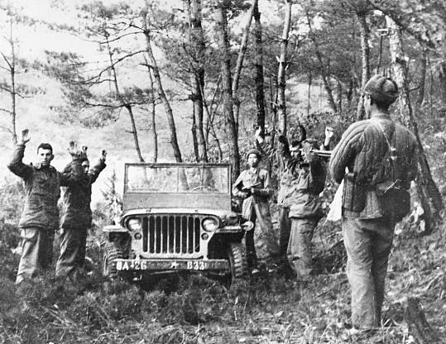
Question Review
Who is responsible for the Korean War?
When did the Korean War begin and when did it end?
How did World War II lead to the Korean War?
What influence did the Cold War have on post-World War II Korea?

