Slide 1

Convolutional Neural Networks
Dong Xu
EECS Department
C. S. Bond Life Sciences Center
Informatics Institute
University of Missouri, Columbia
http://digbio.missouri.edu

Slide 2
Coverage
Concept of CNN
Convolution operation
Pooling
Pro and cons

Slide 3
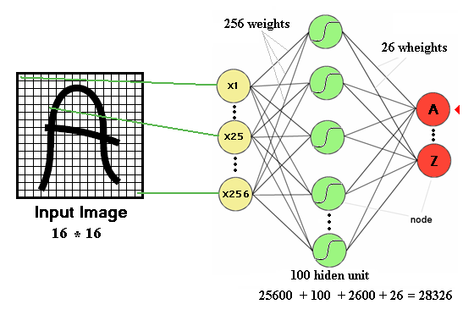
Drawbacks of DNN
Number of trainable parameters becomes extremely large

Slide 4
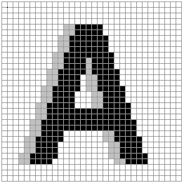
Drawbacks of DNN
Little or no invariance to shifting, scaling, and other forms of distortion
Shift left

Slide 5
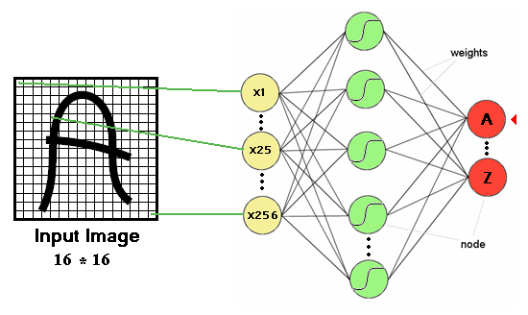
Drawbacks of DNN
Topology of the input data is completely ignored
Feature 1
Feature 2

Slide 6
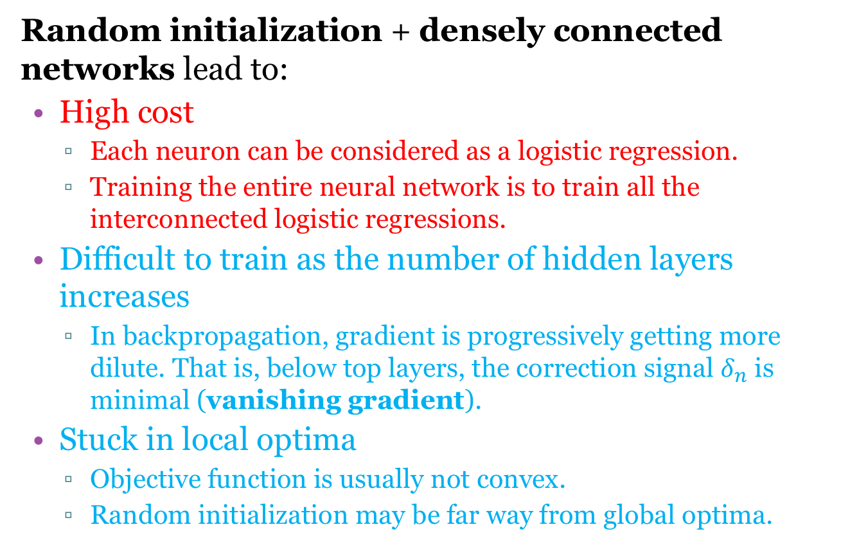
Limitations of Neural Networks
Random initialization + densely connected networks lead to:
High cost
  Each neuron can be considered as a logistic regression.
  Training the entire neural network is to train all the interconnected logistic regressions.
Difficult to train as the number of hidden layers increases
  In backpropagation, gradient is progressively getting more dilute. That is, below top layers, the correction signal $δ_{n}$ is minimal (vanishing gradient).
Stuck in local optima
  Objective function is usually not convex.
  Random initialization may be far way from global optima.

Slide 7
Convolutional Neural Network (CNN)
Convolutional Neural Networks are inspired by mammalian visual cortex.
In 1995, Yann LeCun and Yoshua Bengio introduced the concept of convolutional neural networks.
  Visual cortex contains a complex arrangement of cells, which are sensitive to small sub-regions of the visual field, called a receptive field.
  These cells act as local filters over the input space and are well-suited to exploit the strong spatially local correlation present in natural images.

Slide 8
Resolution to Convolution

Slide 9
Convolutional Neural Network (CNN)
Two basic cell types:
  Simple cells respond maximally to specific edge-like patterns within their receptive field.
  Complex cells have larger receptive fields and are locally invariant to the exact position of the pattern.

Slide 10
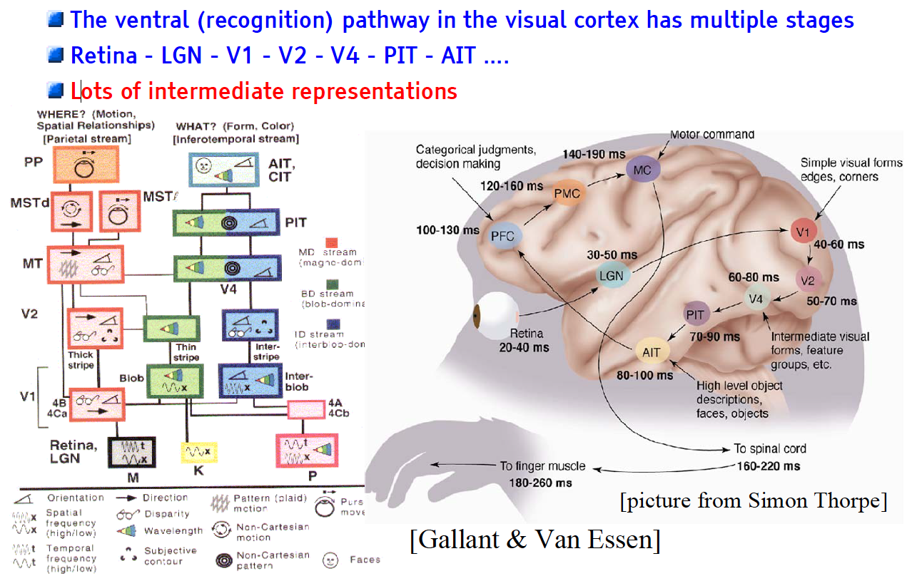
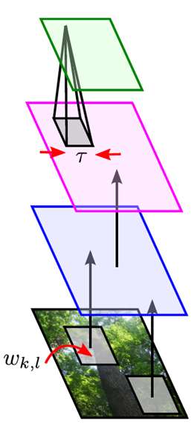
Mammalian Visual Cortex Inspires CNN
Convolutional Neural Net
output
input

Slide 11
Are the horizontal lines straight?

Slide 12
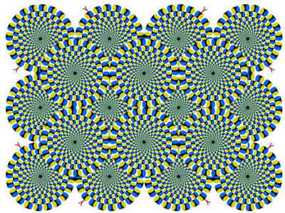
Is it moving?

Slide 13
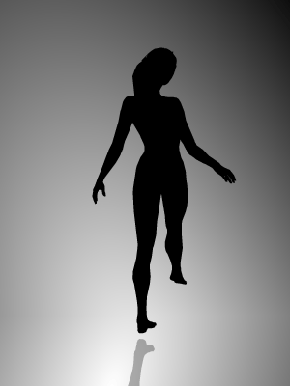
A research from Yale University:
Do you see her rotate
Clockwise or counter-clockwise?

Slide 14
Our brains are different
Clockwise: use right brain, picture, creativity, art
Count-clockwise: use left brain, language, logic, judgment
14% can see both

Slide 15
CNN Architecture
Intuition: Neural network with specialized connectivity structure,
  Stacking multiple layers of feature extractors
  Low-level layers extract local features.
  High-level layers extract global patterns.
A CNN is a list of layers that transform the input data into an output class/prediction:
  Convolutional layer
  Non-linear layer
  Pooling layer

Slide 16
CNN Architecture
Convolution stage
Nonlinearity: a nonlinear transform such as ReLU
Pooling: output a summary statistics of local input, such as max pooling and average pooling

Slide 17
Convolutional Networks
Scale up neural networks to process very large images / video sequences
  Sparse connections
  Parameter sharing
Automatically generalize across spatial translations of inputs
Applicable to any input that is laid out on a grid (1-D, 2-D, 3-D, …)

Slide 18
Key Ideas
Replace weight summation in neural nets with convolution
Everything else stays the same, e.g., back-propagation
Convolution: like matrix multiplication
  Take an input, produce an output (hidden layer)
“Deconvolution”: like multiplication by transpose of a matrix
  Used to back-propagate error from output to input
  Reconstruction in autoencoder / RBM
Weight gradient computation
  Used to back-propagate error from output to weights
  Accounts for the parameter sharing

Slide 19
Convolutional Layer
The core layer of CNNs
The convolutional layer consists of a set of filters.
  Each filter covers a spatially small portion of the input data.
Each filter is convolved across dimensions of input data, producing a multidimensional feature map.
  As we convolve the filter, we are computing the dot product between the parameters of the filter and the input.
Intuition: network will learn filters that activate when they see some specific type of feature at some spatial position in input.
The key architectural characteristics is local connectivity and shared weights.

Slide 20
Camera Filters

Slide 21
Local Connectivity
Neurons in layer m are only connected to 3 adjacent neurons in the m-1 layer.
Neurons in layer m+1 have a similar connectivity with the layer below.
Each neuron is unresponsive to variations outside of its receptive field with respect to the input.
  Receptive field: small neuron collections which process portions of the input data
Ensures the learnt feature extractors produce the strongest response to a spatially local input pattern.

Slide 22
Shared Weights
3 hidden neurons belong to the same feature map
Weights of the same color are constrained to be identical.
Gradient descent can still be used to learn such shared parameters, with a small change to the algorithm.
The gradient of a shared weight is simply the sum of the gradients of the parameters being shared.
Replicating neurons in this way allows for features to be detected regardless of their position in the input.
Weight sharing increases learning efficiency by greatly reducing the number of free parameters being learnt.

Slide 23
Convolution

Slide 24
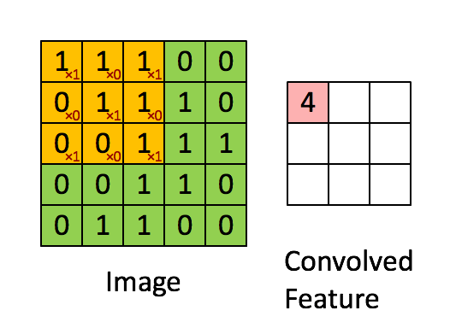
Convolution Example

Slide 25
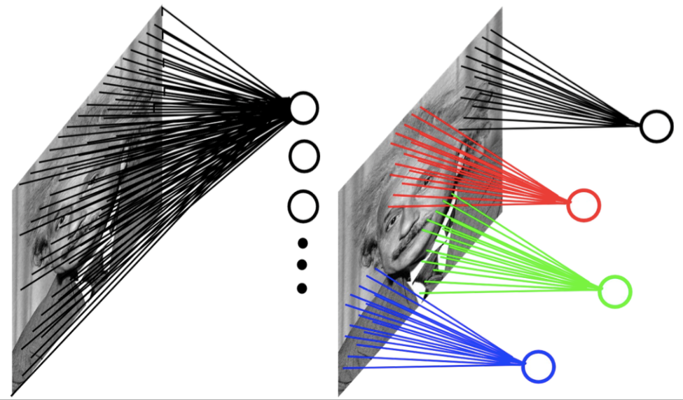
Small Number of Parameters
Input can have very high dimension. Using a fully-connected neural network would need a large amount of parameters.
CNNs’ hidden units are only connected to local receptive field. The number of parameters needed by CNNs is much smaller.
Example: 200x200 image
fully connected: 40,000 hidden units => 1.6 billion parameters
CNN: 5x5 kernel, 100 feature maps => 2,500 parameters

Slide 26
CNN’s Topology
Feature maps
C
Feature extraction layer
Convolution layer
Shift and distortion invariance or
Subsampling layer
S

Slide 27
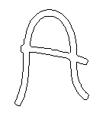
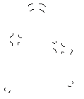
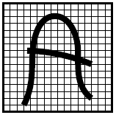
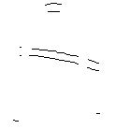
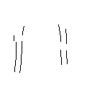

Feature Extraction
Detect the same feature at different positions in input image.
features

Slide 28
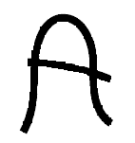
Feature Extraction
-1
0
1
Convolve with
Threshold
-1
0
1
-1
0
1
w11
w12
w13
w11
w12
w13
w21
w22
w23
w21
w22
w23
w31
w32
w33
w31
w32
w33

Slide 29
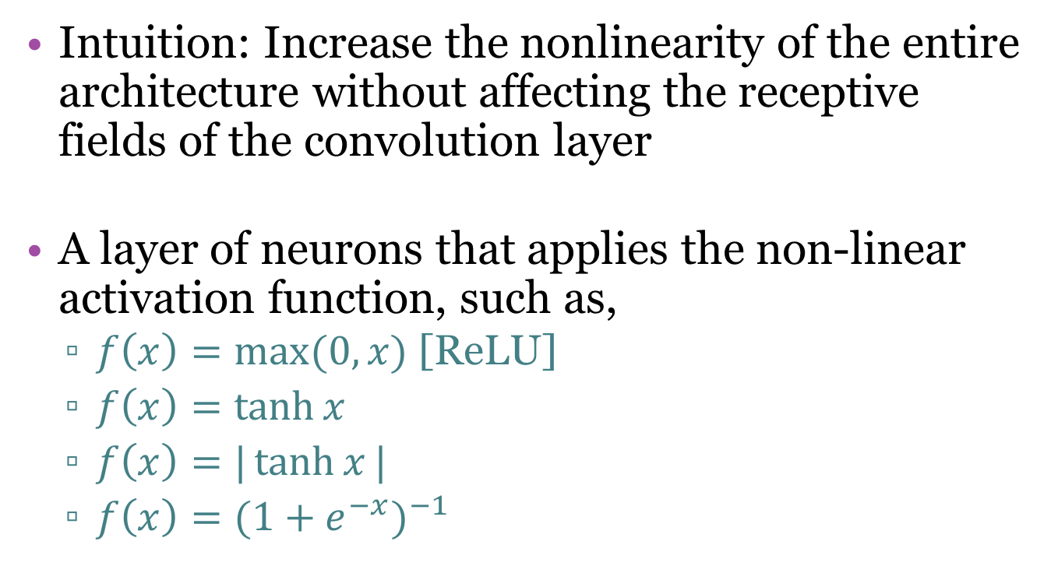
Non-linear Layer
Intuition: Increase the nonlinearity of the entire architecture without affecting the receptive fields of the convolution layer
A layer of neurons that applies the non-linear activation function, such as,
  $f\left(x\right)=\max{(0,x)}$ [ReLU]
  $f\left(x\right)=\tanh{x}$
  $f\left(x\right)=|\tanh{x}|$
  $f\left(x\right)={(1+e^{−x})}^{−1}$

Slide 30

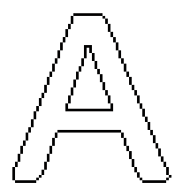
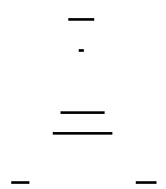
Subsampling Layer
Subsampling layers reduce the spatial resolution of each feature map
By reducing the spatial resolution of the feature map, a certain degree of shift and distortion invariance is achieved.

Slide 31
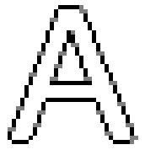
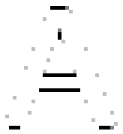
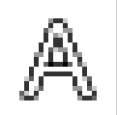
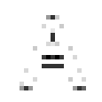


Subsampling Layer
the subsampling layers reduce the spatial resolution of each feature map

Slide 32

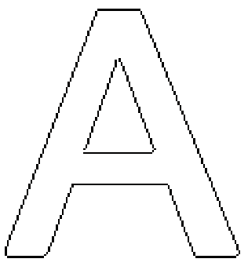
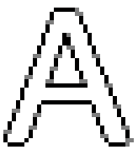



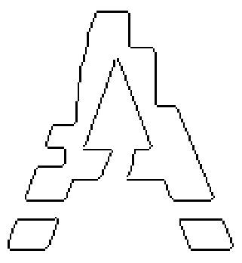
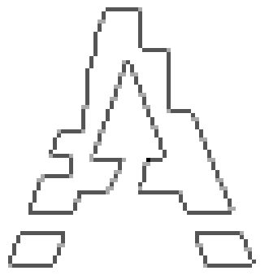
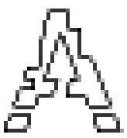

Subsampling Layer

Slide 33
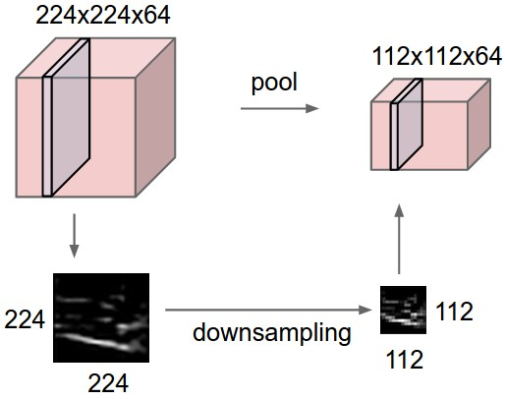
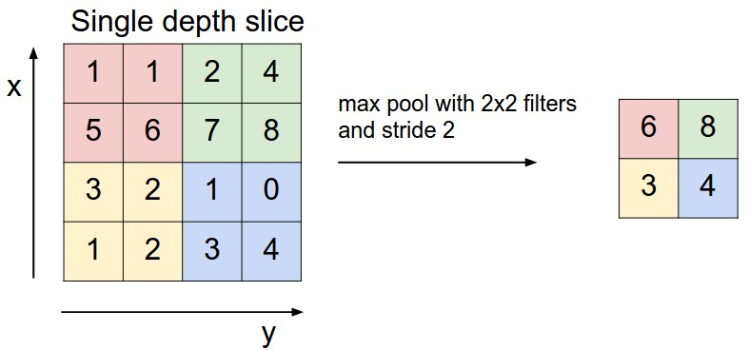
Pooling Layer / Max-Pooling
Intuition: to progressively reduce the spatial size of the representation (amount of parameters) and computation in the network, and hence to also control overfitting
Pooling partitions the input image into a set of non-overlapping rectangles and, for each such sub-region, outputs the maximum value of the features in that region.
Input

Slide 34

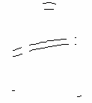
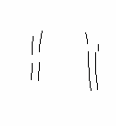
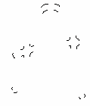
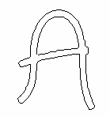
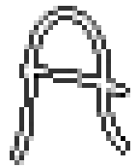
Features at Different Layers

Slide 35

Fully Connected Layer
The final high-level reasoning in the neural network is done via fully connected layers.
  Takes all neurons in the previous layer (pooling or convolutional) and connects it to every single neuron it has.
  Fully connected layers are not spatially located anymore (you can visualize them as one-dimensional), so there will be no convolutional layers after a fully connected layer.

Slide 36
AlexNet for image recognition
AlexNet (Krizhevsky et al., 2012)
Low-level layers
High-level layers
Local features
Global features
Image source: http://vision03.csail.mit.edu/cnn_art/index.html

Slide 37
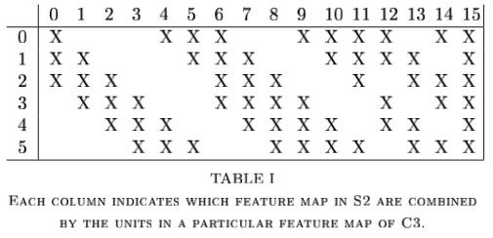
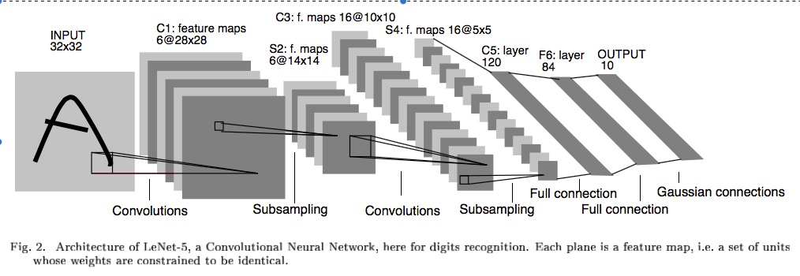
LeNet-5
To help it all sink in:
How many weights to be trained at each layer?
5x5 2x2 5x5 2x2 Fully Connected
Notes:
Why 32x32 to start with. Actual characters never bigger than 28x28. Just padding the edges so for example the top corner node of the feature map can have a pad of two up and left for its feature map.
Same drop occurs with 14x14 to 10x10 drop S2 to C3
C1: 156 weights (26*6), 122,304 connections 26*28*28*6 – Parameter sharing - regularization
S2: 12 weights (6*2). 5 (4 connections plus bias)*6*14*14 = 5880 connections, sampling is adding – the 4 inputs are added, then multiplied by weight, then add bias, then squash, non over-lapping
C3: 6 connect to 3, 9 to 4, and 1 to all 6, forces discovery of more diverse feature combinations
Table 1 only considers contiguous subsets of 3, and more mixed subsets of 4 feature maps, and one with all – heuristic explanation
6*(25*3+1) + 9*(25*4+1) + 1*(25*6+1) =1516 total weights, total connections are 10*10 more than that for 151,600
S4: 16*2 = 32 weights, 16*5*5*5(4 connections plus bias) = 2000 connections
C5: 120*(5*5*16+1) = 48,120 weights and connections are the same since it is just a fully connected MLP at this point
F6: 84*(120+1) = 10,164
Output: 10*(84+1) = 850
He used a special RBF output approach in his LeCun-5 model. Could commonly have just gone into an output layer at F6 with 10 output nodes. Then would have been 10*(120+1) = 1210 weights going to the last output layer
Total: 340,908 connections, but 60,000 trainable parameters

Slide 38
CNN Properties
High accuracy for image applications – Breaking all records using just raw pixel features!
Suitable for problems with strong grid-like local spatial/temporal correlation
Once trained on one problem (e.g. vision) could use same net (often tuned) for a new similar problem – general creator of vision features
Notes:
Dynamic size – Pooling region just sums/maxes over an area with one final weight so no hard changes when we adjust pool region size
Simard 2003, Simple consistent CNN structure 5x5 with 2x2 subsampling with number of features 5 in first C-layer, 50 in next, until too small.
Don’t actually used pool layer as instead just connect every other node which samples rather than max/average.
Each layer reduces feature size by (n-3)/2. Just two layers for mnist.
They also use elastic distortions which is a type of jitter to get increased data. 99.6% - best at the time, Distortions also help a lot with standard MLP
Thus an approach with less Hyperparameter fiddling
Ciresan and Schmidhuber 2012, Multi column DNN. CNN with depth 6-10 (deeper if initial input image is bigger), and wider on fields, 1-2 hidden layers in MLP, columns are CNNs (an ensemble with different parameters, features, etc.) where their output is averaged, jitter inputs, multi-day GPU training, annealed LR (.001 dropping to .00003) 99.76% mnist

Slide 39
CNN Properties
Unlike traditional nets, handles variable sized inputs
  Same filters and weights, across different sized image and dynamically scale size of pooling regions, to normalize different sized images, length speech segments, etc.
Lots of hand crafting and tuning to find the right recipe of receptive fields, layer interconnections, etc.
  Lots more Hyperparameters than standard nets, and even than other deep networks, since the structures of CNNs are more handcrafted
Notes:
Dynamic size – Pooling region just sums/maxes over an area with one final weight so no hard changes when we adjust pool region size
Simard 2003, Simple consistent CNN structure 5x5 with 2x2 subsampling with number of features 5 in first C-layer, 50 in next, until too small.
Don’t actually used pool layer as instead just connect every other node which samples rather than max/average.
Each layer reduces feature size by (n-3)/2. Just two layers for mnist.
They also use elastic distortions which is a type of jitter to get increased data. 99.6% - best at the time, Distortions also help a lot with standard MLP
Thus an approach with less Hyperparameter fiddling
Ciresan and Schmidhuber 2012, Multi column DNN. CNN with depth 6-10 (deeper if initial input image is bigger), and wider on fields, 1-2 hidden layers in MLP, columns are CNNs (an ensemble with different parameters, features, etc.) where their output is averaged, jitter inputs, multi-day GPU training, annealed LR (.001 dropping to .00003) 99.76% mnist

Slide 40
CNN Advantages
Architecture of a CNN is designed to take advantage of the 2D structure of an input image
  Achieved with local connections and tied weights followed by some form of pooling which results in translation invariant features.
CNN are easier to train and have many fewer parameters than fully connected networks with the same number of hidden units.
Demo of CNN: http://scs.ryerson.ca/~aharley/vis/conv/

Slide 41
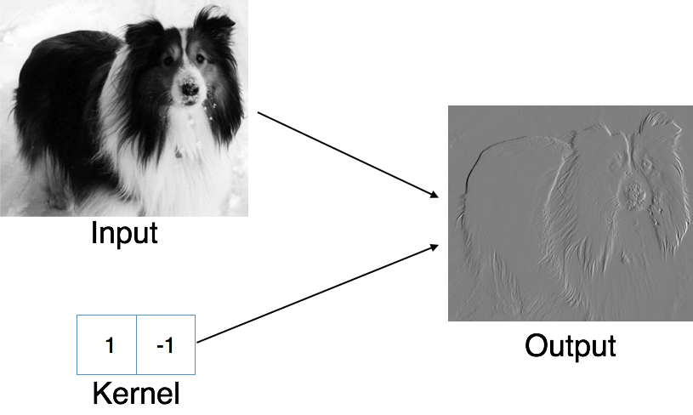
Edge Detection by Convolution

Slide 42
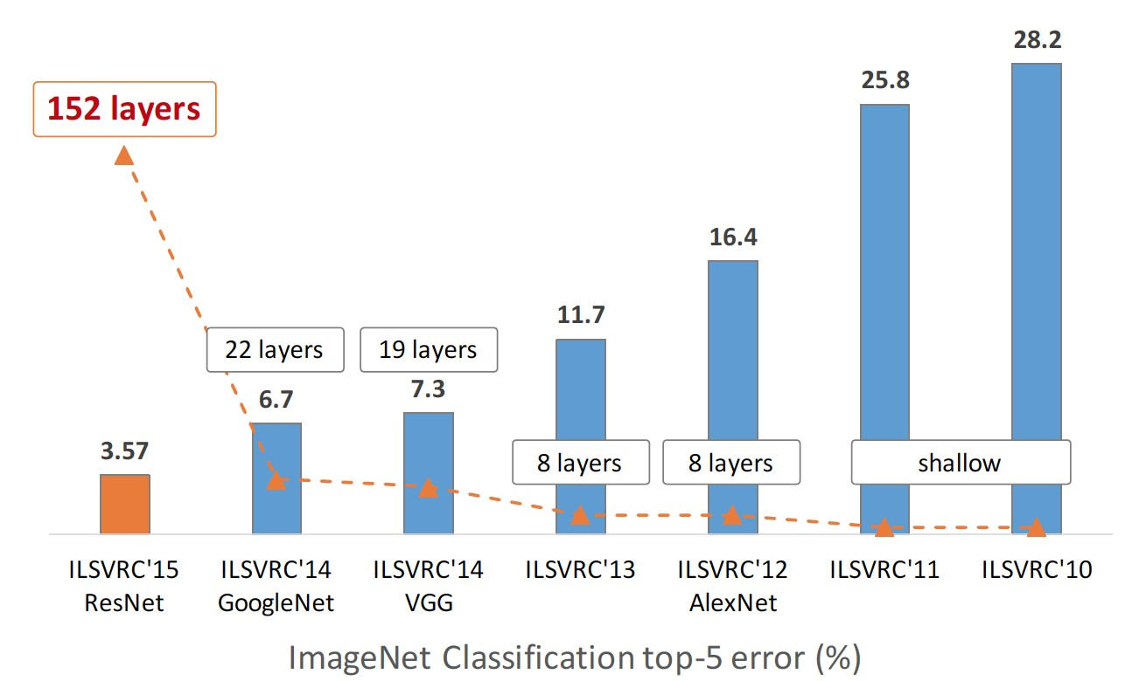
Increasing Depth and Complexity

Slide 43
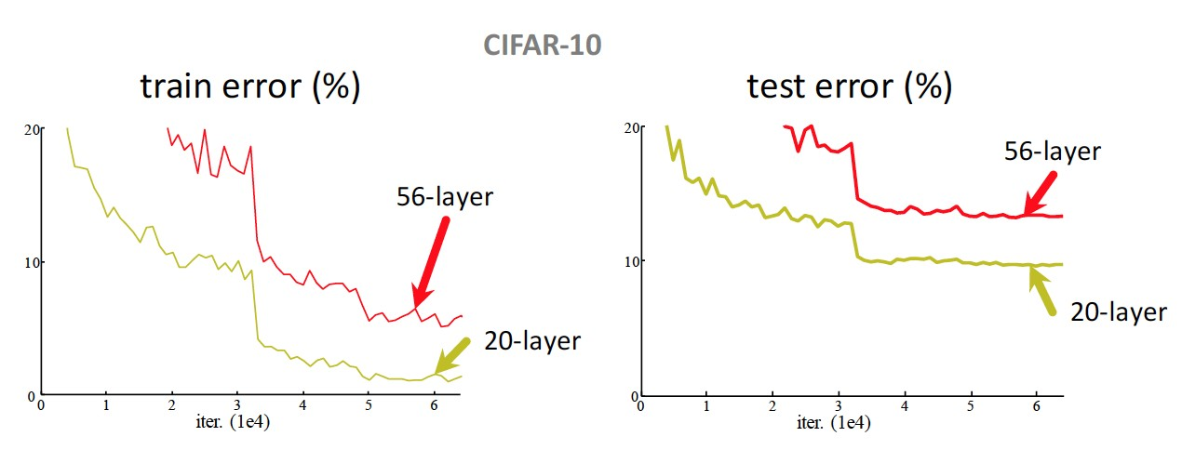
Simply stacking more layers
Plain nets: stacking 3x3 conv layers.
56-layer net has higher training error and test error than 20-layer net.

Slide 44
Summary
CNN for strong grid-like data with local correlation
Convolution operation
  Feature extraction
  Shared weights
Pooling

Slide 45
Further Reading
https://papers.nips.cc/paper/4824-imagenet-classification-with-deep-convolutional-neural-networks.pdf
https://arxiv.org/pdf/1311.2901v3.pdf
https://arxiv.org/pdf/1409.1556v6.pdf
http://www.cv-foundation.org/openaccess/content_cvpr_2015/papers/Szegedy_Going_Deeper_With_2015_CVPR_paper.pdf
https://arxiv.org/pdf/1512.03385v1.pdf
https://arxiv.org/pdf/1506.02025.pdf
Inception-v4, Inception-ResNet and the Impact of Residual Connections on Learning. https://arxiv.org/abs/1602.07261v2.
.., Rethinking the Inception Architecture for Computer Vision. https://arxiv.org/abs/1512.00567v3.
.., Wide-Residual-Inception Networks for Real-time Object Detection. https://arxiv.org/pdf/1702.01243v1.pdf

Slide 46
Acknowledgments
This file is for the educational purpose only. Some materials (including pictures and text) were taken from the Internet at the public domain.

