Slide 1
Solar Energy Development in Six Southwestern States
Cathy Becker
Brinda Bhatt
Makenna Dunlap
Hannah Sargel
Stacey Silverii
Mikhail Yakhnitskiy

Slide 2
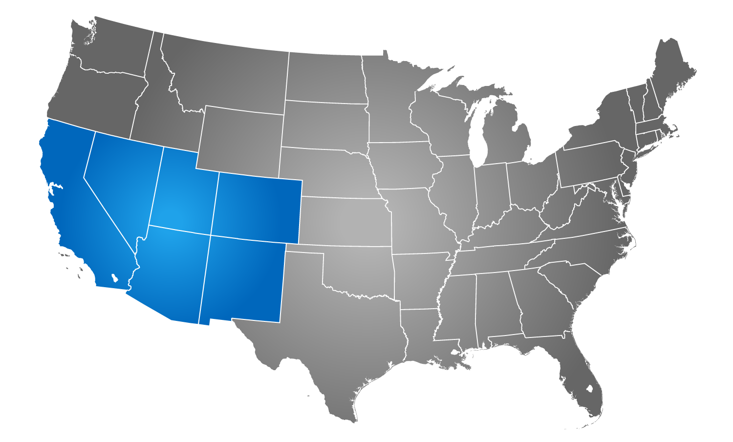
Programmatic EIS
Lead agencies
Bureau of Land Management
Department of Energy
States
Arizona
California
Colorado
Nevada
New Mexico
Utah
BLM administers 120 million acres in these six states

Slide 3
Project Description and Need
Great interest in developing utility-scale solar energy facilities on BLM-administered land
127 active applications as of February 2010
Legislation
Section 211 of Energy Policy Act of 2005
Executive Order 13212
Actions to Expedite Energy-Related Projects
Signed by George W. Bush on May 18, 2001
Secretary of the Interior Order No. 3285A1
Renewable Energy Development
Signed by Ken Salazar on February 22, 2010
Notes:
Section 211 of Energy Policy Act of 2005
The Secretary of the Interior should in the next 10 years have approved non-hydropower renewable energy projects on the public lands with a generation capacity of at least 10,000 megawatts of electricity.
Executive Order 13212 – Signed by George W. Bush on May 18, 2001
For energy-related projects, agencies shall expedite their review of permits while maintaining safety, public health, and environmental protections.
Secretary of the Interior Order No. 3285A1 – Signed by Ken Salazar on February 22, 2010
Renewable Energy Development by the Department of the Interior
Creates Departmental Task Force on Energy and Climate Change
Sets the production, development, and delivery of renewable energy as one of the Department’s highest priorities.
Instructs agencies and bureaus within the Department to work with each other and other federal agencies, departments, states, local communities, and private landowners to encourage the timely and responsible development of renewable energy.

Slide 4
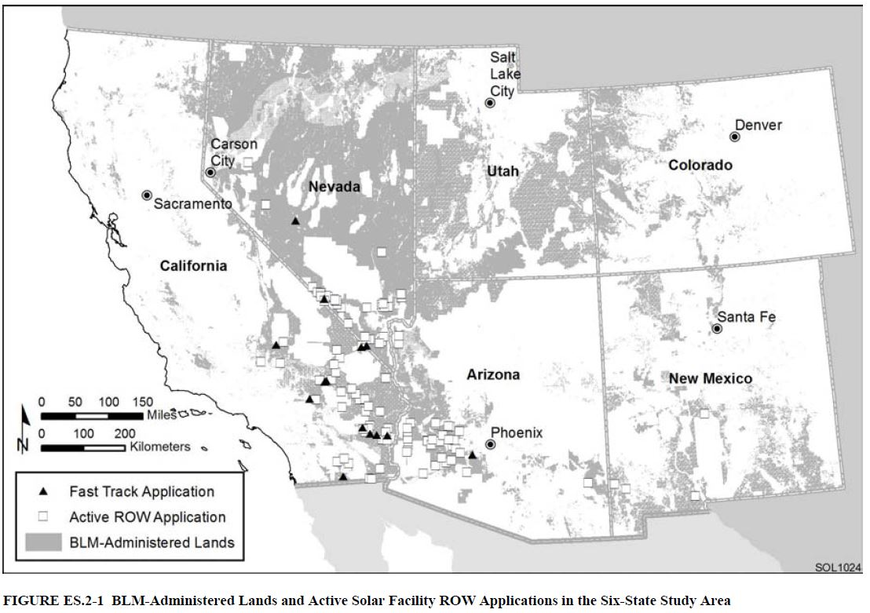
Active Applications 2010
BLM-Administered Lands and Active Solar Facility Applications in the Six-State Area
Notes:
This map shows all the active applications as of 2010 for solar energy developments on public land. It’s a lot, which is why they decided to do a Programmatic EIS.

Slide 5
Objectives
Facilitating near-term utility-scale solar energy development on public lands;
Minimizing potential negative environmental, social, and economic impacts;
Providing flexibility to consider a variety of solar energy projects (location, facility size, technology, and so forth);
Optimizing existing transmission infrastructure and corridors; and
Standardizing and streamlining the authorization process for utility-scale solar energy development on BLM lands.
Notes:
Facilitating utility-scale solar energy development on public land;
Minimizing negative impacts;
Providing flexibility to consider a variety of projects
Optimizing existing transmission infrastructure
Streamlining the authorization process

Slide 6
Alternatives
1
Solar Energy Development Alternative
- Excludes certain types of land from development - Identifies and prioritizes Solar Energy Zones
- Developers could seek variances outside SEZs
2
Solar Energy Zones Alternative
- Projects could be done only in Solar Energy Zones
- All other land is excluded
3
No Action Alternative
Notes:
Solar Energy Development Alternative
Excludes certain types of land from development – 79 million acres
Identifies and prioritizes Solar Energy Zones – 285,000 acres
Developers could seek variances outside SEZs – 19 million acres
Solar Energy Zones Alternative
Projects can only be done in Solar Energy Zones
No Action Alternative
BLM continues to approve projects one at a time

Slide 7
Exclusions Areas (Hannah)
32 categories totaling 79 million acres:
Lands with slopes of greater than 5% determined through GIS analysis
Lands with solar insolation levels less than 6.5 kWh/m2/day determined through National Renewable Energy Laboratory
All Areas of Critical Environmental Concern (ACECs) identified in applicable land use plans
All designated and proposed critical habitat areas for species protected under the Endangered Species Act of 1973
Developed recreational facilities, special-use permit recreation sites (e.g., ski resorts and camps), and all Special Recreation Management Areas
Notes:
These are the first five categories for land exclusions
Slopes greater than 5%
Solar insolation levels less than 6.5 kWh per meter squared per day
All Critical Environmental Areas of Concern excluded
All designated and proposed critical habitat for species listed under the ESA
Al areas where there is an applicable land use plan
Hannah Sargel has more information about this for Q and A

Slide 8
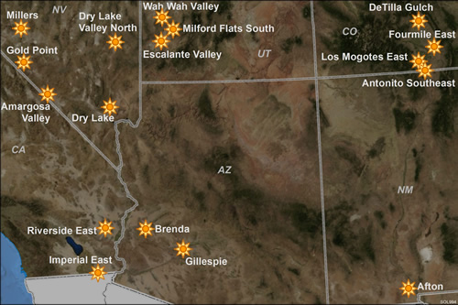
17 Solar Energy Zones (SEZs)
Solar Energy Zones add up to 285,000 acres
Notes:
Started with 24 solar energy zones, 685,000 acres
Cut that back substantially as a result of public comment periods

Slide 9
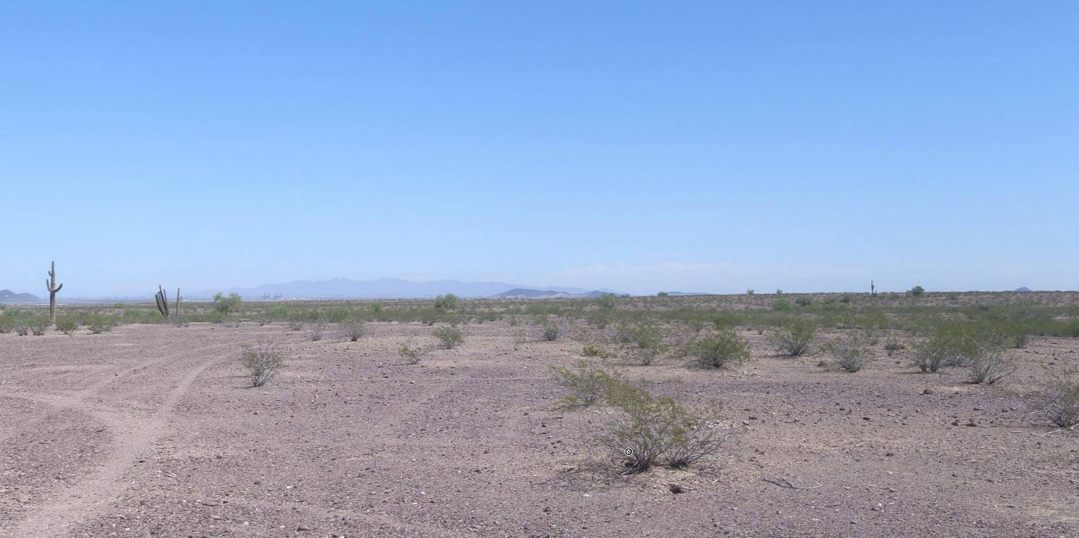
Gillespie, Arizona

Slide 10
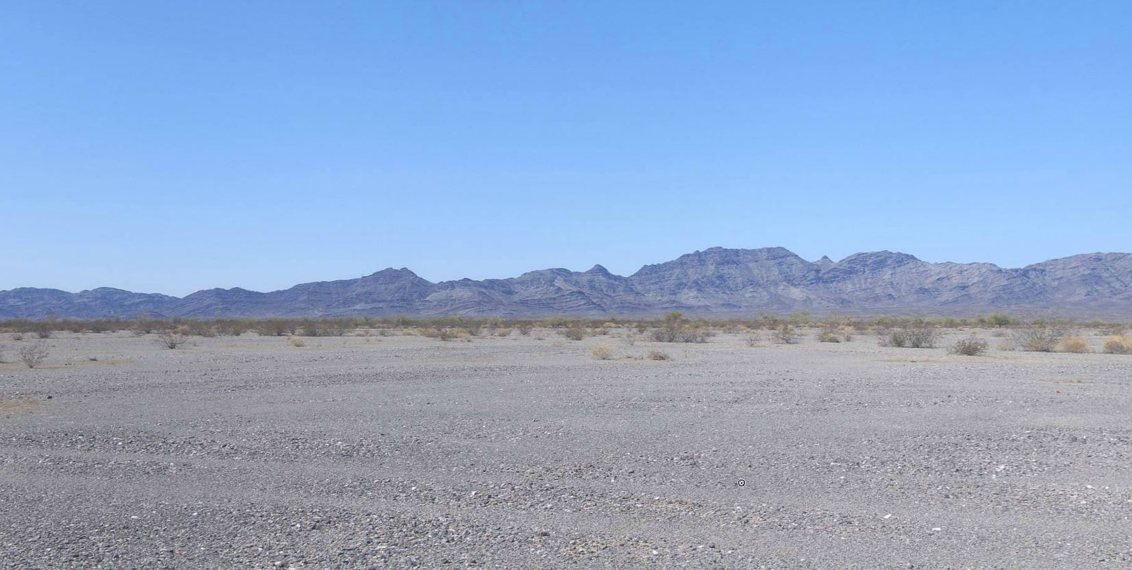
Riverside East, California

Slide 11
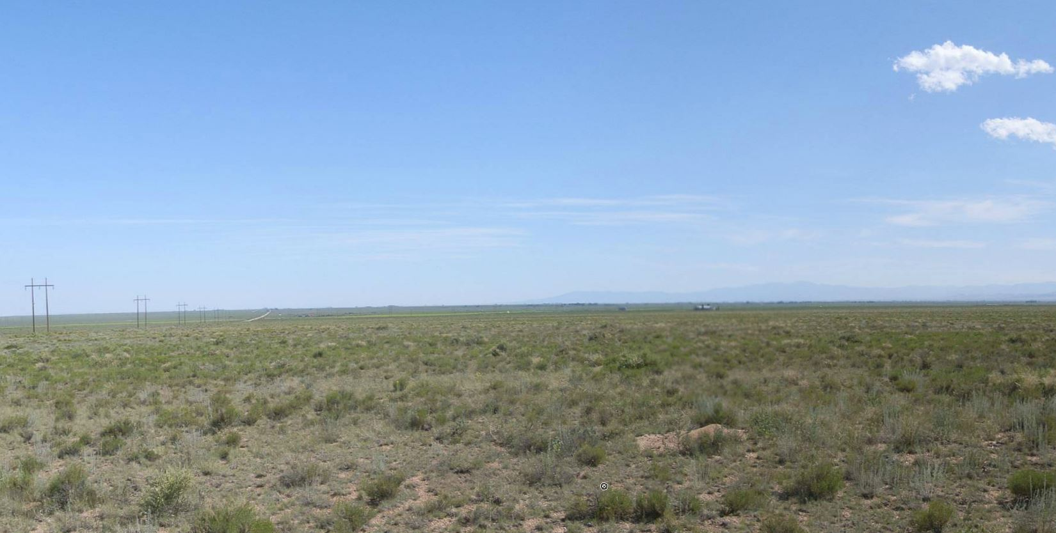
DeTilla Gulch, Colorado

Slide 12
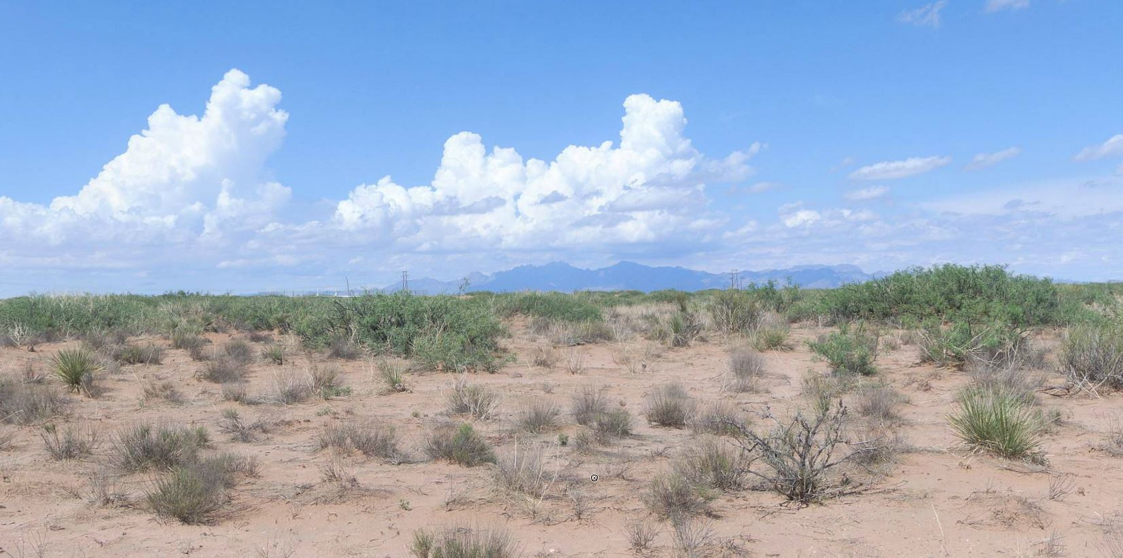
Afton, New Mexico

Slide 13
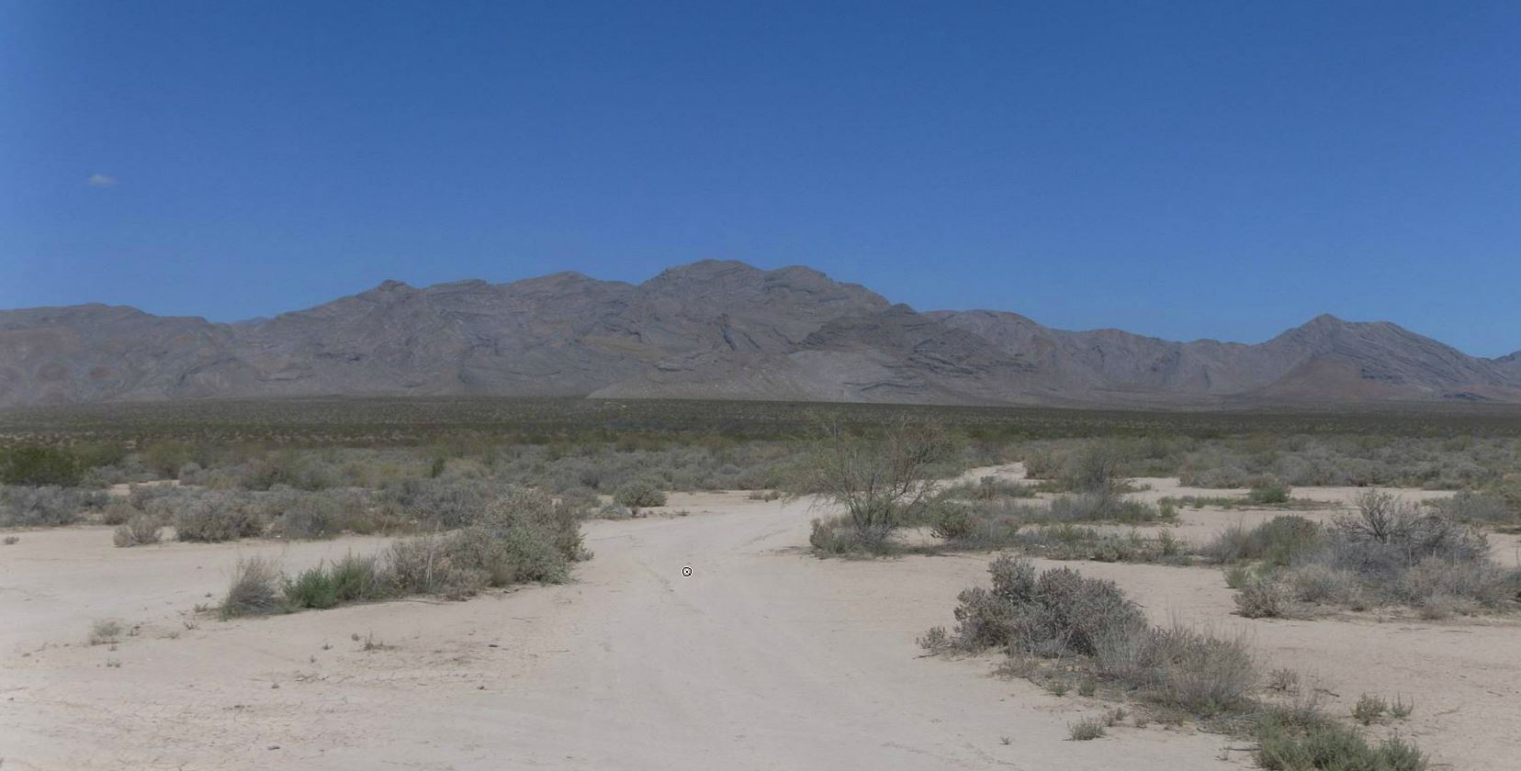
Dry Lake, Nevada

Slide 14
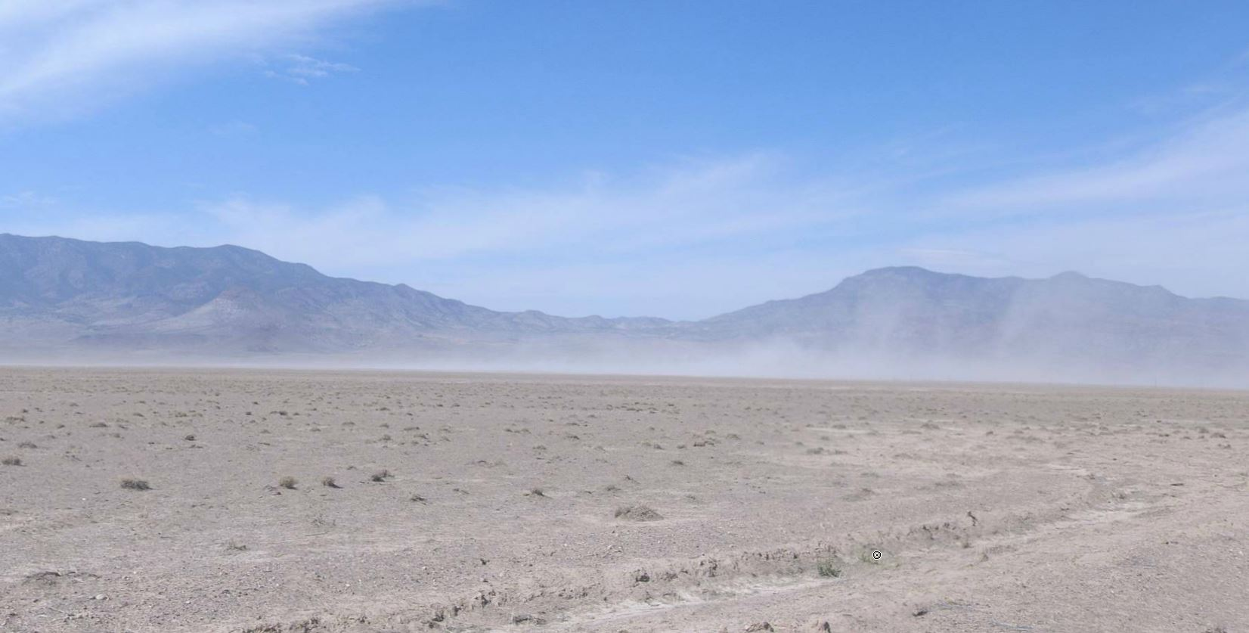
Wah Wah Valley, Utah

Slide 15
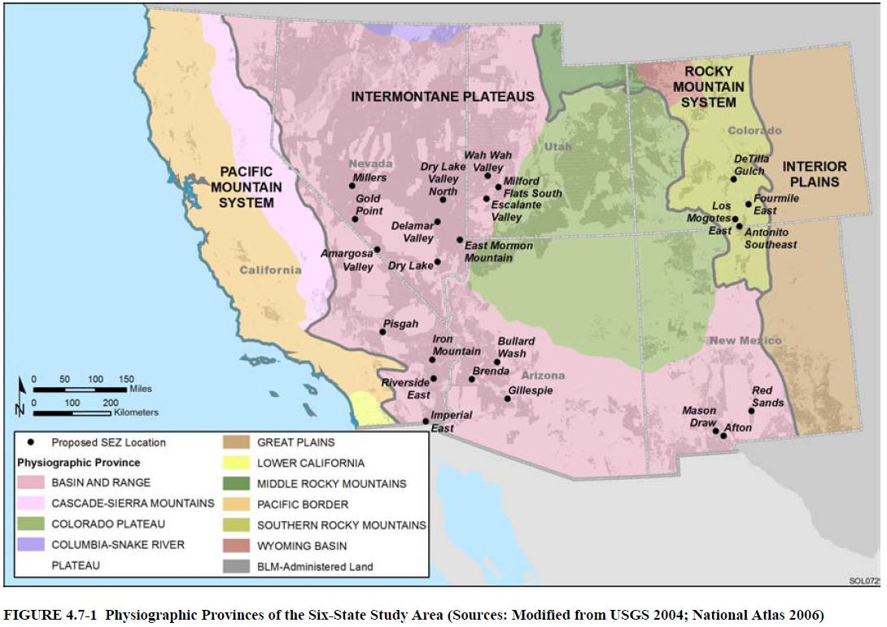
Affected Environment: Geology
Pacific Border and the Lower California provinces
Cascade-Sierra Mountains province
Basin and Range province
Columbia-Snake River Plateau
Colorado Plateau
Middle and Southern Rocky Mountains provinces
Wyoming Basin
Great Plains province
Notes:
So for the affected environment
The PEIS found 11 physiographic provinces in the six states
Of those, most of the Solar Energy Zones are in the big U around the Colorado plateau
Basin and Range
Southern Rocky Mountains

Slide 16
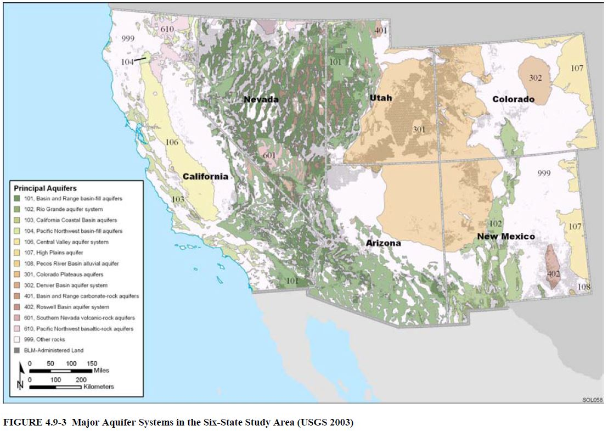
Affected Environment: Water
14 major aquifers
Basin and Range
Colorado Plateau
Central Valley
Rio Grande
High Plains
Notes:
The watersheds follow the same U around the Colorado Plateau.
The Solar Energy Zones are mainly in
Basin and Range
Rio Grande

Slide 17
Affected Environment: Wildlife
Amphibians/ Reptiles
Frogs
Toads
Birds
Waterfowl – ducks, geese, swans, herons, cranes, plovers
Mammals
Elk
Salamanders
Turtles
Snakes
Lizards
Mule deer
White-tailed deer
Pronghorn
Bighorn sheep
Black bear
Cougar
Small mammals – rabbits, fox, beaver, skunk
Migratory – warblers, sparrows, swallows, finches
Birds of prey - owls, hawks, vultures, eagles

Slide 18
Special Status Species (Brinda)
Total ESA, BLM, State
Affected species
In Solar Energy Zones
614 plant species
139 invertebrate species
84 fish species
32 amphibian species
59 reptile species
123 bird species
108 mammal species
May affect but not adversely - 6
1 fish species
4 bird species
1 mammal (Utah prairie dog)
Likely to adversely affect - 17
7 plant species
1 invertebrate species
8 fish species
1 reptile (desert tortoise)
Notes:
Brinda Bhatt has more information about this topic
Special status species are species listed under:
Endangered Species Act
Endangered
Threatened
Candidates
BLM listing of sensitive species
State listings
Rare species
State species of concern
US Fish and Wildlife species of concern
Most will not likely be affected due to
Land exclusions
Design features
Review processes
BLM’s Biological Assessment found:
6 species might be affected but not adversely
17 species likely adversely affected

Slide 19
Species: Alternatives Analysis
Text | No Action Alternative | Solar Energy Program | Solar Energy Zones
ESA Endangered | 118 | 70 | 12
ESA Threatened | 58 | 35 | 8
ESA Proposed | 3 | 2 | 0
ESA Candidate | 29 | 20 | 7
ESA In Review | 35 | 32 | 26
BLM Sensitive | 654 | 420 | 146
State Listed | 420 | 311 | 75
Rare | 1085 | 723 | 344
TOTAL | 1153 | 777 | 358
Note: The total number of species within each alternative area does not equal the sum across status categories because many species have more than one status listing

Slide 20
Affected Environment: Climate
Weather
Carbon Emissions
Temperature
Average: mid-40s to mid-70s F
Range: 10.8° F in Elko, Nev., to 105.6° F in Phoenix
Precipitation
Rain: 4 inches in Las Vegas to 3 feet in Redding, Calif.
Snow: 0 in Los Angeles to 5 feet in Denver
California is largest emitter of CO₂ – 52% of six-state total
Six-state emissions are 12.7% of total U.S. CO₂ emissions
U.S. CO₂ emissions are 21% of worldwide total
Six-state emissions are 2.7% of worldwide total

Slide 21
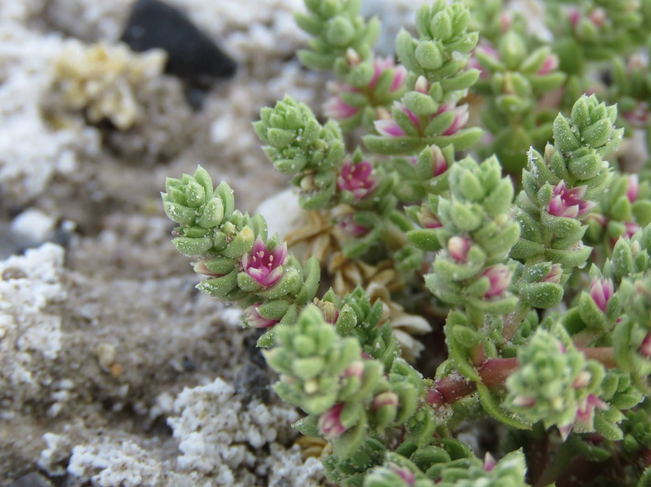
Impacts: Vegetation
Development would require total removal of vegetation
Direct effects
Increased risk of invasive species
Changes in species composition and distribution
Damage to soil crusts
Indirect effects
Dust deposits
Altered drainage
Runoff
Mitigation
Design features can reduce
Exclusions can avoid
Amargosa niterwort Photo: Amargosa Conservancy

Slide 22
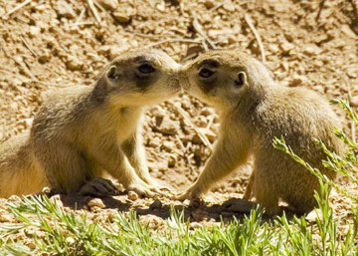
Impacts: Wildlife
Numerous species affected by
Loss of habitat
Disturbance
Loss of food and prey species
Loss of breeding areas
Effects on movement and migration
Introduction of new species
Habitat fragmentation
Changes to water availability
Mitigation
Design features can reduce
Exclusions can avoid key areas
Utah prairie dogs Photo: National Park Service

Slide 23
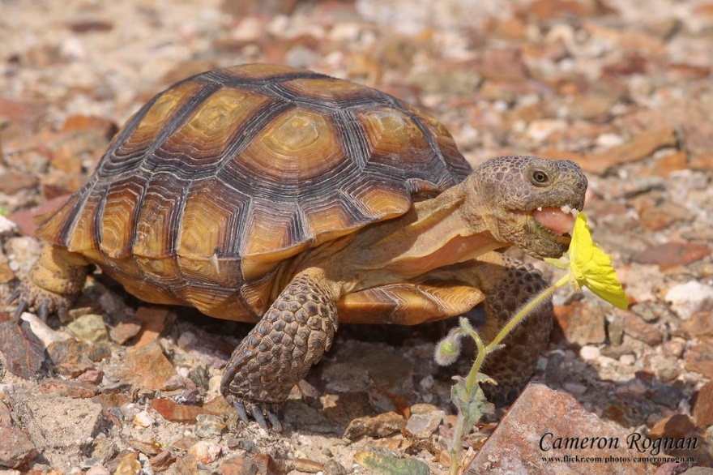
Impacts: Special Status Species
Same problems as non-status species, but small population makes them more vulnerable
Habitat fragmentation
Habitat degradation
Human disturbance
Mortality
Loss of genetic diversity
Most can be mitigated
Critical habitat excluded
5.9 million acres
Difficult to mitigate
Habitat fragmentation
Clearing vegetation
Desert tortoise Photo: Red Cliffs Desert Reserve

Slide 24
Impacts: Climate
Air Quality
Carbon Emissions
Adversely affected by dust and vehicle emissions during construction
Local and temporary
Can be mitigated
Each MWh of solar energy produced displaces 1,578 lb. CO₂ emissions per year
400 MW solar energy facility at 20% capacity
Avoids .21% CO₂ emissions from electric power facilities

Slide 25
Impacts: Socioeconomic (Makenna)
Direct
Indirect
In-migration
Expenditures on wages and salaries
Procurement of goods and services required for construction and operation
Collection of state sales and income taxes
Circulation through the economy of:
Project wages and salaries
Procurement expenditures
Tax revenues
Influx of workers and their families would affect
Rental housing
Public services
Local government employment
Notes:
Makenna Dunlap has more information about this

Slide 26
Impacts: Jobs
 | Arizona | California | Colorado | Nevada | New Mex | Utah
Recreation (lost) | -1879 | -12,114 | -1967 | -1827 | -627 | -809
 | -3758 | -24,229 | -3933 | -3653 | -1253 | -1617
Transmission Lines (per 25 miles) | 69 | 72 | 74 | 68 | 77 | 79
 | 158 | 167 | 170 | 157 | 178 | 181
Parabolic Trough (per facility) | 894 | 1935 | 833 | 909 | 682 | 844
 | 3577 | 7740 | 3332 | 3635 | 2728 | 3377
Power Tower (per facility) | 433 | 977 | 403 | 404 | 330 | 409
 | 1732 | 3748 | 1614 | 1616 | 1321 | 1625
Dish Engine (per facility) | 18 | 38 | 16 | 16 | 13 | 17
 | 1319 | 2855 | 1228 | 1230 | 1004 | 1244
Photovoltaic (per facility) | 8 | 18 | 8 | 8 | 6 | 8
 | 615 | 1331 | 573 | 573 | 468 | 580
Notes:
Some jobs lost through loss of use of some recreation areas
But a lot of jobs gained
These figures and low and high estimates
Transmission lines – every 25 miles
Then four types of solar facilities – Jobs are per facility
Parabolic Trough and Power Tower facilities create the most jobs
The more facilities are built, the more jobs are created

Slide 27
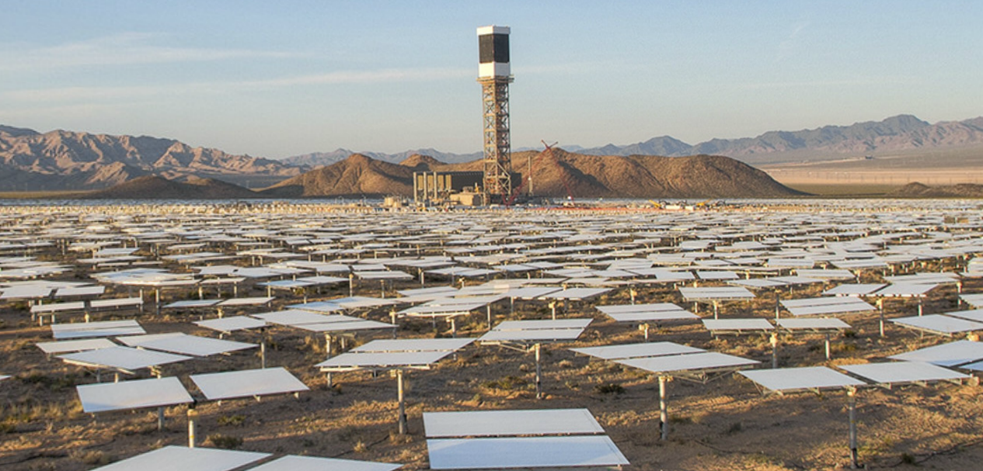
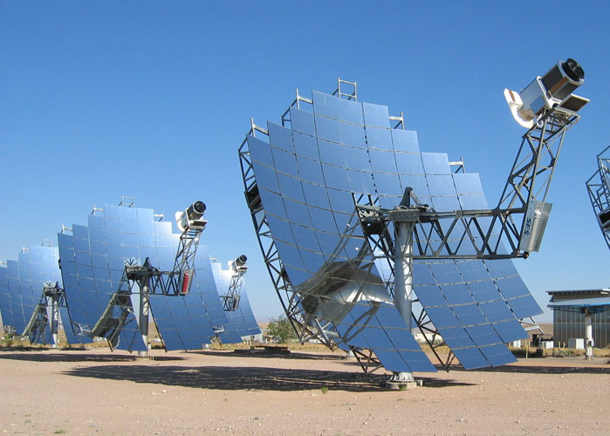
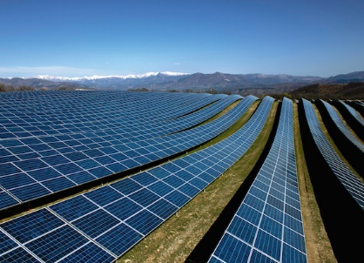
Solar facility types
Parabolic Trough
Power Tower
Dish Engine
Photovoltaic (PV)
Notes:
Parabolic trough – creates the most jobs
Curved panels
Heat up water in pipes
Power tower – also creates a lot of jobs
Mirrors reflect energy to a tower
Dish Engine
Shaped like a satellite dish
Photovoltaic or PV
Regular solar panels

Slide 28
Timeline of events
Notice of Intent May 29, 2008
Draft PEIS
Dec. 17, 2010
Final PEIS
July 27, 2012
Record of Decision October 2012
2008
2009
2010
2011
2012
2013
2014
2015
First scoping period May–July 2008
Supplemental Draft PEIS October 28, 2011
Second scoping period June 2009
First projects approved June 9, 2015

Slide 29
Public Involvement (Stacey)
First Scoping Period
May 29 – July 15, 2008
11 public meetings
Second Scoping Period
Started June 30, 2009
Draft PEIS
December 17, 2010
15,900 comments
24 SEZs, 677,000 acres
300 comments
14 public meetings
86,000 comments
134 days to comment
Supplement Draft PEIS
October 28, 2011
90 days to comment
Final PEIS
July 27, 2012
Record of Decision
October 2012
5 public meetings
17 SEZs, 285,000 acres
15 comment letters
134,000 comments
Notes:
Stacey Silverii has more information
Scoping process
First scoping period May 29, 2008 through July 15, 2008
BLM held 11 public meetings in six states
Comments collected online and by mail
15,900 individuals, organizations, and government agencies commented
Second scoping period starting June 30, 2009
Comments solicited on 24 proposed Solar Energy Zones / 677,000 acres
300 entities provided comments
Draft PEIS
Published December 17, 2010
Comment period open 134 days
BLM held 14 public meetings in six states
86,000 comments received
Supplement Draft PEIS
Published October 28, 2011
Comment period open 90 days until January 27, 2012
BLM held 5 public meetings
134,000 comments received
Final PEIS
Published July 27, 2012
Solar Energy Zones reduces to 17 SEZs / 285,000 acres
BLM received 15 comment letters from
county officials
nongovernmental organizations
solar energy developers
solar energy industry associations
utility representatives
state and Federal agencies
tribes
Used those to make clarifications and modifications in ROD
Record of Decision - October 2012

Slide 30
Decision
Preferred Alternative
Solar Energy Development
Environmentally Preferred Alternatives
Solar Energy Development
Solar Energy Zones
Decision
Solar Energy Development

Slide 31
Where are we now? (Mikhail)
State | SEZ | Name | MW | Type | Status
Arizona | Brenda | Quartzite | 100 | tower | operational
 |  | Little Horn | 1000 | trough | pending
 | Gillespie | Sonoran | 300 | trough | pending
Note: 1 MW can power about 1000 homes
Notes:
Mikhail Yathnitskiy has more information about this in Q and A
Arizona
1 operational
2 pending
All 3 in a Solar Energy Zone

Slide 32
Where are we now? (Mikhail)
State | SEZ | Name | MW | Type | Status
California | Riverside East | McCoy | 750 | PV | operational
 |  | Blythe | 485 | PV | operational
 |  | Genesis | 250 | trough | operational
 |  | Desert Harvest | 150 | PV | operational
 |  | Desert Quartzite | 700 | PV | pending
 |  | Sonoran West | 450 | PV | pending
 | Outside SEZ | Desert Sunlight | 550 | PV | operational
 |  | Ivanpah 2 | 370 | tower | operational
 |  | Stateline | 300 | PV | operational
 |  | Ocotillo Sol | 20 | PV | operational
 |  | Soda Mountain | 287 | PV | approved
Notes:
California
8 operational
3 pending
6 in a Solar Energy Zone
5 outside a Solar Energy Zone

Slide 33
Where are we now? (Mikhail)
State | SEZ | Name | MW | Type | Status
Nevada | Dry Lake | Dry Lake Zone | 200 | PV | operational
 |  | Dry Lake Center | 130 | PV | operational
 |  | Harry Allen Solar | 112 | PV | operational
 |  | Silver State North | 50 | PV | operational
 |  | Silver State South | 350 | PV | operational
 | Millers | Crescent Dunes | 110 | tower | operational
 | Outside SEZ | Luning | 50 | PV | approved
Notes:
Nevada
6 operational
1 approved
All operational facilities in a Solar Energy Zone

Slide 34
Questions
What kind of land was excluded from solar energy development? (Hannah Sargel)
How does the project affect endangered and rare species? (Brinda Bhatt)
Did the EIS discuss socioeconomic impacts? What were they? (Makenna Dunlap)
Did the public get a chance to comment on this project? How many comments did they get? (Stacey Silverii)
Where is this project now? Were any site-specific solar energy facilities approved? (Mikhail Yakhnitskiy)

