Slide 1
Galaxies and image processing
Catch our group on Twitter and Instagram @HowWeScience

Slide 2
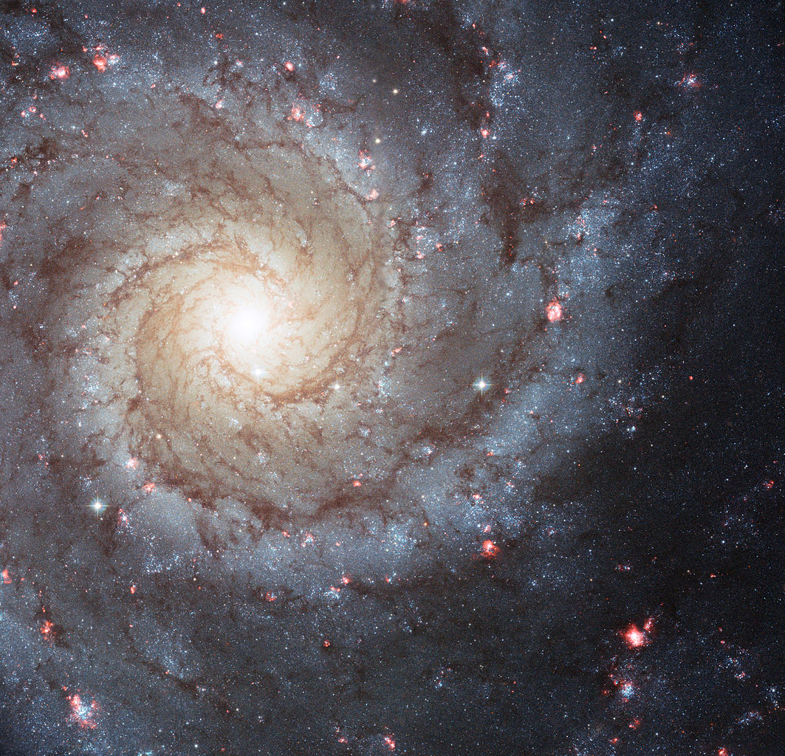
ASPIRE Galaxies and image processing
What is a galaxy?
A collection of stars, gas, dust (i.e., big molecules), and dark matter, bound together by gravity.
NGC 628, a spiral galaxy
Image: NASA, ESA, and the Hubble Heritage (STScI/AURA)-ESA/Hubble Collaboration. Acknowledgment: R. Chandar (University of Toledo) and J. Miller (University of Michigan)

Slide 3
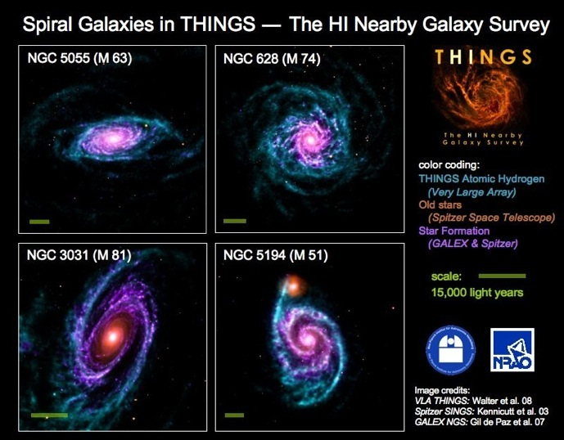
ASPIRE Galaxies and image processing
What is a galaxy?
A collection of stars, gas, dust (i.e., big molecules), and dark matter, bound together by gravity.
NGC 628, a spiral galaxy
Image from the THINGS survey
Notes:
http://www.mpia.de/THINGS/Overview.html

Slide 4
ASPIRE Galaxies and image processing
What is dark matter?
A type of mystery matter. It’s not anything familiar to us, but it’s the glue (frosting) keeping the galaxy together. We want to know what it is! We can learn something about it by counting how many galaxies there are of different sizes.
Contents of the Universe. Gas and stars make up only 4%--they’re like the sprinkles on the cupcake. Dark matter is about 25%. What’s the rest? Something mysterious called dark energy!
Notes:
http://u.osu.edu/apeter/

Slide 5
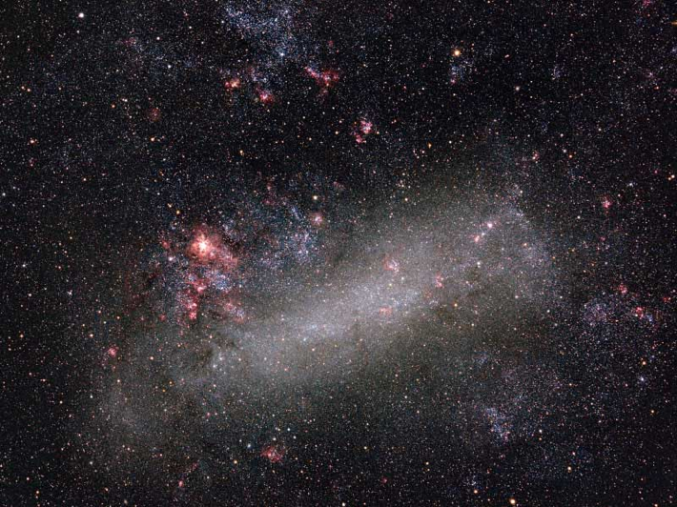
ASPIRE Galaxies and image processing
Galaxies come in different shapes and sizes.
Enormous elliptical galaxy (M87); pic by CWRU’s Chris Mihos
Big spiral galaxy
Small, irregular Large Magellanic Cloud; pic by Wei-Hao Wang (Hawaii)
Notes:
https://apod.nasa.gov/apod/ap060510.html

Slide 6
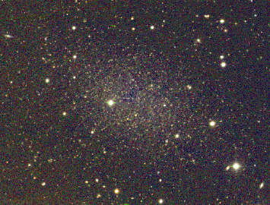
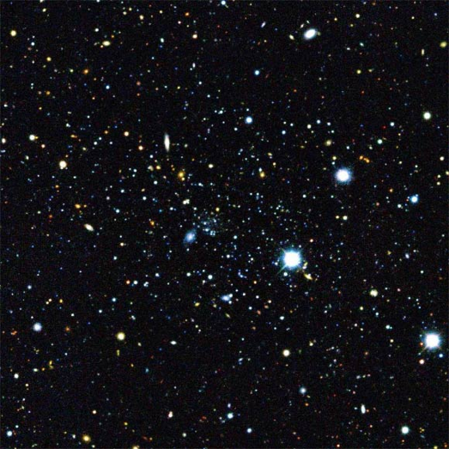
ASPIRE Galaxies and image processing
We’re looking for the smallest ones---different dark matter theories predict different numbers of tiny galaxies, called “dwarfs”.
Cetus dwarf
These dwarfs are near the Milky Way
How do we find ones that are far away?
Eridanus II, discovered in 2015 by the Dark Energy Survey
Notes:
https://www.ast.cam.ac.uk/~mike/local.html
http://www.sci-news.com/astronomy/science-nine-new-satellites-milky-way-galaxy-02579.html

Slide 7
ASPIRE Galaxies and image processing
We look at patches of sky for a long time to get enough light to see the tiny galaxy, and then do some image processing to really reveal it.

Slide 8
Goal: Learn how to use astronomer tools to find tiny dwarf galaxies!

Slide 9
1. What is the data we get from telescopes?

Slide 10
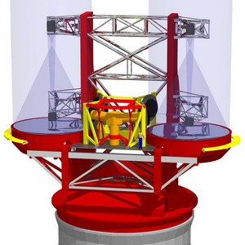
ASPIRE Galaxies and image processing
Light gets collected by the primary mirror, then focused to the camera. The camera is like a fancy version of the camera in your phone. The thing that collects light is usually (for optical light) a charge-coupled device (CCD).
Primary mirror
camera
Large Binocular Telescope. OSU owns a big share. Each primary mirror is 8.4 m in diameter!!!
Notes:
https://www.mpia.de/homes/LBTBWEB/NEWS/pm260601.html

Slide 11
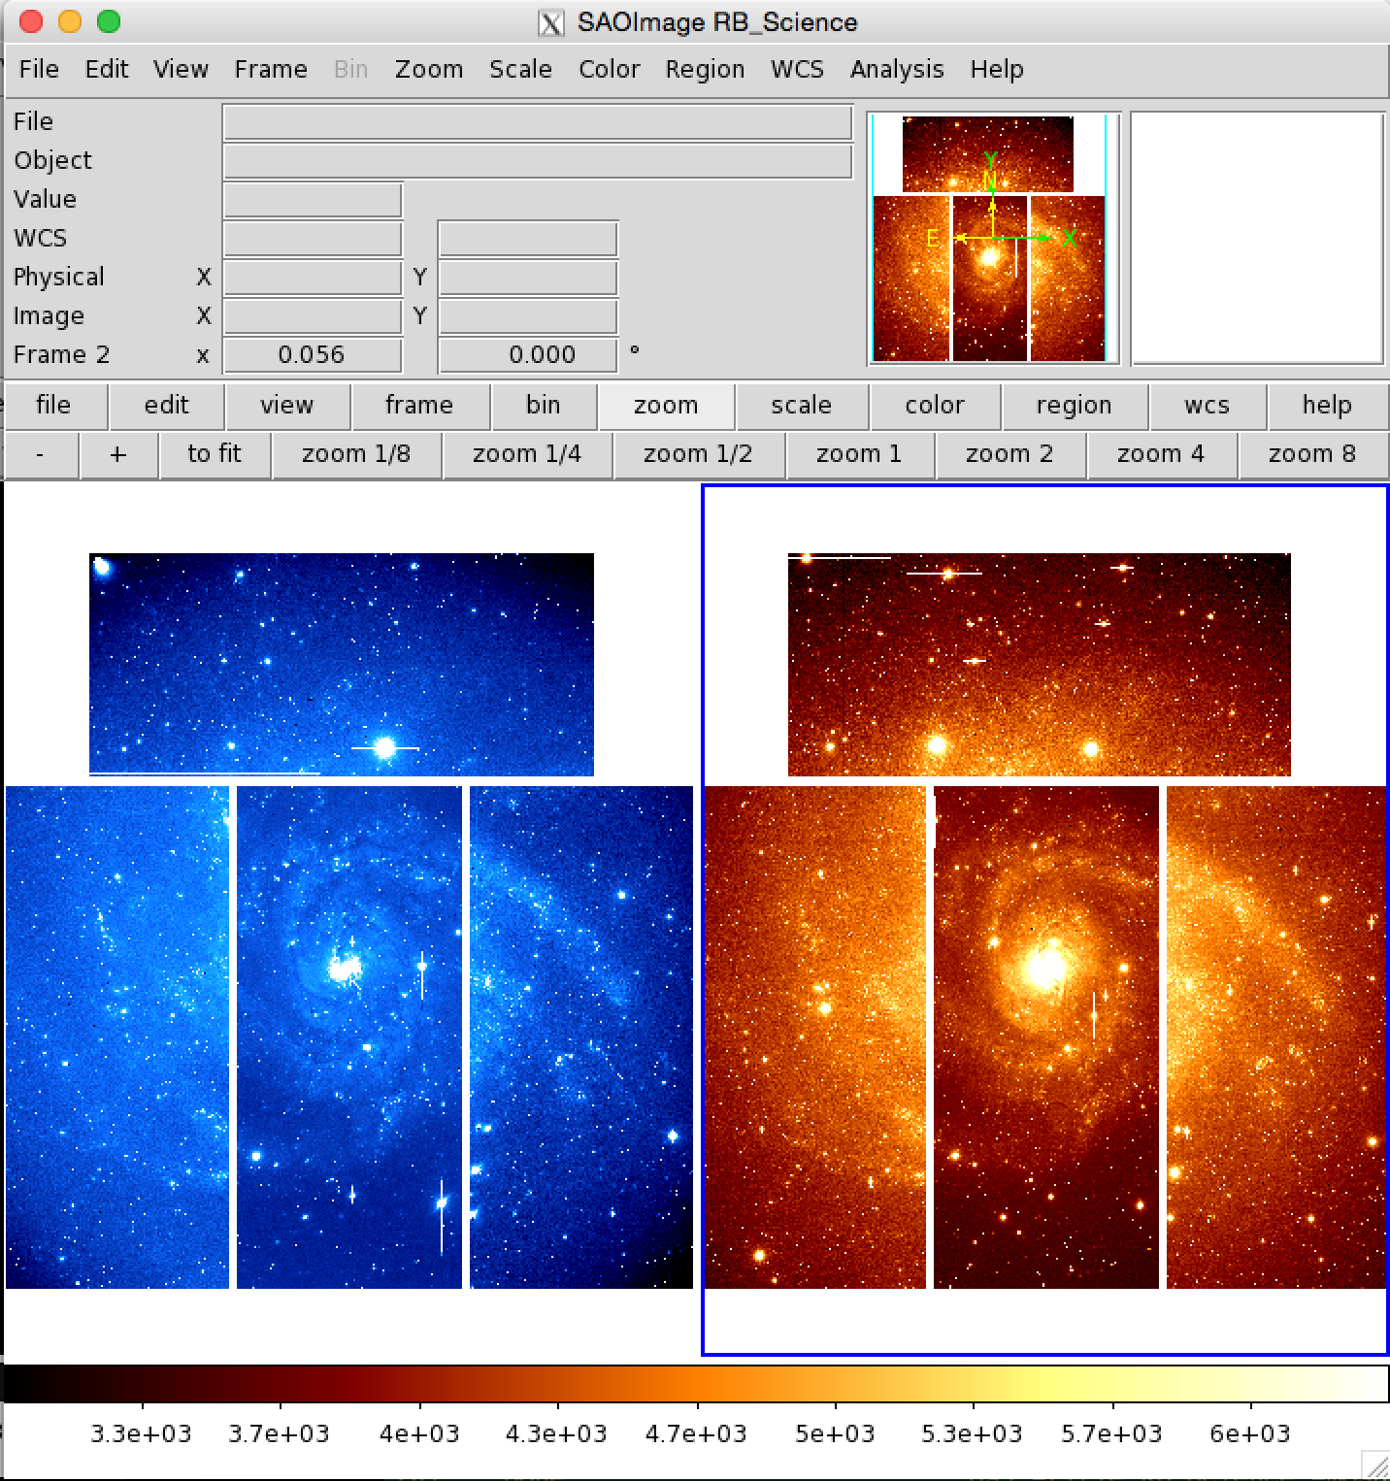
ASPIRE Galaxies and image processing
The light gets recorded on a grid. Often, filters are put in front of the camera to collect light in a narrow “waveband”.
Image from the Large Binocular Camera
Notes:
https://en.wikipedia.org/wiki/Charge-coupled_device
https://sites.google.com/a/lbto.org/lbc/

Slide 12
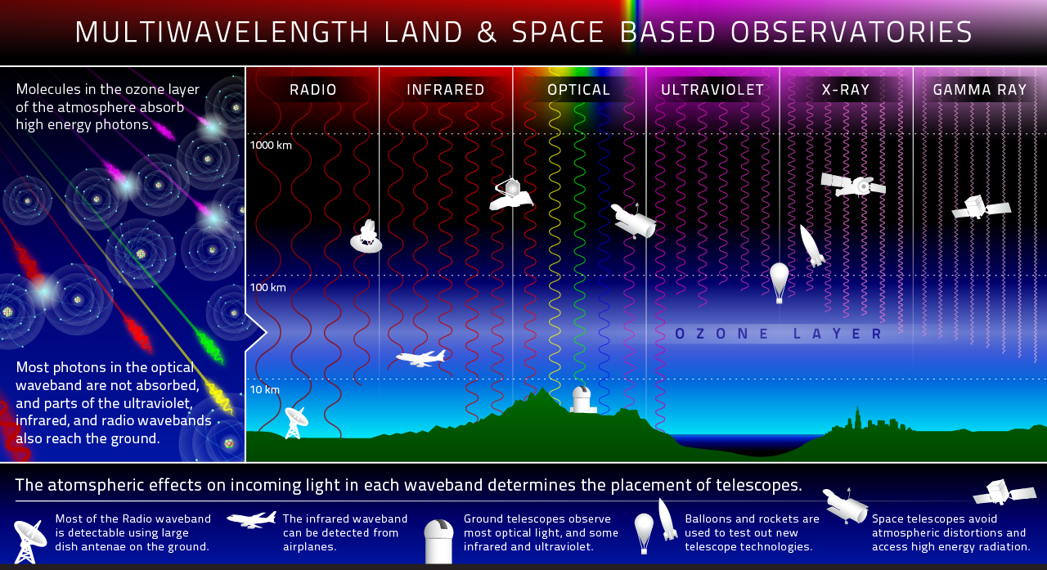
ASPIRE Galaxies and image processing
Different astronomical objects glow in different wavebands. The distribution of light as a function of waveband depends on all the physics of light emission in the object.
Notes:
http://ecuip.lib.uchicago.edu/multiwavelength-astronomy/astrophysics/07.html

Slide 13
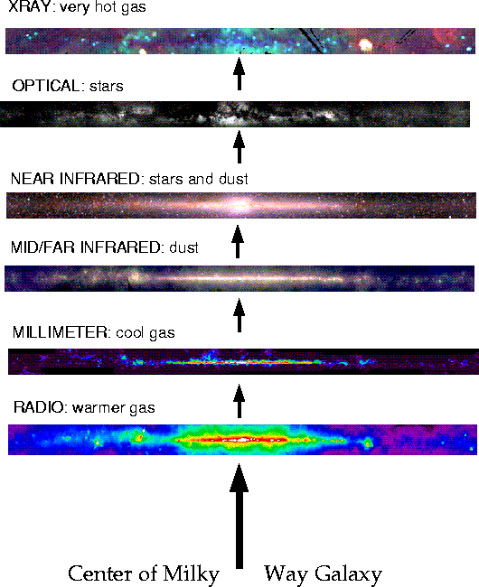
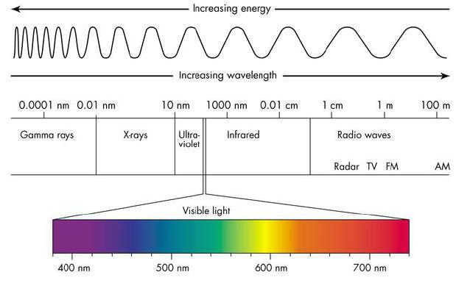
ASPIRE Galaxies and image processing
Different astronomical objects glow in different wavebands. The distribution of light as a function of waveband depends on all the physics of light emission in the object.
Notes:
http://www.astro.ucla.edu/~ghezgroup/gc/journey/wavelength.html
https://jcconwell.wordpress.com/2012/08/02/spectroscopy-the-astronomers-amazing-tool/

Slide 14
ASPIRE Galaxies and image processing
The light gets recorded on a grid. Often, filters are put in front of the camera to collect light in a narrow “waveband”. A grid element is called a “pixel”.
Notes:
https://lco.global/spacebook/what-is-photometry/

Slide 15
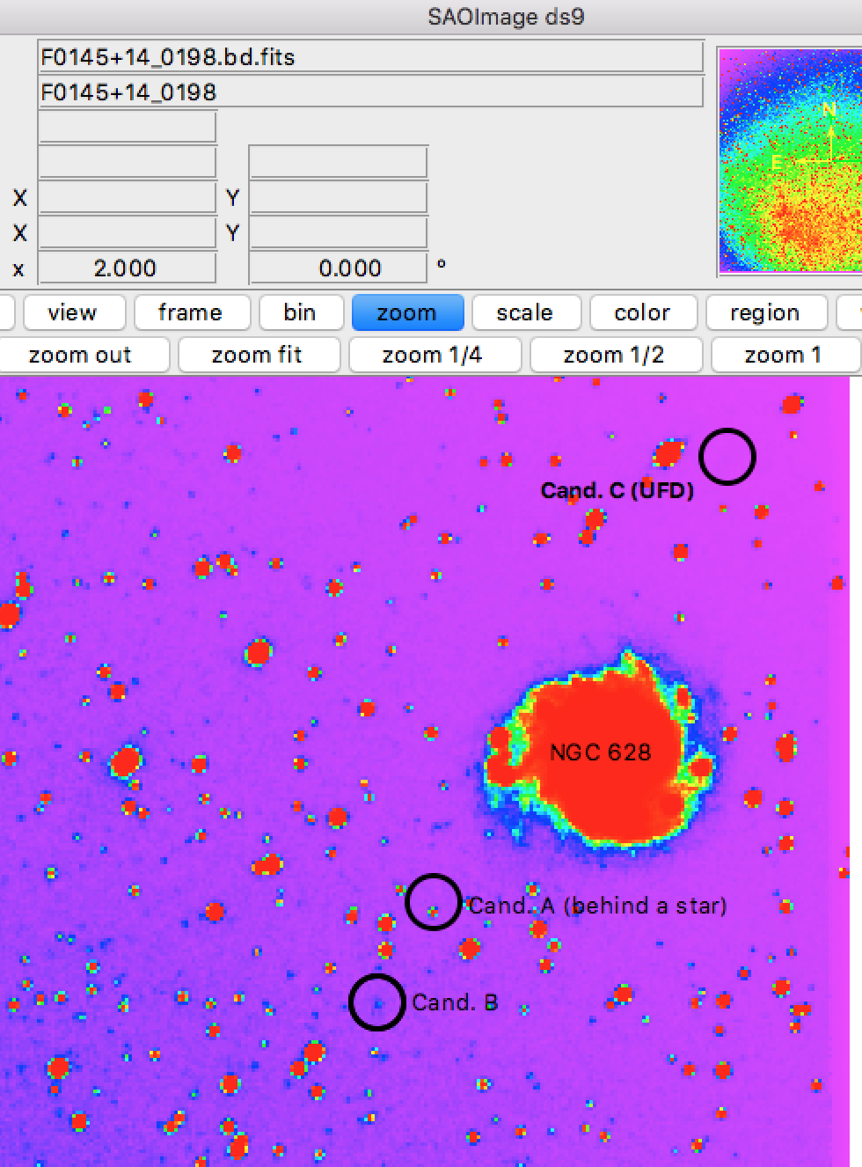
ASPIRE Galaxies and image processing
Big pixels + bad “seeing” Little pixels and good “seeing”
From ASAS-SN (OSU)
Seeing: how much the telescope and atmosphere smear out light
Notes:
http://www.astronomy.ohio-state.edu/asassn/index.shtml
https://en.wikipedia.org/wiki/Astronomical_seeing

Slide 16
ASPIRE Galaxies and image processing
Different file formats store the amount of light in each pixel a little differently. Formats you may be familiar with: jpeg, gif, png. What does your phone use?
Astronomers use the FITS file format for images. You can export to other formats, but the data from the CCD, and other information you need to know about the observations, are easily stored according to a specific universal structure in fits files. Universal standards are your friends!
If you want to know about the different formats, Wikipedia is a great place to start.
Notes:
https://en.wikipedia.org/wiki/FITS
https://en.wikipedia.org/wiki/JPEG
https://en.wikipedia.org/wiki/GIF

Slide 17
2. Load an image into a FITS viewer (SAOImage ds9)

Slide 18
ASPIRE Galaxies and image processing
Goal: Load a real astronomical image into the fits viewer SAO Viewer DS9, and play around with it.
The data you will play with first comes from the Sloan Digital Sky Survey (SDSS; sdss.org), a survey with huge OSU involvement. You can download any data from it you want here: https://www.sdss.org/dr14/imaging/

Slide 19
ASPIRE Galaxies and image processing
2(a) There are two ways to load an image. We’re going to use the GUI interface, but your project leader can show you how to use something called the “command line” if you’re interested.

Slide 20
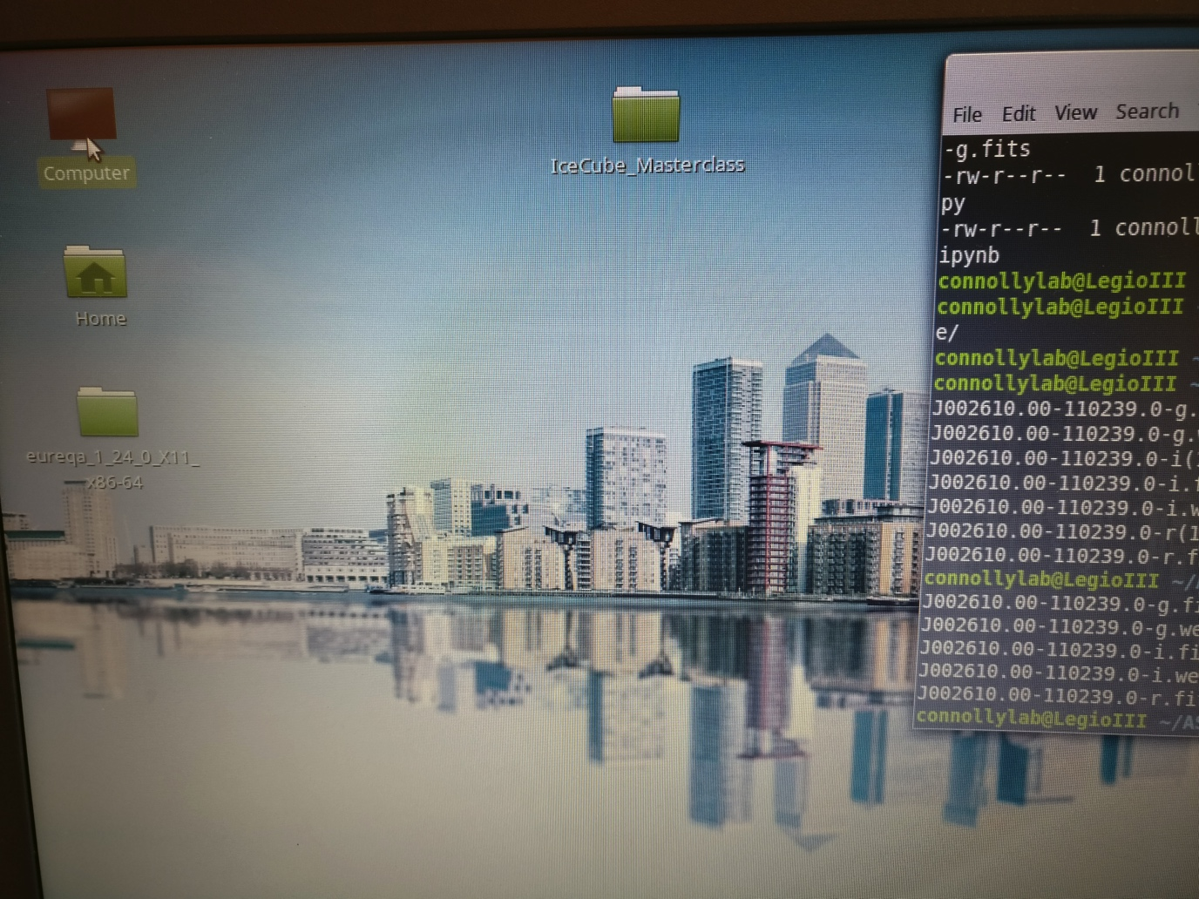
ASPIRE Galaxies and image processing
2(b) Click on the computer tab

Slide 21
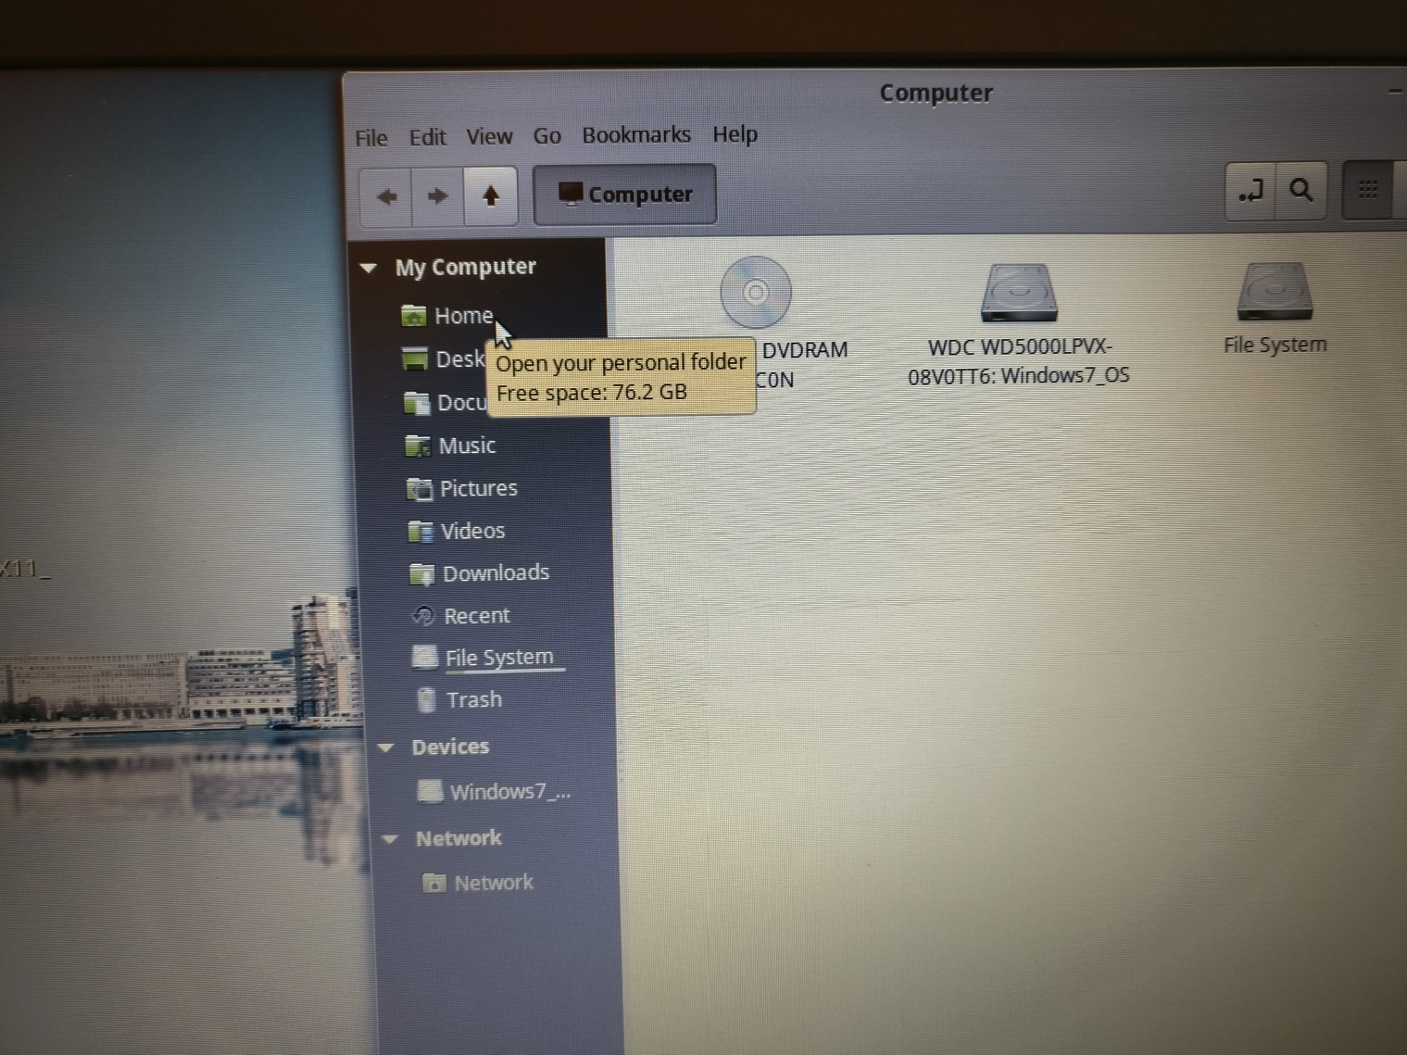
ASPIRE Galaxies and image processing
2(c) Click on “Home”

Slide 22
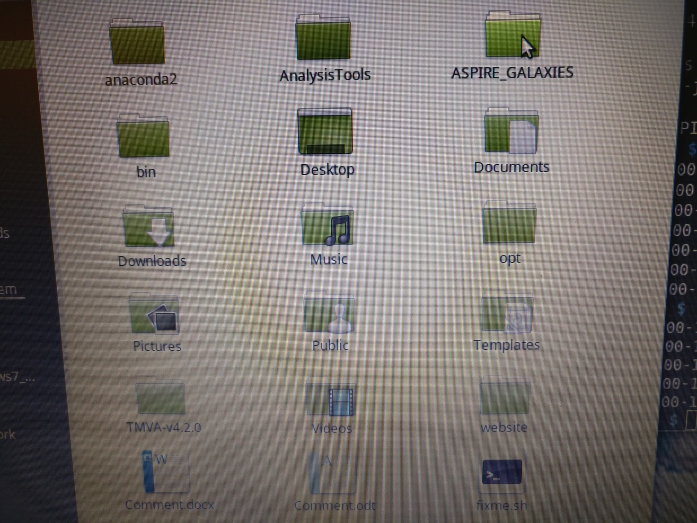
ASPIRE Galaxies and image processing
2(d) Click on “ASPIRE_GALAXIES”

Slide 23
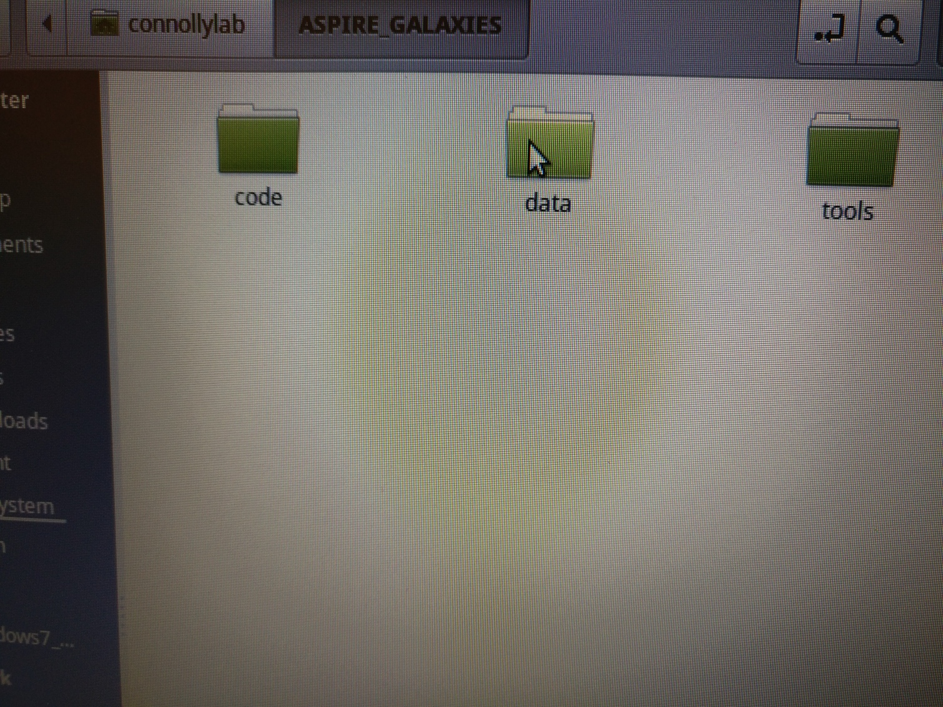
ASPIRE Galaxies and image processing
2(e) Click on “data”

Slide 24
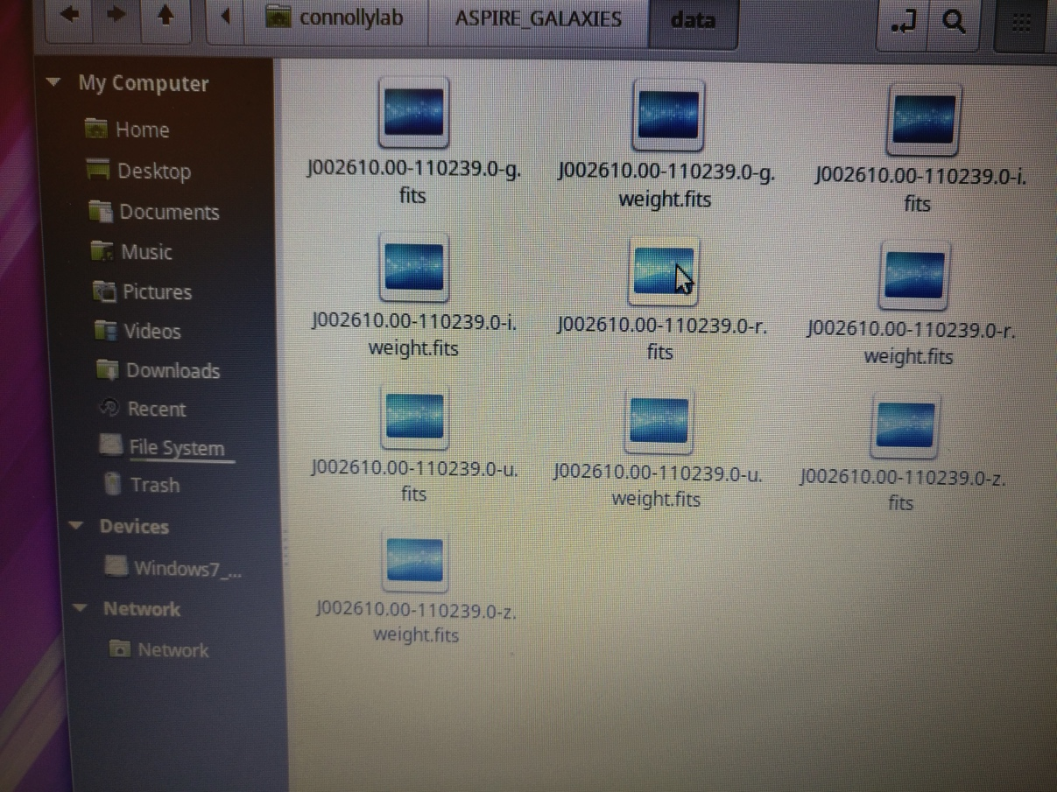
ASPIRE Galaxies and image processing
2(f) Here is a bunch of data! The u, g, r, i, and z markers denote different wavebands. U is ultraviolet/blue, g is green, etc. We will open r, red.

Slide 25
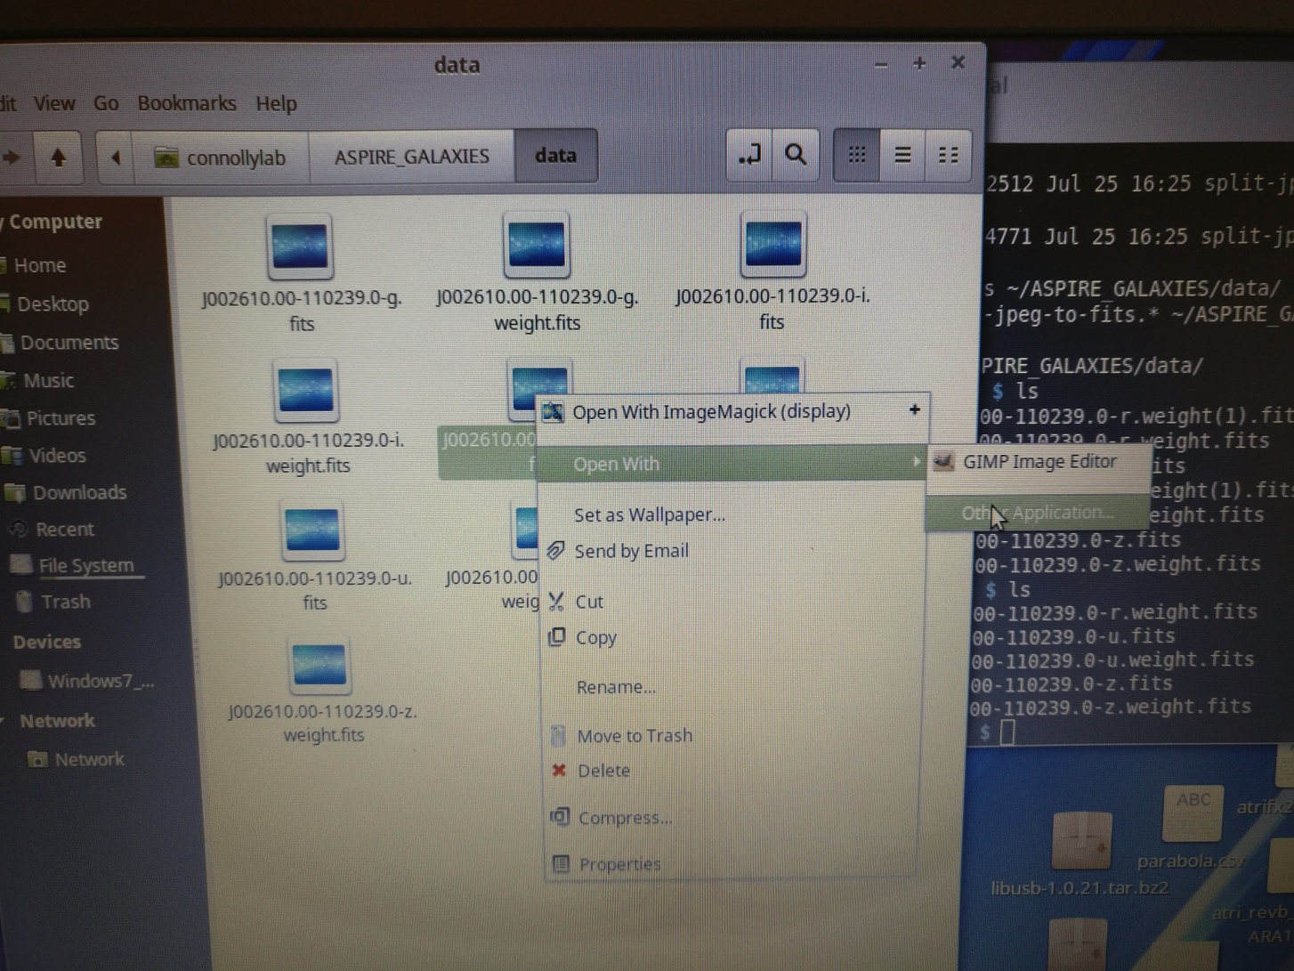
ASPIRE Galaxies and image processing
2(g) How to open the file with the right program.

Slide 26
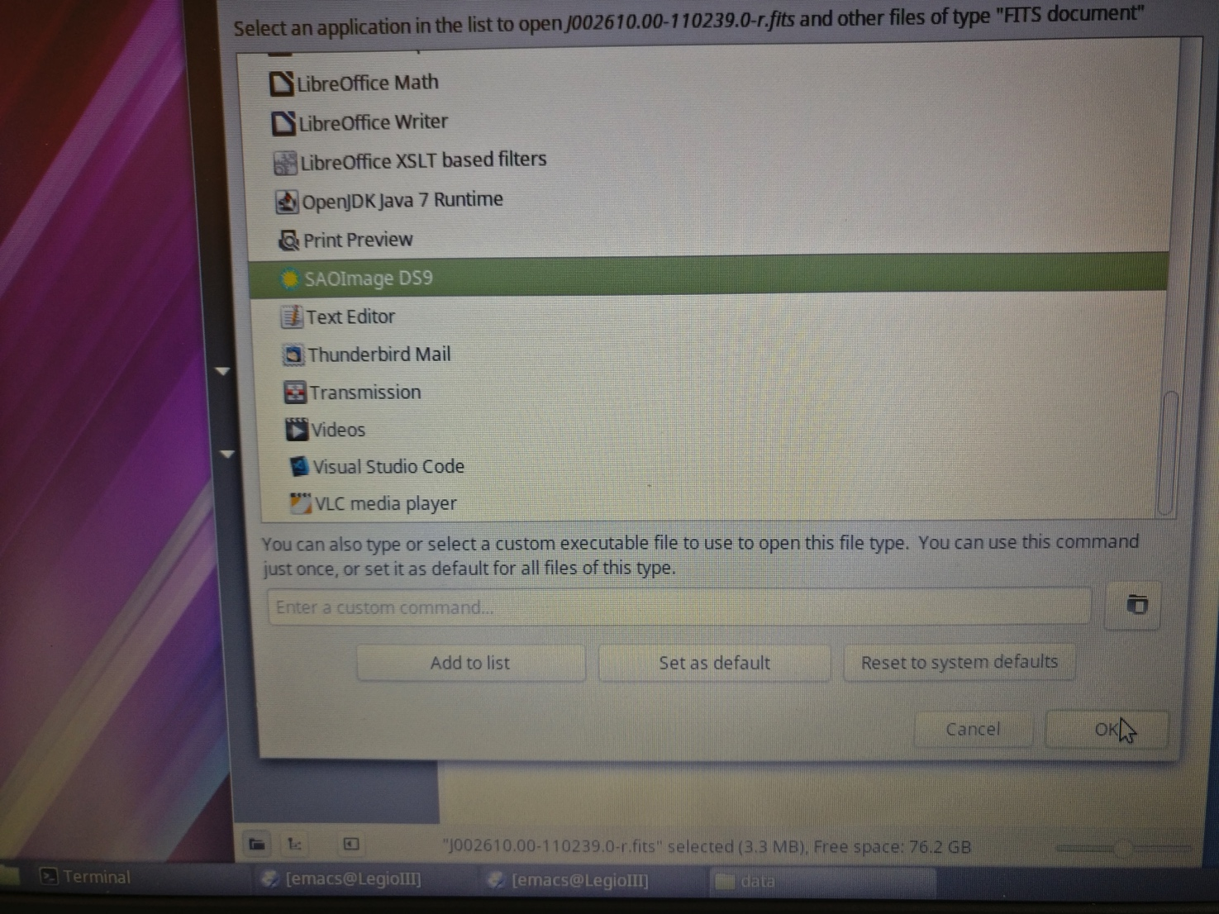
ASPIRE Galaxies and image processing
2(h) Click on SAOImage DS9.

Slide 27
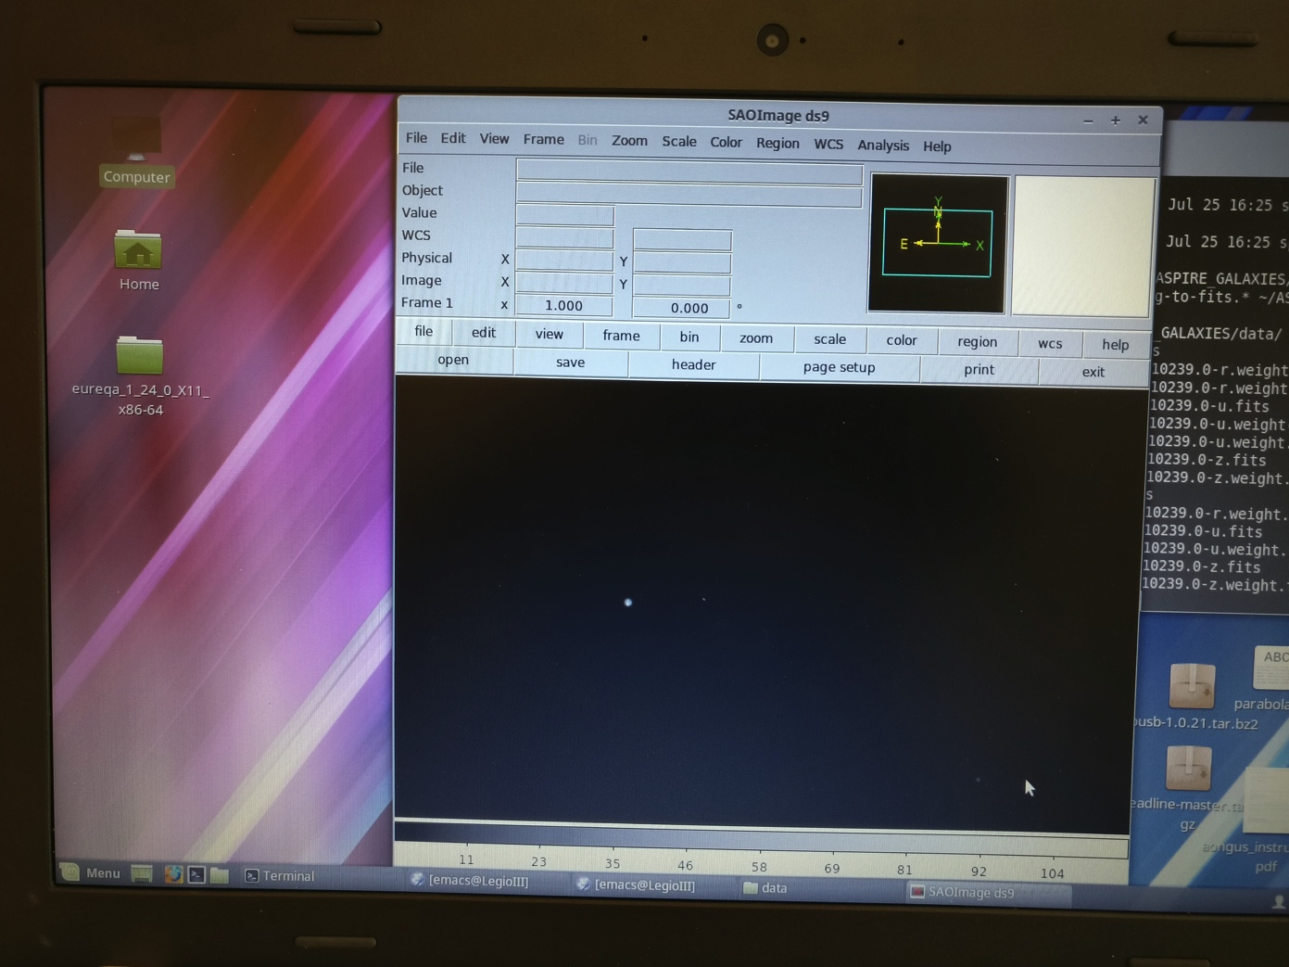
ASPIRE Galaxies and image processing
2(i) Voila! But why does it look like a whole lot of black?

Slide 28
ASPIRE Galaxies and image processing
2(j) It has to do with the “dynamic range” or stretch of the image. This image tells you that there are a few VERY BRIGHT things in the image, and the rest are pretty dim. We want to play with the “stretch” of the image to highlight different features.

Slide 29
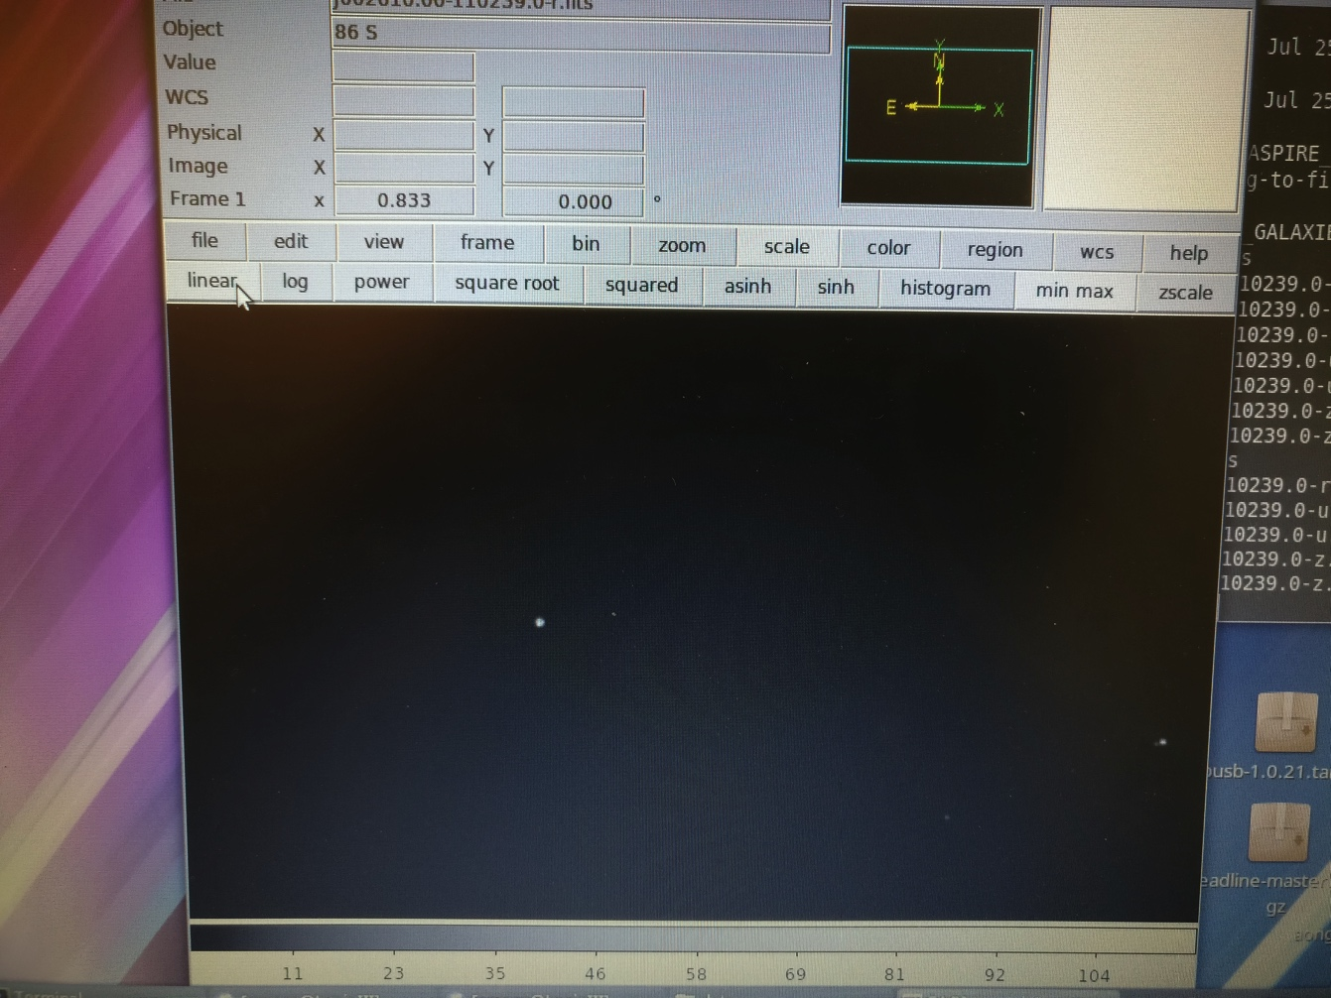
ASPIRE Galaxies and image processing
2(j) It has to do with the “dynamic range” or stretch of the image. Click on “stretch” for options.
What happens when you try out the different options?

Slide 30
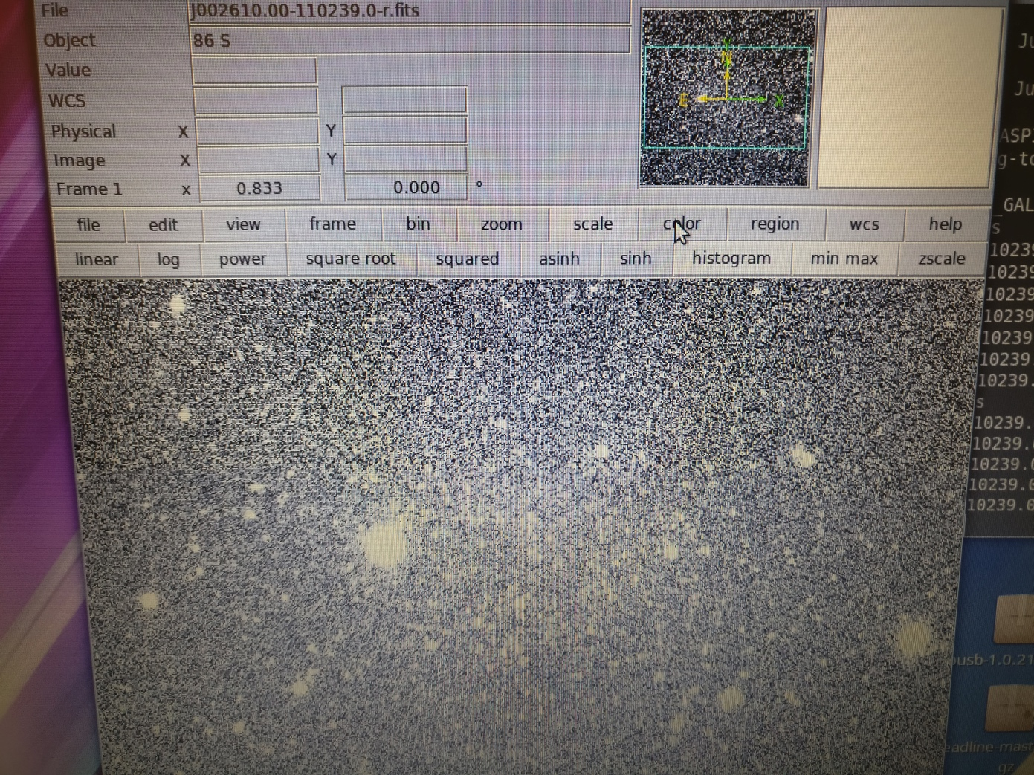
ASPIRE Galaxies and image processing
2(k) “Histogram” is our favorite because it highlights faint objects.
Get a sense of relative brightness by looking at the numbers in the “Value” box. What’s the range of values?
What are the things you see in the image? Ask the project lead.

Slide 31
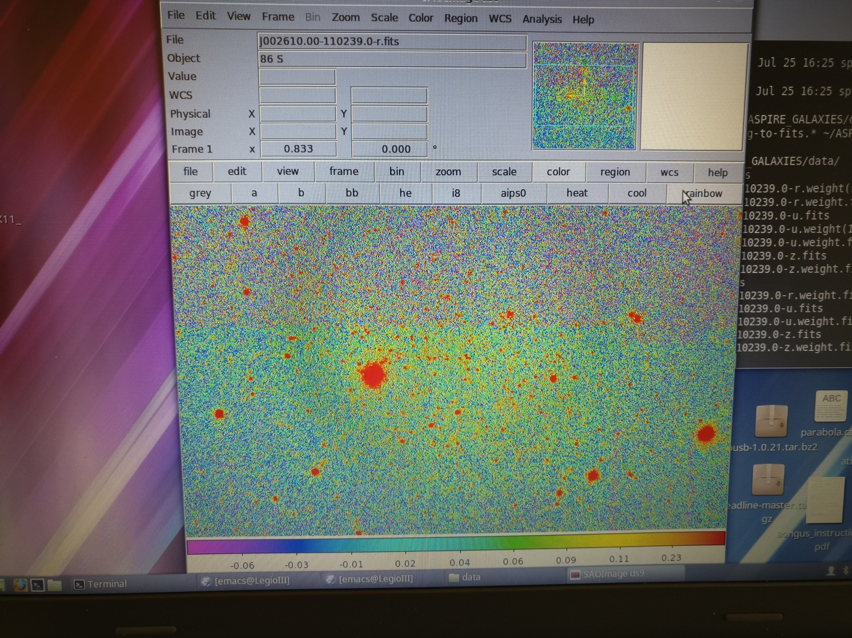
ASPIRE Galaxies and image processing
2(l) You don’t have to use black and white. The eye picks up rainbow colors better. Try it out!

Slide 32
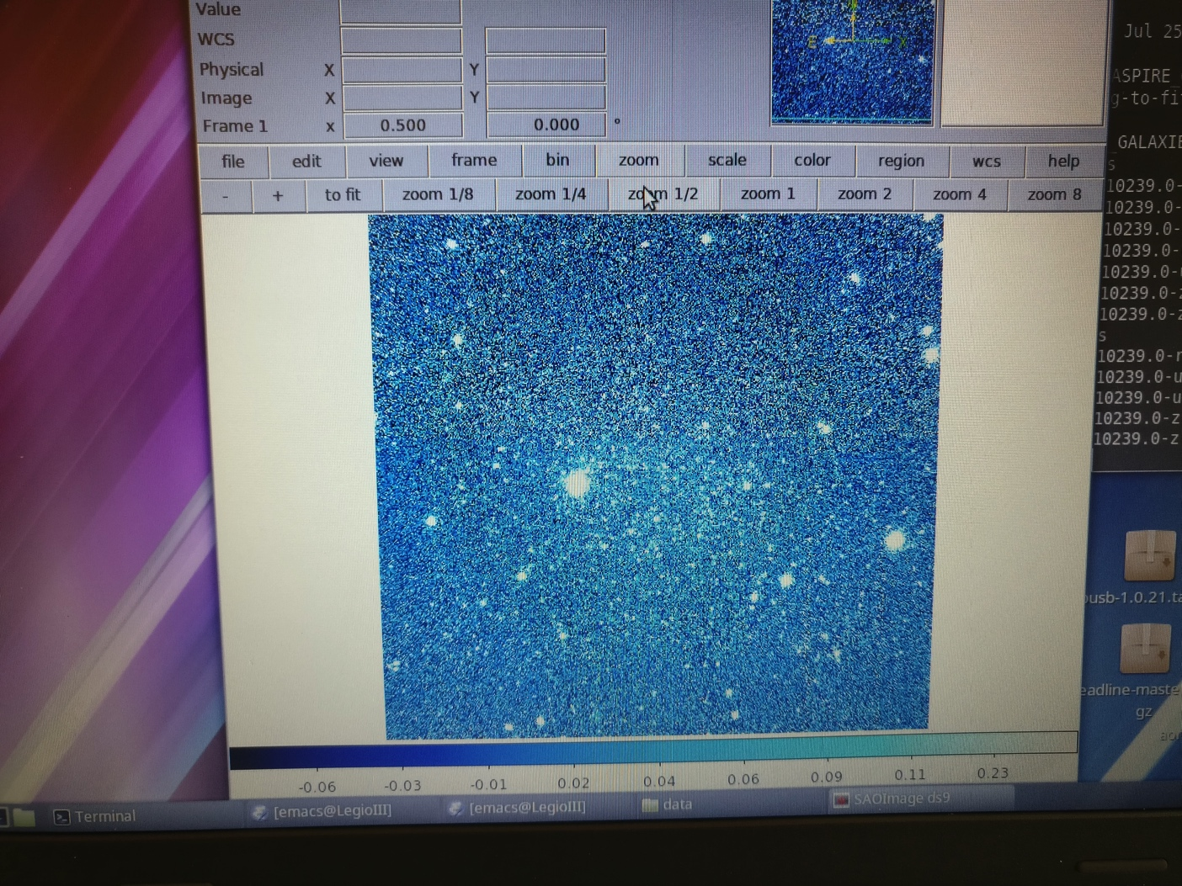
ASPIRE Galaxies and image processing
2(m) You can zoom in and out.

Slide 33
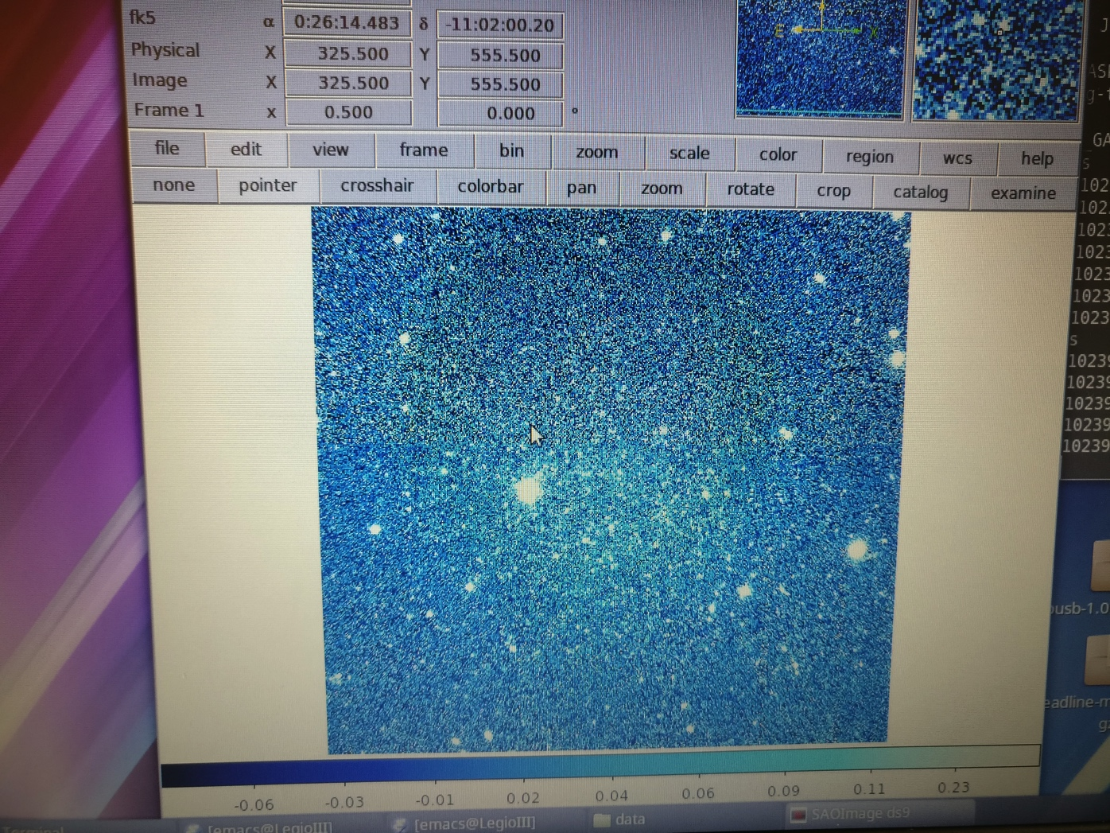
ASPIRE Galaxies and image processing
2(n) There are a lot of different pointers to use. Try it out!

Slide 34
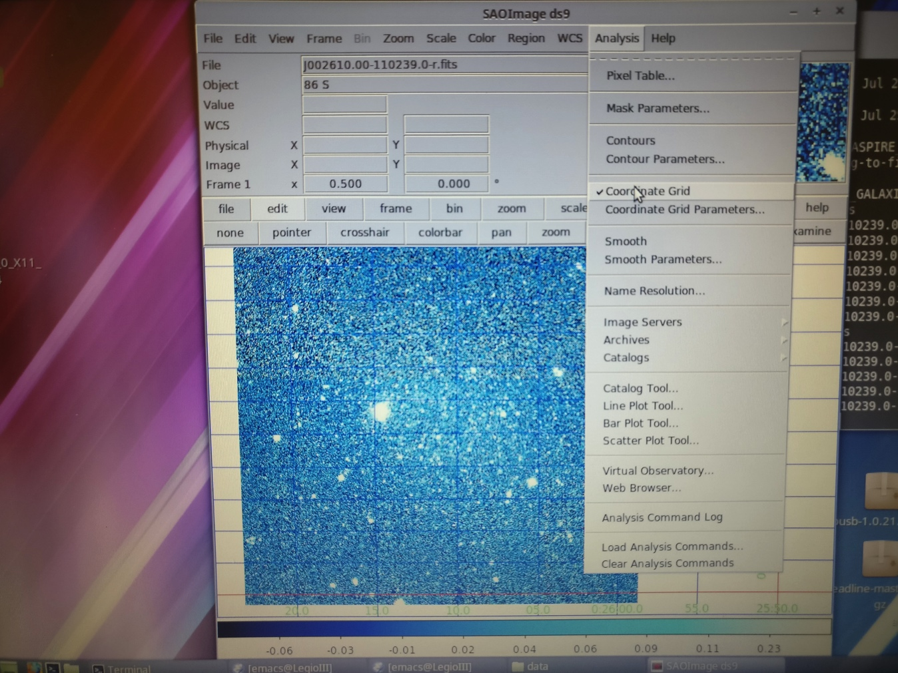
ASPIRE Galaxies and image processing
2(o) Try out coordinate grids. Ask your project lead about astronomical coordinates.
Notes:
https://lco.global/spacebook/what-is-photometry/

Slide 35
ASPIRE Galaxies and image processing
2(p) Play with different tools, see what they do. Ask the project lead if you have questions. There is a large body of (dry) documentation, but it’s more fun to experiment unless there’s something specific you want to do. User manuals are here: http://ds9.si.edu/site/Documentation.html

Slide 36
3. Find the (dwarf) galaxy in this image!

Slide 37
ASPIRE Galaxies and image processing
Goal: Find the big galaxy in this image. The galaxy is a dwarf, but is close enough to us (around a million light years) that it spans a large angle on the sky.

Slide 38
ASPIRE Galaxies and image processing
When an object is faint, it’s hard to see above the “background noise” of the image. In our case, the background is the night sky.
We often “smooth” an image to see how many pixels near each other similarly slightly pop up above the background noise.
Smoothing takes the value at some discrete point and smears it, according to some function, over a broader area. Blurring the image like this can help filter out small-scale details so you can see the whole object.
Note: sometimes instead you want to sharpen images…
Notes:
http://www1.phys.vt.edu/~jhs/SIP/processing.html (Technical but a good place to start your search)
https://www.stat.tamu.edu/~jlong/astrostat/fall2015/Astro2D.pdf

Slide 39
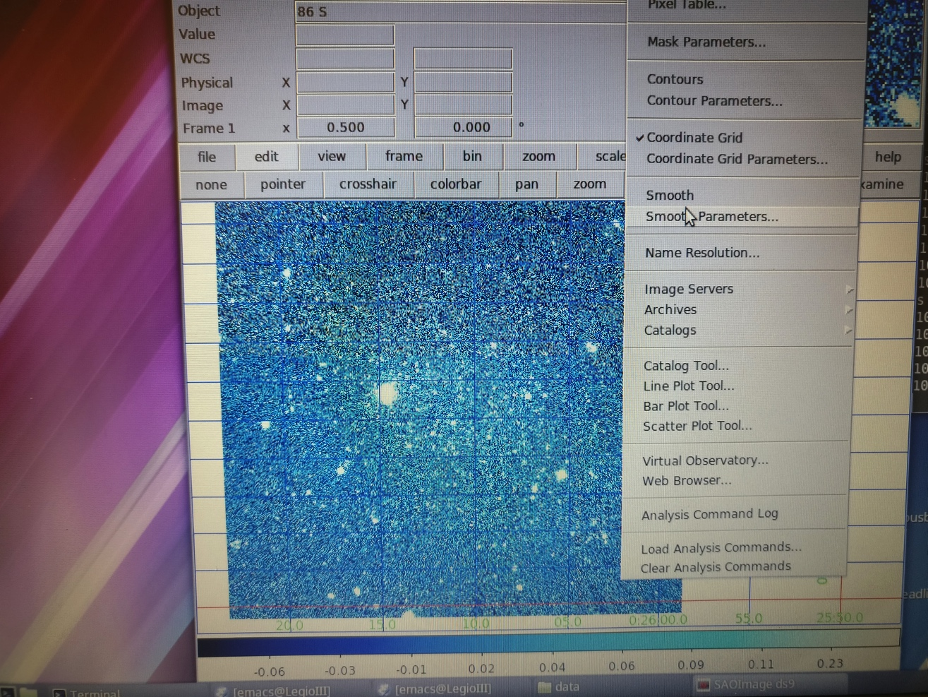
ASPIRE Galaxies and image processing
3(a) Look for the smoothing function. Go to the “Analysis” tab at the top of DS9, and go down the menu.
Notes:
Astronomy coordinate systems: https://en.wikipedia.org/wiki/Celestial_coordinate_system

Slide 40
ASPIRE Galaxies and image processing
3(b) Look for the smoothing function. Go to the “Analysis” tab at the top of DS9, and go down the menu.
Notes:
http://www.astro.sunysb.edu/fwalter/PHY515/astrostatistics.html

Slide 41
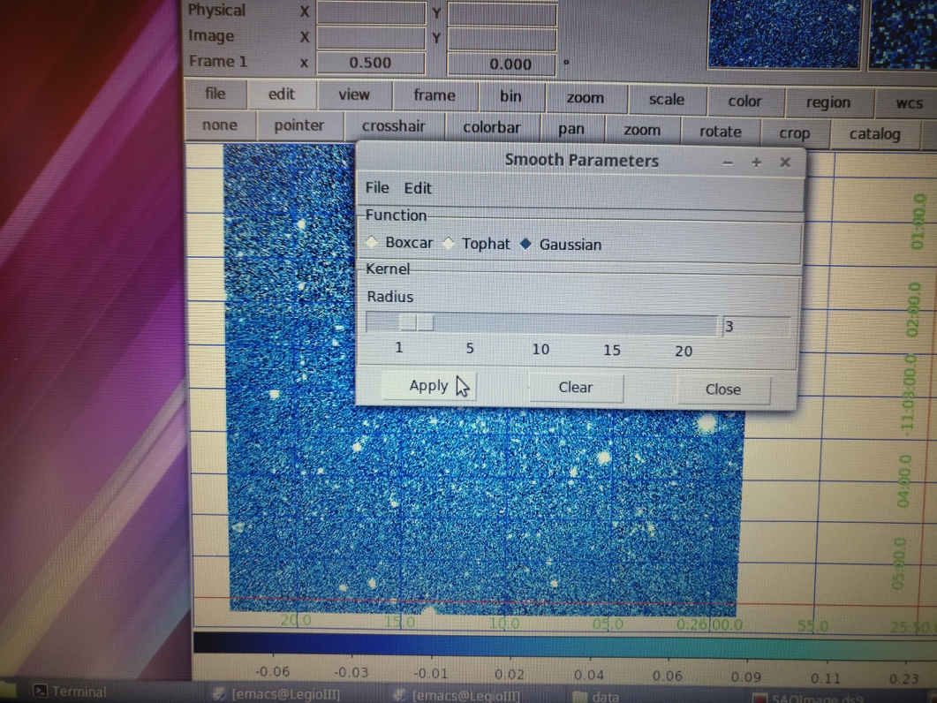
ASPIRE Galaxies and image processing
3(c) There are several different filter functions. The numbers indicate the width, in pixels, of the smearing function. Experiment with it. What do you see? Did you find the galaxy?

Slide 42
ASPIRE Galaxies and image processing
3(d) Open the file “N628_chip4_R.fits”. This is an image Bianca is using for part of her thesis. Can you find a small, faint, “low surface brightness” galaxy in this image? Does smoothing help you find it?

Slide 43
4. Check a catalog to see what else is in the image

Slide 44
ASPIRE Galaxies and image processing
4(a) Open up either the “J002610.00-110239.0-r.fits” file (or one of the other J’s) or NGC628_chip4_R.fits file. Use whatever scale you like, and whatever zoom you like. We’re going to see what other surveys found in this patch of sky. The sky looks different in different wavebands, because different physics processes create light at different energies (wavelengths).
Notes:
Astronomy coordinate systems: https://en.wikipedia.org/wiki/Celestial_coordinate_system

Slide 45
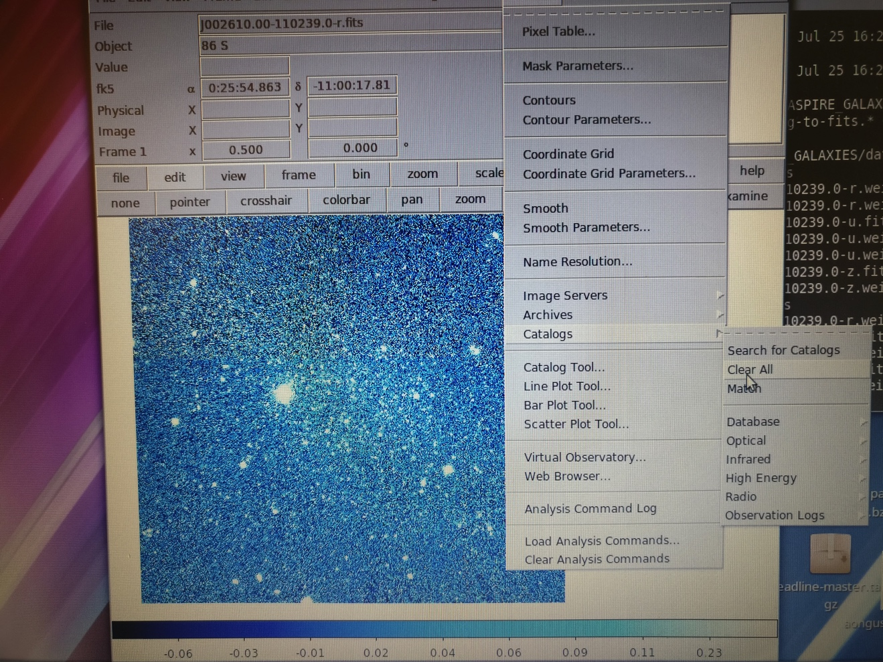
ASPIRE Galaxies and image processing
4(b) Click on the “Analysis” tab, and then go down to “Catalogs”. Try an Optical catalog---say, SDSS 9.
What kinds of
objects do you
see?
Notes:
There are a bunch of different optical surveys, taken with different purposes in mind. They may pick up different options. Generally, all the surveys find the really bright things.

Slide 46
ASPIRE Galaxies and image processing
4(c) Do “Analysis”→”Catalogs”→”Clear All” to delete regions and try something else. Try an infrared
catalog.
What do you find?
Notes:
You should mostly find galaxies, because galaxies with lots of gas are good infrared emitters. This is because the “dust” in galaxies reprocesses the starlight dominantly at infrared wavelengths.

Slide 47
ASPIRE Galaxies and image processing
4(d) Do “Analysis”→”Catalogs”→”Clear All” to delete regions and try something else. Try an something else.
What do you find?

Slide 48
ASPIRE Galaxies and image processing
4(e) The NGC 628 data were taken on the Large Binocular Telescope and are very “deep”. Load the SDSS catalog when you have the NGC 628 image loaded into SAOImage DS9.
What objects are in the SDSS catalog? Which aren’t?

Slide 49
5. Make a color image of this dwarf galaxy

Slide 50
ASPIRE Galaxies and image processing
You can make a color image of the galaxy with SDSS data. Most color maps need three images in different wavebands (a red, a blue, and a green) to make a color composite image. We sometimes call this an “RGB” color map. The human eye is great at picking up color, so it’s a useful way to look at data.

Slide 51
ASPIRE Galaxies and image processing
5(a) Look at the Legacy Survey search region for Cetus.
*http://legacysurvey.org/viewer#NGC%202882
*Type in the coordinates for Cetus
RA: 00: 26:11.0 Dec: -11:02:40 (use a comma to separate the two coordinates; see link below for more on astro coordinate systems)
*You can scroll around the image---what else do you see?
Notes:
Astronomy coordinate systems: https://en.wikipedia.org/wiki/Celestial_coordinate_system

Slide 52
ASPIRE Galaxies and image processing
5(b) We will make a color image with SAOImage ds9. We will use “g”, “r”, and “I” as our RGB colors. Your project lead can show you how to use the “command line” to start ds9. Type in the terminal:
ds9 -rgb –red J002610.00-110239.0-i.fits –green J002610.00-110239.0-r.fits –blue J002610.00-110239.0-g.fits

Slide 53
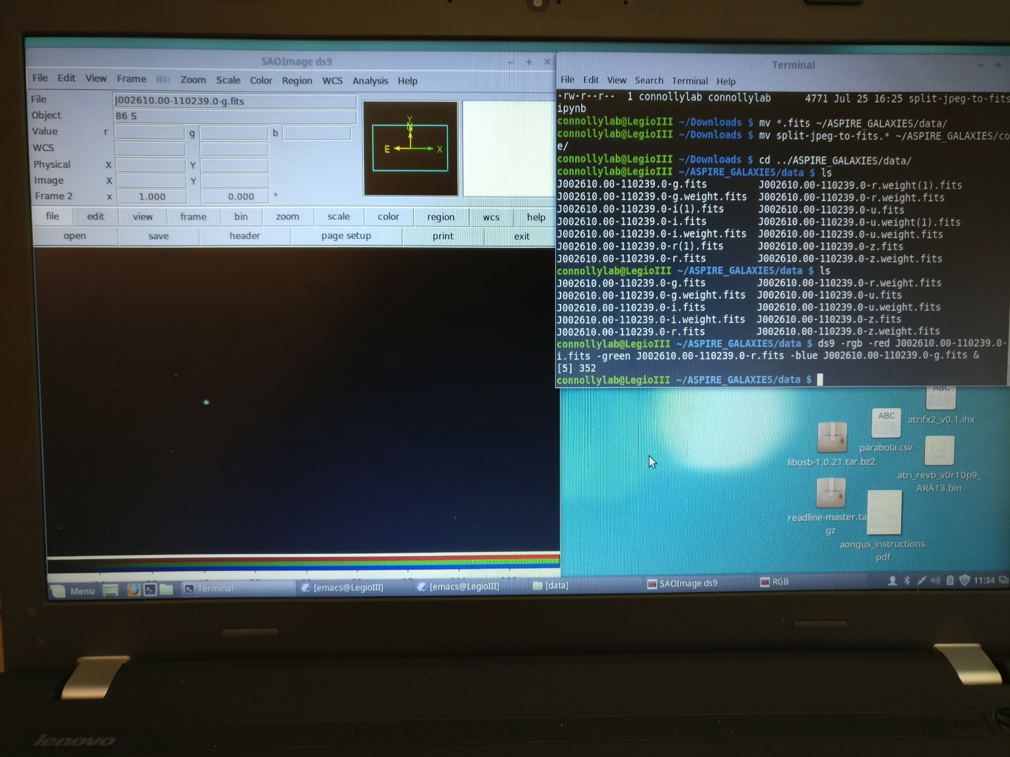
ASPIRE Galaxies and image processing
5© It should look like this:

Slide 54
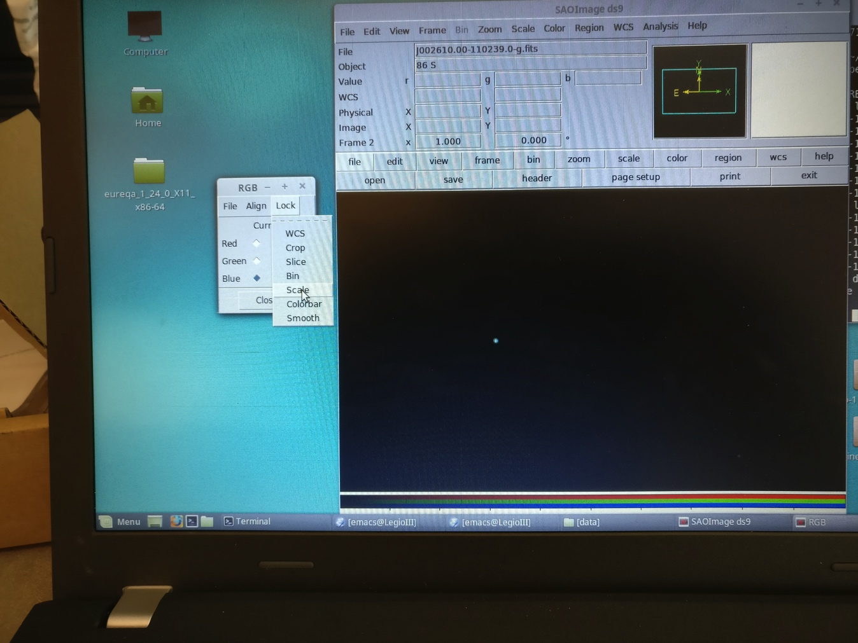
ASPIRE Galaxies and image processing
5(d) We need to lock the scales on the RGB color map. Use the little window. Lock WCS, scale, and smooth.

Slide 55
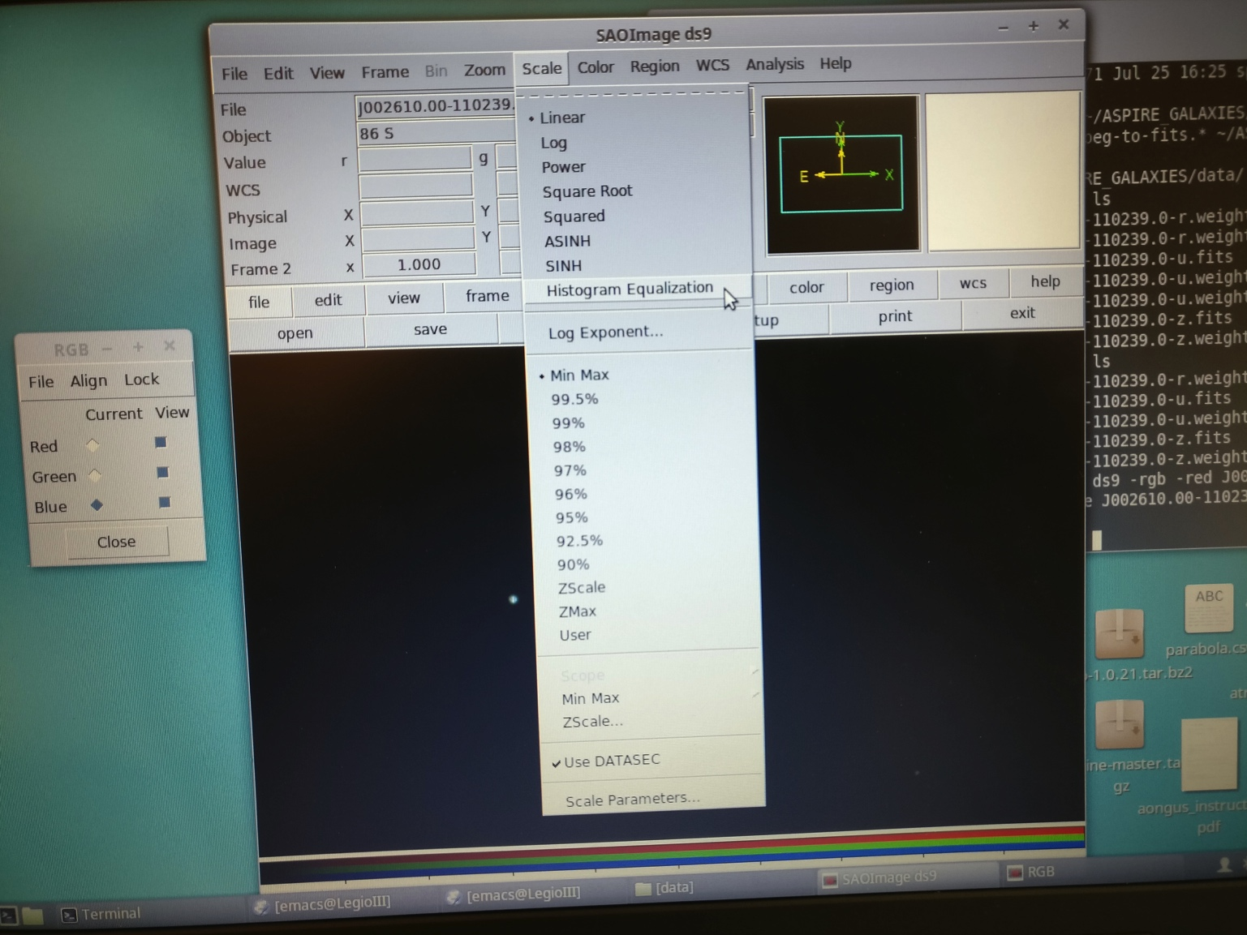
ASPIRE Galaxies and image processing
5(e) Next, we need to set the scale. We like histogram.
What does it look like?

Slide 56
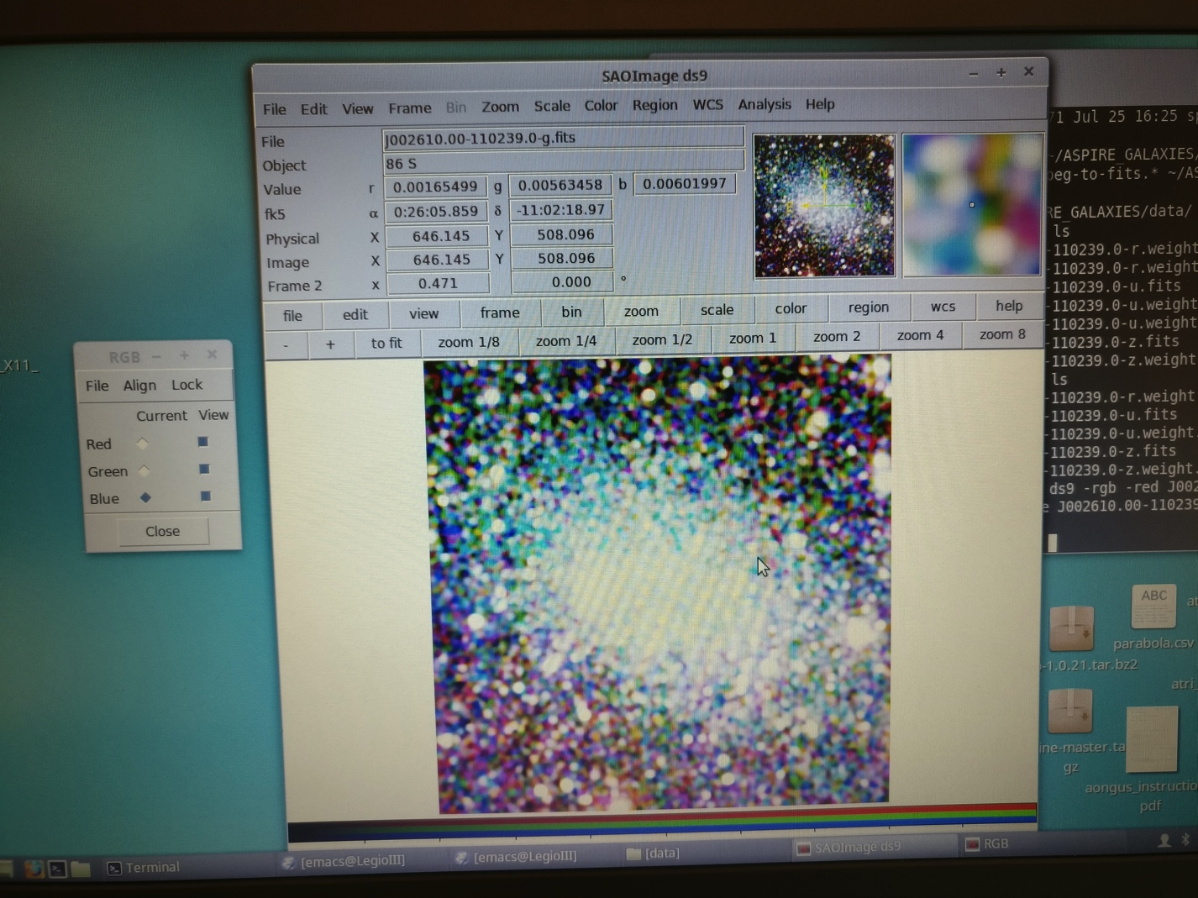
ASPIRE Galaxies and image processing
5(f) Does your galaxy pop up? Try smoothing it. What does it look like? Try linear scale with zscale, too.

Slide 57
ASPIRE Galaxies and image processing
5(g) You can try different color schemes (even reloading the image with different red, blue, and green-designated files) and smoothing. Try adjusting the Scale parameters. Once you have an image you like, you can print it by going to File-->Save Image

Slide 58
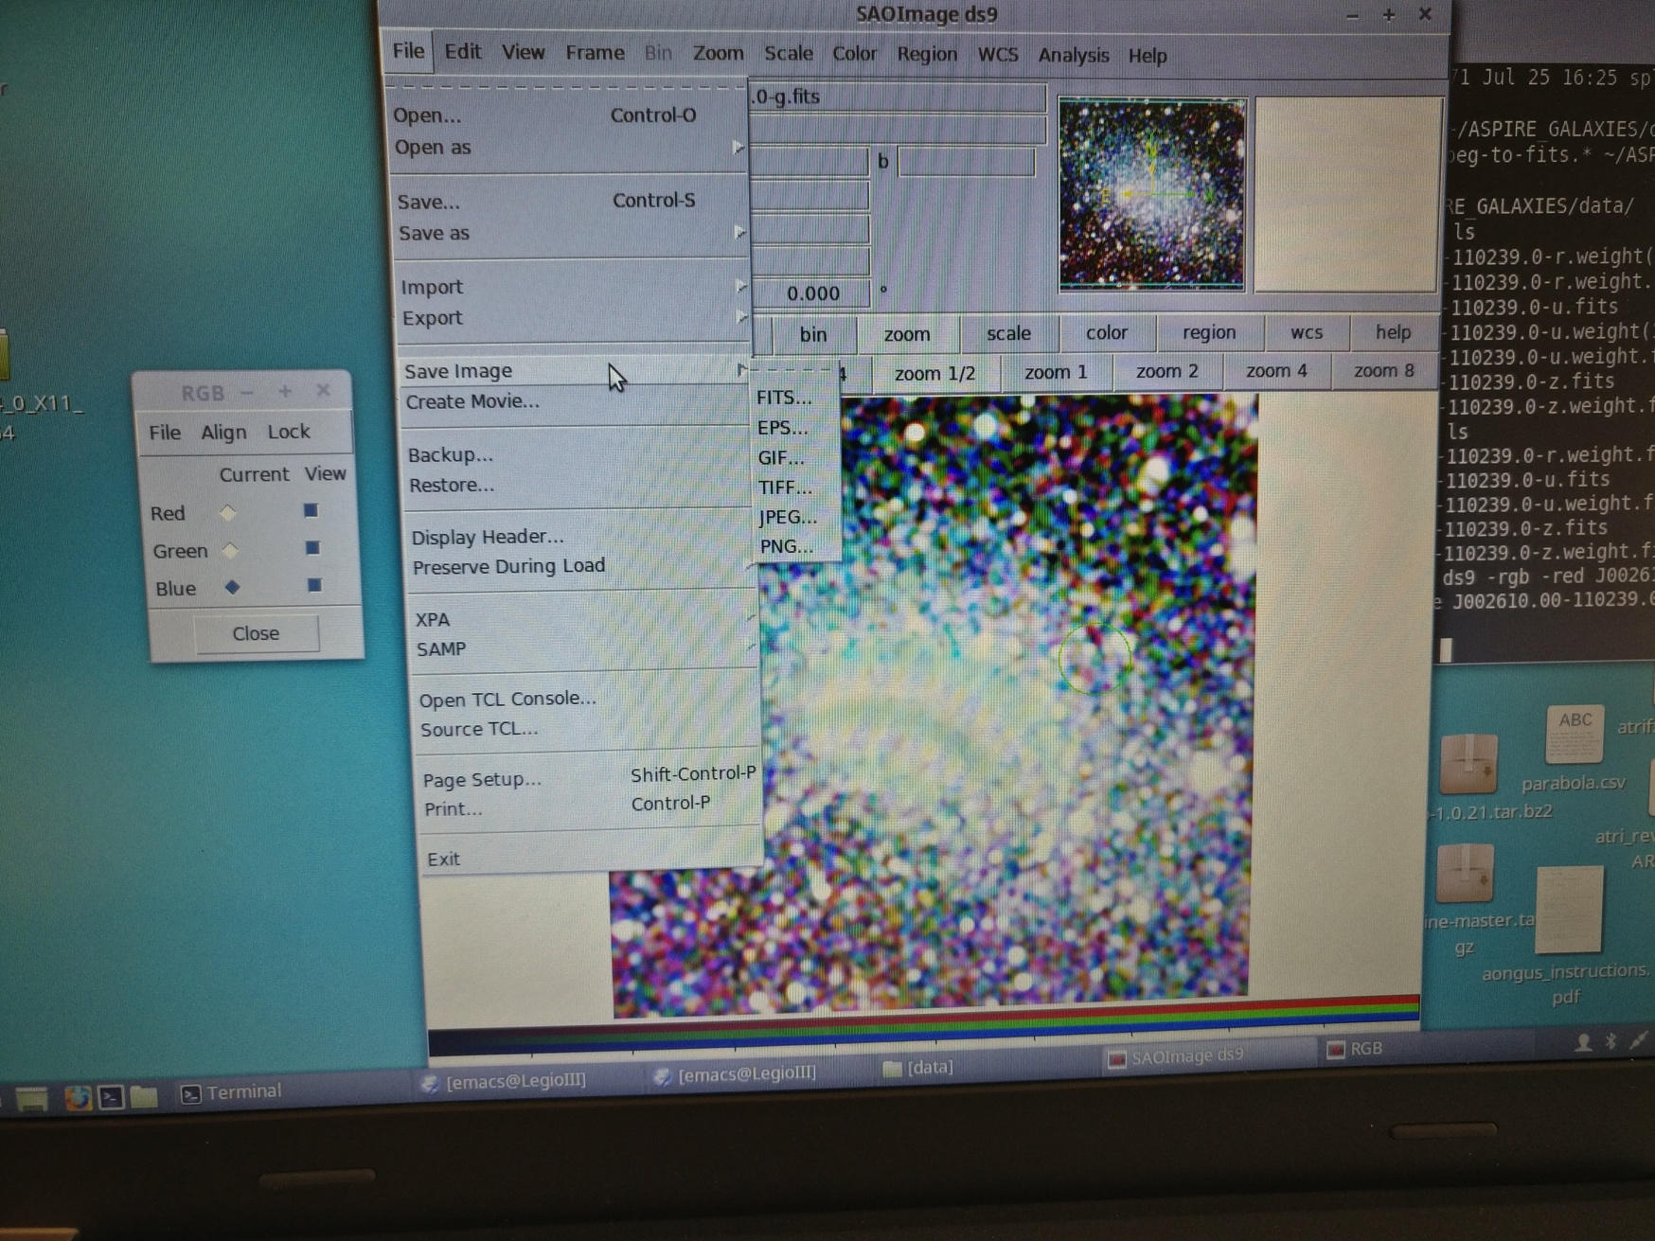
ASPIRE Galaxies and image processing
5(g)

Slide 59
6. Use python to manipulate the FITS image

Slide 60
ASPIRE Galaxies and image processing
It’s a lot of fun to play around with SAOImage ds9, and it’s got some powerful functions. However, when we need to get through a lot of data, or do things more systematically, we write (or use other people’s!) software to process the images. You can do a lot more customized things, and do them systematically.

Slide 61
ASPIRE Galaxies and image processing
The computer language that a lot of astronomers now use is python.
https://www.python.org/about/gettingstarted/
It’s publicly available, easy(er) to use, and there are a lot of online tutorials or classes on its many functions.
The astronomy community has its own astropy package. http://www.astropy.org/

Slide 62
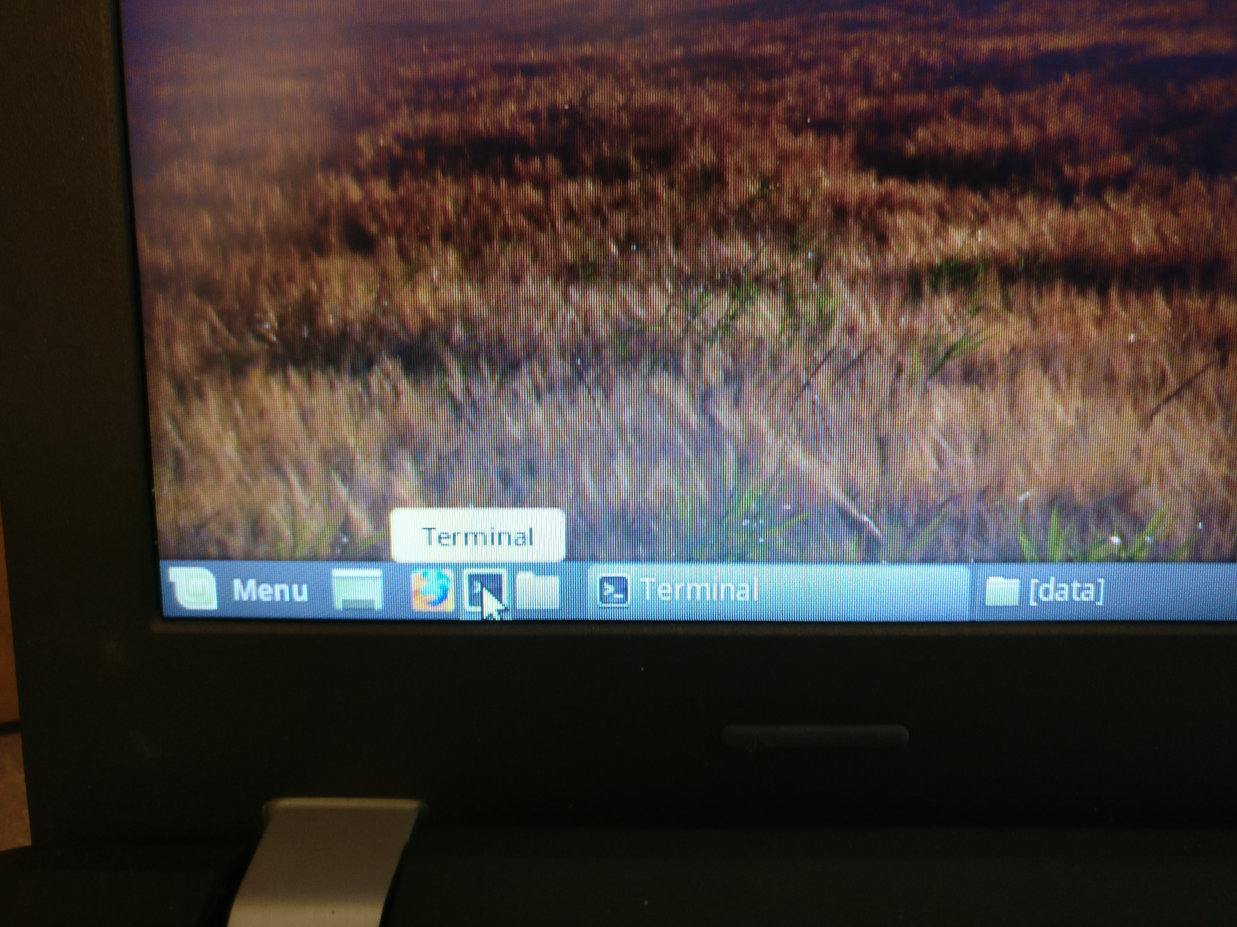
ASPIRE Galaxies and image processing
6(a) We’re going to try out a couple of astropy tools to play around with the data in the FITS files. We are going to use an interactive environment, Jupyter notebooks, for this. Open a terminal:
Notes:
Extra astropy tutorials: http://astropy-tutorials.readthedocs.io/en/latest/

Slide 63
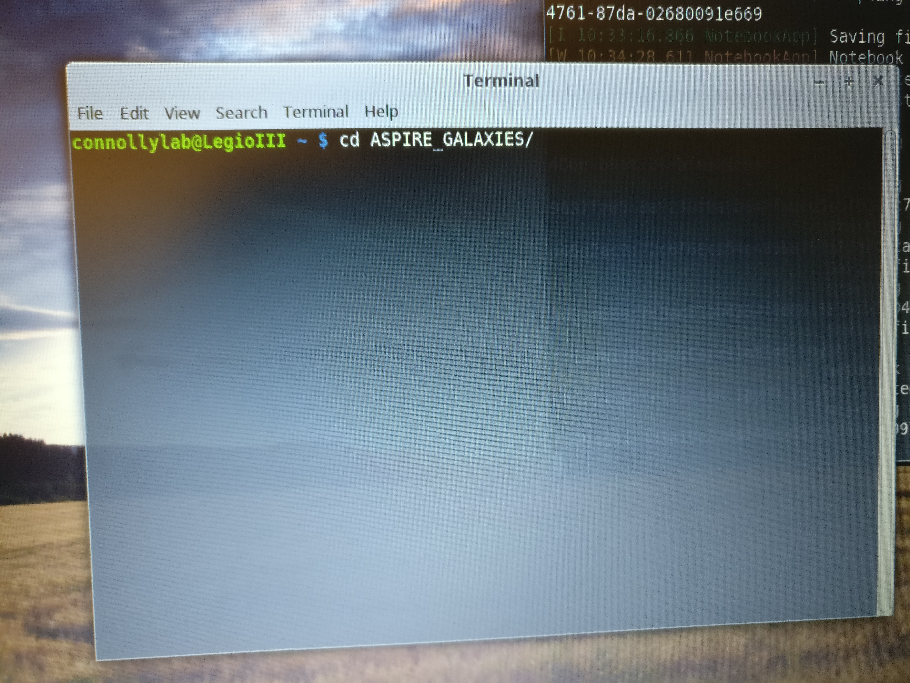
ASPIRE Galaxies and image processing
6(b) Type in “cd ASPIRE_GALAXIES”
This takes you to the directory with all your activities!
Notes:
Extra astropy tutorials: http://astropy-tutorials.readthedocs.io/en/latest/

Slide 64
ASPIRE Galaxies and image processing
6(c) Write in the terminal:
cd code
Then in the terminal, write:
jupyter notebook
This will pop up the interactive browser. If you’re not in the “code” directory, you’ll need to find that directory in the browser that pops up.
Notes:
Extra astropy tutorials: http://astropy-tutorials.readthedocs.io/en/latest/

Slide 65
ASPIRE Galaxies and image processing
6(d) In the browser, open the file called “astropy_image_tutorial_jupyter.ipynb”
You will work through this with the interactive Jupyter framework. Code is organized in “cells”. You can run each “cell” using the “Run” button. Add more cells if you want, change inputs, whatever you want!
If you’re not in the “code” directory, you’ll need to find that directory in the browser that pops up.

Slide 66
7. Use python to manipulate a non-FITS file

Slide 67
ASPIRE Galaxies and image processing
7(a) Of course, most of the time, you take pictures in other formats, not FITS. There are a lot of built-in python tools for manipulating images
In the terminal, write:
jupyter notebook
In the browser, open the file with the name:
images.ipynb

Slide 68
ASPIRE Galaxies and image processing
7(b) This tutorial is lightly edited from https://matplotlib.org/tutorials/introductory/images.html#sphx-glr-tutorials-introductory-images-py
Check out more tutorials here:
https://matplotlib.org/tutorials/index.html
http://www.scipy-lectures.org/advanced/image_processing/

Slide 69
ASPIRE Galaxies and image processing
7(c) Try out the object detection tutorial, which is in a subdirectory of your “code” folder.
This tutorial was written by UC Berkeley computer science graduate student Lisa Anne Hendricks.

Slide 70
8. Turn a graphic into a FITS file

Slide 71
ASPIRE Galaxies and image processing
Take a screenshot with the computer or download a cool graphic of your choice.
Follow the steps here to convert your photo from jpeg format to fits format. https://casaguides.nrao.edu/index.php/Convert_jpg_to_fits
You can also use the split-jpeg-to-fits.ipynb file in your code folder. This makes separate red, green, and blue FITS files.
Play with your new FITS files with any of the tools you’ve already used!
Notes:
https://casaguides.nrao.edu/index.php/Convert_jpg_to_fits

Slide 72
Things you can do at home

Slide 73
ASPIRE Galaxies and image processing
“Mouse around” on the Legacy Survey Sky Viewer tool. Click on the radio buttons to see what the sky looks like with different data sets. (http://legacysurvey.org/viewer#IC%202841)
Click on objects in SDSS Finding Chart (https://skyserver.sdss.org/dr12/en/tools/chart/image.aspx)
You can download SAOImage DS9 (http://ds9.si.edu/site/Download.html)
We used the “anaconda” distribution of python. Download it here :https://anaconda.org/anaconda/python
Astropy tutorials for FITS images: http://astropy-tutorials.readthedocs.io/en/latest/
Image processing using non-astro images: https://matplotlib.org/users/image_tutorial.html
Data from SDSS, space telescopes (like Hubble), and other surveys are public. Google them and download as much as you want!
Notes:
https://casaguides.nrao.edu/index.php/Convert_jpg_to_fits

Slide 74
ASPIRE Galaxies and image processing
If you really liked the image processing technical details, there’s more for you, too!
Check out tutorials on the matplotlib and scipy (scientific coding module for python) websites: http://www.scipy-lectures.org/advanced/image_processing/, https://matplotlib.org/tutorials/index.html
For a lot of “real world” image processing, you want to preserve edges for object identification. The Gaussian smoothing often used for astronomy does NOT cut it. If you want to learn more, try https://www.pyimagesearch.com/2015/04/06/zero-parameter-automatic-canny-edge-detection-with-python-and-opencv/
Edit your photos with science! Take out “uninteresting” parts of your image:https://www.pyimagesearch.com/2017/01/23/seam-carving-with-opencv-python-and-scikit-image/
Learn to code w/python! https://www.codecademy.com/learn/learn-python

