Slide 1
Agroecosystem Resilience:
Regional Integrated Modeling of Farmer Adaptations to Guide Management in a Changing Climate
School of Environment and Natural Resources
Department of Agricultural, Environmental and Development Economics
Byrd Polar and Climate Research Center
Department of Extension
Department of Geography

Slide 2
Agenda
Photo credit: Blanchard Demo Farms
9:30 AM Introductions, Project Overview and Q&A
10:00 AM Climate Projections and Q&A
10:50 AM 10 minute break
11:00 AM Climate Projections Discussion
12:00 PM Lunch
1:00 PM Farmer Survey
2:00 PM Ecosystem Services
2:30 PM Dissemination Plan
3:00 PM Adjourn!!
Photo credit: Midwest Cover Crops Council
Photo credit: Seneca County Conservation District

Slide 3
Introductions
Photo credit: Blanchard Demo Farms
Research Team
  Dr. Robyn Wilson – project director
  Dr. Elena Irwin – land use modeling
  Dr. Aaron Wilson – climate modeling
  Dr. Kaiguang Zhao – services modeling
  Dr. Yongyang Cai – economic modeling
  Greg LaBarge - extension
  Dr. Bryan Mark – State Climatologist
  Dr. Alan Randall – economic modeling
  Jason Cervenec – educ & outreach
  Dr. Kristi Lekies (evaluator)
  Post-docs/GRAs: Emily Sambuco, Mary Doidge, Maggie Beetstra, Ziqian Gong, Brian Cultice, Ziyu Guo
Stakeholder Advisory Team
  Kirk Merritt – Ohio Soybean Council
  Dr. Larry Antosch – Ohio Farm Bureau
  Dr. Dennis Todey – USDA Midwest Climate Hub
  Dr. Carl Zulauf – OSU Emeritus Ag Policy
  Steve Emery – Nutrien Ag Solutions
  Mark Apelt – Becks Hybrid
  John Stark – The Nature Conservancy
  Nate Andre – Andre Farms
  Tadd Nicholson – Ohio Corn & Wheat Growers
  Jeff Goetz – The Andersons
  Rod Mobley – Ag Credit
  Gail Hesse –National Wildlife Federation
  Kevin Elder – Farmer
Photo credit: Midwest Cover Crops Council
Photo credit: Seneca County Conservation District

Slide 4
Background and Rationale
Photo credit: Blanchard Demo Farms
Climate change in the eastern Corn Belt is projected to bring:
  Higher temperatures
  More variable and extreme levels of precipitation
  Longer growing seasons
This will induce agricultural land use and management adaptations
These changes will depend on both the values and goals of the individual farmer as well as the conditions imposed by society at-large
Adaptations at both the individual and the societal level will generate multiple trade-offs, the effects of which are largely unknown
Photo credit: Midwest Cover Crops Council
Photo credit: Seneca County Conservation District

Slide 5
Our Research Questions
Photo credit: Blanchard Demo Farms
How are farmers likely to adapt to these climate-induced risks and uncertainties?
How will these changes in land use and management influence the sustainability and resilience of the agroecosystem?
What policies and programs best balance agricultural production with protection of critical ecosystem services?
Photo credit: Midwest Cover Crops Council
Photo credit: Seneca County Conservation District
Notes:
.

Slide 6
Our Study Goals
Photo credit: Blanchard Demo Farms
To increase the capacity of decision makers in the ECBR to identify adaptive strategies that mitigate the risks posed by climate extremes.
To demonstrate a holistic integrated approach for assessing these policies at a regional scale that can be applied to other agroecosystems.
Photo credit: Midwest Cover Crops Council
Photo credit: Seneca County Conservation District

Slide 7
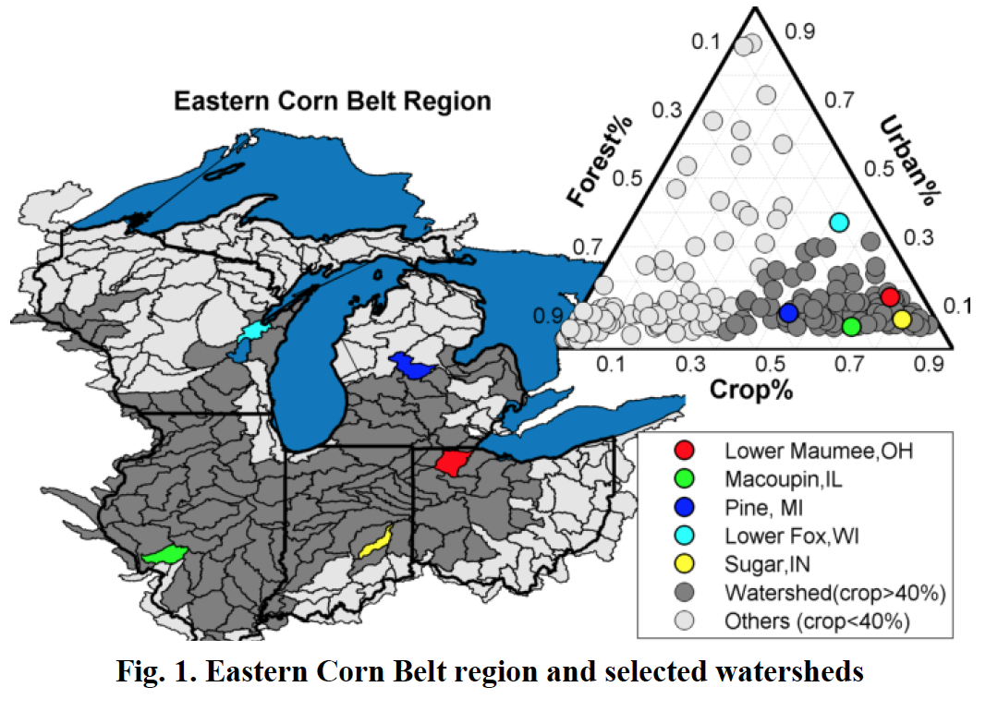
Our Study Area: 40%+ land in crops
Photo credit: Blanchard Demo Farms
Photo credit: Midwest Cover Crops Council
Photo credit: Seneca County Conservation District
Notes:
.

Slide 8
Obj 1: Engage Stakeholders (You!)
Photo credit: Blanchard Demo Farms
Goals: Use participatory processes to improve the usefulness of our models and legitimacy of the policy analysis
Approach: Work with key stakeholder groups to guide our selections for scenario and policy analysis
Outcome: More accurate and familiar modeling framework and set of policy recommendations that are more likely to be applied
Photo credit: Midwest Cover Crops Council
Photo credit: Seneca County Conservation District

Slide 9
Obj 1: Engage Stakeholders (You!)
Photo credit: Blanchard Demo Farms
What have you agreed to?
  Helping build the scenarios we present to farmers
    Identifying what climate-induced changes are most relevant
    Identifying how the human system at-large will respond to climate change
    Identifying the policy scenarios to assess with the integrated model
  Quarterly conference calls, with one of those replaced annually by a one-day, in-person facilitated workshop (late winter)
  Participating in an evaluation process to assess the impact of the engagement process (you received that this morning!)
Photo credit: Midwest Cover Crops Council
Photo credit: Seneca County Conservation District

Slide 10
Obj 2: Develop future climate projections
Photo credit: Blanchard Demo Farms
Goal: To understand the impact of climate variability on ag systems across the ECBR
Approach: Assess and analyze high-resolution climate data, specifically projections of future precipitation and temperature variability for this region, and critically evaluate the particular stresses that might impact ag systems
Outcome: A clearly defined set of scenarios of future climate variability scaled to the ECBR
Photo credit: Midwest Cover Crops Council
Photo credit: Seneca County Conservation District

Slide 11
Obj 3: Identify farmer adaptations
Photo credit: Blanchard Demo Farms
Goal: To model farmer land use/management adaptations to climate variability and broader human system changes
Approach: Specify the relevant set of farmer adaptations under future scenarios using a combo of qualitative, historical and experimental data.
Outcome: A model of the likely adaptations of diverse farmers to climate uncertainty under varying market, policy and technological conditions
Photo credit: Midwest Cover Crops Council
Photo credit: Seneca County Conservation District

Slide 12
Obj 4: Develop regional economic model
Photo credit: Blanchard Demo Farms
Goal: To develop a model that accounts for price feedbacks in simulating land use and management adaptations
Approach: Develop the model without explicit uncertainty and simulate it for a baseline climate scenario, then parameterize it to account for uncertainty and heterogeneous farmer behavior
Outcome: A fully specified model of the regional economy that accounts for spatial heterogeneity and uncertainty, and generates predictions in the allocation of land to different uses and management for future climate scenarios.
Photo credit: Midwest Cover Crops Council
Photo credit: Seneca County Conservation District

Slide 13
Obj 5: Model change in ecosystem services
Photo credit: Blanchard Demo Farms
Goal: Determine the extent to which climate variability and changes in farmer land use/mgmt will impact ecosystem services
Approach: Quantify these impacts using spatially explicit models of farmer land use/mgmt decisions and process-based agroecosystem models
Outcome: An improved understanding of the realistic impacts of climate change on crop production, carbon sequestration, water quality and biophysical climate regulation.
Photo credit: Midwest Cover Crops Council
Photo credit: Seneca County Conservation District

Slide 14
Obj 6: Identify optimal policies
Photo credit: Blanchard Demo Farms
Goal: Find the socially optimal agriculture, energy and conservation policies and programs
Approach: Create a principal-agent model in which the government decides on an ensemble of policies, while farmers and firms choose their optimal decisions (land use transitions, crops, investments)
Outcome: A novel framework that embeds behavioral heterogeneity, land and labor markets, and projected changes in agroecological outcomes into a model that determines the optimal policy ensemble for a given future climate scenario and specified level of uncertainty
Photo credit: Midwest Cover Crops Council
Photo credit: Seneca County Conservation District

Slide 15
Obj 7: Engage farmers & stakeholders
Photo credit: Blanchard Demo Farms
Goal: Make climate variability and climate change adaptation strategies relevant for a diverse set of stakeholders
Approach: In-person and online dissemination of products related to four key outputs: climate trajectories, farmer profiles, agroecosystem impacts and optimal policies
Outcome: Enhanced stakeholder capacity to conduct climate science programming, engage farm clientele, and lobby for more informed policy making
Photo credit: Midwest Cover Crops Council
Photo credit: Seneca County Conservation District

Slide 16
Project Outcomes (at the end of 3 yrs!)
Photo credit: Blanchard Demo Farms
Innovations in the science and art of integrated systems modeling
Increased understanding of the implications of climate variability on the agroecosystem
Increased ability to identify the policies and programs needed to increase sustainability and resilience
Increased stakeholder confidence in his/her ability to adapt to climate-induced risks
Photo credit: Midwest Cover Crops Council
Photo credit: Seneca County Conservation District

Slide 17
Any questions??
Notes:
Any questions?

Slide 18
Climate Projections
Dr. Aaron Wilson
Byrd Polar and Climate Research Center
Department of Extension
Notes:
First of all, a little bit about me. I created a wordle based on the titles of my journal articles just to give you a visual sense of what I focus on in my work. I am a behavioral scientist interested in how people make decisions under risk and uncertainty. I do most of this work in the context of environmental problems – where my focus has been on land and resource management decisions.

Slide 19
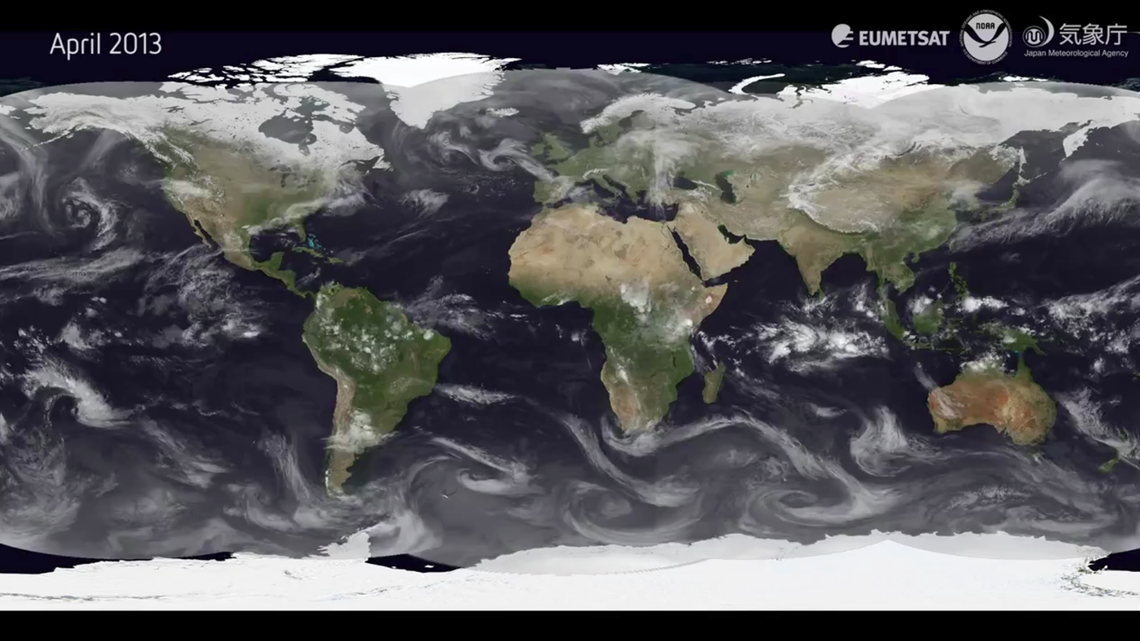
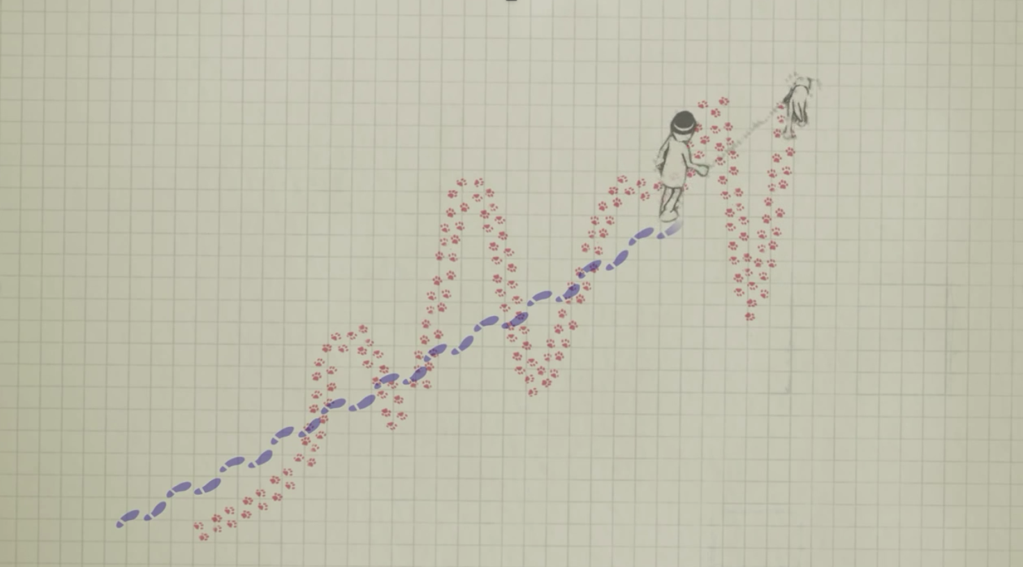
Weather and Climate
Climate: Slower-varying aspects; Averages over longer periods.
Weather: High-frequency; seconds to days variations

Slide 20
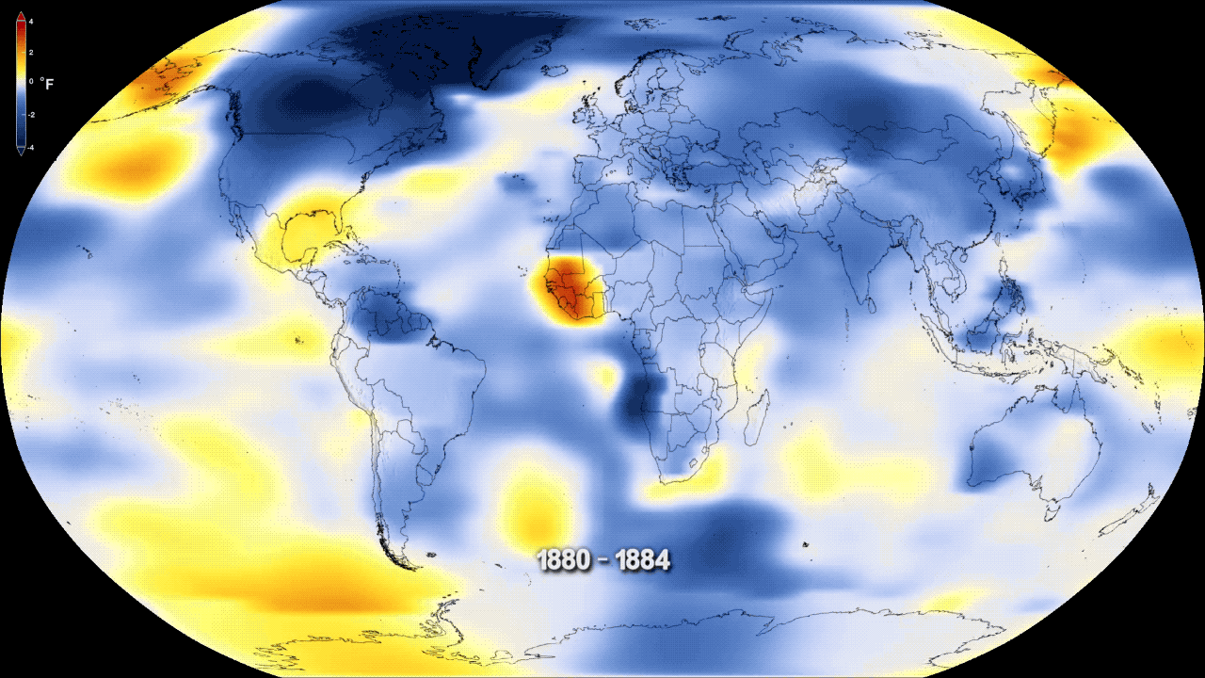

Global Temperatures Have Warmed

Slide 21
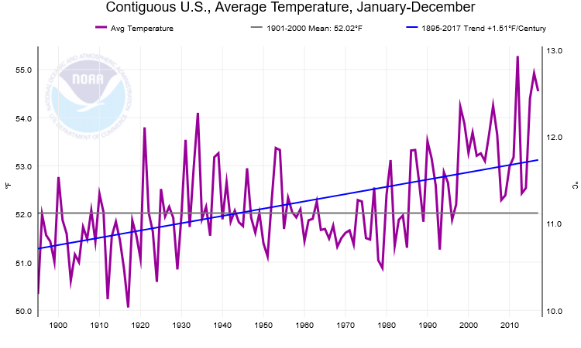
Global Temperatures Have Warmed

Slide 22
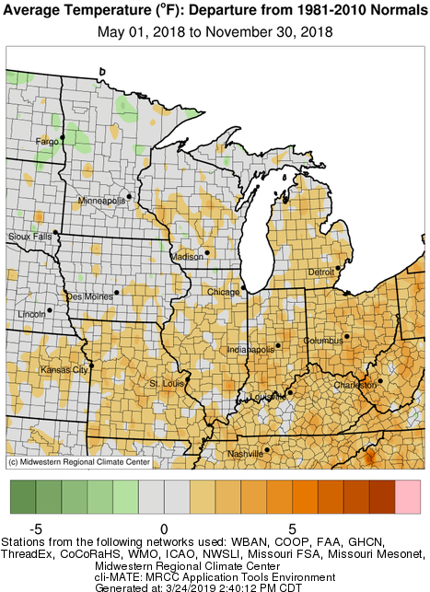
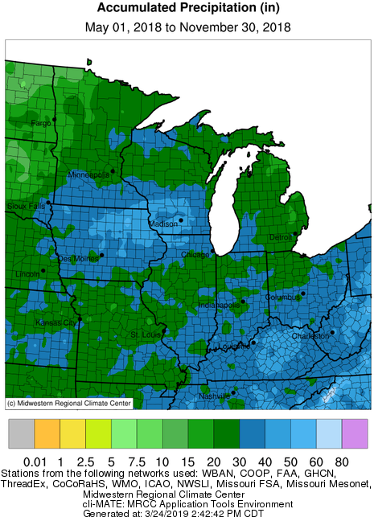
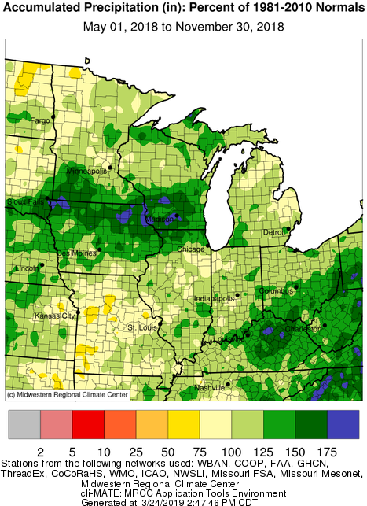
2018 Growing Season Overview

Slide 23
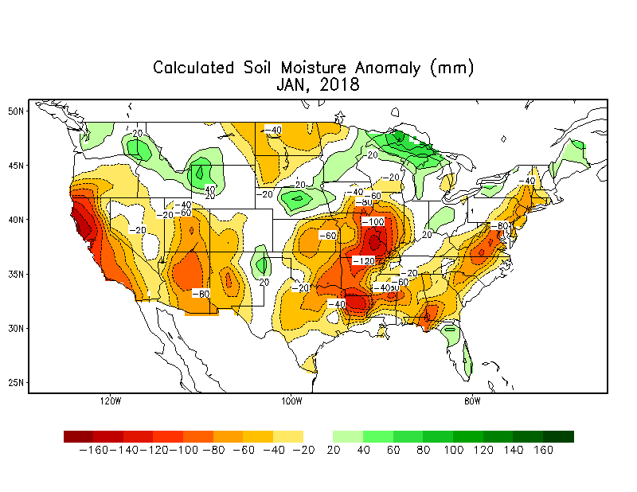

Growing Season Overview: Who Ordered the Water?
https://www.cpc.ncep.noaa.gov/products/Soilmst_Monitoring/US/Soilmst/Soilmst.shtml

Slide 24
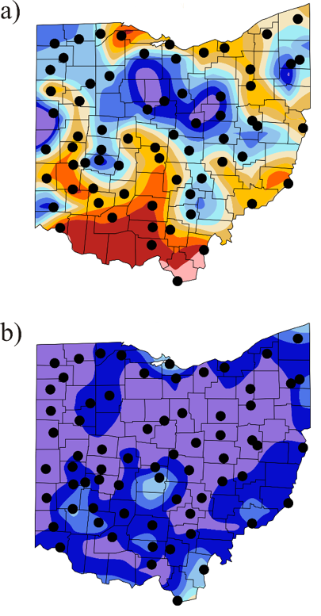

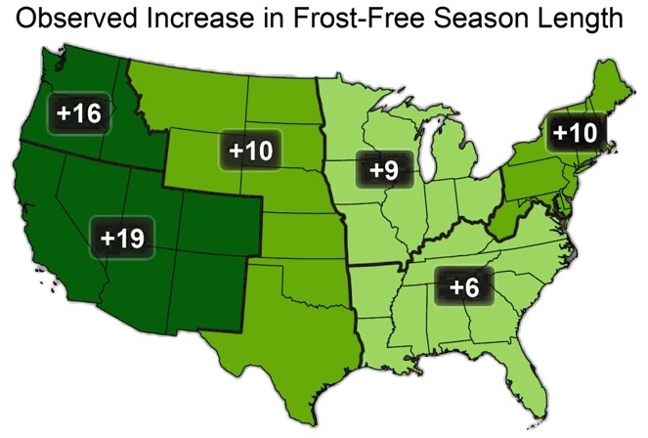
Growing Season Overview: Season Length
Last frost date (32°F): Apr 21 and May 1
First frost date (32°F):Oct 16 and 25
Spatially, the patterns are consistent with the topography and infrastructure of Ohio.
Growing season length
approximately 10 days longer than the long-term median and is consistent with the climate trends
Growing season length defined by the number of days between minimum temperature observations of a) 28°F and b) 32°F. Black dots represent station locations used to spatially interpolate across the state.

Slide 25
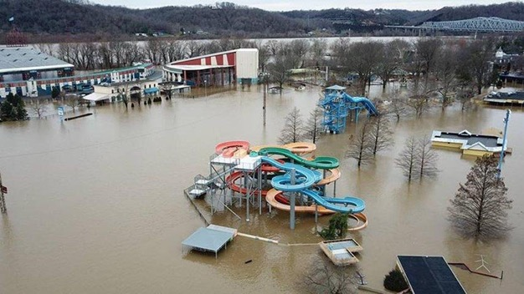
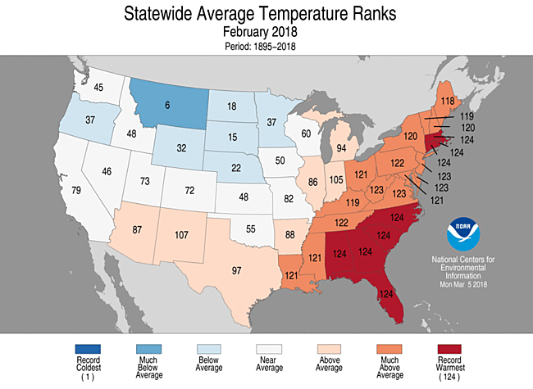
Highlights: A Very Wet and Warm February
Winter of extreme variability: Cold January/Warm February
Cincinnati eclipsed its daily and all-time February record temperature on the 20th at 79°F (other cities as well Akron, Cleveland, Toledo, Youngstown, Mansfield, Columbus, Dayton, Zanesville)
2nd wettest February on record for Ohio: The Ohio River at Cincinnati crested at 60.53 ft. on February 26, 2018 – the highest since 1997
Coney Island flooding in Cincinnati on February 24, 2018. - Brian Lewis

Slide 26
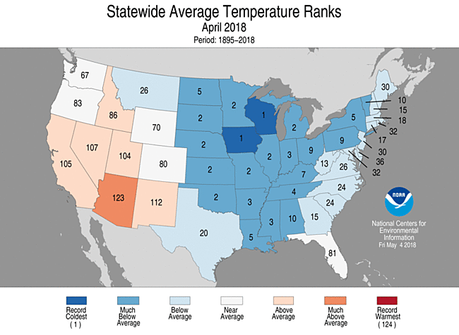
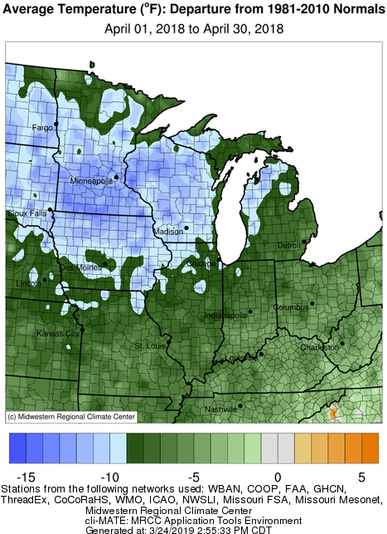
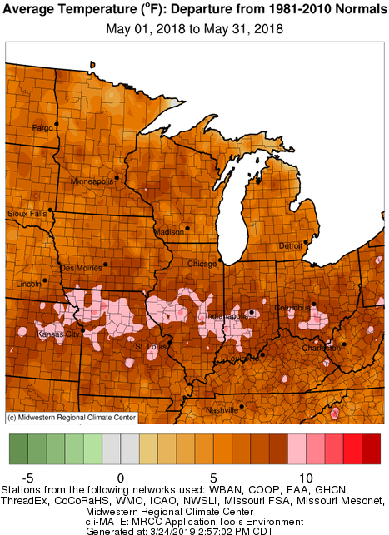
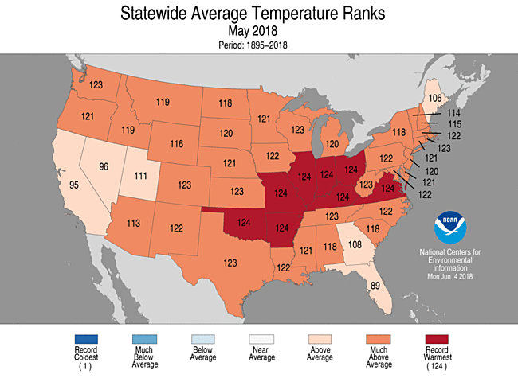
Highlights: A Wild Spring

Slide 27
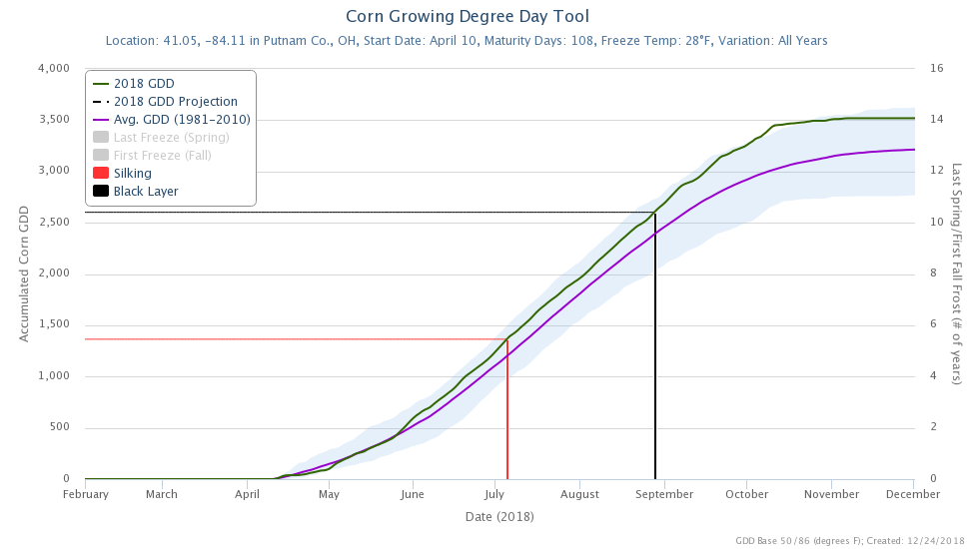
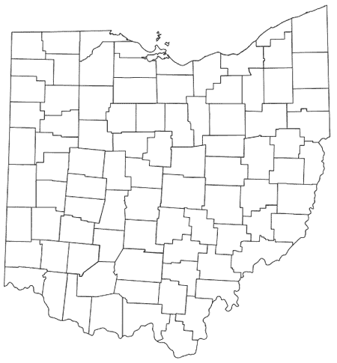
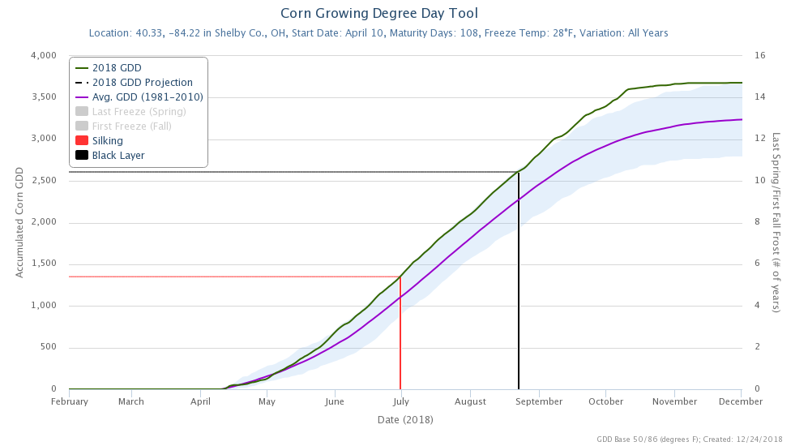
Highlights: GDDs like Whoa!
U2U@MRCC: mrcc/illinois.edu/U2U/gdd/
Thanks to Jim DeGrand

Slide 28
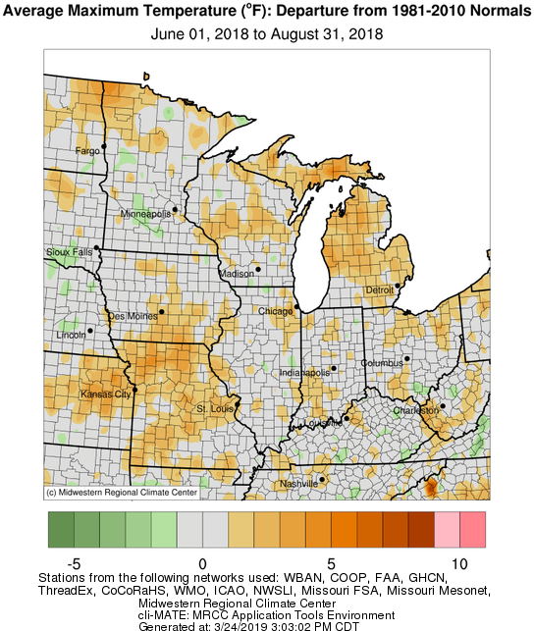
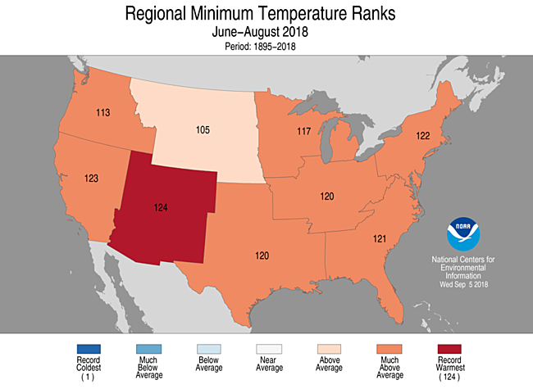
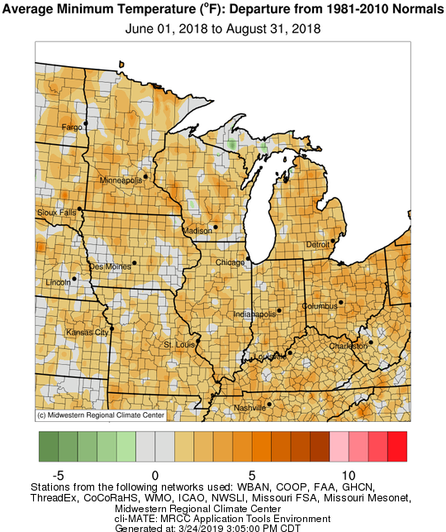
Highlights: Those Warm Summer Nights

Slide 29
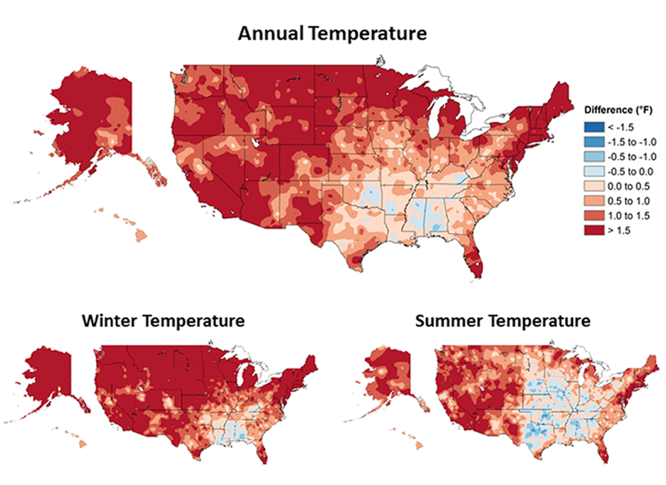
Long-term Temperature Trends
More than 95% of the land surface demonstrated an increase in annual average temperature
Paleoclimate records suggest recent period the warmest in at least the past 1,500 years
Greatest and most widespread in winter
Annual average temperature over the contiguous United States has increased by 1.2°F (0.7°C) for the period 1986–2016 relative to 1901–1960 and by 1.8°F (1.0°C) based on a linear regression for the period 1895–2016: National Climate Assessment CCSR: https://science2017.globalchange.gov/

Slide 30
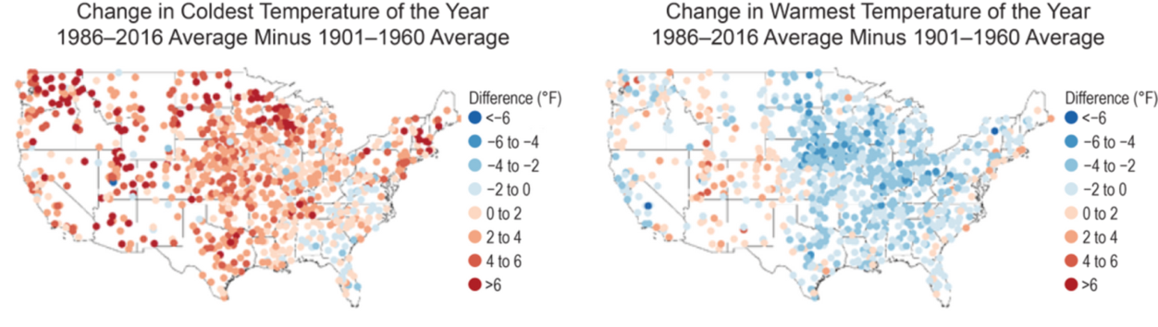
Highlights: Fitting the Temperature Trends
The 1930s Dust Bowl era
Agricultural intensification may have suppressed the hottest extremes in the Midwest. (Muller et al, 2016: Nature Climate Change; Science http://www.sciencemag.org/news/2018/02/america-s-corn-belt-making-its-own-weather)
https://science2017.globalchange.gov/chapter/6/
Maximum (maxT) and minimum (minT) temperature records set in 2018
Location | highest maxT | lowest maxT | Ratio | highest minT | lowest minT | Ratio
Cincinnati | 4 | 2 | 2.00 | 6 | 2 | 3.00
Cleveland | 6 | 0 | > 6.00 | 11 | 0 | > 11.00
Columbus | 1 | 3 | 0.33 | 12 | 0 | > 12.00
Toledo | 5 | 1 | 5.00 | 7 | 0 | > 7.00
Youngstown | 6 | 4 | 1.50 | 9 | 2 | 4.50
Thanks to Jim DeGrand

Slide 31
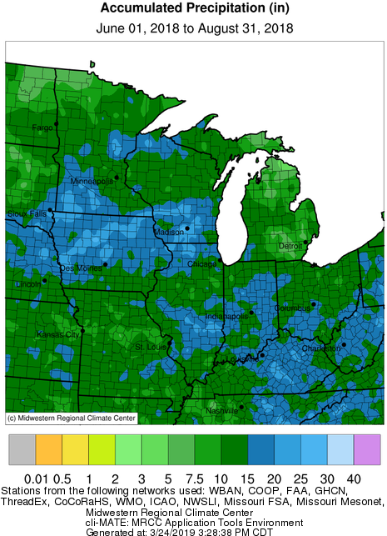
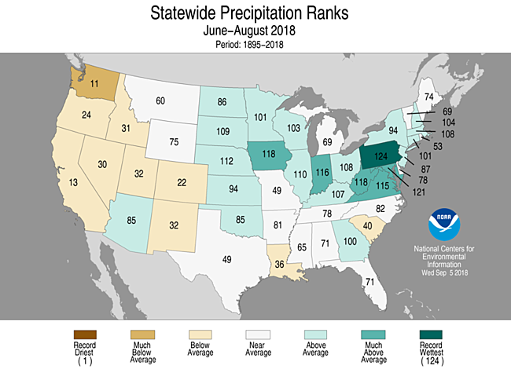
Highlights: Rain Makes Grain

Slide 32
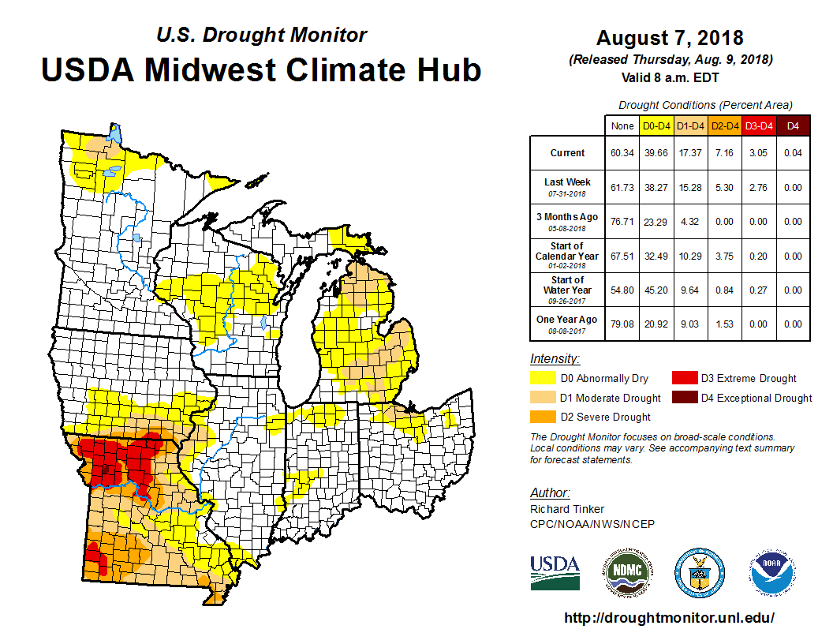
Summer Dryness Extent
Figure: Maximum extent of drought conditions as depicted by the U.S. Drought Monitor on August 7, 2018.

Slide 33
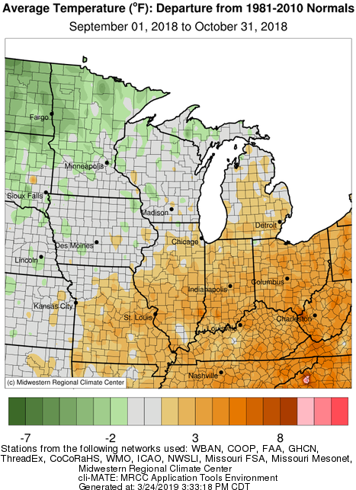
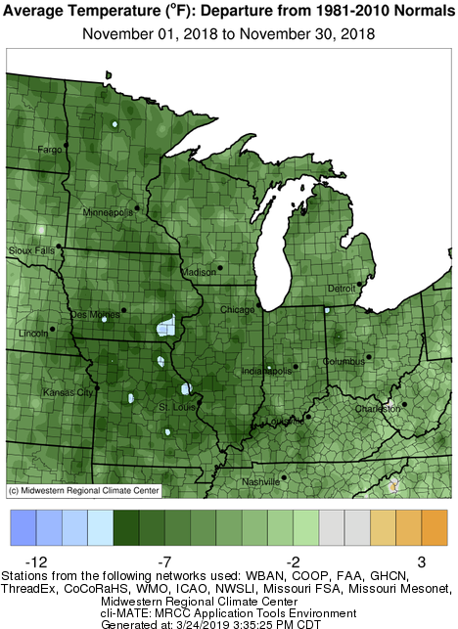
Highlights: Perfect for Harvest?
Extreme monthly variability!
Warm Sep-Oct, with warm overnight lows and high humidity throughout Oct.
Cold, wet November delayed harvest (still many fields across Ohio with crops in the field)

Slide 34
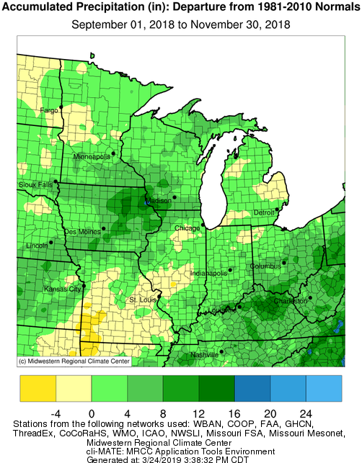
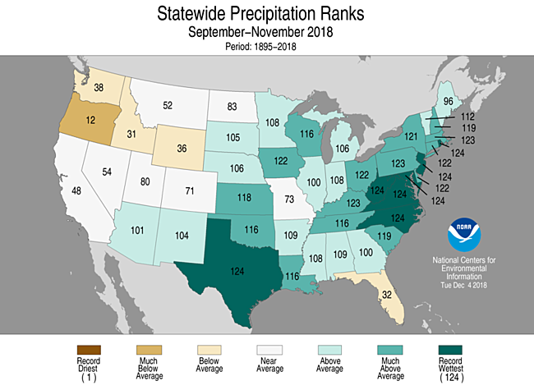
Highlights: Too Much Rainfall

Slide 35
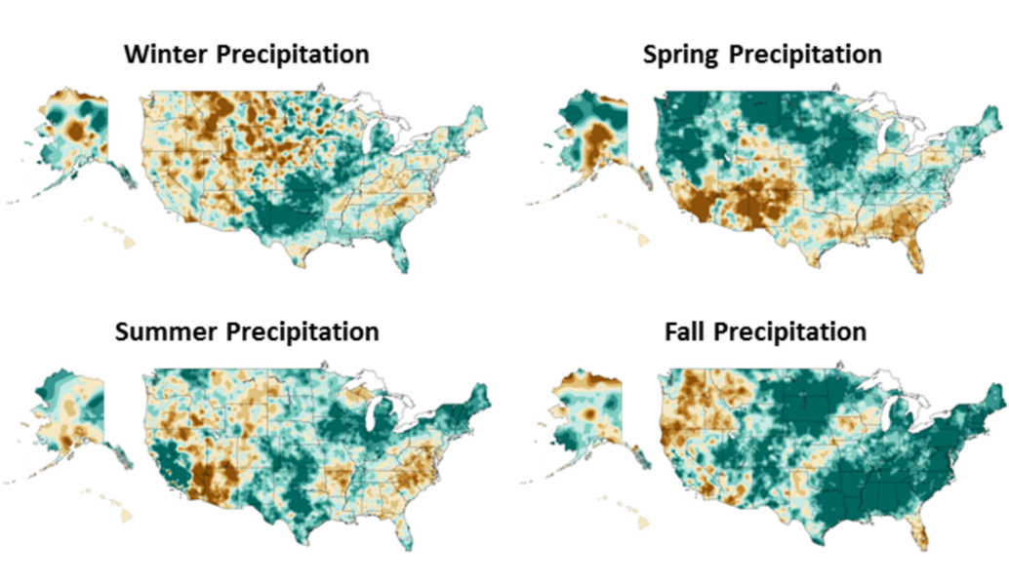
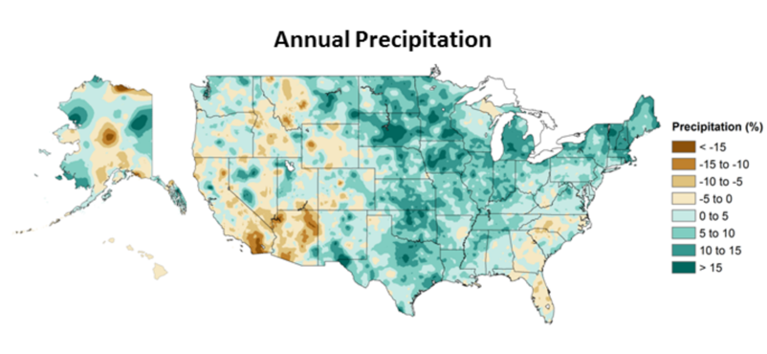
Precipitation Trends: Annual and Seasonal
National Climate Assessment CCSR: https://science2017.globalchange.gov/
National average increase of 4% in annual precipitation since 1901: Ohio: 5-15%
Driven strongly by fall trends (10-15% in some locations)
Regional Spring, Summer, and Fall Trends across Ohio
Increased Intensity of rainfall events

Slide 36
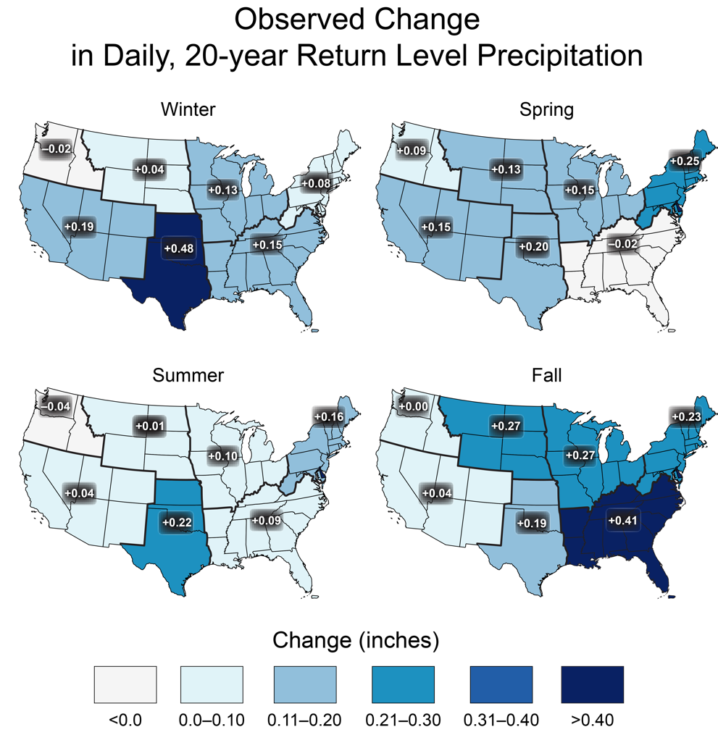
Observed changes in extreme precipitation
Extreme precipitation events are generally observed to increase in intensity by about 6% to 7% for each degree Celsius of temperature increase.
Change in seasonal maximum 1-day precipitation (1948-2015)

Slide 37
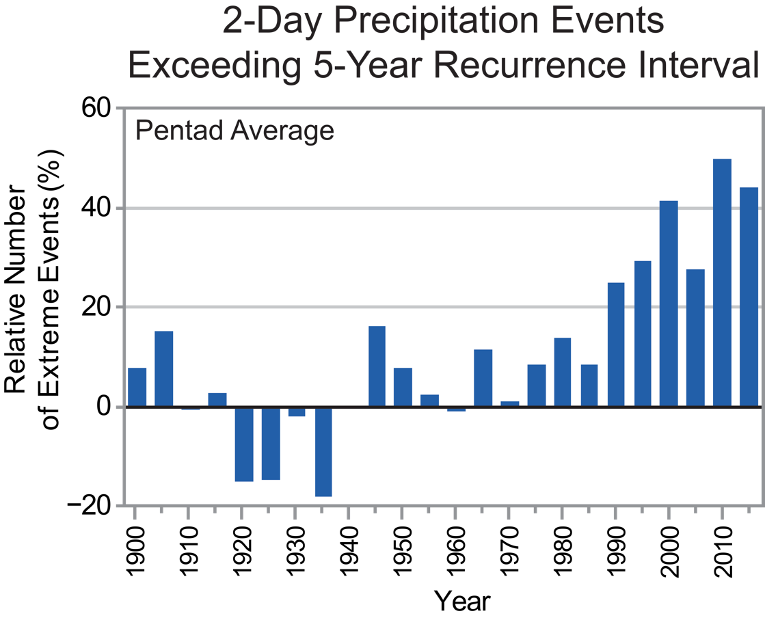
Multiday Events
Number of 2-day precipitation events exceeding the threshold for a 5-year recurrence
Well above average for the last 3 decades
2012 Drought Impact
Index value for 2015 was 80% above the 1901–1960 reference period average (3rd highest value after 1998 and 2008).
Notes:
The values were calculated by first arithmetically averaging the station data for all stations within each 1° by 1° latitude/longitude grid for each year and then averaging over the grid values across the contiguous United States for each year during the period of 1896–2015.

Slide 38
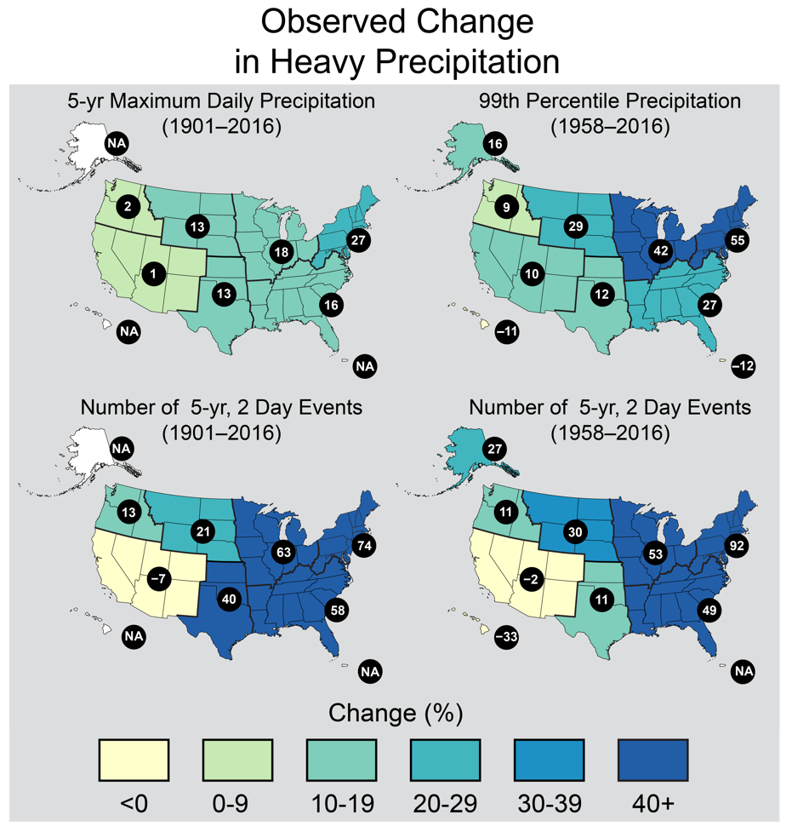
Other Heavy Precipitation Metrics
Maximum daily precipitation totals were calculated for consecutive 5-year blocks from 1901
The total precipitation falling in the top 1% of all days with precipitation

Slide 39
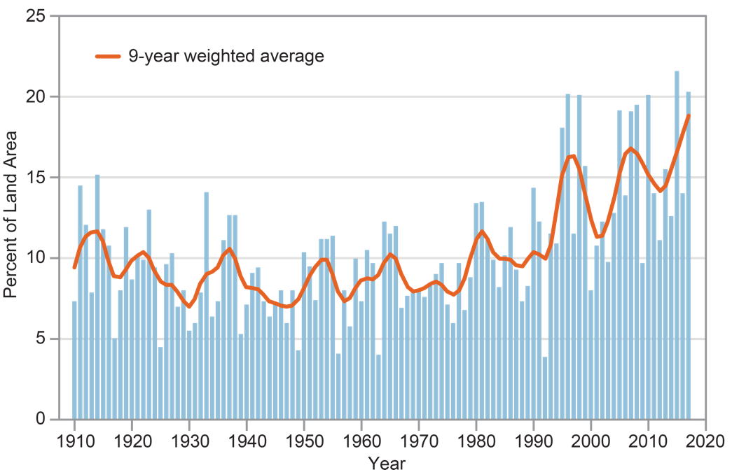
Extreme Precipitation
The figure shows the percent of land area in the contiguous 48 states experiencing extreme one-day precipitation events between 1910 and 2017. These extreme events pose erosion and water quality risks that have increased in recent decades. The bars represent individual years, and the orange line is a nine-year weighted average. Source: adapted from EPA 2016.
https://nca2018.globalchange.gov/chapter/10/

Slide 40
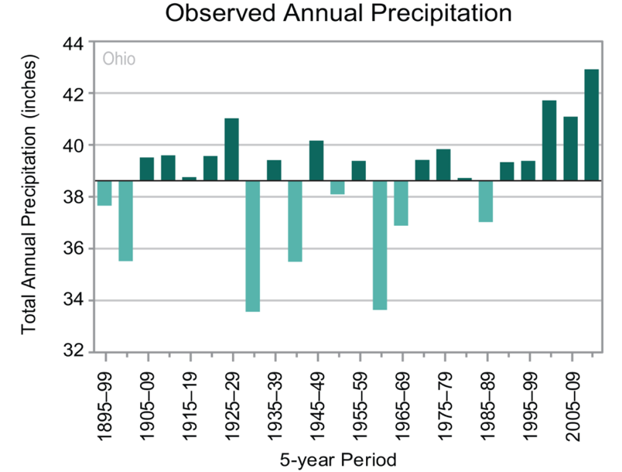
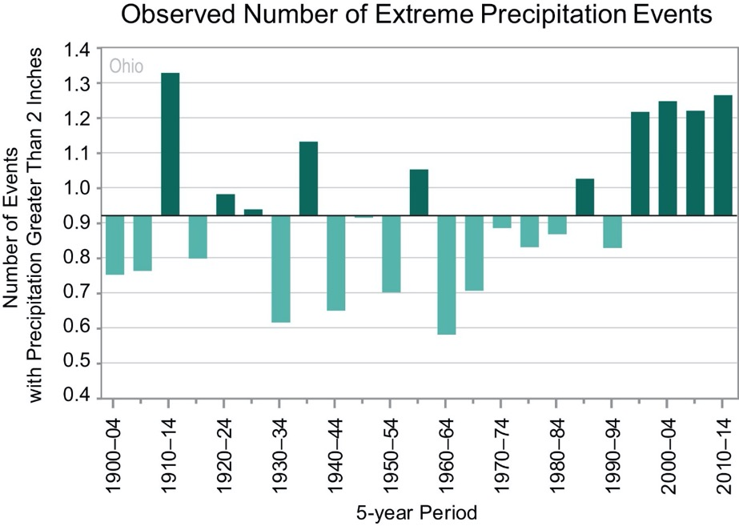

Long-term Precipitation Trends
1913
1937
1959
https://statesummaries.ncics.org/oh

Slide 41
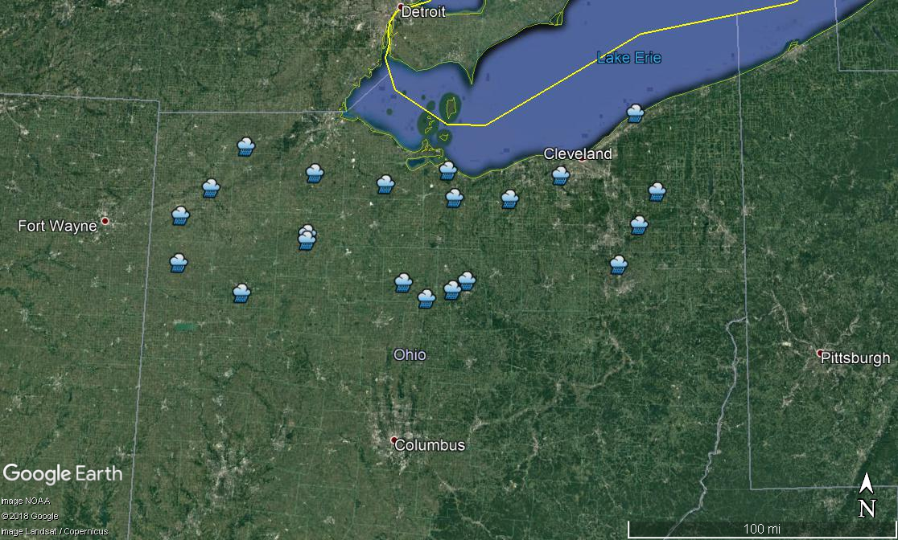
Lake Erie Basin Rainfall (1950-2014)

Slide 42
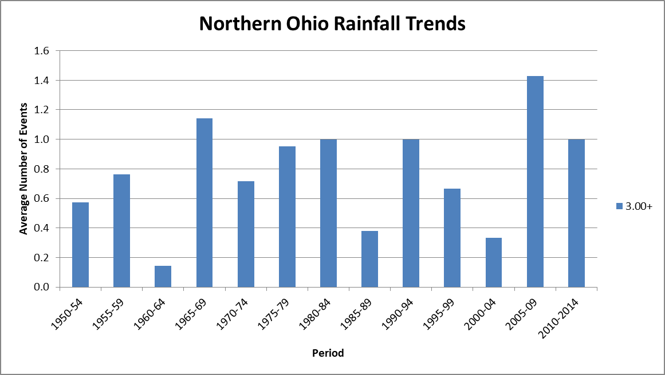
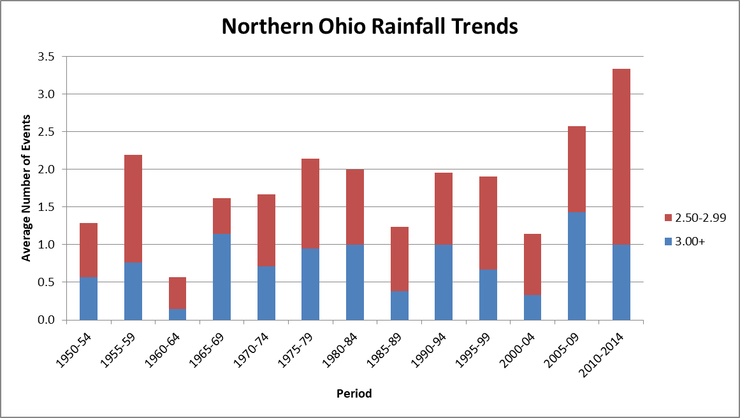
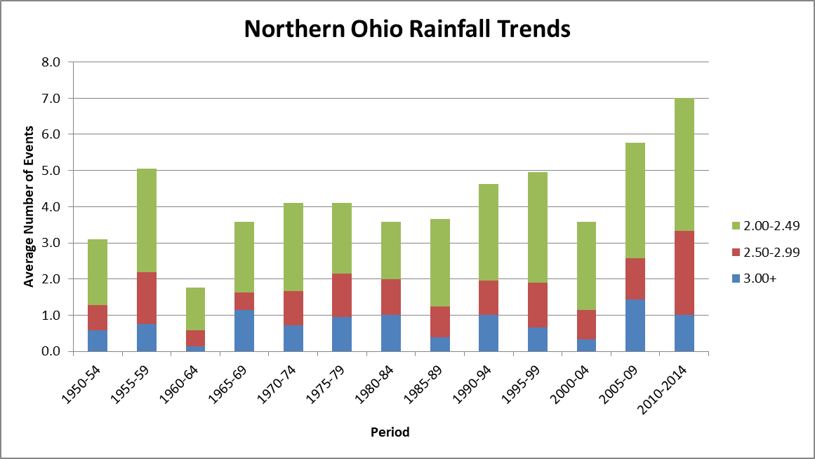
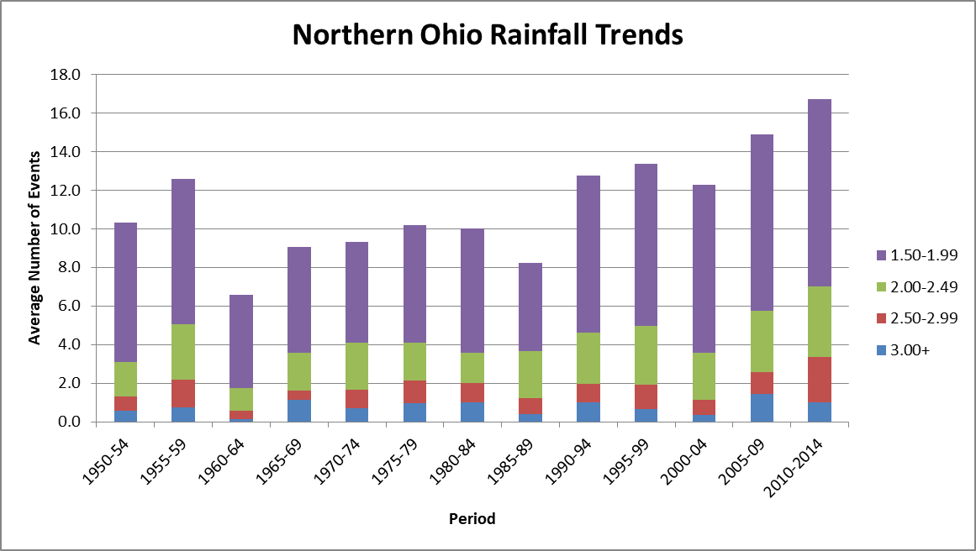
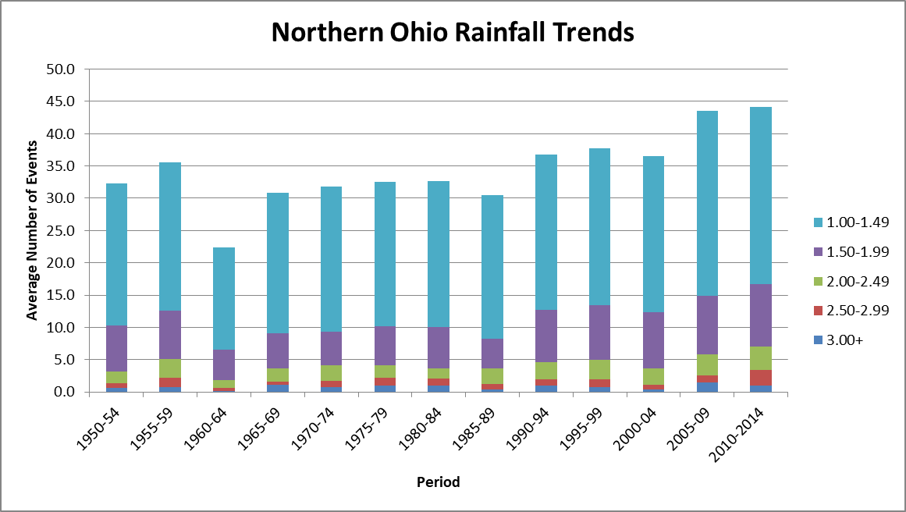
Daily Rainfall Frequencies
Total Number of Events
Data Source: NCEI

Slide 43
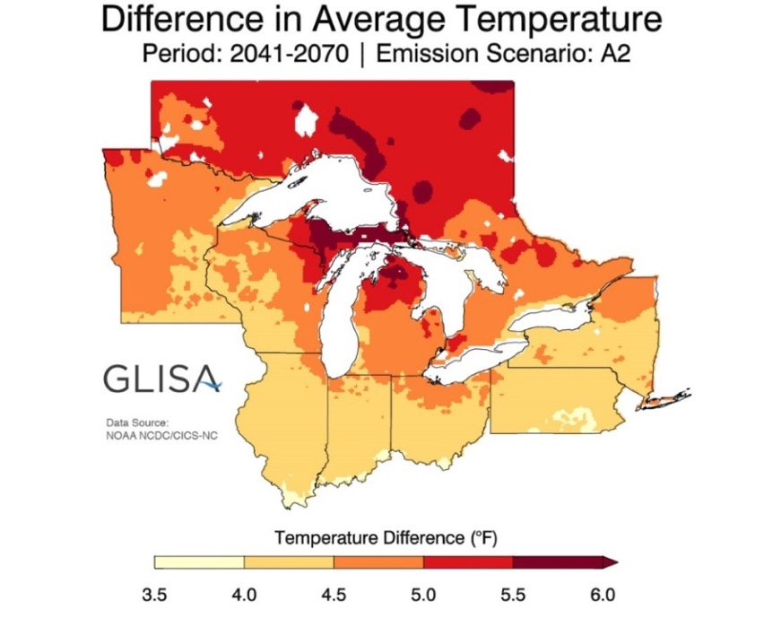
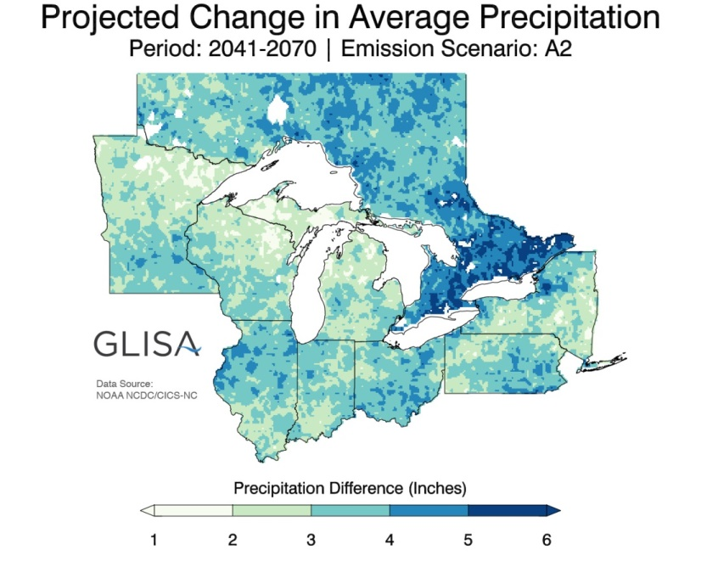
Future Climate

Slide 44
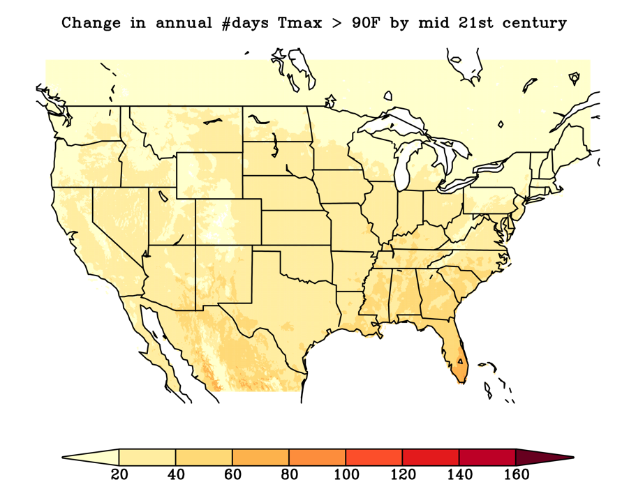
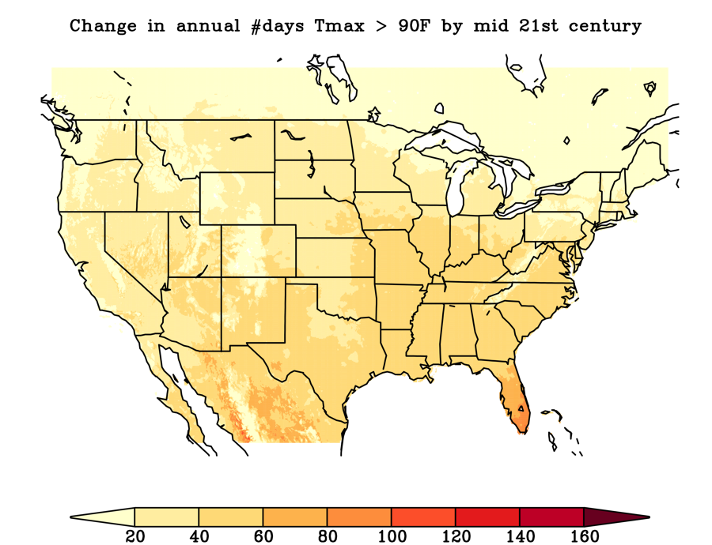
Change in Annual Number of Days > 90°F
Lower Emissions
Higher Emissions
(1976-2005): 20-40 days per year
https://scenarios.globalchange.gov/loca-viewer/

Slide 45


Change in Annual Number of Nights > 75°F
Lower Emissions
Higher Emissions
(1976-2005): <10 days per year
https://scenarios.globalchange.gov/loca-viewer/

Slide 46


Change in Annual Number of Days < 32°F
Lower Emissions
Higher Emissions
Ohio (1976-2005): 80-160 days per year
https://scenarios.globalchange.gov/loca-viewer/

Slide 47


Change in Growing Degree Days (Base 50)
(1976-2005): 2500-4500
https://scenarios.globalchange.gov/loca-viewer/

Slide 48


Change in Mean Annual Days with Precipitation > 2”
Lower Emissions
Higher Emissions
(1976-2005): < 1 day
https://scenarios.globalchange.gov/loca-viewer/

Slide 49

So what if I told you 2018 is our new normal?
Longer Growing Season
Warmer Temperatures (Winter and at Night)
Higher Humidity
More Rainfall
More Intense Rainfall Events
More Autumn Precipitation

Slide 50
Climate Discussion
Photo credit: Blanchard Demo Farms
What can we learn from last year’s weather?
  Key challenges?
  Who struggled the most to deal with the conditions?
  What would you have done differently this past year had you known this was the new norm?
Generally, what challenges have emerged (or may emerge) as a result of a changing climate?
What steps might you take moving forward?
  What actions might a farmer vs. a crop adviser vs. others take?
  What are the costs and benefits of these actions?
Photo credit: Midwest Cover Crops Council
Photo credit: Seneca County Conservation District
Notes:
To that end, in our first project we explored the extent to which different groups of farmers with different motivations and constraints, have already adopted, or will adopt in the future, conservation practices such as subsurface placement and cover crops.

Slide 51
10 minute break
Notes:
Any questions?

Slide 52
Climate Discussion
Photo credit: Blanchard Demo Farms
What can we learn from last year’s weather?
  Key challenges?
  Who struggled the most to deal with the conditions?
  What would you have done differently this past year had you known this was the new norm?
Generally, what challenges have emerged (or may emerge) as a result of a changing climate?
What steps might you take moving forward?
  What actions might a farmer vs. a crop adviser vs. others take?
  What are the costs and benefits of these actions?
Photo credit: Midwest Cover Crops Council
Photo credit: Seneca County Conservation District
Notes:
To that end, in our first project we explored the extent to which different groups of farmers with different motivations and constraints, have already adopted, or will adopt in the future, conservation practices such as subsurface placement and cover crops.

Slide 53
So what are the impacts of more rainfall, more intense events on our conservation practices?
How robust are conservation practices to increased intensity of rainfall?
Practices should provide adequate cover, reduce runoff and promote infiltration as much as possible, ensure soil stability and limit erosion.
Understanding how our local climate is changing is important to building the resilience and conservation desired. What are the pros and how do we take advantage of them?

Slide 54
Temperature Impacts
  Additional (sustained) stress on humans and livestock; Increased need for adequate cooling
  Pollination and grain, fiber, or fruit production sensitive to high temperatures – lower productivity and reduced quality
  Increased weed pressure, insects, and potential disease

Slide 55
Extreme Precipitation Risks (General)
Greater Flood Risk (Increased Frequency of Flooding)
Increased risk (damage to water infrastructure and changing floodplains (roads, floodwalls, dams, electric grid, water intakes, etc.)
Health risks associated with floods (mold, exposure to chemicals and waterborne pathogens, vector control, drinking water and food contamination
Increased transportation issues (major disruptions to local economy, difficult for police and ambulances to respond to emergencies when areas are flooded).
Reduced Water Quality
Intensity means more runoff and potential contamination
Increased need for water treatment due to deteriorated water quality.
Potential for summer droughts and seasonal water shortages, particularly for agricultural and industrial use.

Slide 56
Fieldwork Days for Ohio
Trend = -0.2 days per year
~5 days loss in both April and October since 1995
Data Source: NASS

Slide 57




North Edge of Arcanum: July 6, 2017
Photos Courtesy of Sam Custer/Janelle Brinksneader
Photo courtesy of Ohio DOT: Flooding of I-70 through Licking County in Central Ohio on July 14, 2017

Slide 58
Lunch Break
Reconvene at 1 PM

Slide 59
Farmer Surveys
Dr. Robyn Wilson and Mary Doidge
School of Environment and Natural Resources

Slide 60
Survey Overview
Photo credit: Blanchard Demo Farms
The main goal of the survey is to understand how farmers and landowners are likely to change their farming practices in the face of changing climatic conditions
Design
  Farmers will be asked a suite of questions about how they currently manage their operation
  They will then be presented with a set hypothetical future climate scenarios and asked how the practices used on their farms might change
  Other factors will be controlled for as well…
Photo credit: Midwest Cover Crops Council
Photo credit: Seneca County Conservation District

Slide 61

Photo credit: Blanchard Demo Farms
Photo credit: Midwest Cover Crops Council
Photo credit: Seneca County Conservation District
Notes:
To that end, in our first project we explored the extent to which different groups of farmers with different motivations and constraints, have already adopted, or will adopt in the future, conservation practices such as subsurface placement and cover crops.

Slide 62
Climate Scenario Discussion
Photo credit: Blanchard Demo Farms
Are we likely to get meaningful changes in response to the range of climate futures presented here? (see table on next slide)
What shifts are more important to represent in terms of impacts?
What impacts should be highlighted?
  E.g., What are the BIGGEST problems/opportunities associated with longer growing seasons, more rain, heavier rain events, warmer nights temps, etc. etc?
Photo credit: Midwest Cover Crops Council
Photo credit: Seneca County Conservation District

Slide 63
Variable | Modern Conditions | Low Range | High Range
Air Temperature | 45-60°F (North to South) | +3-5°F | 4-6°F
5-day Max Air Temp. | 90-95°F (100°F South) | +4-6°F | 6-8°F
5-day Min Air Temp. | -10-20°F | +6-8°F | 8-10°F
Days > 95°F | 20-40 days | +20-40 days | +40-60 days
Nights > 75°F | < 10 days | +10-20 days | +10-20 days
Lows < 32°F | 80-160 days | 10-30 fewer days | 20-30 fewer days
Growing Degree Days | 2500-4500 GDDs | +800-1200 GDDs | +1200-1600 GDDs
Frost-Free Season Length | 150-200 days | +10-20 days | +20-30 days
Annual Precipitation | 30-50” per year | 5-10% greater | 10% greater
Extreme Precip. Events | < 2 days per year | 30-60% more frequent | 60-90% more frequent
Based on statistically downscaled models used for the 4th National Climate Assessment (https://scenarios.globalchange.gov/loca-viewer/)
Low Range – Based on assumption of fairly significant reduction in emissions
High Range – Based on assumption of “business as usual” type emissions
All outputs based on mid-21st projections

Slide 64
Adaptation Practice Discussion
Photo credit: Blanchard Demo Farms
What are the likely adaptations that should be included?
  Buying or selling farmland, leaving farming
  Shifting land into other uses (energy, conservation)
  Crop insurance
  Selection of planting dates, double cropping
  Tillage choices (no-till, conservation tillage)
  Choice of crop and seed variety
  Nutrient and pest management strategies
  Diversification (adding livestock, changing crop rotation, seeking off-farm income)
  Investing in irrigation or water storage, also more drainage/tile
  Investing in additional manure storage
  Improving soil health (how???)
  Buying smaller, unmanned equipment
  Hiring more labor
  Participating in PES/conservation program (filter strips, saturated buffers, wetlands, etc)
Photo credit: Midwest Cover Crops Council
Photo credit: Seneca County Conservation District
Notes:
To that end, in our first project we explored the extent to which different groups of farmers with different motivations and constraints, have already adopted, or will adopt in the future, conservation practices such as subsurface placement and cover crops.

Slide 65
Adaptation Practice Discussion
Photo credit: Blanchard Demo Farms
What other drivers of change should be incorporated?
  Changes in temperature/rainfall vs. Market/social/political stresses?
    Commodity prices
    Water quality/carbon credits
    Conservation payments/PES
  How will the cost of land play a role?
Photo credit: Midwest Cover Crops Council
Photo credit: Seneca County Conservation District
Notes:
To that end, in our first project we explored the extent to which different groups of farmers with different motivations and constraints, have already adopted, or will adopt in the future, conservation practices such as subsurface placement and cover crops.

Slide 66
Survey Overview and Discussion
Photo credit: Blanchard Demo Farms
We will also collect information about farm/farmer characteristics
  Physical characteristics of field/farm: Location, slope, size, etc.
  Management characteristics: Current tillage practices, typical rotation, etc.
  Farmer characteristics: Age, experience, education, etc.
  Farmer beliefs: Beliefs about climate impacts, attitude towards conservation, etc.
What specific characteristics are critical to understanding variation in how individual farms/farmers adapt?
  Tenure, “farmer type”, livestock, perception of environmental impacts, attitudes toward policies
Photo credit: Midwest Cover Crops Council
Photo credit: Seneca County Conservation District
Notes:
To that end, in our first project we explored the extent to which different groups of farmers with different motivations and constraints, have already adopted, or will adopt in the future, conservation practices such as subsurface placement and cover crops.

Slide 67
Survey Population and Timeline
Photo credit: Blanchard Demo Farms
Will be sent to farmers and landowners in the Eastern Corn Belt Region, focusing on representative watersheds
  OH, MI, IL, IN, WI
  Sample size TBD
Will develop survey over the summer, and send it out late summer or early fall (i.e., August/September)
  Survey will be administered online and through mailed surveys
Photo credit: Midwest Cover Crops Council
Photo credit: Seneca County Conservation District
Notes:
To that end, in our first project we explored the extent to which different groups of farmers with different motivations and constraints, have already adopted, or will adopt in the future, conservation practices such as subsurface placement and cover crops.

Slide 68
Ecosystem Services
Dr. Kaiguang Zhao
School of Environment and Natural Resources
Notes:
First of all, a little bit about me. I created a wordle based on the titles of my journal articles just to give you a visual sense of what I focus on in my work. I am a behavioral scientist interested in how people make decisions under risk and uncertainty. I do most of this work in the context of environmental problems – where my focus has been on land and resource management decisions.

Slide 69

What are Ecosystem Services (ES)?
Photo credit: Blanchard Demo Farms
What Nature provides us “for free”.
An umbrella term: a “catch-all” phrase.
Four categories
  Supporting: habitat, pollination, soil formation, & photosynthesis
  Provisioning: food, raw materials, water, energy
  Regulating: carbon storage, climate regulation, pest control, water purification
  Cultural: recreational, therapeutic, educational
Photo credit: Midwest Cover Crops Council
Photo credit: Seneca County Conservation District
Notes:
To that end, in our first project we explored the extent to which different groups of farmers with different motivations and constraints, have already adopted, or will adopt in the future, conservation practices such as subsurface placement and cover crops.

Slide 70


Ecosystem Services (ES)– a nascent field
Photo credit: Blanchard Demo Farms
Still poorly defined and hard to operationalize.
What constitutes an ES?
  Context-specific
  Its linkage to ecosystem/health sustainability (more of a process than of an endpoint)
how to define, identify, measure, quantify, valuate, monitor, and manage ES?
Photo credit: Midwest Cover Crops Council
Photo credit: Seneca County Conservation District
Notes:
To that end, in our first project we explored the extent to which different groups of farmers with different motivations and constraints, have already adopted, or will adopt in the future, conservation practices such as subsurface placement and cover crops.

Slide 71


The ecosystem services cascade
Photo credit: Blanchard Demo Farms
a
Photo credit: Midwest Cover Crops Council
Photo credit: Seneca County Conservation District
Notes:
To that end, in our first project we explored the extent to which different groups of farmers with different motivations and constraints, have already adopted, or will adopt in the future, conservation practices such as subsurface placement and cover crops.

Slide 72

Possible approaches to assess ES
Photo credit: Blanchard Demo Farms
Ecosystem Services indicators
  Proxies often used (water yield, acreage cultivated, fish stock, timber biomass)
  Information used to communicate characteristics and trends of ES
  Built upon a set of metrics representing actual states, quantity, processes of biophysical structures/areas
Photo credit: Midwest Cover Crops Council
Photo credit: Seneca County Conservation District
Notes:
To that end, in our first project we explored the extent to which different groups of farmers with different motivations and constraints, have already adopted, or will adopt in the future, conservation practices such as subsurface placement and cover crops.

Slide 73
Possible approaches to assess ES
Photo credit: Blanchard Demo Farms
Ecosystem Services indicators
  Ideally, measuring the complete bundle of the ES cascade
  Practical metrics only measure parts of the cascade
Notes:
To that end, in our first project we explored the extent to which different groups of farmers with different motivations and constraints, have already adopted, or will adopt in the future, conservation practices such as subsurface placement and cover crops.

Slide 74

Emphasis of this project
Photo credit: Blanchard Demo Farms
Ecosystem Services indicators
  Ideally, measuring the complete bundle of the ES cascade
  Practical metrics only measure part of the cascade
Water
Food
Climate
Notes:
To that end, in our first project we explored the extent to which different groups of farmers with different motivations and constraints, have already adopted, or will adopt in the future, conservation practices such as subsurface placement and cover crops.

Slide 75

Food: crop yield/production
Photo credit: Blanchard Demo Farms
Ecosystem Services indicators
  Ideally, measuring the complete bundle of the ES cascade
  Practical metrics only measure part of the cascade
Notes:
To that end, in our first project we explored the extent to which different groups of farmers with different motivations and constraints, have already adopted, or will adopt in the future, conservation practices such as subsurface placement and cover crops.

Slide 76


Water: water quality metrics
Photo credit: Blanchard Demo Farms
Ecosystem Services indicators
  Ideally, measuring the complete bundle of the ES cascade
  Practical metrics only measure part of the cascade
Notes:
To that end, in our first project we explored the extent to which different groups of farmers with different motivations and constraints, have already adopted, or will adopt in the future, conservation practices such as subsurface placement and cover crops.

Slide 77





Climate: soil carbon storage and biophysical climate regulation
Photo credit: Blanchard Demo Farms
Notes:
To that end, in our first project we explored the extent to which different groups of farmers with different motivations and constraints, have already adopted, or will adopt in the future, conservation practices such as subsurface placement and cover crops.

Slide 78


Our approach: Modeling
Photo credit: Blanchard Demo Farms
A modeler’s manifesto
  We can't look into the unknowns, the unmeasured, and the future without models.
Models
  Verbal model
  Conceptual model
  Physical model
  Analytical/mathematical model
  Empirical/Statitsical models
  Artificial Intelligence
  Numerical simulation model (e.g., climate)
Ecosystem Services
Ohio P index
Notes:
To that end, in our first project we explored the extent to which different groups of farmers with different motivations and constraints, have already adopted, or will adopt in the future, conservation practices such as subsurface placement and cover crops.

Slide 79





Our Modeling approach
Photo credit: Blanchard Demo Farms
EPIC is a comphrehensive process-based model built to describe climate-soil-management interactions at point or small watershed scales
  Crops, grasses, trees
  Up to 100 plants
  Up to 12 plant species together
Key processes simulated
  Weather
  Plant growth
    Light use efficiency, PAR
    CO₂ fertilization effect
    Plant stress
  Erosion by wind and water
  Hydrology
  Soil temperature and heat flow
  Carbon, Nitrogen, and Phosphorus cycling
  Tillage
  Plant environment control: fertilizers, irrigation, pesticides
  Pesticide fate
  Economics
EPIC: the Environmental Policy Integrated Climate Model
Solar irradiance
Precipitation
Wind
Plant growth
Operations
Erosion
Runoff
Soil layers
C, N, & P cycling
Pesticide fate
Representative EPIC modules
Notes:
To that end, in our first project we explored the extent to which different groups of farmers with different motivations and constraints, have already adopted, or will adopt in the future, conservation practices such as subsurface placement and cover crops.

Slide 80
SWAT, a watershed model to simulate plant growth, hydrology, soil erosion and nutrient cycling on multiple fields
Routing runoff & sediments (soil, nutrients, pesticides)
Carbon
and nutrient
cycling
Belowground flow

Slide 81
Ecosystem Services Discussion
Photo credit: Blanchard Demo Farms
Questions about the ecosystem services modeling?
How can we best represent/measure changing services in a way that is meaningful to you?
  Water quality = e.g., N and P retention/loading at the watershed scale
  Food production = e.g., yield/acre
  Climate regulation = e.g., land use effects on local temperature/humidity
  Carbon sequestration = e.g., soil organic matter
Photo credit: Midwest Cover Crops Council
Photo credit: Seneca County Conservation District

Slide 82
Dissemination Plan
Dr. Robyn Wilson, Greg LaBarge, Jason Cervenec and Dr. Aaron Wilson
School of Environment and Natural Resources
Byrd Polar and Climate Research Center
Department of Extension

Slide 83
Findings & Products – of greatest interest?
Photo credit: Blanchard Demo Farms
Key findings/outputs throughout the project:
  Project overview
  Climate trajectories
  Farmer profiles – individual or archetypes? What do you want to know?
  Agroecosystem impacts
  Policy scenarios (full integration)
Develop an infographic, video, webinar, and fact sheets (farmers/policy makers) for each output – post to websites
Photo credit: Midwest Cover Crops Council
Photo credit: Seneca County Conservation District

Slide 84
Dissemination – specific ideas?
Photo credit: Blanchard Demo Farms
Extension outlets
Extension newsletters
Train-the-trainers workshop
Local to national policy meetings
Pitch stories to OCJ, Ohio Farmer, etc
Modules for educators
Policy workshop
Photo credit: Midwest Cover Crops Council
Photo credit: Seneca County Conservation District

Slide 85
Thank you!
Project Updates: https://u.osu.edu/agroecosystemresilience/
SAT Stipend: Details to come

