Slide 1
Winter-Type Oilseed Pennycress Staging
Kyle Verhoff, Winthrop Phippen, Nicholas Heller, and Alexander Lindsey
http://dx.doi.org/10.1002/cft2.20165
www.iprefercap.org

Slide 2
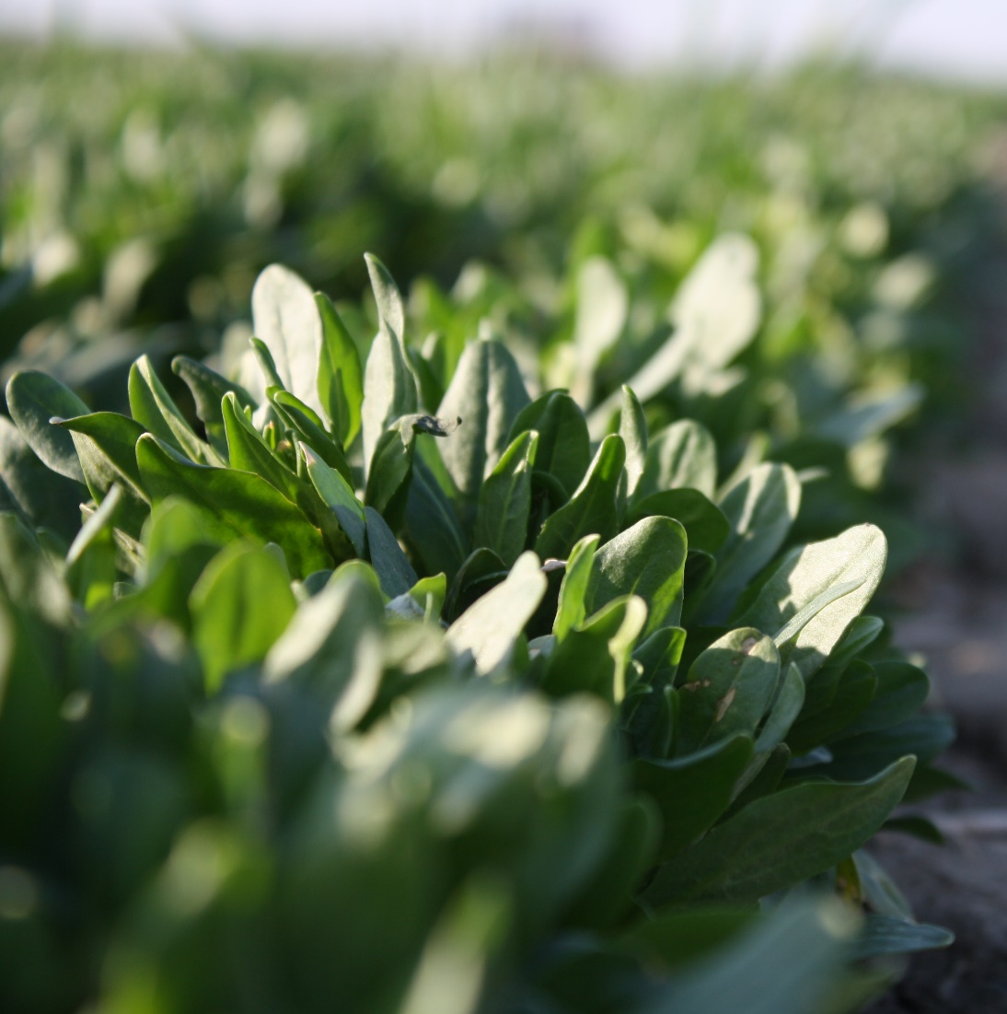
Oilseed Pennycress
New crop for the central Midwest
May have utility in summer annual cropping systems (corn-soybean)
Plant in September-October
Harvest in late-May to early June
Standardized staging process is lacking
Past papers use BBCH method
May be too resolved for production purposes
Developed an adapted staging system that is proposed for use
www.iprefercap.org

Slide 3
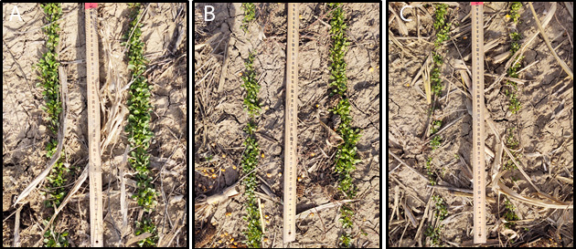
Plant anatomical components
Begins as a vegetative rosette
Established prior to dormancy
Size of rosette is dependent on planting date
Pennycress rosettes formed prior to winter. Earlier planting dates will result in more robust rosettes, showing (A) 15 September, (B) 2 October, and (C) 14 October planting dates in Hoytville, OH in 2020. Images were all collected on 19 November 2020.
www.iprefercap.org

Slide 4
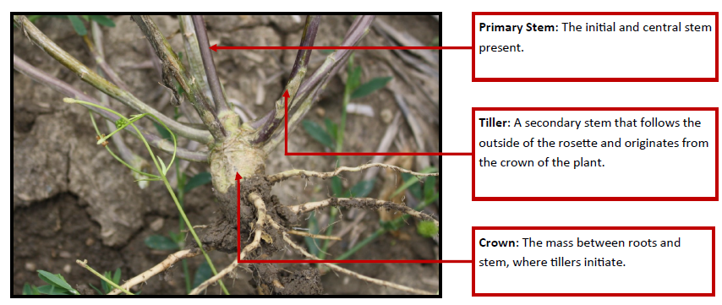
Plant anatomical components
Rosettes overwinter
Resume growth in spring
Produce secondary stems from crown called tillers
www.iprefercap.org

Slide 5
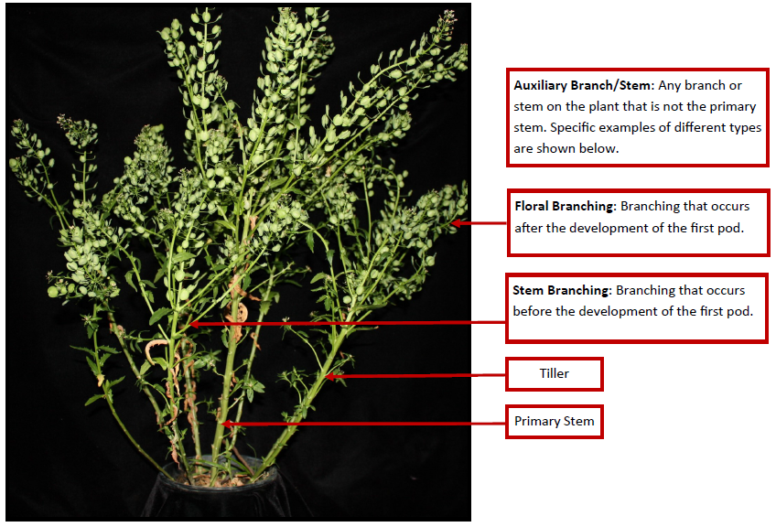
Plant anatomical components
Rosettes overwinter
Resume growth in spring
Produce secondary stems from crown called tillers
Tillers and main stem can experience branching
Amount of branching may be controlled by plant density
Greater densities will branch less
Lower densities branch more
www.iprefercap.org

Slide 6
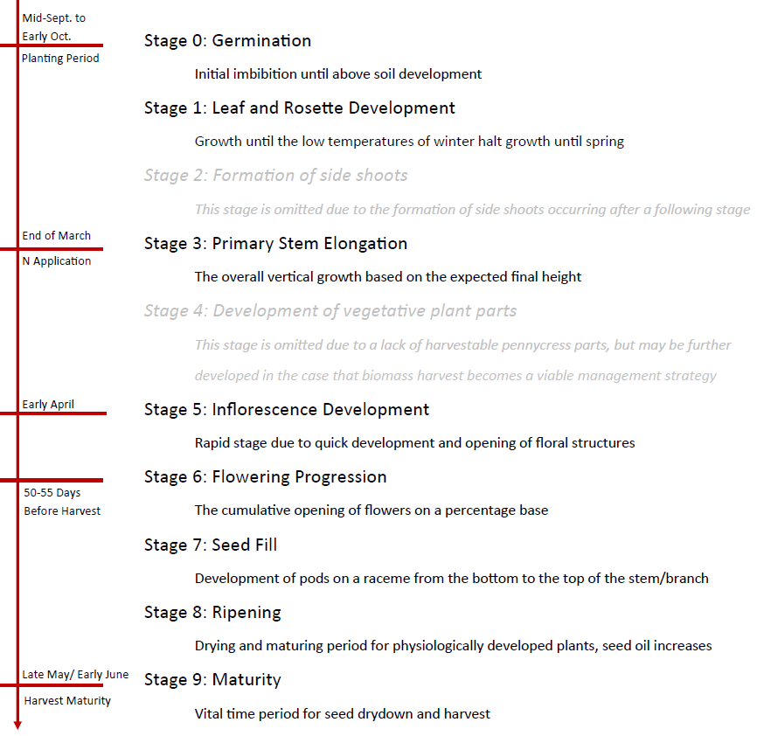
Overall Growth Stage Progression
Approximated calendar dates are for latitudes south of 42 degrees N
Some numerical stages are not included at this point as they occur concurrent with or after a progressing stage
Included as placeholders in the event future varieties exhibit these traits
www.iprefercap.org

Slide 7
Stage 0: Germination
Germination of seed through emergence
0.0 – Dry Seed
Black seed types (wild types)
Golden seed types (some commercial cultivars)
0.5 – Radicle emerged underground
0.7 – Hypocotyl and cotyledons emerged from seed below the soil surface
0.9 – Plant breaking through soil surface (emergence)
Stage 0.0 of golden seed type
Stage 0.9 showing an emerging plant
www.iprefercap.org

Slide 8
Stage 1: Leaf and Rosette Development
Rosette forms initially
Leaves unfurl in pairs
Increase in size depending on planting date
For GDD accumulation use base of 28 °F
Overwinters in this stage
Tillers are not clearly evident until after stem elongation begins
Stage 1.0 unfolded cotyledons
Stage 1.1 first true leaves present
Stage 1.8 eight pairs of leaves present
www.iprefercap.org

Slide 9
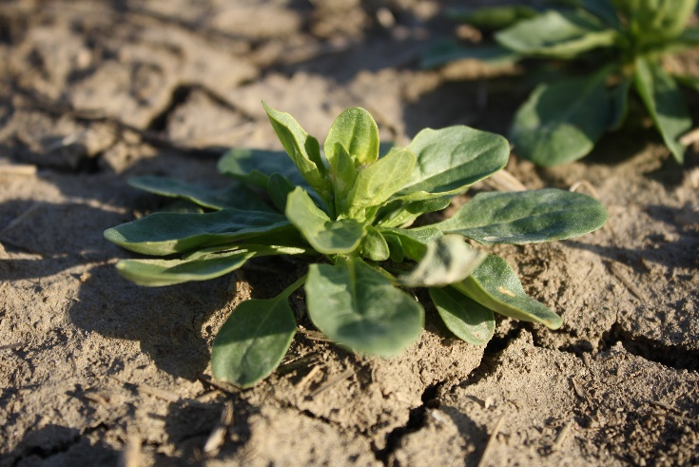
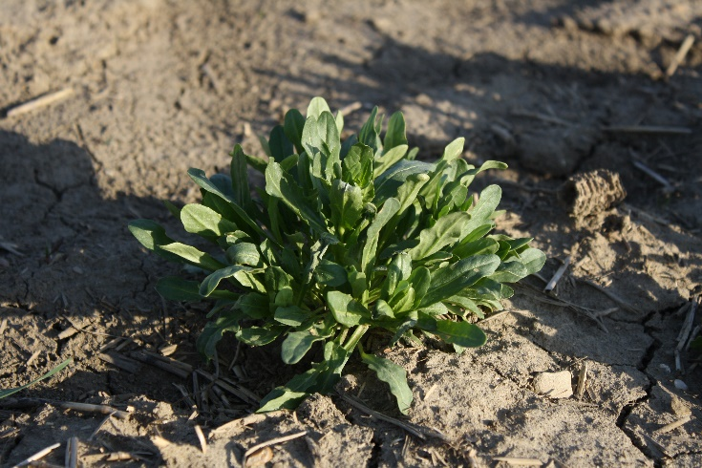
Stage 3: Primary Stem Elongation
Begins in spring when temperatures start to warm
Elongation of main stem occurs first
Tillers elongate as well
Substages set by approximate final height
Can be difficult to stage
Presence of developing flower buds (stage 5) occurs concurrently with stem and tiller elongation
If flower bud formation is delayed in future varieties, Stage 4 may be necessary indicating tiller/secondary stem elongation
Current varieties does not necessitate having stage 4
Stage 3.0 Initial vertical growth of primary stem
Stage 3.2 primary stem is approximately 20% of final height
www.iprefercap.org

Slide 10
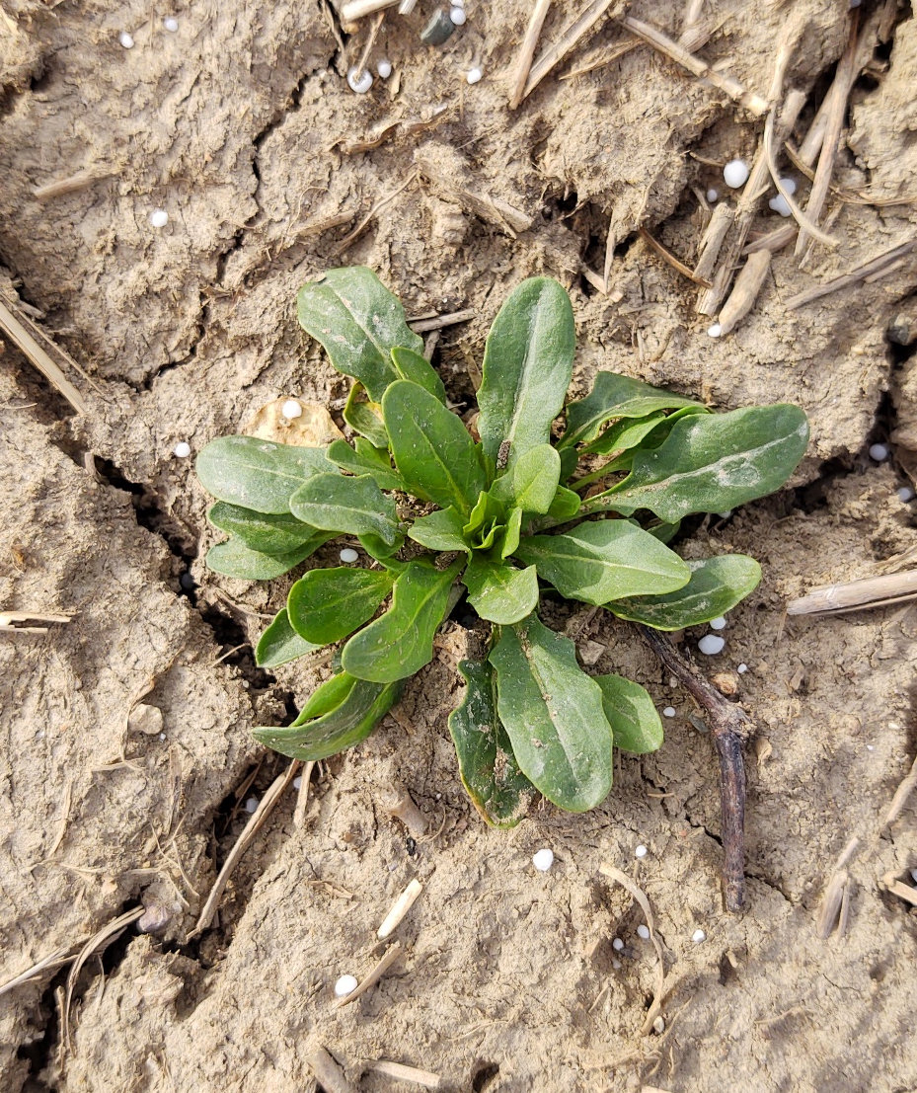
Stage 3: Primary Stem Elongation
Good timing to broadcast fertilizer
N fertilizer use most common/necessary
Soil P and K (if adequate for annual crop production) are sufficient not to limit yield
Future work is needed to better understand P and K removal for managing nutrient budgets into the future
Stage 3.1 pennycress with topdressed ureal prills near the rosette.
www.iprefercap.org

Slide 11
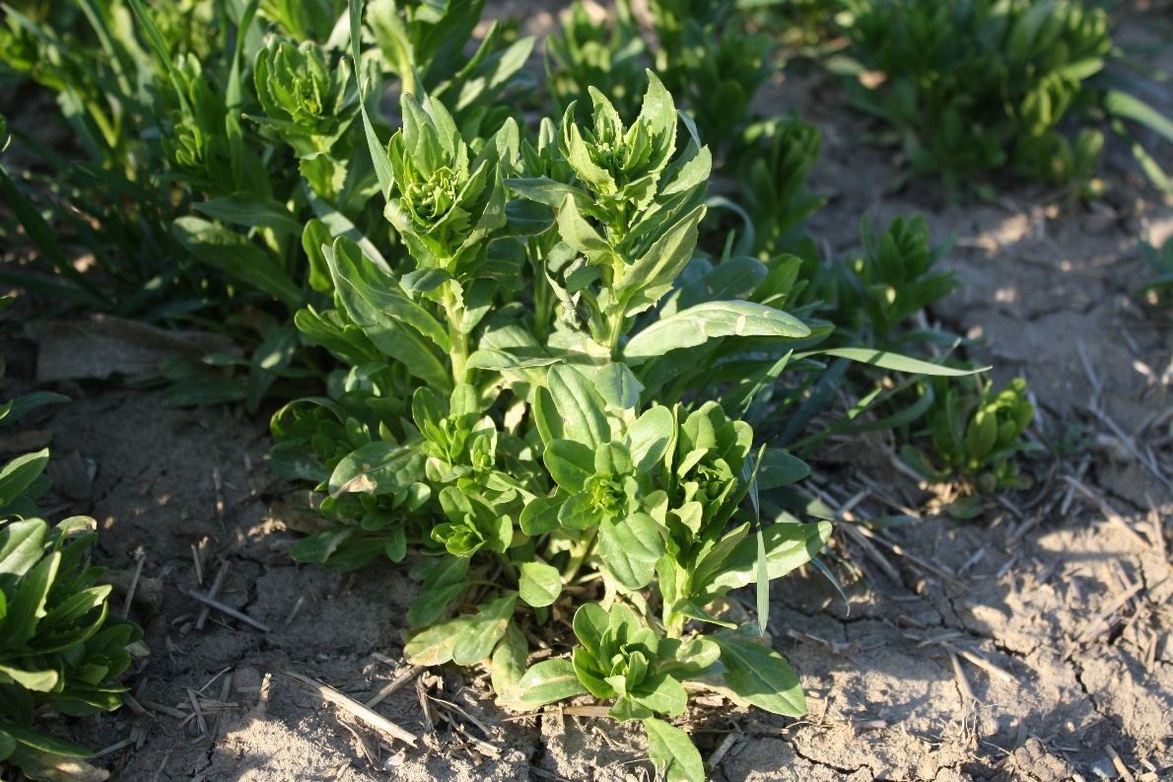
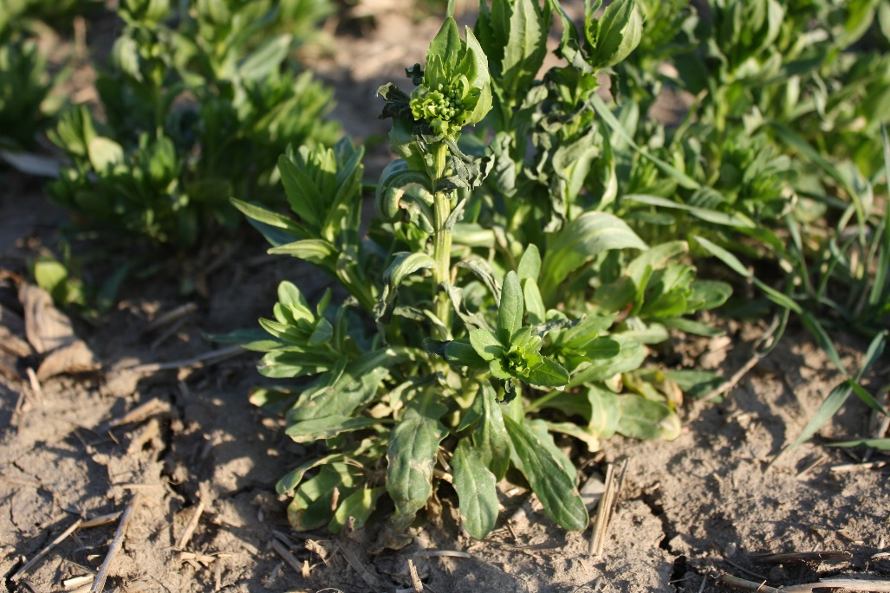
Stage 5: Inflorescence Development
Inflorescence development happens shortly after stem elongation (Stage 3)
Stage 5.0 indicates floral cluster is present but is enclosed by leaves
Substages denote flower buds on auxiliary stems are visible
Stage 5.5 with primary flower buds marked by red and auxiliary flower buds by blue arrows.
Stage 5.3 with primary flower buds marked by red and auxiliary flower buds by blue arrows.
www.iprefercap.org

Slide 12
Stage 6: Flowering Progression
Stage 6.0 shows primary flowers starting to open
Stage 6.5 shows 50% of all flowers (primary and auxiliary stems) open
Approximately 1-2 weeks after first flowers open, depending on variety and environmental conditions
Stage 6.7 shows fruit set starting on main stem
Stage 6.9 has fruit set starting on auxiliary stems
Pennycress at (A) stage 6.0, (B) stage 6.7 and (C) stage 6.9 of flowering progression.
www.iprefercap.org

Slide 13
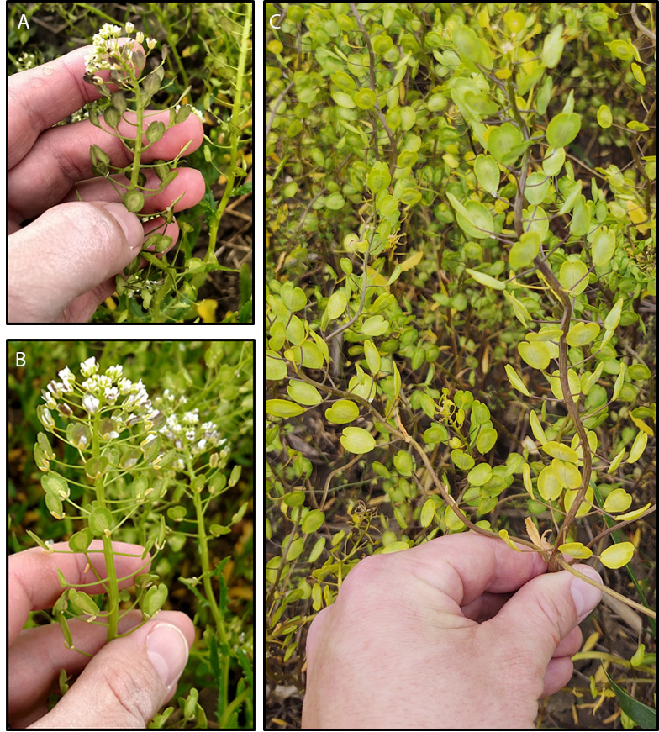
Stage 6: Flowering Progression
Plants can experience cold temperatures during this phase
Common plant responses are purpling of silicles
Stems may become wavy
Rarely are exposed pods terminated by the plant, and does not typically cause yield reductions
www.iprefercap.org

Slide 14
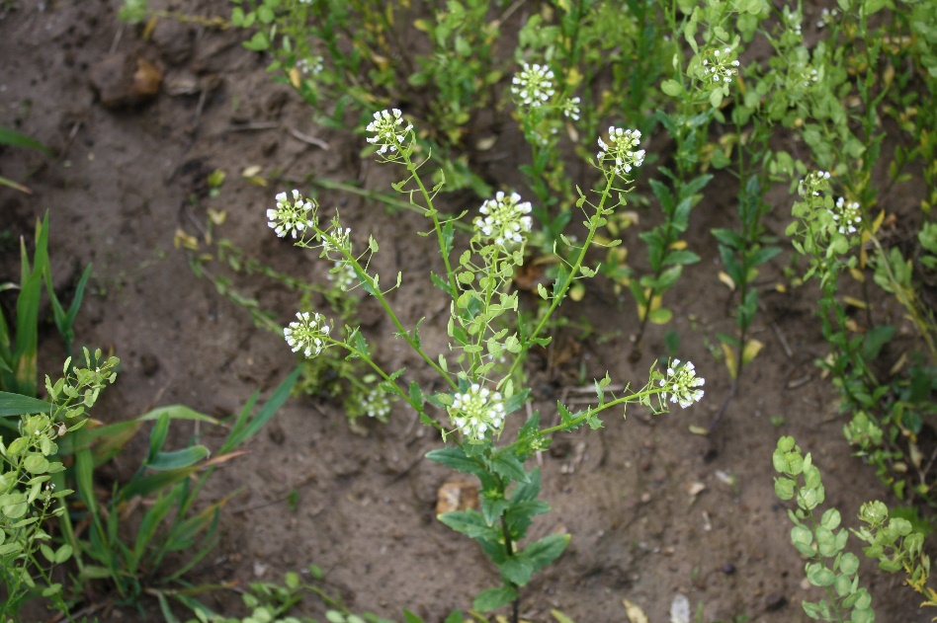
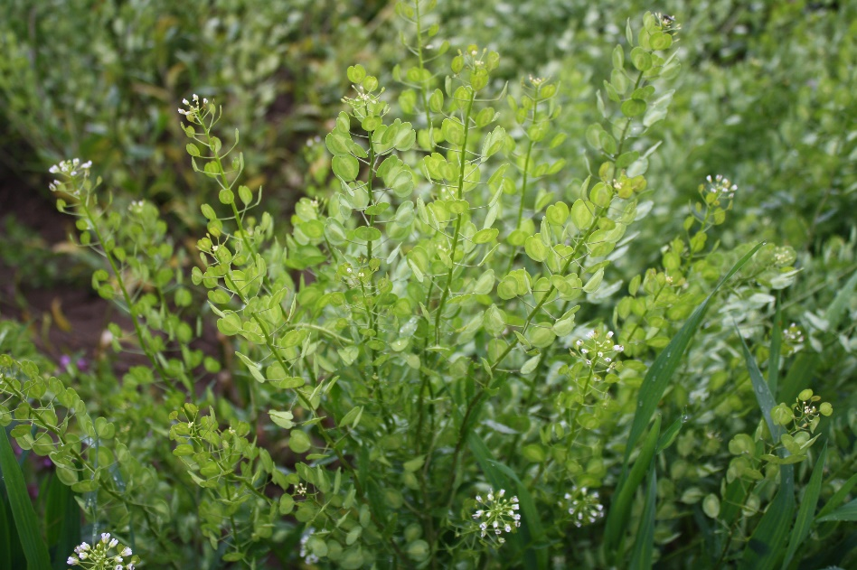
Stage 7: Seed Fill
Stage 7.0 – first pod is filled
Most pods contain between 10-14 seeds
Substages progress based on the percent of pods filled
7.2 = 20% of pods filled
7.8 = 80% of pods filled
Stage 7.1
Stage 7.8
www.iprefercap.org

Slide 15
Stage 8: Ripening
Pods begin to turn yellow in color and ripen
Leaves may senesce and fall off
Seed oil profile goes through substantive changes in this stage
Application of a preharvest dessicant can limit oil yield
Seed maturity is achieved some time between stage 8.4-8.8
Moisture content at maturity (approx. 40%) too high for harvest
www.iprefercap.org

Slide 16
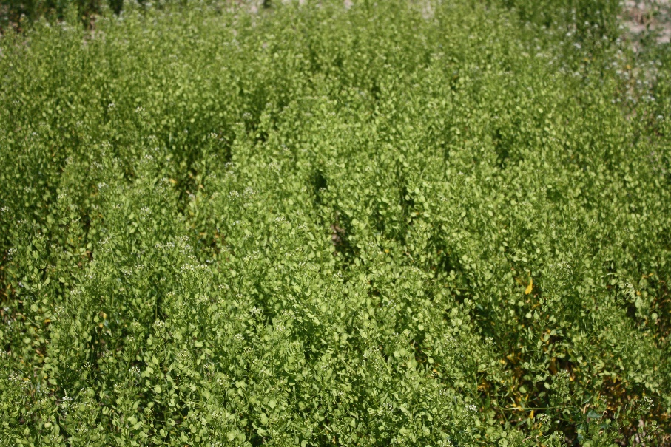
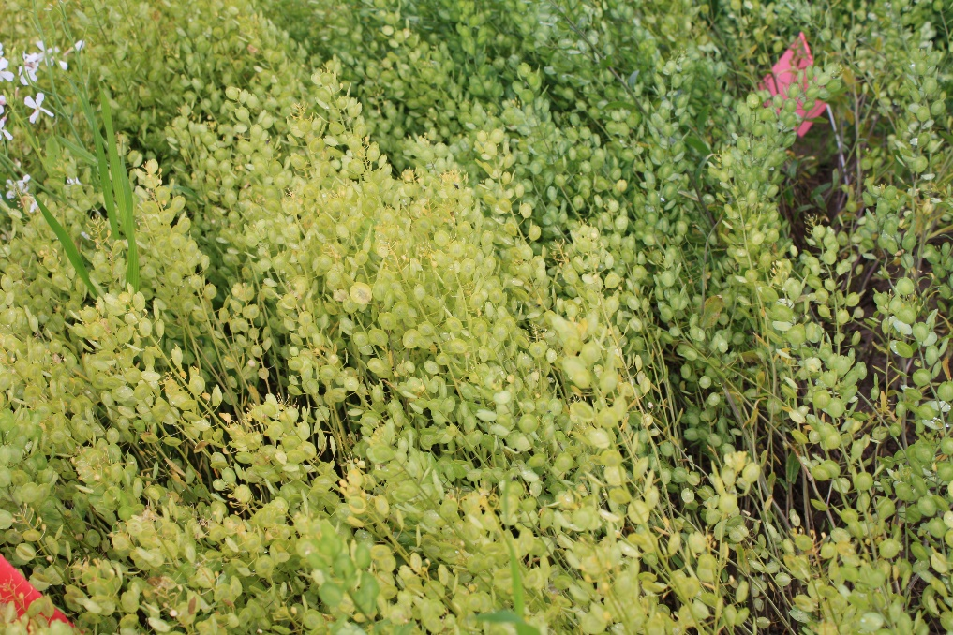
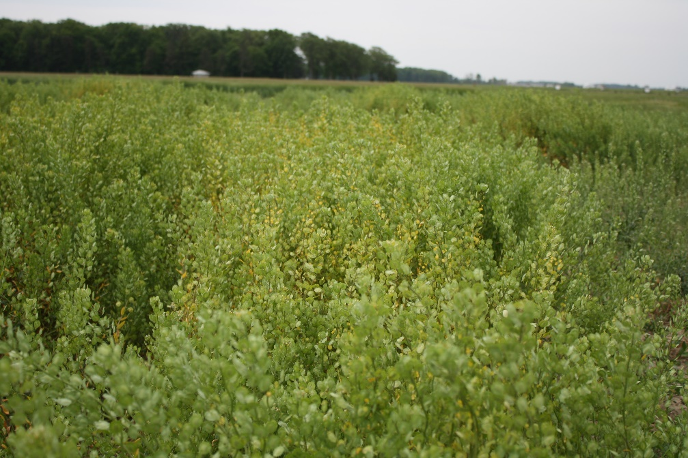
Stage 8: Ripening
Stage 8.1 showing 10% of pods have yellowed
Stage 8.9 showing 90% of pods having yellowed
Stage 8.3 on the left, stage 8.5 shown in the middle of this image
www.iprefercap.org

Slide 17
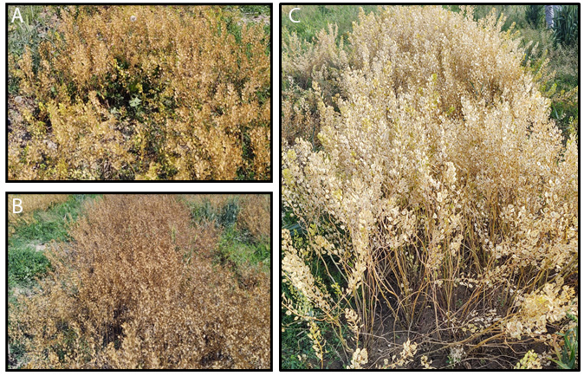
Stage 9: Maturity
Seeds are mature, but not ready to harvest at the beginning (Stage 9.0)
Stage 9.7 indicates pods have achieved mature pod color
Brown, tan or gray
Depends on environment and variety
Seed losses can occur if harvest is delayed after this stage
Pennycress at (A) stage 9.0 and (B-C) stage 9.7 of maturity.
www.iprefercap.org

Slide 18
Author Institutions
Adapted from Verhoff, Phippen, Heller, and Lindsey. 2022. Winter-Type Oilseed Pennycress Crop Staging Guide. Crop, Forage and Turfgrass Management. http://dx.doi.org/10.1002/cft2.20165
www.iprefercap.org

