Slide 1
Ecosystem Dynamics

Slide 2
Focus Questions
How much does a bushel of corn weigh?
What is the optimum seeding rate for corn in Ohio?
What is a seedbank?

Slide 3
Bushel and Acre
Bushel – A measure of grain used in agriculture that corresponds to a specific weight
  1 bushel of corn = 56 pounds
  1 bushel of soybeans = 60 pounds
Acre – a measure of land area used in agriculture
  1 acre = 43,560 ft²
  1 acre is roughly the area of 1 football field

Slide 4
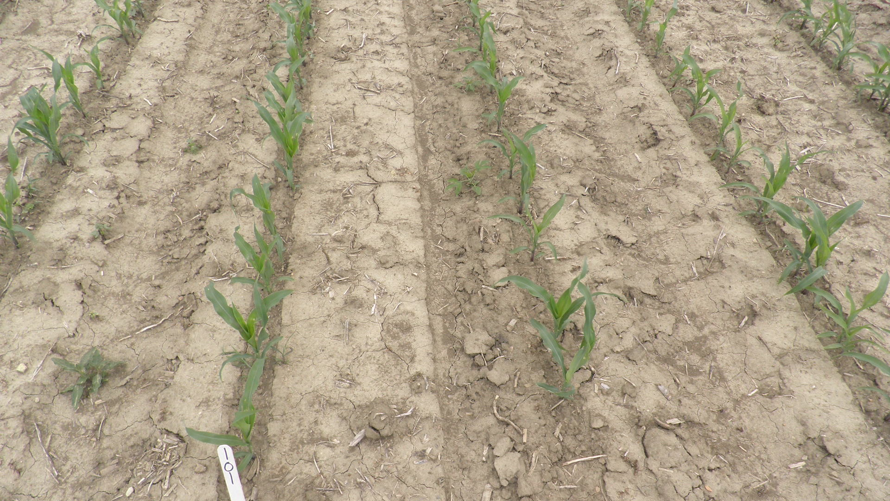
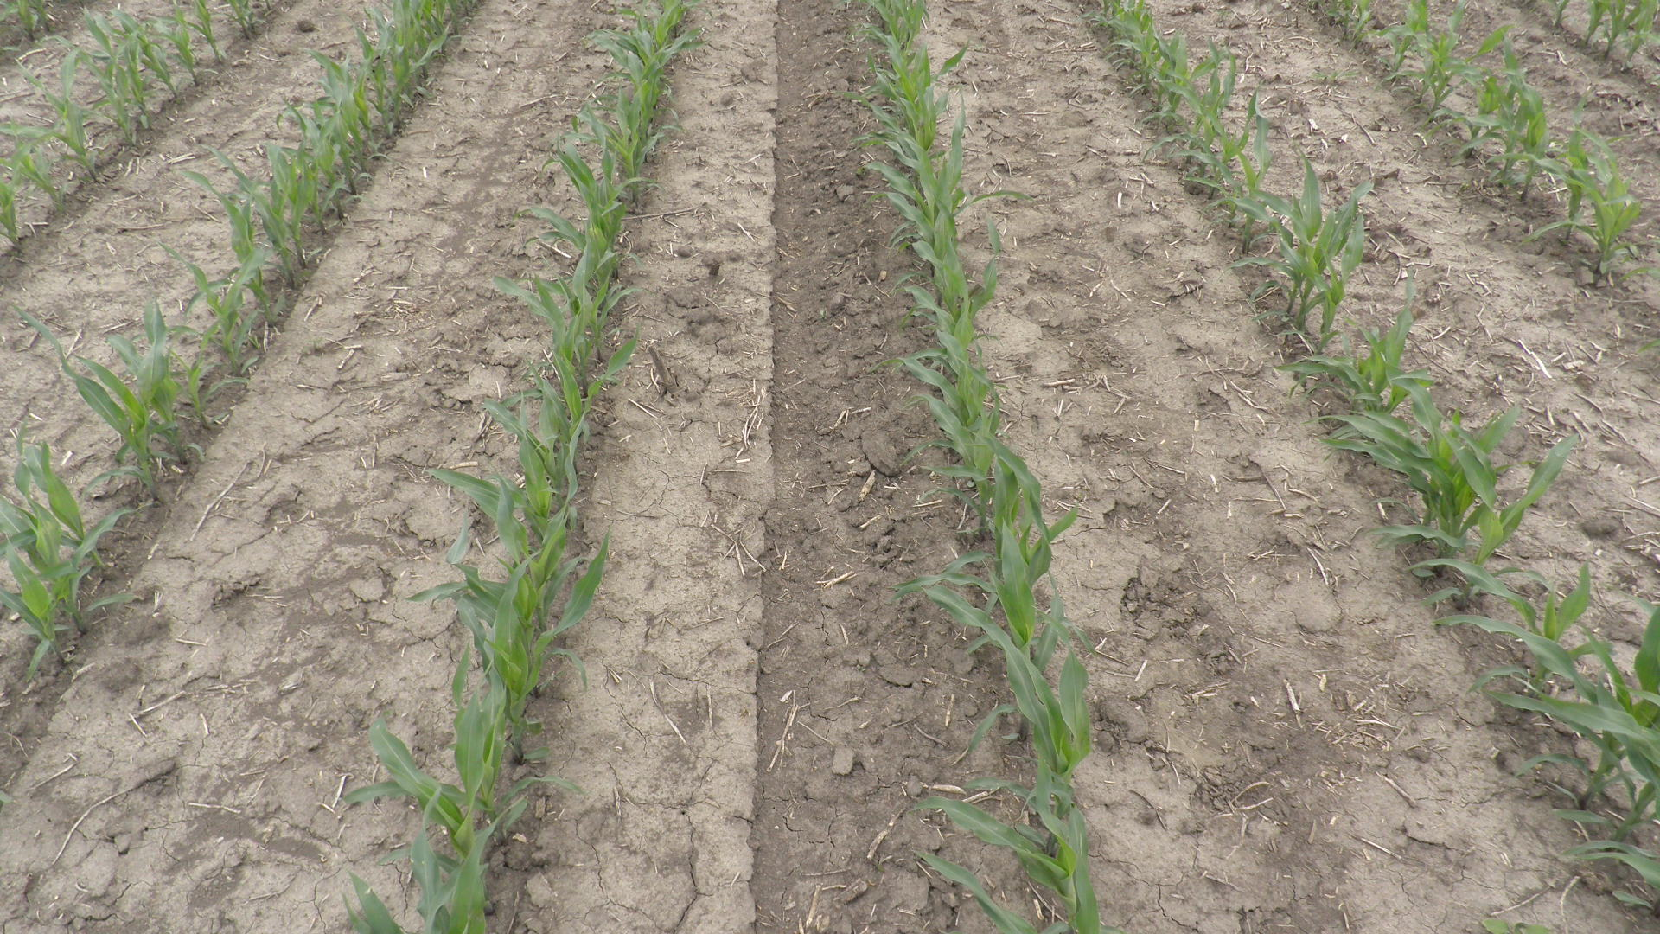
Corn Seeding Rate Considerations
24,000 plants/acre
42,000 plants/acre

Slide 5
Seeding rate carrying capacity connection
Carrying Capacity – Maximum population size of a biological species that can be sustained by a specific environment.
Influenced by
  Nutrients
  Energy
  Water
  Space
https://www.biologyonline.com/dictionary/carrying-capacity

Slide 6
Yield Contributions Shift
Kernel weight per acre
  Plant number increases, kernels per plant decrease
  Rate of change for each determines yield response curve

Slide 7
Seeding Rate Response Types
Lindsey, Thomison, and Nafziger 2018. https://ohioline.osu.edu/factsheet/agf-520

Slide 8
Seeding Rate Response Types
Lindsey, Thomison, and Nafziger 2018. https://ohioline.osu.edu/factsheet/agf-520

Slide 9
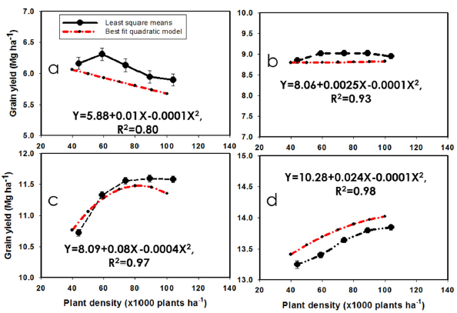
Response may be yield-level specific*
Low yield environments (<110 bu/ac)
Medium yield environments
(110-160 bu/ac)
High yield environments
(160-210 bu/ac)
Very high yield environments
(>210 bu/ac)
*124,374 observations from 22 states
Assefa et al. 2016. doi: 10.2135/cropsci2016.04.0215
Notes:
ASSEFA CROP SCIENCE FIGURE SHOWING ANTICIPATED RESPONSE FUNCTIONS FROM YIELD POTENTIALS

Slide 10
Yield Environment Matters – Ohio Data
High Yield Environments
  Higher seeding rates
  Greater final stands
  34,000 plants/acre or more
Low Yield Environments
  Lower seeding rates
  Final stands 24,000 to 26,000 plants/ac
  Seeding rate may need to be adjusted to account for attrition
Recommended range is generally 30,000 to 36,000 seeds/ac
(31,000-32,000 plants/ac for most environments)

Slide 11
Weeds!

Slide 12
Why are weeds considered “pests”?
Rob crops of resources
  Water
  Light
  Nutrients
  Space
Ultimately limits crop yield
Crop density vs weed density
Susceptibility to disease/insect feeding/as alternative hosts
  (alternative = opportunistic disease carrier, not required for the life cycle)

Slide 13
Factors that impact weeds as pests
Life cycle
  Emergence timing
  Growth rate
Ability to come back
  Seed production/ dispersal
  Seed dormancy
  Vegetative propagules
Transport of propagules on/in equipment
  New species introduced
Growth habit
  Prostrate vs erect
  Broadleaf vs grass
  Height and leaf type
Growing conditions
  If they favor the crop, they probably favor the weeds too.

Slide 14
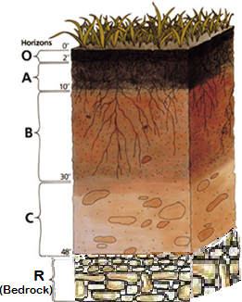
Soil Seed Banks
A soil seed bank is the stable reserve of seeds in soil to which additions are made and from which losses occur.

Slide 15
Net inputs (deposits) to the soil seed bank:
1. Seed rain
2. Dispersal
Net losses (withdrawals) occur by:
1. Seedling death before emergence
2. Predators and pathogens
3. Senescence and natural decay
4. Human activities

Slide 16
Every species forms a characteristic seed bank, e.g., transient or persistent (or some have both)
  Can be influenced somewhat by the environment during seed maturation and tillage timing and depth
1. Transient seed bank (seeds persist < 1 yr)
  Asteraceae, Poaceae
  regular opportunities for establishment
  spatially unpredictable disturbance
2. Persistent seed bank (seeds persist > 1 yr)
  Fabaceae, Malvaceae, Caryophyllaceae
  irregular opportunities for establishment
Every habitat develops a characteristic seed bank in terms of persistence type, species composition, and size (number of seeds)

Slide 17
Factors to consider in ascertaining soil disturbance history based on seed bank characteristics:
1. History of soil disturbance - influences seed bank size & species composition.
History of weed control effectiveness
Life cycle and history of crops grown.
4. Growth habit & morphology of crop - look for obligate "indicator" weeds

Slide 18
Example: Comparison of two theoretical seed banks
Seed bank characteristic | Successional Forest | Annual crop production field
Seed bank size (seed/m²), top 10 cm | 400 | 4000
Number of species in seed bank | 5 | 20
% of seed bank in top 3 cm soil | 90 | 30
% annuals in seed bank | 75 | 99
% tall, upright weeds growing | 20 | 95
Poison ivy or honeysuckle present? | Yes | No

Slide 19
Examples 1 and 2
Exercise 1: Focus on seeding rate impact on yield production in corn
Exercise 2: Provides opportunity to see how survival and seed production affects weed populations

Slide 20
Ecosystem Dynamics Module
Science Content​
To have students explain ecological concepts using mathematical depictions and explanations, and understand better the role humans play in managing ecosystems for crop production.
Take Home Message about Ag:​
Each field producing crops is affected by environmental conditions, and the optimum levels to maximize yield can change with location and year. Sometimes other factors than seeding rate can impact yield, which can make production challenging. Weed control is key for production, and some species due to reproductive patterns can be more challenging to control.

Slide 21
Extending Further Activities

Slide 22
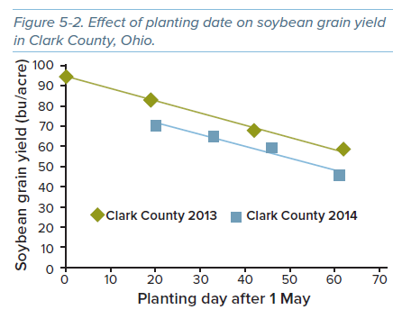
Soybeans affected by planting date
Earlier planted soybeans can have greater yield
May also be influenced by weather
Not the only factor in all sites
Extending Further 1

Slide 23
Planting Date - Corn
Delayed planting can reduce yield
11% on average reduction
Loss can increase with further planting delays
June plantings may be less damaging in northern environments
Notes:
TABLE 4-9 OHIO AGRONOMY GUIDE

Slide 24
Planting Date x Seeding Rate in Corn
Extending Further 2

